Slide 1

Optimizing the Traveling Route around United States by Airplane
Presentation by
Jiaxin Yang
Yuyang He
Ben He
ISE3230 Project Group 25
Dec 1st, 2021

Slide 2
Crazy Graduation Trip
Most people have been home for at least one and a half years without any traveling due to the pandemic. Students have to learn at home, my friends and I will graduate in a half year. All of us want to escape from staying at home to taking hard classes and release interior pressure by traveling after graduation.
A better and crazy trip route is to take an airplane to travel around the United States at a relatively cheap price. To achieve this, we are going to develop a technique that optimizes the traveling route and minimizes the cost of airplane tickets.

Slide 3
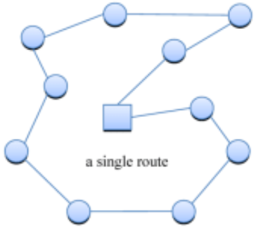
Our Goal
We will try to optimize the traveling route around the United States by minimizing the cost of nonstop airplane tickets.
We will mathematically model this problem as a Multiple Traveling Salesman Problem (MTSP).

Slide 4
Data and Assumptions
City Data: We have 24 destination cities.
Airplane Tickets Price: We have a 24 * 24 matrix.
Budget: We assume that we cannot spend more than $4000 on airplane tickets.
Luggage checking: We decide to just take one checked luggage on the way ($35).
United Airlines(UA) standard checked baggage fees for US domestic flights: First bag: $35.00 USD. Second bag: $45.00 USD.

Slide 5
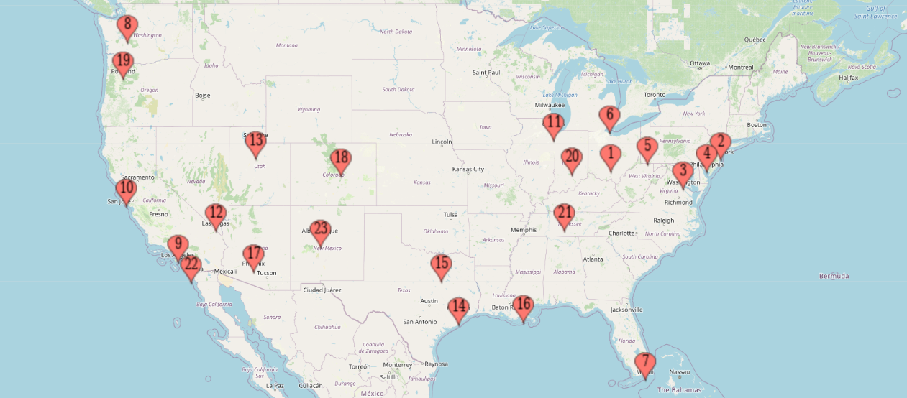
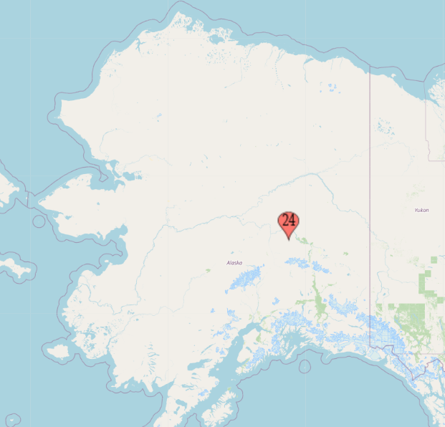
Location Data in Map

Slide 6
Constraints
1. The budget for the graduation trip is $4000. We have to minimize the total price of tickets.
2. Each city arrives from exactly one other city.
3. From each city, there is a departure to exact one other city.
4. There is only one single circular tour covering all cities (first depart from Columbus and last end back in Columbus).

Slide 7

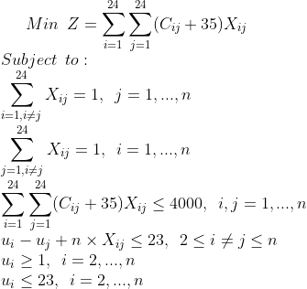
Formulations

Slide 8
Results
- Best Route:
Columbus -> San Diego-> Washington DC -> Salt Lake City -> New York -> Las Vegas -> Chicago -> Portland -> Phoenix -> Indianapolis -> Los Angeles -> Detroit -> New Orleans -> Houston -> Nashville -> San Francisco -> Seattle -> Dallas -> Pittsburgh -> Fairbanks -> Albuquerque -> Miami -> Philadelphia -> Denver -> Columbus
- Total costs on flights: $3001

Slide 9
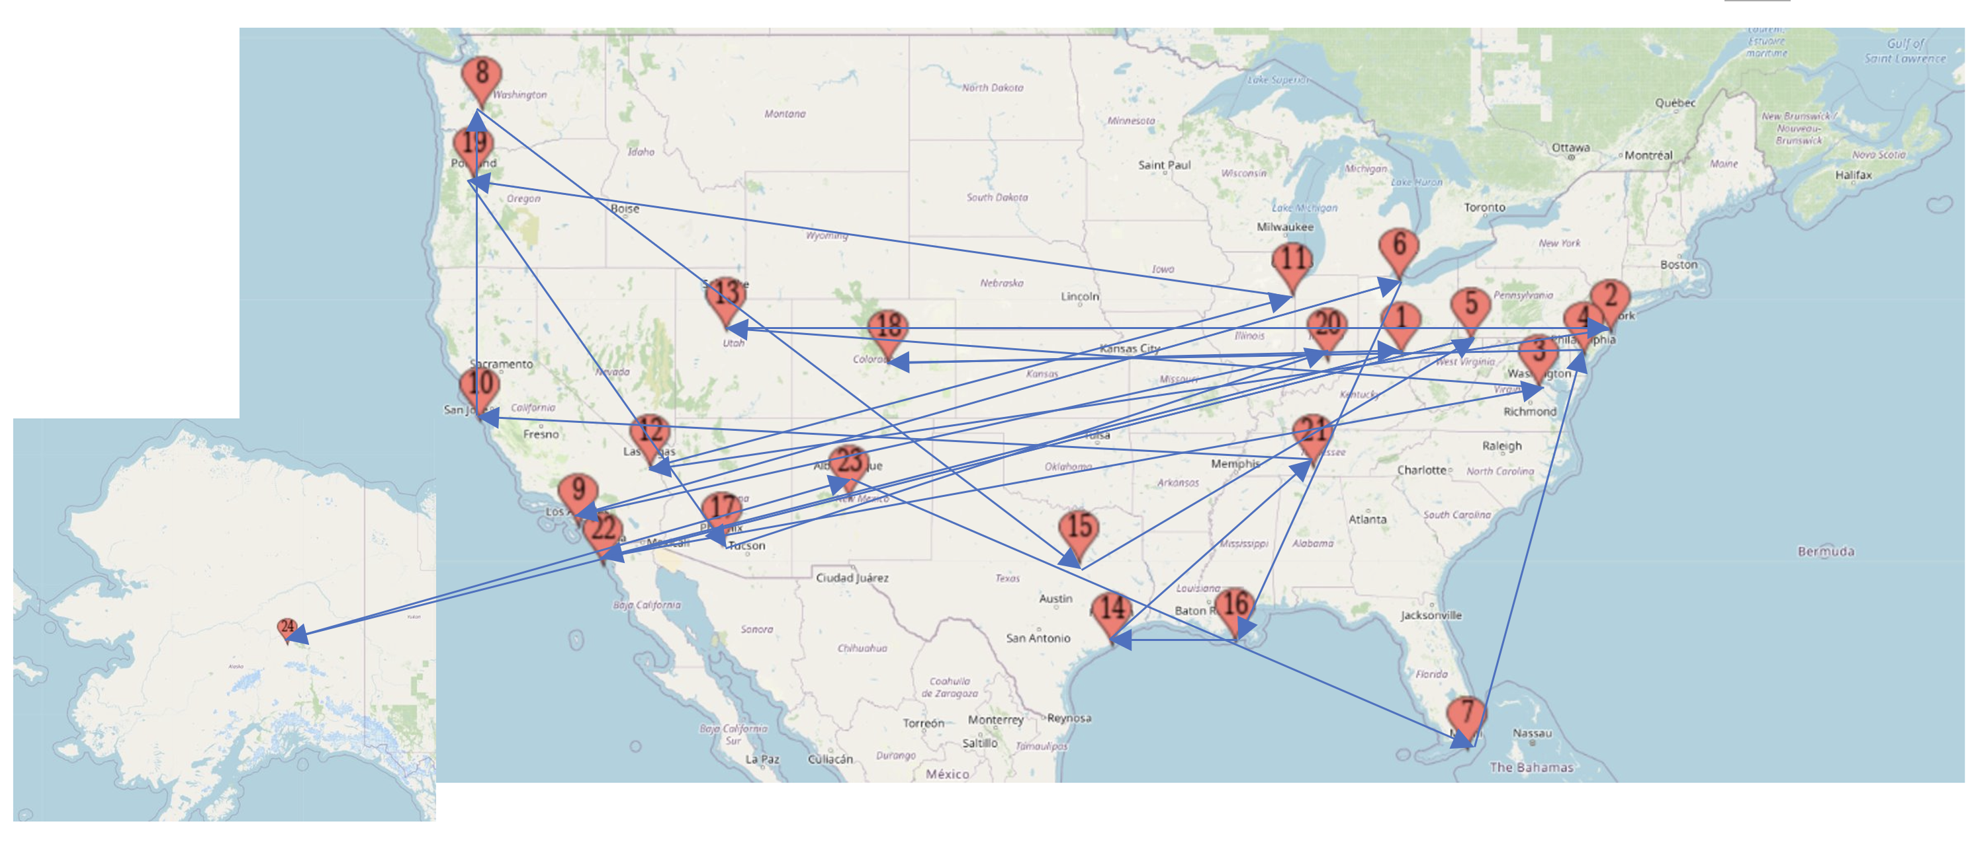
Visualization

