Slide 1
III. The rule of the graphics system
From semiology of graphics
Created by Jiaxin Yang

Slide 2
B: Image theory
What is “Image Theory”:
The set of observations which define reading facility enables us to formulate an “image theory.” Efficiency is linked to the degree of facility characterizing each stage in the reading of a graphic.
Efficiency:
If, in order to obtain a correct and complete answer to a given question, all other things being equal, one construction requires a shorter observation time than another construction, we can say that it is more efficient for this question.
We will discussion five aspects of “image theory” in the following pages.

Slide 3
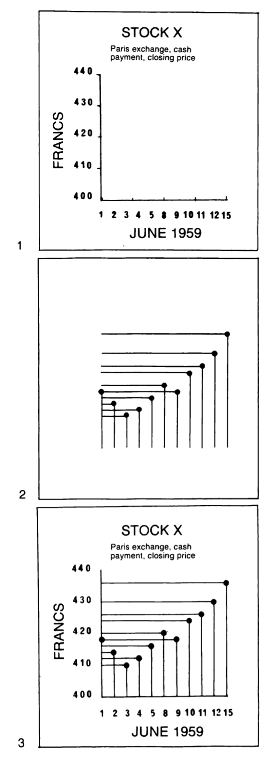
1. Stages in the reading process
i. External Identification
External identification relies on acquired habits, on the recognition of words, shapes, or colors. It permits us to isolate, from the vast realm of human knowledge, the precise domain treated by the figure.
ii. Internal Identification
Then, the reader must recognize by what visual variables each of the components is represented in the graphic.
iii. Perception of Pertinent (New) Correspondences
After identification, the reader is ready to perceive the series of pertinent correspondences which the drawing isolates from the vast number of possible correspondences.
According to the graph on the right, figure 2 obviously has no meaning without a prior understanding of the terms in figure 1 (i); the name of each component is inscribed in figure 1 to define its meaning precisely (ii); figures 1 and 2 are superimposed to form figure 3 (iii).

Slide 4
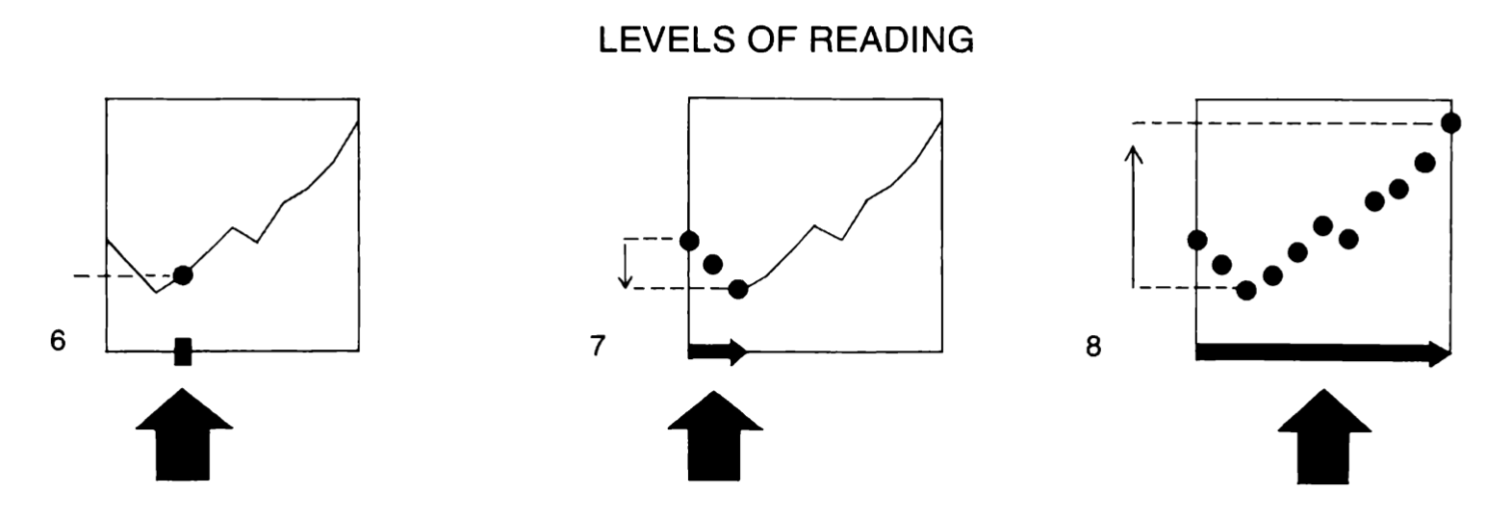
2. Possible questions
i. Type of question
ii. Level of the question or reading level
For a given type of question one must distinguish the following cases.
Questions introduced by a single element of the component and resulting in a single correspondence.
Questions introduced by a group of elements or categories and resulting in a group of correspondences.
A question in traduced by the whole component.
We can therefore say that:
In approaching information there are as many types of question as there are components.
within a type of question there are three levels of reading: the elementary level, the intermediate level, the overall level.
Any question can be defined by its type and level.

Slide 5
3. Definition of an image
Example process:
an input identification (a given date).
perception of a correspondence between the components (a point).
an output identification (the answer: “so many francs”).
Image is the meaningful visual form, perceptible in the minimum instant of vision.
Notes:
This process implies that the eye can isolate the input date from all the other dates and DURING AN INSTANT OF PERCEPTION can see only those correspondences that are determined by this input identification, but can SEE ALL OF THESE.

Slide 6
4. Construction of an image

Slide 8
5. Limits of an image

Slide 10
C: Three functions of graphic representation

Slide 18
D: General rules of construction
A rigorous definition of the components of the information, specifying their number, level, and length, must precede any graphic construction.
The general rules of graphic construction:
1. To represent the information in a single image,
2. To simplify the image without reducing the umber of correspondences.
3. To simplify the image by reduction.
These rules are represented by the standard schemas which follow in next page.

Slide 19
Standard schemas
1. Diagrams
2. An inventory drawing (figure5,comprehensive)
This is easy to draft but must be reread, point by point, for comparisons.
3. Processing graphics
4. The drawing of a “message” (figure 5,simplified)
This generally involves an image-figuration superimposition.
5. Networks
This construction immediately displays the principal characteristics of the information.
6. Maps
Information which includes a geographic component can be constructed according to any of the three impositions - DIAGRAM, NETWORK, OR MAP.

Slide 20
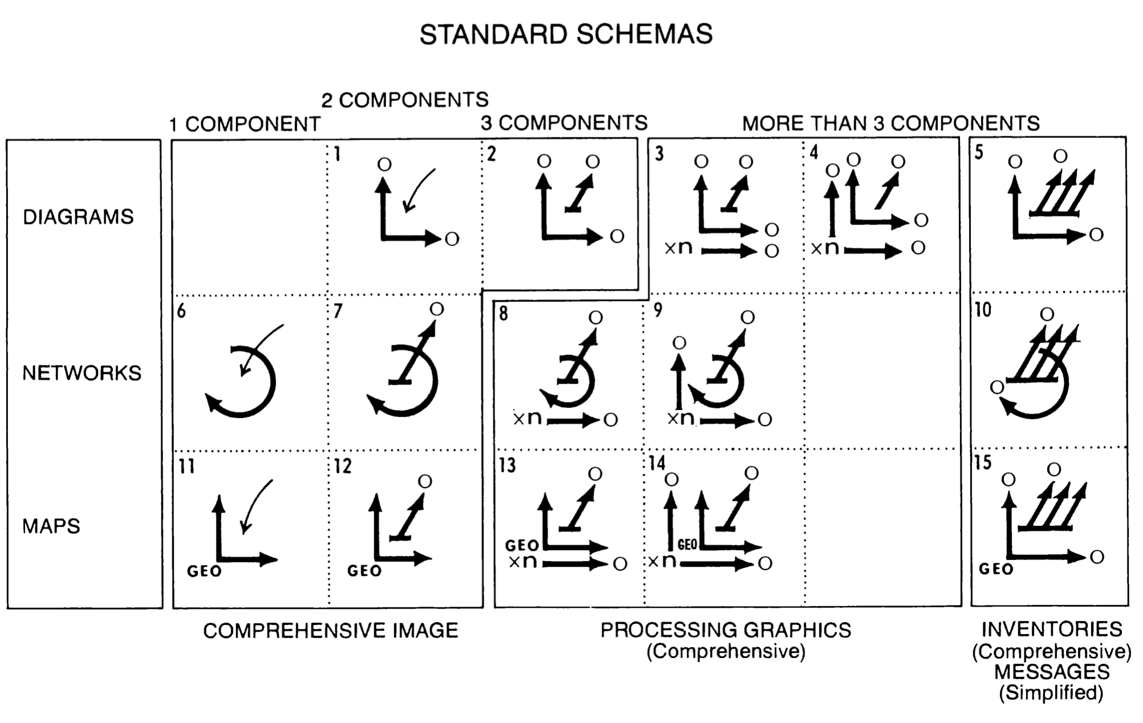

Slide 21
E: General rules of legibility (or rules of separation)

Slide 28
Reference
Bertin, J., & Berg, W. J. (2011). Semiology of graphics: Diagrams, networks, maps. ESRI Press.

