Slide 1
III. The rule of the graphics system
From semiology of graphics
Created by Jiaxin Yang

Slide 2
B: Image theory
What is “Image Theory”:
The set of observations which define reading facility enables us to formulate an “image theory.” Efficiency is linked to the degree of facility characterizing each stage in the reading of a graphic.
Efficiency:
If, in order to obtain a correct and complete answer to a given question, all other things being equal, one construction requires a shorter observation time than another construction, we can say that it is more efficient for this question.
We will discussion five aspects of “image theory” in the following pages.

Slide 3
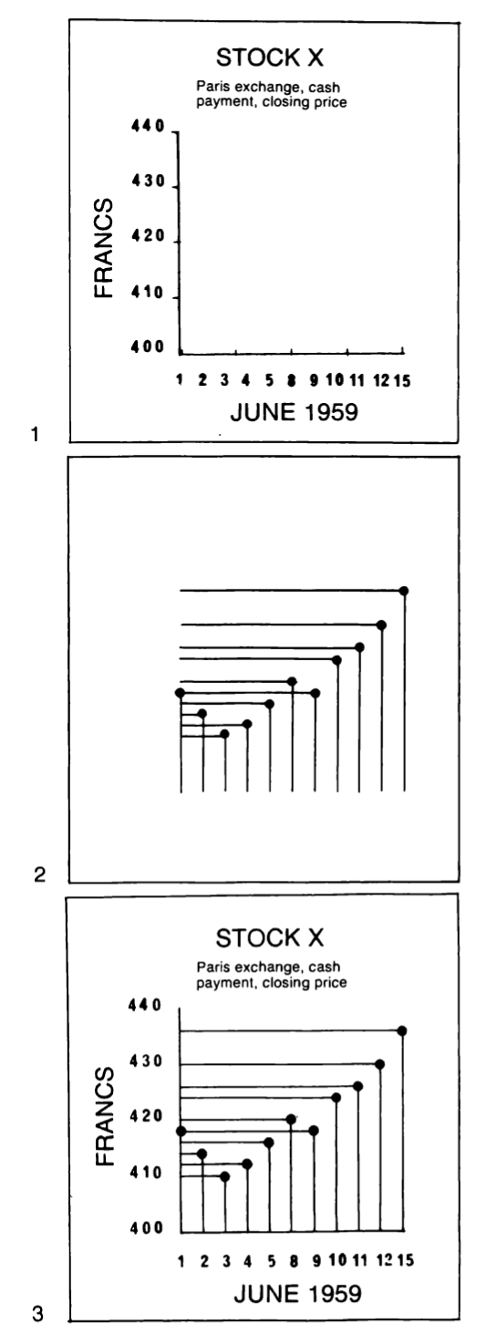
1. Stages in the reading process
i. External Identification
External identification relies on acquired habits, on the recognition of words, shapes, or colors. It permits us to isolate, from the vast realm of human knowledge, the precise domain treated by the figure.
ii. Internal Identification
Then, the reader must recognize by what visual variables each of the components is represented in the graphic.
iii. Perception of Pertinent (New) Correspondences
After identification, the reader is ready to perceive the series of pertinent correspondences which the drawing isolates from the vast number of possible correspondences.
According to the graph on the right, figure 2 obviously has no meaning without a prior understanding of the terms in figure 1 (i); the name of each component is inscribed in figure 1 to define its meaning precisely (ii); figures 1 and 2 are superimposed to form figure 3 (iii).

Slide 4
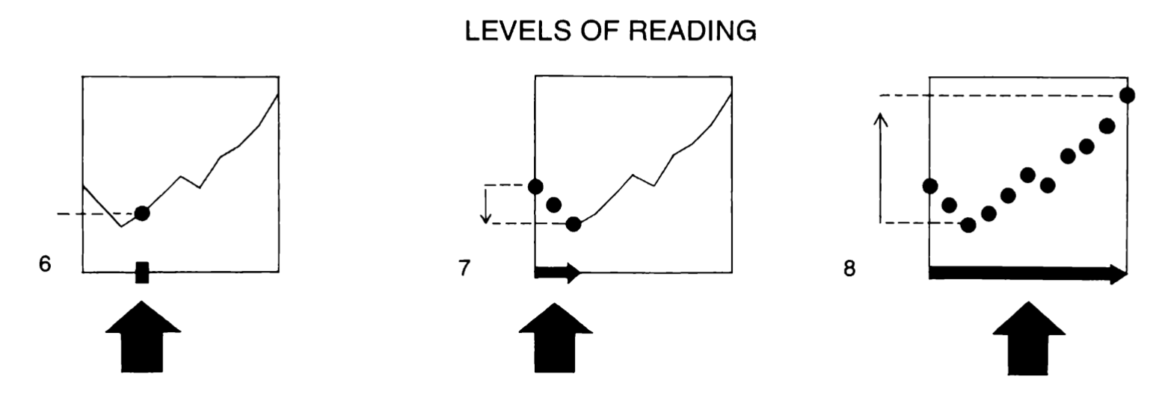
2. Possible questions
i. Type of question
ii. Level of the question or reading level
For a given type of question one must distinguish the following cases.
Questions introduced by a single element of the component and resulting in a single correspondence.
Questions introduced by a group of elements or categories and resulting in a group of correspondences.
A question in traduced by the whole component.
We can therefore say that:
In approaching information there are as many types of question as there are components.
within a type of question there are three levels of reading: the elementary level, the intermediate level, the overall level.
Any question can be defined by its type and level.

Slide 5
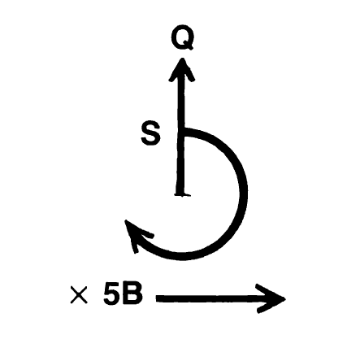
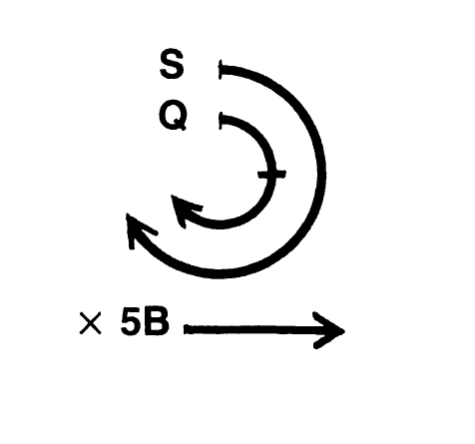
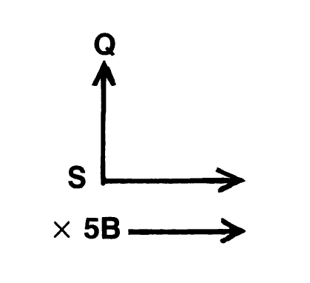
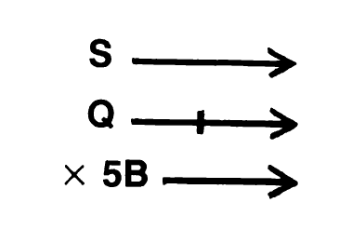
3. Definition of an image
Example process:
an input identification (a given date).
perception of a correspondence between the components (a point).
an output identification (the answer: “so many francs”).
This process implies that the eye can isolate the input date from all the other dates and DURING AN INSTANT OF PERCEPTION can see only those correspondences that are determined by this input identification, but can SEE ALL OF THESE.
Image is the meaningful visual form, perceptible in the minimum instant of vision.
Notes:
This process implies that the eye can isolate the input date from all the other dates and DURING AN INSTANT OF PERCEPTION can see only those correspondences that are determined by this input identification, but can SEE ALL OF THESE.

Slide 6
The inefficiency of figurations:
is due to the large number of images which the viewer would haveto select and retain in order to obtain a correct answer.
Efficiency of the image:
the most efficient constructions are those in which any question, whatever its type and level, can be answered in a single instant of perception, that is, IN A SINGLE IMAGE.
Efficiency of graphics:
Only the graphic sign-system, provided it utilizes the minimum number of images, enables us to rapidly assimilate the complex relationships among four components.

Slide 7
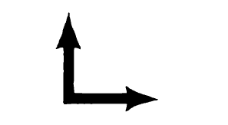
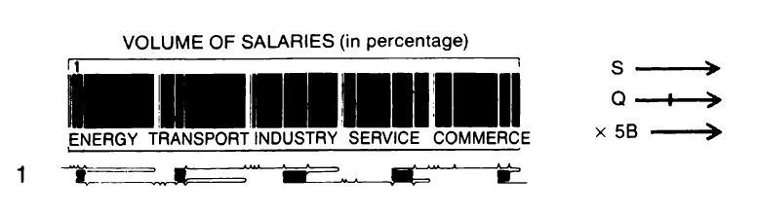
4. Construction of an image
The IMAGE is formed within a HOMOGENEOUS FIELD, in which any RECTILINEAR SCANNING, suggested by the construction, groups identical elements. The standard differentiation between two planar systems of identification is ORTHOGONAL DIFFERENTIATION.
a schema and a rule:
Any graphic problem necessitating two visual variables bases its standard construction on the following schema:

Slide 8
4. Construction of an image
The use of retinal variables in forming an image:
1) THE IMAGE is formed by three HOMOGENEOUS and ORDERED variables, the two planar dimensions and an ordered retinal variable.
2) For information to be represented as a single image, each of its components must be homogeneous and must correspond to an ordered concept.
IMAGE AND FIGURATION
1) IMAGE: describe the meaningful form immediately perceptible in the minimum instant of vision.
2) FIGURATION: the apparent and illusory unit defined by the sheet of paper, by a linear frame, or by a geographic boundary.
LEVELS OF READING IN AN IMAGE
1) the overall level: see the image as a whole, and compare it to another.
2) the intermediate level: isolate partial images, and compare them with each other.
3) isolate only a single element and create an image for the smallest meaningful form.

Slide 9
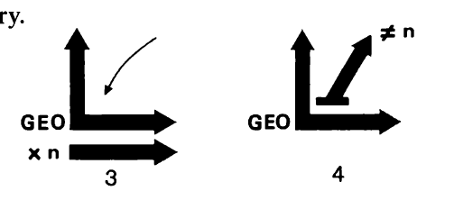
5. Limits of an image
i. An image will not accommodate more than three variables
in order to respond efficiently to all the types of question which can be generated by information:
— having more than three components(in diagrams), or
— having more than two components (in networks and maps)
ii. An image will only accommodate a reorderable component
We could thus superimpose several images in a figuration, and it would still remain efficient, provided that the images were not very numerous, that they were very simple, and were differentiated in the most efficient graphic manner.

Slide 10
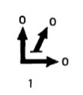
C: Three functions of graphic representation
1. Recording information
2. Communication information
3. Processing information
Why need these functions?
Image is limited to three visual variables. -- Figure 1: Only 3 dimensions could be shown here.
Communication information with more than three components.
Utilize human memory to understand the data. -- Increasing number of images make more difficult.
Solution:
Conditions of memorization linked to the amount and conceptual level of the information.

Slide 11
1. Recording information
The graph is convenient and information storage.
Purpose of plane and visual signs to record all the correspondence in the give information set:
Create a storage mechanism
Avoids the effort of memorization
Example: subway diagram, highway map
Strength:
Include all the information
Weakness:
Time consuming in query information

Slide 12
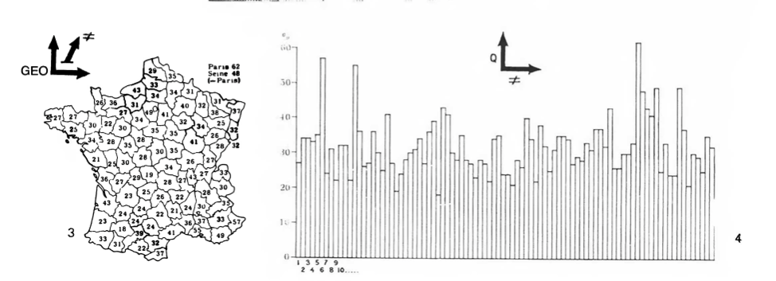
1. Recording information
Figure 3 and figure 4 show the same information.
Only involves the inventory stage of graphics.
All these documents must be reread point by point.

Slide 13
2. Communication information
A graph could gain the same static information with different means.
Purpose of plane and visual signs to be utilized for communicating information:
Create a memoizable image
Inscribes the overall information within the field of assimilated knowledge
Example: maps, sketches
Strength:
memoizable
Weakness:
Relative information are less included

Slide 14
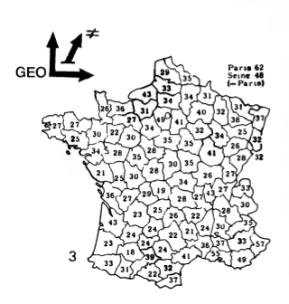
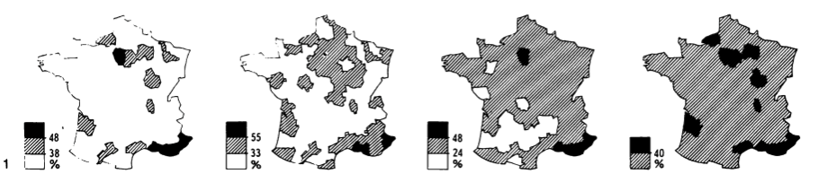
2. Communication information
Figure 1 is the same meaning of figure 3.
Which one could contain more comprehensive
information?
Ans: 1, but it is not always the best

Slide 15
3. Processing information
A graph could simplify and make the message memorizable.
In order to simplify but not lose any data:
Use the mechanisms of ordering and classing for the purposes of discovering
The grouping contained in the information being processed
Deriving from it new components or categories, reduced in number and consequently easier to memorize than the comprehensive information
The combination of these new elements must enable us to recall and understand the whole of the initial information.
Strength:
Find answers to questions in a limited number of comparable images

Slide 16
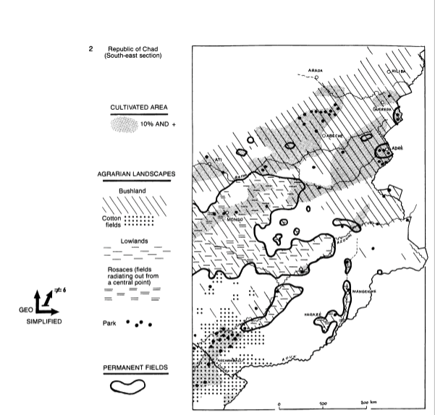
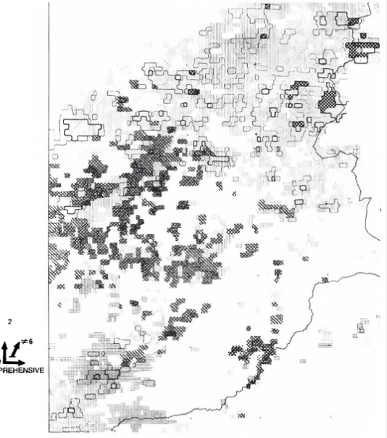
3. Processing information
Right figure is more independent than the left image.
Question:
Alway necessary?

Slide 17
Graphic processing of information
Simplification is an obligation of the communication process
Discover combinational elements in simpler form
Be creative when information is logical
Logical simplification that is information-processing.
What is the modalities proper to graphic information processing?
Graphic information-processing operates by simplification of the image.
By ordering a qualitative component
By eliminating certain correspondences in ordered components.

Slide 18
Ordering a qualitative component
Transformation, Diagonalization
Order of the image matters:
1) Simplification of the image by ordering does not eliminate any correspondence and preserves the integrated totality of the information.
2) It involves the diagonalization of diagrams and the transformation of networks.

Slide 19
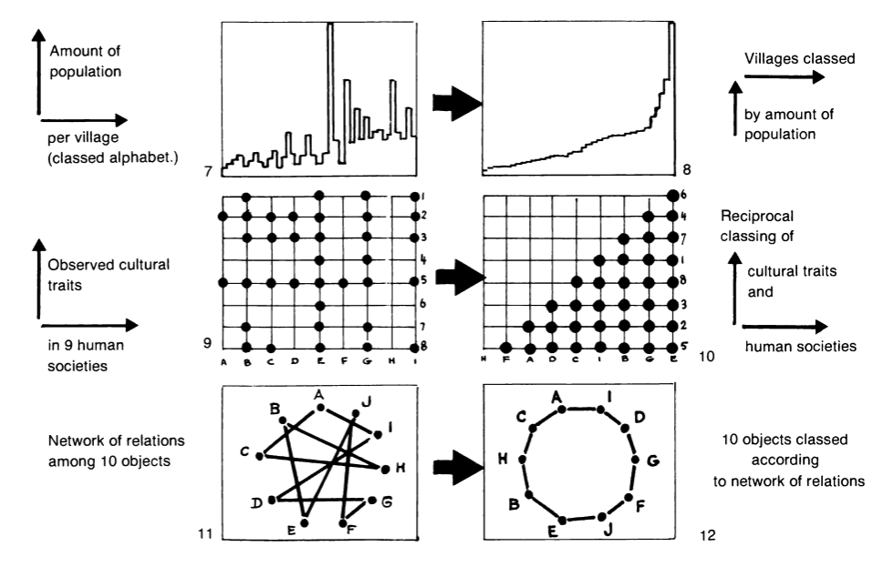
Ordering a qualitative component
Transformation and diagonalization examples:

Slide 20
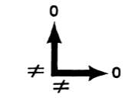
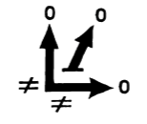
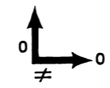
Ordering a qualitative component
The diagonalization of diagrams
Diagonalization of two components schema:
Diagonalization of three components schema:
Two components involves one components
Two components involves two components
Three components involves three components

Slide 21
Eliminating certain correspondences
Smoothing, regionalization
The simplification of an ordered image can be accomplished only by the elimination of certain correspondences, by a diminution of the information.
The internal method
Calculating the internal math
Visual operations
The external method
Methods encompasses all the processes

Slide 22
D: General rules of construction
A rigorous definition of the components of the information, specifying their number, level, and length, must precede any graphic construction.
The general rules of graphic construction:
1. To represent the information in a single image,
2. To simplify the image without reducing the umber of correspondences.
3. To simplify the image by reduction.
These rules are represented by the standard schemas which follow in next page.

Slide 23
Standard schemas
1. Diagrams
2. An inventory drawing (figure5,comprehensive)
This is easy to draft but must be reread, point by point, for comparisons.
3. Processing graphics
4. The drawing of a “message” (figure 5,simplified)
This generally involves an image-figuration superimposition.
5. Networks
This construction immediately displays the principal characteristics of the information.
6. Maps
Information which includes a geographic component can be constructed according to any of the three impositions - DIAGRAM, NETWORK, OR MAP.

Slide 24
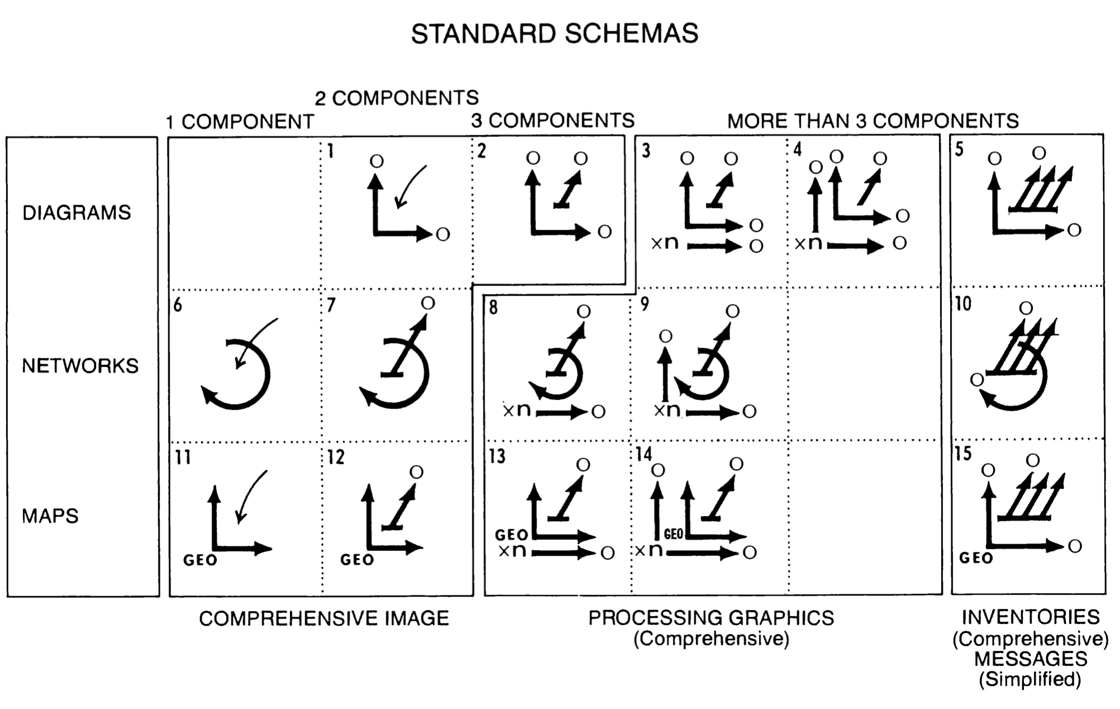

Slide 25
E: General rules of legibility (or rules of separation)
Graphic density
Angular legibility
Retinal legibility
The rules of construction that we have just examined govern the choice of visual variables. With some constructions, a reading may only be possible on the elementary level; with standard constructions, it will be possible on all levels.

Slide 26
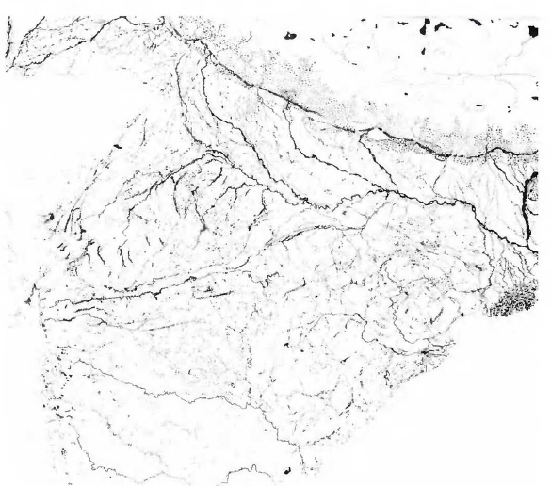
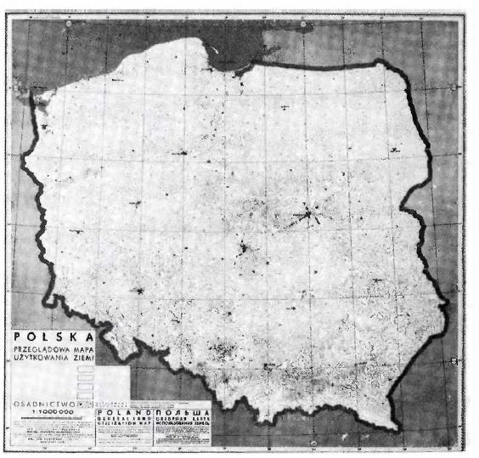
1. Graphic density
The legibility of a FIGURATION is drastically altered by too great a density of signs. Ten signs per cm’ represents a maximum limit.
An IMAGE remains legible while accommodating great graphic densities and thus substantial photographic reductions. Consequently, reading on the intermediate and overall levels is generally found to be easier.

Slide 27
2. Angular legibility
1) Angles
On the elementary level optimum angular legibility is located near 70 degrees.
On the overall level the image tends toward the form of a square where optimum angular legibility is provided by the diagonal.
Since these two conditions can be contradictory, angular legibility results from a compromise between the conditions of legibility for the two extreme levels of reading.
Shapes
On the elementary level of reading a meaningful shape must have a minimal size of about 2 mm in order to be legible as such.
With smaller sizes there are only three distinct shapes: (a) the point (b) the dash (c) the intersection of two dashes(i.e., the cross).
On the overall level of reading, provided they are of sufficient size, the dash, the point, and the cross produce three steps which permit visual selection. Any other shape, being only intermediate, will diminish perceptible differentiation and eliminate selectivity.

Slide 28
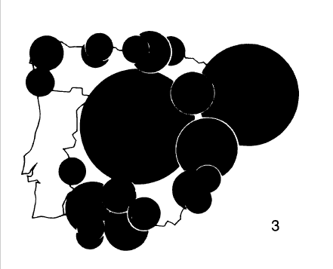
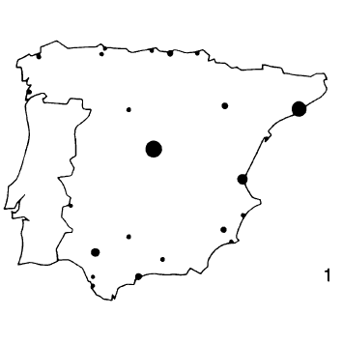
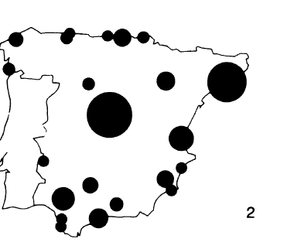
3. Retinal legibility
to have a total amount of “black”
2) to obtain the greatest amount of differentiation
Experience shows that when the total amount of black varies between 5% and 10% of the meaningful area of the plane, legibility is optimum.

Slide 29
Reference
Bertin, J., & Berg, W. J. (2011). Semiology of graphics: Diagrams, networks, maps. ESRI Press.

