Slide 1
Introduction to Software Quality and Testing

Slide 2
Expectation
CLO | Expectation | Mark
CLO 1 | Understand established software quality and testing concepts, the fundamental test process, test approaches, and principles to support test objectives. | 24
CLO 2 | Design tests by using established techniques | 45
CLO 3 | Execute test cases according to test design, and analyze and report on the results of tests. | 25
CLO 4 | Ability to do work effectively in a team and lead the team in the test activities throughout the software testing life cycle. | 6

Slide 3
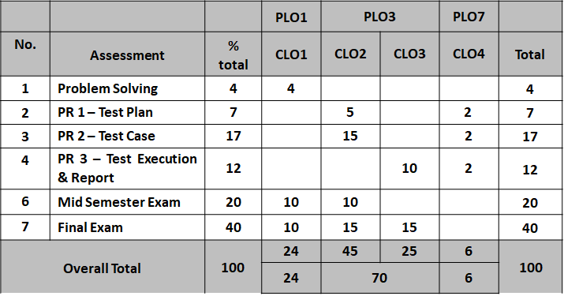
Assessment
Notes:
Throw a question,
PS – individu/group?
Project Assignment – individu/group?

Slide 4
SQA Section 3 Rules
Must read lecture materials before come to the class
Must come to the class on time
Always bring notebook

Slide 5
Objectives
What is Software?
What is Software Quality?
What is Software Quality Assurance?
What is Software Testing
Importance of Software Quality
Software Quality Assurance

Slide 6
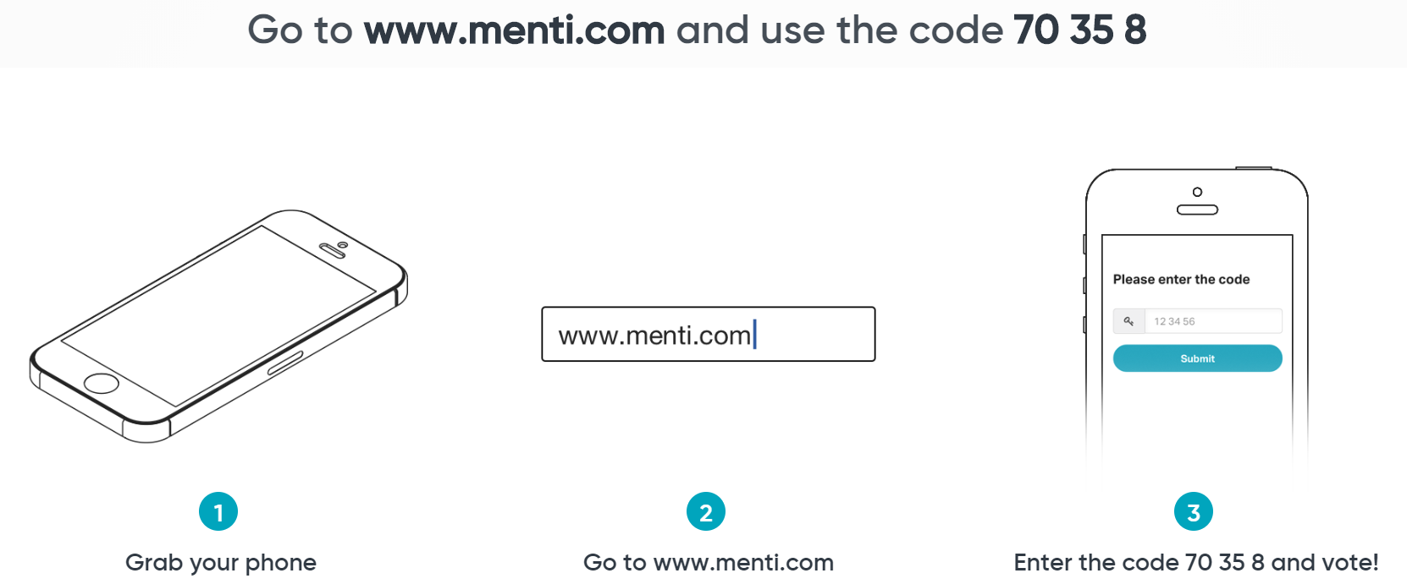
What is Software?
Notes:
Activity 1.0:
Lecturer can sign up and use Mentimeter, throw the question, to know student’s prior knowledge.

Slide 7

What is Software?
Software is:
Computer programs, procedures, and possibly associated documentation and data pertaining to the operation of a computer system.
System Software
Serves as a base for application software.
System software includes device drivers, operating systems (OSs), compilers, disk formatters, and utilities helping the computer to operate more efficiently.
Responsible for managing hardware components
Programming Software
is a set of tools to aid developers in writing programs.
The various tools available are compilers, linkers, debuggers, interpreters and text editors
Application Software
is intended to perform certain tasks.
Examples of application software include office suites, gaming applications, database systems and educational software.
Application software can be a single program or a collection of small programs.
Notes:
"The application of a systematic, disciplined, quantifiable approach to the development, operation, and maintenance of software"—IEEE Standard Glossary of Software Engineering Terminology

Slide 8
What is Software Quality?
Software quality is:
The degree to which a system, component, or process meets specified requirements.
The degree to which a system, component, or process meets customer or user needs or expectations.
Software quality is:
Conformance to explicitly stated functional and performance requirements, explicitly documented development standards, and implicit characteristics that are expected of all professionally developed software.
Pressman's
Definition
Notes:
Activity 2.0:
i) Identify the similar points from 2 definitions?
ii) Think individually for 1 minute and complete the answer in a given table below.
iii) Discuss with your neighbor for 2 minutes.
iv) Share with the class when asked
To fulfil expectations.
Agree, quality we normally expects something… internet banking software… u expect?
References:
https://slideplayer.com/slide/8337903/
Link: http://tryqa.com/what-is-software-quality/
Quality software is reasonably bug or defect free, delivered on time and within budget, meets requirements and/or expectations, and is maintainable.

Slide 9
What is Software Quality Assurance?
A planned and systematic pattern of all actions necessary to provide adequate confidence that an item or product conforms to established technical requirements.
A set of activities designed to evaluate the process by which the products are developed or manufactured. Contrast with quality control.
ISO 9000-3, 1997.
Notes:
Quality Control = activities designed to evaluate the quality of a product
Quality Assurance = activities to prevent and correct errors

Slide 10

Basic Questions
What does SQA mean?
Software quality assurance (SQA) is a process that ensures that developed software meets and complies with defined or standardized quality specifications.
SQA is an ongoing process within the software development life cycle (SDLC) that routinely checks the developed software to ensure it meets desired quality measures.
Notes:
Point of SQA
- better product
- lower production costs via better production methods
How good is Sftware
- example: microsoft warranty
Is software creation an art form or is it engineering?
Outline Note:
We will address each of these questions in this lecture, in reverse order.

Slide 11
Basic Questions
What is the point of SQA?
better product
lower production costs via better production methods
How necessary is SQA?
How good is software?
Is software production different from producing other products? If so, how and why?
Notes:
Point of SQA
- better product
- lower production costs via better production methods
How good is Sftware
- example: microsoft warranty
Is software creation an art form or is it engineering?
Outline Note:
We will address each of these questions in this lecture, in reverse order.

Slide 12
What is Software Testing?
A process of analyzing a software item to detect the differences between existing and required conditions (i.e., defects) and to evaluate the features of the software item.
An activity in which a system or component is executed under specified conditions, the results are observed or recorded, and an evaluation is made of some aspect of the system or component.
ANSI/IEEE 1059 standard.
IEEE Std 829™-2008.

Slide 13
Difference between SQA and software testing
Activity:
Use Google to search the answer.
Think individually for 1 minute and complete the answer in the table below.
Discuss with your neighbor for 2 minutes.
Share with the class when asked
Software quality assurance | Software testing
Notes:
SQA – check/audit every processes involved in SDLC
ST – analyse software items have differences between existing and required conditions
– which a system or component is executed under specified conditions, the results are observed or recorded, and an evaluation is made of some aspect of the system or component

Slide 14
IMPORTANCE OF SOFTWARE QUALITY

Slide 15
Importance of Software Quality
Software is a major component of computer systems (about 80% of the cost) – used for
Communication (e.g. phone system, email system).
Health monitoring.
Transportation (e.g. automobile, aeronautics).
Economic exchanges (e.g. e-commerce).
Entertainment.
etc.
Software defects are extremely costly in term of
money
reputation
loss of life
Notes:
Brief & gives example.

Slide 16
Causes of software errors
Faulty requirements definition
Client-developer communication failures
Deliberate deviations from software requirements
Logical design errors
Coding errors
Non-compliance with documentation and coding instructions
Shortcomings of the testing process
Procedure errors
Documentation errors
Notes:
Activity 4.0: 20 mins
Form 8 groups. Every group is assigned with 1 cause of SW. Only group #8 is assigned 2 causes #8 and #9.
Every group, take out 1 piece of A4 paper, draw a pictographic to represent the given cause of error (Refer slide #16-24). Prepare drawing in 10 mins.
After 10 min, snapshot the drawing and upload in a padlet, give 3 mins to student to read & observe. https://padlet.com/rohayanti1/softErrors
Ask student to list the causes of SW errors (Answer in slide #25) for the next famous software disaster cases (Refer slide #26-33). 5 min

Slide 17
Causes of Software Errors (Example of Instruction)
Activity (20 mins):
Form 8 groups. Every group is assigned with 1 cause of software error. Only group #8 is assigned 2 causes #8 and #9.
Every group, take out 1 piece of A4 paper, draw an infographic to represent the given cause of error (Refer slide #16-24). Prepare drawing in 10 mins.
After 10 min, snapshot the drawing and upload in forum, give 3 mins to student to read & observe.
Ask student to list the causes of software errors (Answer in slide #25) for the next famous software disaster cases (Refer slide #26-33). 5 min
Notes:
Activity 4.0: 20 mins
Form 8 groups. Every group is assigned with 1 cause of SW. Only group #8 is assigned 2 causes #8 and #9.
Every group, take out 1 piece of A4 paper, draw a pictographic to represent the given cause of error (Refer slide #16-24). Prepare drawing in 10 mins.
After 10 min, snapshot the drawing and upload in a padlet, give 3 mins to student to read & observe. https://padlet.com/rohayanti1/softErrors
Ask student to list the causes of SW errors (Answer in slide #25) for the next famous software disaster cases (Refer slide #26-33). 5 min

Slide 18
Causes of software errors
Faulty Requirements Definition
Usually considered the root cause of software errors
Incorrect requirement definitions
Simply stated, ‘wrong’ definitions (formulas, etc.)
Incomplete definitions
Unclear or implied requirements
Missing requirements
Just flat-out ‘missing.’ (e.g. Program Element Code)
Inclusion of unneeded requirements
(many projects have gone amuck for including far too many requirements that will never be used.
Impacts budgets, complexity, development time, …

Slide 19
Causes of software errors
Client-developer communication failures
Misunderstanding of instructions in requirements documentation (written / graphical instructions)
Misunderstanding of written changes during development.
Misunderstanding of oral changes during development.
Lack of attention
to client messages by developers dealing with requirement changes and
to client responses by clients to developer questions
Very often, these very talented individuals come from different planets, it seems.
Clients represent the users; developers represent a different mind set entirely some times!

Slide 20
Causes of software errors
Deliberate deviations from software requirements
Developer reuses previous / similar work to save time.
Often reused code needs modification which it may contain unneeded / unusable extraneous code.
Book suggests developer(s) may overtly omit functionality due to time / budget pressures.
Another BAD choice; System testing will uncover these problems to everyone’s dismay!
I have never seen this done intentionally – but understand it!
Developer inserting unapproved ‘enhancements’ (perfective coding; a slick new sort / search….); may also ignore some seemingly minor features, which sometimes are quite major.
Have seen this and it too causes problems and embarrassment during reviews.

Slide 21
Causes of software errors
4. Logical design errors
Definitions that represent software requirements by means of erroneous algorithms.
Yep! Wrong formulas;
Wrong Decision Logic Tables;
Incorrect descriptions in text
Process definitions: procedures specified by systems analyst not accurately reflecting the real business process
Note: all errors are not necessarily software errors.
This seems like a procedural error, and likely not a part of the software system…But they are errors nonetheless!
Erroneous Definition of Boundary Condition – a common source of errors
The “absolutes” like ‘no more than’ “fewer than,” “n times or more;” “the first time,” etc.

Slide 22
Causes of software errors
4. Logical design errors
Omission of required software system states
If rank is >= O1 and RPI is numeric, then….easy to miss an action based on the software system state.
Omission of definitions / procedures concerning reactions to illegal operation of the software system.
Including not only code to detect an illegal operation but failure to design the computer software reaction to this: Gracefully terminate, sound alarm, etc. ??

Slide 23
Causes of software errors
Coding errors
Too many to try to list.
Syntax errors (grammatical errors)
Logic errors (program runs; results wrong)
Run-time errors (crash during execution)
Know the differences. Be also able to supply an example. Examples do not ‘define’ something, but they may be used to ‘support’ or ‘supplement’ a definition.

Slide 24
Causes of software errors
Non-compliance with documentation and coding instructions
Non-compliance with published templates (formats)
Non-compliance with coding standards
(Standards and Integration Branch)
Size of program;
Other programs must be able to run in environment!
Coding: Data Elements and Codes: AFM 300-4;
Development Procedures: Required documentation manuals and operating instructions; AFDSDCM 300-8, etc…
SQA Team: testing not only execution software but coding standards; manuals, messages displayed; resources needed; resources named (file names, program names,…)

Slide 25
Causes of software errors
7. Shortcomings of the Testing Process
Likely the part of the development process cut short most frequently!
Incomplete test plans
Parts of application not tested or tested thoroughly!
Superficial; boundary conditions…
Path testing, branch testing … (coverage measures)
Failure to document and report detected errors and faults
So many levels of testing….we will cover.
Failure to quickly correct detected faults due to unclear indications that there ‘was’ a fault
Failure to fix the error due to time constraints
Many philosophies here depending on severity of error.

Slide 26
Causes of software errors
User Interface and Procedure errors
Remember: to the user, the interface is the entire system.
If the Interface is unsatisfactory, this view will be absolutely conveyed ‘up the line.’
The ‘learnability,’ and utility of the interface.
Documentation Errors
Errors in the design documents
If Docs do not represent the implemented design, this is trouble for subsequent redesign and reuse
Errors in the documentation in the User Manuals, Operators Manual, other manuals (Installation…)
Errors in on-line help, if available.
Listing of non-existing software functions
Planned early but dropped; remain in documentation!
Many error messages are totally meaningless

Slide 27
Famous Software Disasters
Notable consequences of software errors:
Disaster | Cause of software errors
1. Ariane Rocket Goes Boom (1996)
2. Pentium Fails Long Division (1993)
3. Patriot Fails Soldiers (1991)
4. AT&T Lines Go Dead (1990)
5. Medical Machine Kills (1985)
6. Mars Climate Crasher (1998)
7. Y2K (1999)
8. Love Virus (2000)
Notes:
Answer:
1.
Reference:
http://www.devtopics.com/20-famous-software-disasters/
1988 shooting down of Airbus 320 by the USS Vincennes - cryptic and misleading output displayed by tracking software.
1991 patriot missile failure - inaccurate calculation of time due to computer arithmetic errors.
London Ambulance Service Computer Aided Dispatch System – several deaths.
On June 3, 1980, the North American Aerospace Defense Command (NORAD) reported that the U.S. was under missile attack.
First operational launch attempt of the space shuttle, whose real-time operating software consists of about 500,000 lines of code, failed - synchronization problem among its flight-control computers.
9 hour breakdown of AT&T's long-distance telephone network - caused by an untested code patch.

Slide 28
Famous Software Disasters
Case #1: Ariane 5 explosion June 4, 1996
Ariane 5, Europe’s newest unmanned rocket, was intentionally destroyed seconds after launch on its maiden flight. Also destroyed was its cargo of four scientific satellites to study how the Earth’s magnetic field interacts with solar winds.
Cause:
Shutdown occurred when the guidance computer tried to convert the sideways rocket velocity from 64-bits to a 16-bit format. The number was too big, and an overflow error resulted. When the guidance system shut down, control passed to an identical redundant unit, which also failed because it was running the same algorithm.
Implication:
$500 million

Slide 29
Famous Software Disasters
Case #2: Pentium Fails Long Division (1993)
Intel’s highly-promoted Pentium chip occasionally made mistakes when dividing floating-point numbers within a specific range. For example, dividing 4195835.0/3145727.0 yielded 1.33374 instead of 1.33382, an error of 0.006%. Although the bug affected few users, it become a public relations nightmare. With an estimated 5 million defective chips in circulation, Intel offered to replace Pentium chips only for consumers who could prove they needed high accuracy. Eventually Intel replaced the chips for anyone who complained.
Cause:
The divider in the Pentium floating point unit had a flawed division table, missing about five of a thousand entries and resulting in these rounding errors.
Implication:
$475 million, corporate credibility

Slide 30
Famous Software Disasters
Case #3: Patriot Fails Soldiers (1991)
During the first Gulf War, an American Patriot Missile system in Saudi Arabia failed to intercept an incoming Iraqi Scud missile. The missile destroyed an American Army barracks.
Cause:
A software rounding error incorrectly calculated the time, causing the Patriot system to ignore the incoming Scud missile.
Implication:
28 soldiers dead, 100 injured

Slide 31
Famous Software Disasters
Case #4: AT&T Lines Go Dead (1990)
A single switch at one of AT&T’s 114 switching centers suffered a minor mechanical problem and shut down the center. When the center came back up, it sent a message to other switching centers, which in turn caused them to shut down and brought down the entire AT&T network for 9 hours.
Cause:
A single line of buggy code in a complex software upgrade implemented to speed up calling caused a ripple effect that shut down the network.
Implication:
75 million phone calls missed, 200 thousand airline reservations lost

Slide 32
Famous Software Disasters
Case #5: Medical Machine Kills (1985)
Canada’s Therac-25 radiation therapy machine malfunctioned and delivered lethal radiation doses to patients.
Cause:
Because of a subtle bug called a race condition, a technician could accidentally configure Therac-25 so the electron beam would fire in high-power mode without the proper patient shielding.
Implication:
Three people dead, three people critically injured

Slide 33
Famous Software Disasters
Case #6: Mars Climate Crasher (1998)
After a 286-day journey from Earth, the Mars Climate Orbiter fired its engines to push into orbit around Mars. The engines fired, but the spacecraft fell too far into the planet’s atmosphere, likely causing it to crash on Mars.
Cause:
The software that controlled the Orbiter thrusters used imperial units (pounds of force), rather than metric units (Newtons) as specified by NASA.
Implication:
$125 million

Slide 34
Famous Software Disasters
Case #7: Y2K (1999)
One man’s disaster is another man’s fortune, as demonstrated by the infamous Y2K bug. Businesses spent billions on programmers to fix a glitch in legacy software. While no significant computer failures occurred, preparation for the Y2K bug had a significant cost and time impact on all industries that use computer technology.
Cause:
To save computer storage space, legacy software often stored the year for dates as two digit numbers, such as “99” for 1999. The software also interpreted “00” to mean 1900 rather than 2000, so when the year 2000 came along, bugs would result.
Implication:
$500 billion

Slide 35
Famous Software Disasters
Case #8: Love Virus (2000)
The LoveLetter worm infected millions of computers and caused more damage than any other computer virus in history. The worm deleted files, changed home pages and messed with the Registry.
Cause:
LoveLetter infected users via e-mail, Internet chat and shared file systems. The email had an executable file attachment and subject line, “ILOVEYOU.” When the user opened the attachment, the virus would infect the user’s computer and send itself to everyone in the address book.
Implication:
$8.75 billion, millions of computers infected, significant data loss

Slide 36
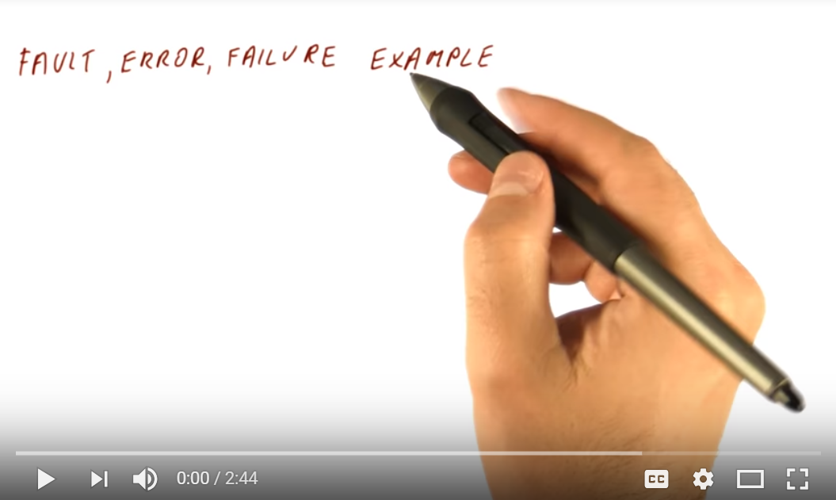
Software fault, error and failure
Activity:
Watch the following video.
Think individually for 1 minute and complete the answer in a table below.
Discuss with your neighbor for 2 minutes.
Share with the class when asked
Category | Description
Software fault
Software Error
Software failure
Notes:
Activity 5.0:
See the vid (4 mins), url: https://www.youtube.com/watch?v=yAtIBswQ-P8Think individually for 1 minute and complete the answer in Table 1.
Discuss with other participants beside you for 2 minutes.
Share with the class when asked
"software error"
"software fault"
"software failure"
types of errors
code error
procedure error
documentation error
software data error

Slide 37
When are defects introduced?
The majority of defects are introduced in earlier phases.
Requirements are the top factor in a project’s success or failure.
Phase | % of defects | % effort to fix
Requirements | 56 | 82
Design | 27 | 13
Code | 7 | 1
Other | 10 | 4

Slide 38
Cost of fixing defects
Relative cost of fixing defects
benchmark: cost at requirements phase = 1
Phase found | Cost ratio
Requirements | 1
Design | 3 – 5
Coding | 10
Unit / integration testing | 15 - 40
System / acceptance testing | 30 – 70
Production | 40 - 1000

Slide 39
Role of Customer
Customers don’t buy products, they buy assurances that their expectations with the products would met.
You also, can only sell assurances – in other words, Quality.
Customer is in absolute position to judge the quality.

Slide 40
SOFTWARE QUALITY ASSURANCE

Slide 41
SQA Activities
Assuring, with acceptable levels of confidence, conformance to functional technical requirements.
Assuring, with acceptable levels of confidence, conformance to managerial requirements of scheduling and budgets.
Initiating and managing activities for the improvement and greater efficiency of software development and SQA activities.

Slide 42
SQA Responsibilities for a Project
Review of documents developed by development team.
Track the compliance with standards.
Development of QA Plan (test plan + test cases).
Implementation of test cases (Black Box or Glass Box Testing).
Management of bug repository.
Participating in code and design reviews.

Slide 43
SQA Across the Life Cycle
Phases in SDLC and relevant artifacts
SQA Responsibilities
Requirements Collection
Requirement Specs
Reviews
Analysis
Functional Specs
Reviews
Architecture & Design
Design Specs
Reviews
Development
Code & Executables
Implement
Test Cases
Testing
Deployment
Deployment Docs
Review

Slide 44
SQA Artifacts for a Project
Dev. artifacts
SQA artifacts
SQA artifacts
(more)
Requirement Specs
RS Reviews
Functional Specs
FS Reviews
Test Plan
Design Specs
DS Reviews
Test Cases
Code & Executables
Bug Reports
More Test Cases
Deployment Docs
DD Reviews

Slide 45
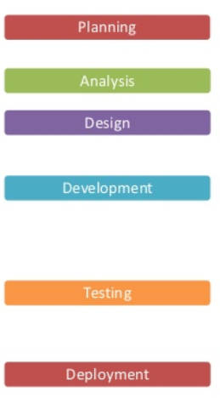
Software Quality Assurance
SQA is an ongoing process within the software development life cycle (SDLC) that routinely checks the developed software to ensure it meets desired quality measures.
What?
Phases in SDLC
SQA activities (checking process)
? ?
? ?
? ?
? ?
? ?
? ?
Notes:
Activity:
i) Think individually for 1 minute and complete the answer in a given table below.
ii) Discuss with your neighbor for 2 minutes.
iii) Share with the class when asked

Slide 46
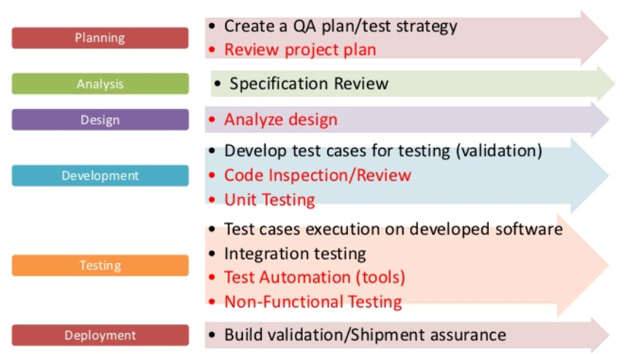
Software Quality Assurance (Answer)
Phases in SDLC
SQA activities (checking process)
Notes:
Activity:
Show example of SQA activities

Slide 47
Summary
Relationship of software, software quality, SQA & software testing
Importance of SQA
Causes of software errors
SQA and SDLC

