Slide 1

SECD2523 DATABASE
TOPIC 5
ENHANCED ENTITY RELATIONSHIP MODELLING
Content adapted from Connolly, T., Begg, C., 2015. Database Systems: A Practical Approach to Design, Implementation, and Management, Global Edition. Pearson Education.

Slide 2
LECTURE LEARNING OUTCOME
By the end of this lecture, students should be able to:
01
Define basic concepts associated with EER diagram
02
Produce EER model to represent information to application system

Slide 3
Introduction
Limitations of basic concepts of the ER model and requirements to represent more complex applications using additional data modeling concepts.
Most useful additional data modeling concept of Enhanced ER (EER) model is called specialization/generalization.
A diagrammatic technique for displaying specialization/generalization in an EER diagram using UML.

Slide 4
Enhanced Entity-Relationship Model
To respond to increase requirements of more complex applications
Basic concepts of ER modeling are not sufficient to represent requirements of newer, more complex applications.
Response is development of additional ‘semantic’ modeling concepts.
Semantic concepts are incorporated into the original ER model and called the Enhanced Entity-Relationship (EER) model.
Examples of additional concept of EER model is called specialization / generalization.

Slide 5
Vehicles can be specialized into more specific groups (maximize difference)
Superclass: Vehicles
Subclasses:
Cars: Smaller, used for personal transport, 4-5 seats.
Trucks: Larger, used for transporting goods, may have extra features like a loading bed.
Bikes: Two wheels, often for single riders, fuel-efficient.
In specialization, focusing on the differences between the types of vehicles and organizing them into distinct groups.

Slide 6

specific types of jobs like "Doctor," "Engineer," and "Teacher”: share common characteristics, like working hours, qualifications, and salaries.
Subclasses: Doctor, Engineer, Teacher
Superclass: Professionals
In generalization, grouping different entities together based on what they have in common to create a broader category (minimize difference).

Slide 7
Generalization vs Specialization
Generalization: specific animals like Dogs, Cats, and Horses, and group them under a single category: Mammals (common traits: warm-blooded, have hair, give live birth).
Specialization: Within Mammals, you distinguish differences:
Dogs: Domesticated, known for loyalty.
Cats: Domesticated, known for independence.
Horses: Larger, used for transport or racing.

Slide 8
Specialization / Generalization
Superclass
An entity type that includes one or more distinct subgroupings of its occurrences, which must be represented in a data model.
Subclass
A distinct subgrouping of occurrences of an entity type, which must be represented in a data model.

Slide 9
Specialization / Generalization
Superclass-subclass relationship is one-to-one (1:1).
Superclass may contain overlapping or distinct subclasses.
Not all members of a superclass need be a member of a subclass.
Notes:
Superclass: Vehicles
Includes all kinds of vehicles (e.g., Cars, Trucks, Bikes).
Subclasses:
Cars
Trucks
In this case:
Every Car or Truck is a Vehicle (one-to-one relationship).
But some Vehicles (like a Bicycle) might not fit into the Car or Truck subclass—they still belong to the Vehicle superclass, but not any subclass.
Superclass: Person
Represents all people in a system.
Subclasses:
Student: People currently studying in an institution.
Teacher: People who are teaching in the same institution.
Every Student or Teacher is a Person (one-to-one relationship between a subclass member and the superclass).
However, not every Person is necessarily a Student or a Teacher.
For instance: A Janitor or Visitor is still a Person, but they don’t belong to the Student or Teacher subclass.

Slide 10
Specialization / Generalization
Attribute Inheritance
An entity in a subclass represents same ‘real world’ object as in superclass, and may possess subclass-specific attributes, as well as those associated with the superclass.
Specialization
Process of maximizing differences between members of an entity by identifying their distinguishing characteristics.
Generalization
Process of minimizing differences between entities by identifying their common characteristics.
Notes:
Example:
Superclass: Vehicle
Attributes: Make, Model, Year
Subclasses:
Car
Inherits: Make, Model, Year
Unique Attribute: Number of Seats
Truck
Inherits: Make, Model, Year
Unique Attribute: Cargo Capacity
Motorcycle
Inherits: Make, Model, Year
Unique Attribute: Type of Handlebars
All vehicles share the attributes Make, Model, Year (inherited from the superclass).
Each specific type of vehicle (Car, Truck, or Motorcycle) adds its own unique characteristics.

Slide 11
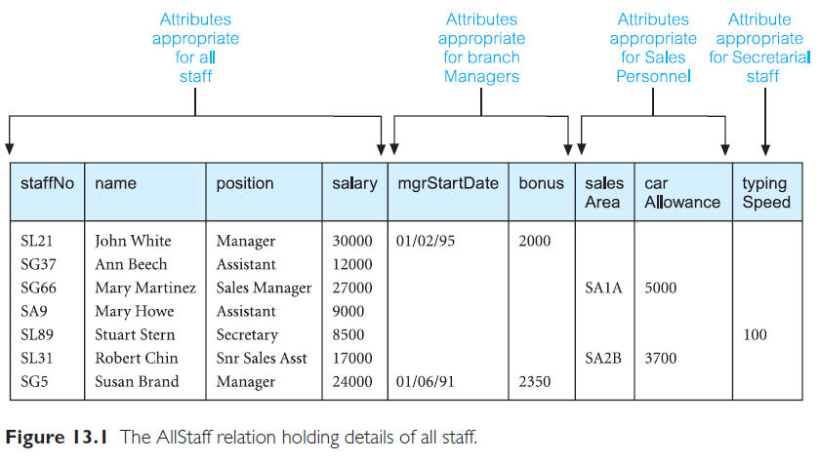
Example: AllStaff relation holding details of all staff

Slide 12
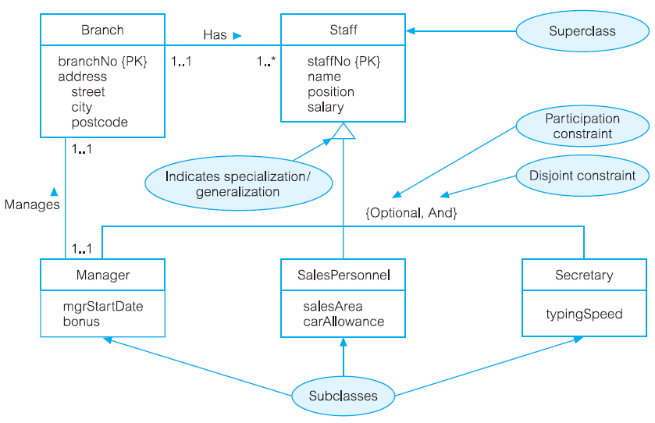
Specialization/generalization of Staff into subclasses representing job roles

Slide 13
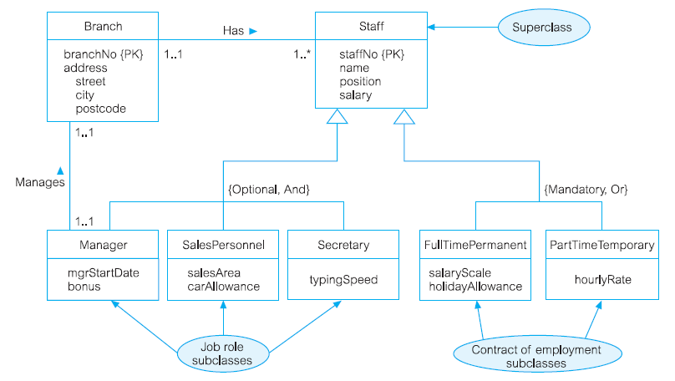
Specialization/generalization of Staff into job roles and contracts of employment

Slide 14
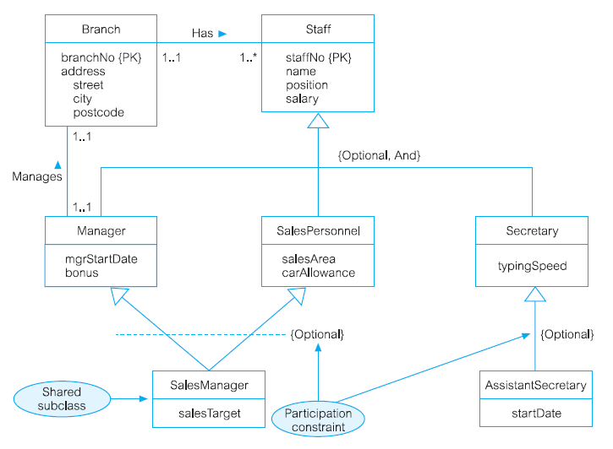
EER diagram with shared subclass and subclass with its own subclass

Slide 15
Constraints on Specialization/Generalization
Two constraints that may apply to a specialization/ generalization:
participation constraints
disjoint constraints.
Participation constraint
Determines whether every member in superclass must participate as a member of a subclass.
May be mandatory or optional.
Mandatory: Every member of superclass must be a member of a subclass
Optional: Every member of superclass need not belong to any of its subclasses

Slide 16
Constraints on Specialization/Generalization
Disjoint constraint
Describes relationship between members of the subclasses and indicates whether member of a superclass can be a member of one, or more than one, subclass.
May be disjoint (OR) or non-disjoint (AND)
Disjoint: An entity occurrence can be a member of only one of the subclass
Non-disjoint: An entity occurrence can be a member of more than a subclass

Slide 17
Constraints on Specialization/Generalization
There are four categories of constraints of specialization and generalization:
mandatory and disjoint {mandatory, or}
E.g.: Any member of staff must be attached to a department, but it is possible for a department to have no staff allocated.
optional and disjoint {optional, or}
E.g.: A member of staff does not have to be placed in a department, but all departments must have at least one member of staff.

Slide 18
Constraints on Specialization/Generalization
There are four categories of constraints of specialization and generalization:
mandatory and non-disjoint {mandatory, and}
E.g.: A member of staff must be assigned to a given department, and any department must have staff. There can be no unassigned staff, and it is not possible to have an 'empty' department
optional and non-disjoint {optional, and}
E.g.: A member of staff might be assigned to work in a department, but this is not compulsory. A department might, or might not, have staff allocated to work within it

Slide 19
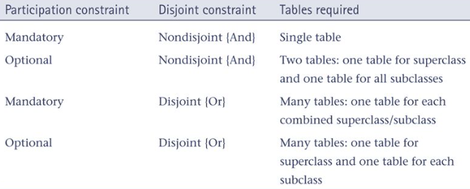
Constraints on Specialization/Generalization
Notes:
Participation Constraints
Mandatory: Every member of the superclass must belong to a subclass.
Example: Superclass: Employees Subclasses: Full-Time, Part-Time
Every Employee must either be a Full-Time or Part-Time worker. There are no employees who don’t fit into one of these categories.
Optional: A member of the superclass may or may not belong to a subclass.
Example: Superclass: Vehicles Subclasses: Cars, Trucks
Some Vehicles might not be a Car or Truck (e.g., a bicycle). It’s optional for vehicles to belong to these subclasses.
Disjoint Constraints
Disjoint (OR): A member of the superclass can belong to only one subclass.
Example: Superclass: Students Subclasses: Undergraduate, Graduate
A student can only be either Undergraduate or Graduate, not both.
Non-disjoint (AND): A member of the superclass can belong to more than one subclass.
Example: Superclass: Staff Subclasses: Teacher, Administrator
A staff member can be both a Teacher and an Administrator at the same time.

Slide 20
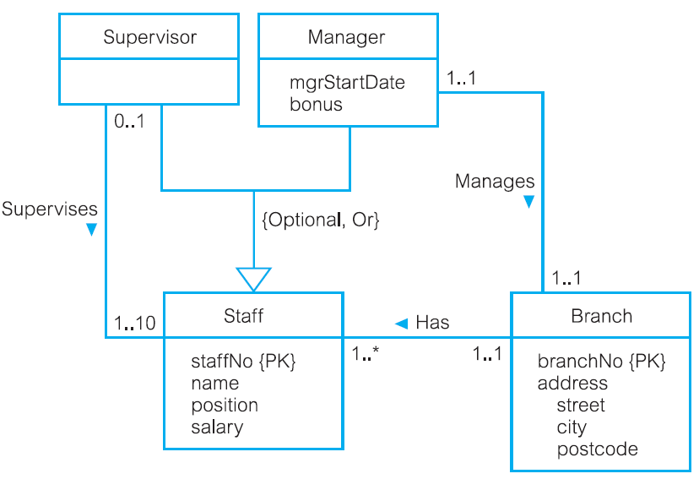
DreamHome example - Staff Superclass with Supervisor and Manager subclasses

Slide 21
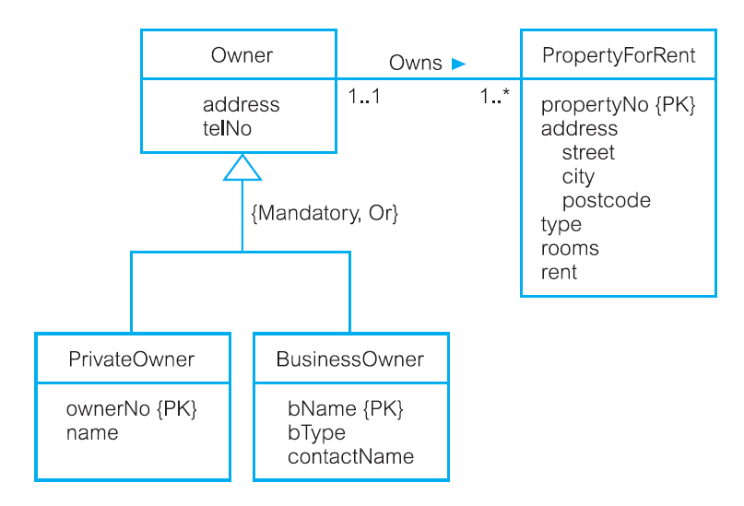
DreamHome example - Owner Superclass with PrivateOwner and BusinessOwner subclasses

Slide 22
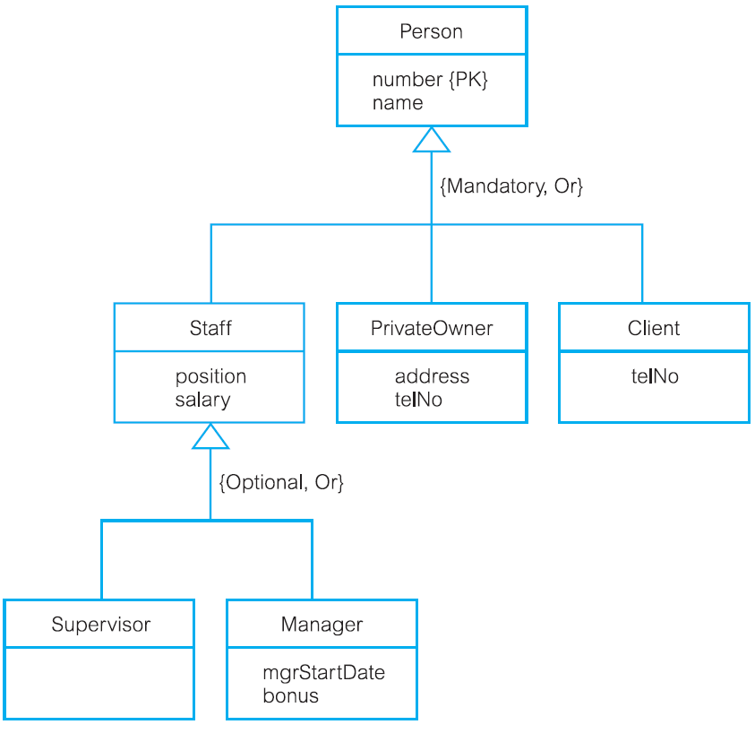
DreamHome example - Person superclass with Staff, PrivateOwner, and Client subclasses

Slide 23
Problem 1: EERM
A car dealership wishes to maintain data about the customers who purchase a car. Each customer may purchase one or more vehicles, and each vehicle can be purchased by many different customers over time (for example, a customer may purchase a new vehicle, trade that vehicle in and someone else can purchase the vehicle traded in.) Data that the dealership wishes to keep regarding customers includes customer identification number, name, address, home phone, work phone, cell phone and e-mail address.
Information about vehicle includes vehicle identification number, make, model, year, transmission type, engine size and color. Vehicles can be a member of one of the following categories: cars, trucks, minivans or SUVS. A vehicle can be a member of only one category at a given time. Trucks, minivans and SUVS have unique attributes – cars does not. Trucks have the following unique attributes: Cab (example: regular, super or crew) and Driver (for example: 94X2 or (4X4); Minivans have Accessory package and SUVS have SUV style.
The dealership is interested in the date of Purchase, amount of sale and Salesperson(s) completing each sale.
Participation Constraints:
Mandatory: Every superclass member belongs to a subclass.
Optional: Superclass members may not belong to a subclass.
Disjoint Constraints:
Disjoint (OR): A member can only belong to one subclass.
Non-disjoint (AND): A member can belong to multiple subclasses.
Notes:
Entities and Attributes
Customer (Superclass):
Attributes: CustomerID, Name, Address, HomePhone, WorkPhone, CellPhone, Email
Vehicle (Superclass):
Attributes: VehicleID, Make, Model, Year, TransmissionType, EngineSize, Color
Vehicle Subclasses:
Car: No unique attributes (inherits attributes from Vehicle).
Truck: CabType (Regular, Super, Crew), Drive (4x2, 4x4).
Minivan: AccessoryPackage.
SUV: SUVStyle.
Constraints:
Mandatory Participation: Every vehicle must belong to one of these subclasses.
Disjoint Constraint (OR): A vehicle can belong to only one subclass at a time.
Sale:
Attributes: PurchaseDate, Amount, Salesperson.
Relationships:
Customer - Sale: A customer may make multiple purchases.
Vehicle - Sale: A vehicle may have multiple sales over time.
Relationships
Purchases (Customer and Vehicle):
Cardinality: Many-to-Many (A customer can purchase multiple vehicles, and each vehicle can be purchased by multiple customers over time.).
Attributes: Included in the Sale entity (e.g., PurchaseDate, Amount, Salesperson).
Participation and Constraints
Participation:
Customers and vehicles can exist without participating in a sale, making their relationship to Saleoptional.
Disjoint Constraint:
A vehicle can only belong to one category (e.g., Truck, SUV, etc.) at any time.
EER Diagram Description
Superclass/Subclass Structure:
Vehicle is the superclass, and Car, Truck, Minivan, and SUV are its subclasses, following the mandatory participation and disjoint constraint.
Relationships:
Customer is related to Sale (to capture who purchased the vehicle).
Sale connects Customer and Vehicle in a many-to-many relationship.

Slide 24
ERD
Entities: Things or objects that are represented in the database (e.g., Customer, Product).
Attributes: Properties of entities (e.g., Name, Price).
Relationships: How entities are related (e.g., Customer places Order).

Slide 25
EERD
Subclasses and Superclasses: EERD supports specialization and generalization (e.g., grouping similar entities into a general category or splitting entities into subclasses based on common or unique characteristics). This helps represent inheritance in systems (e.g., a Vehicle superclass might have subclasses like Car, Truck, and SUV).
Categorization: You can define categories for your entities and apply specific attributes to those categories (e.g., a Product category with subcategories like Electronics, Clothing).
Constraints:
Participation Constraints: Defines whether every entity in a superclass must participate in a subclass (e.g., every Vehicle must be a Car, Truck, or SUV).
Disjoint and Overlapping Constraints: Indicates whether a subclass can have only one superclass member (disjoint) or multiple (non-disjoint).
Complex Relationships: EERD handles many-to-many relationships, recursive relationships, and multi-valued attributes in a way that ERD cannot.

Slide 26
Why EERD not ERD
Complex Systems: EERD is needed when the system you're designing is more complex and requires additional details like categorization, subclassing, and specialized constraints.
Real-world Complexity: Many real-world applications have complex relationships, specialized roles, and inheritance that need to be represented. For example, in a Hospital Management System, you might have an Employee superclass with subclasses like Doctor, Nurse, and Administrator.
Better Representation: EERD allows you to represent real-world scenarios more accurately. For instance, an EERD can represent a Product that belongs to a Category while having unique attributes for each type of product within that category.

Slide 27
the need for subclassing (Employee → Manager/Developer), specialization/generalization, and complex participation
Simple Scenario (ERD):
Entities: Customer, Order, Product
Relationships: A Customer places an Order, and an Order contains many Products.
Complex Scenario (EERD):
Entities: Employee, Department, Project
Superclass/Subclass: Employee superclass with Manager and Developer subclasses, each having unique attributes.
Participation Constraints: All employees must belong to a department. A project must have at least one employee assigned.
Notes:
When You Don’t Need EERD:
Simple Systems: If your system is not complex and doesn’t require handling inheritance, subclasses, or detailed constraints, an ERD will be sufficient. Examples include:
A basic inventory management system where you track products and suppliers.
A library system where you simply track books, authors, and borrowers.
Basic Relationships: If your entities have basic relationships, such as one-to-one or one-to-many, and you don’t need to group entities into categories or create special subclasses, an ERD is enough. For example:
A Customer places Orders in an online store, but the orders don’t need categories (just products in them).
Limited Data and Constraints: When the data involved is straightforward and doesn’t need special constraints (like mandatory participation or disjoint constraints), an ERD works just fine. For instance:
A company database that just stores employee details, departments, and employee assignments without needing complex rules.
Example Where ERD Is Enough:
designing a simple Customer Order System for an online store:
Entities: Customer, Order, Product
Relationships: A Customer places an Order, an Order contains multiple Products.
No Subclasses: Products are all the same type (no need for categories like "electronics" or "clothing").
No Special Constraints: Each order can contain many products, but there’s no special rule for whether a product is in multiple categories or whether a customer must place an order.
When You Do Need EERD:
You should consider using EERD when:
Inheritance: You have entities that share common attributes but need specialized subclasses. For example, a Person entity with subclasses like Student and Teacher, each with unique attributes.
Categories: You need to categorize entities into distinct groups (e.g., a Vehicle superclass with Car, Truck, and SUV subclasses, where each has specific attributes).
Complex Constraints: You need advanced constraints, like ensuring that every entity in a superclass participates in a subclass (mandatory participation), or you need to model overlapping or disjoint sets (e.g., a Product that can belong to multiple categories).

Slide 28
Feature | ERD | EERD
Entity Types | Basic entities with attributes | Includes advanced types like subclasses and superclasses
Relationships | Basic relationships (one-to-many, many-to-many) | Handles complex relationships (recursive, multi-valued)
Constraints | Simple constraints | Includes advanced constraints (disjoint, participation)
Use Case | Simple systems | Complex systems with inheritance, categories, and constraints
Notes:
modeling a Library System.
Basic Scenario (ERD):
Entities: Book and Author.
Relationship: An Author writes a Book.
ERD Use: This is simple. A Book can be written by multiple Authors, but it's straightforward.
Complex Scenario (EERD): Now, let's say some Books are Ebooks and others are PhysicalBooks. Authors can have different roles: Primary Author and Co-author. Also, each Book has a Category (like Fiction, Non-fiction).
In an EERD, you'd use:
Subclasses: Create subclasses for Ebook and PhysicalBook to capture their differences.
Categories: Use categories for Books (like Fiction, Non-fiction).
Special Constraints: For example, a Primary Author must be assigned to each Book, but a Co-author can be optional.
Why Would You Use EERD in This Case?
Inheritance: Ebook and PhysicalBook are both types of Book, but they have unique attributes (e.g., FileFormatfor Ebooks).
Categories: You might want to track whether a Book belongs to the Fiction or Non-fiction category.
Complex Rules: For example, every Book must have a Primary Author, but Co-authors are optional.

Slide 29

Notes:
Scenario: Online Store System
We want to keep track of Customers, Products, and Orders.
Entities and Attributes
Customer:
Attributes: CustomerID, Name, Email, PhoneNumber, Address
Product:
Attributes: ProductID, ProductName, Price, StockQuantity
Order:
Attributes: OrderID, OrderDate, TotalAmount
Relationships
Customer and Order:
A Customer can place multiple Orders.
Each Order is placed by only one Customer.
This is a one-to-many relationship: one Customer can have many Orders.
Order and Product:
An Order can contain multiple Products.
A Product can be part of many Orders.
This is a many-to-many relationship: one Order can have many Products and vice versa.
Participation and Constraints
Mandatory Participation:
Every Order must be linked to a Customer.
Every Order must include at least one Product.
Optional Participation:
Customers might not have placed an order yet (optional).
Disjoint Constraints:
We don’t need a disjoint constraint here since Products aren’t categorized (just a basic catalog).
EERD Overview
Entities: Customer, Product, Order
Relationships:
Customer to Order: One-to-many
Order to Product: Many-to-many
Constraints:
Order must always have a Customer.
Order must always have at least one Product.
Simple Concept:
Customer → Order → Product
A Customer places an Order, and an Order can contain multiple Products.

