Slide 1
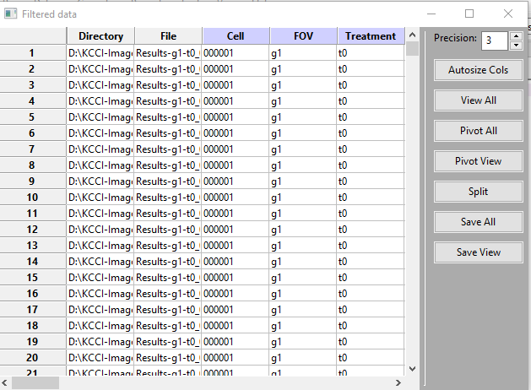
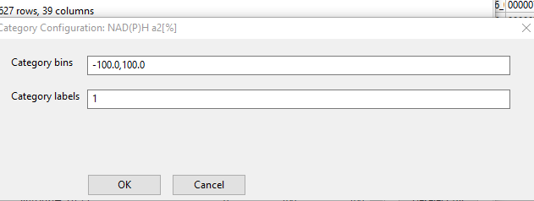
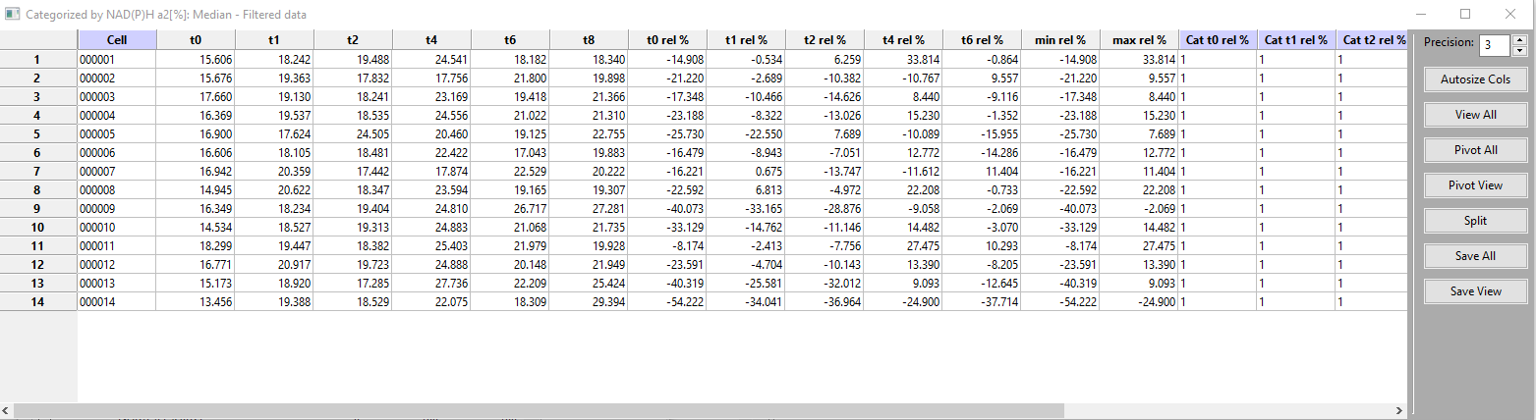
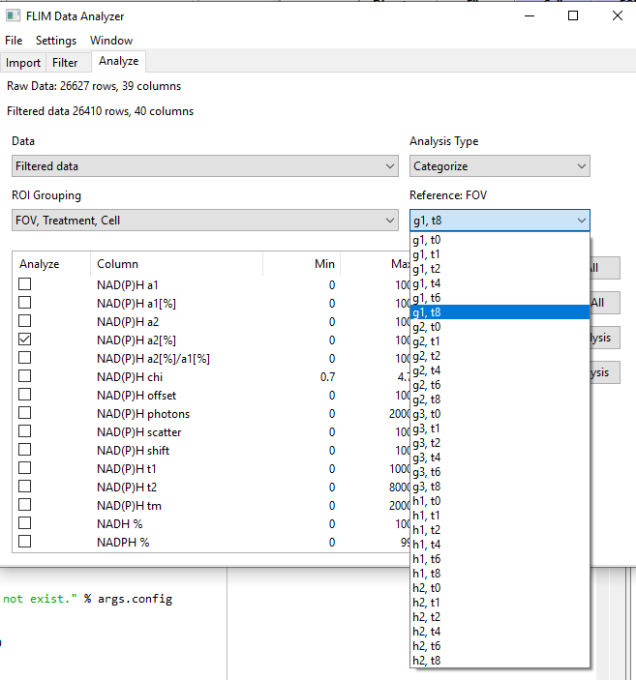
Categorization does not show cells by FoV- Is this a summary of sorts?
Step 1-to just get % change to define ranges
Filtered Master shows all FoVs, Cells, Treatment (BTW, parser was FoV, treatment, cell)
All of the reference FoVs should appear. This is the actual output. The % changes do not match the numbers. What is the T0 rel %?

Slide 2
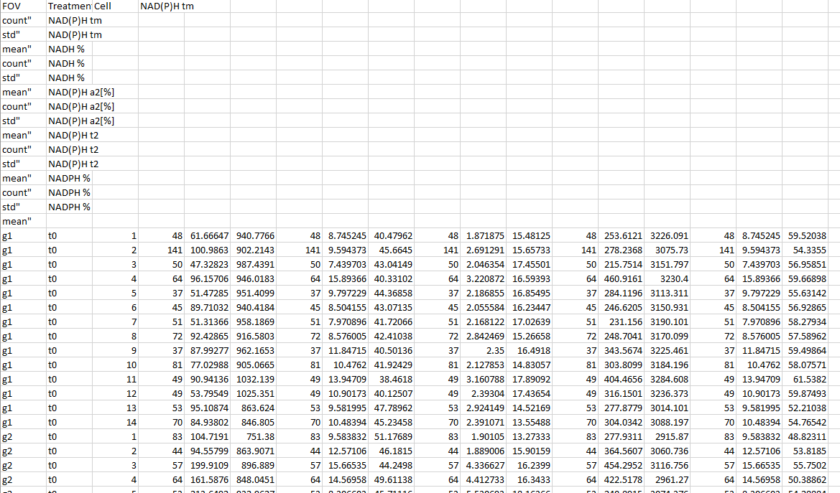
Having saved data (e.g. summary) selections of FoV, treatment or cells –if any – defined on the opening master (a great feature!), we now proceed to analysis. Select FLIM headings etc, show analysis, save analysis, It asks again “save view”, obviously referring to the opening popup. Is this necessary?
Headings are perpendicular to data

Slide 3
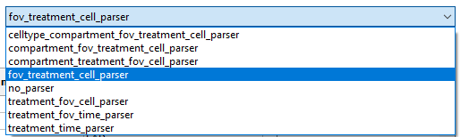
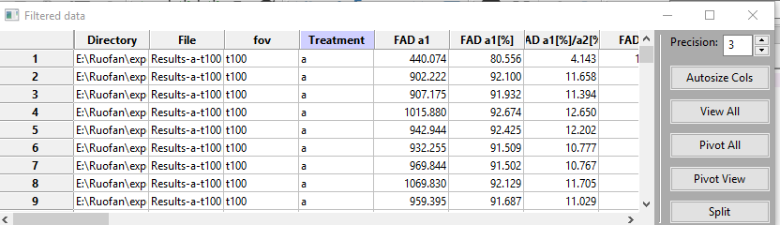

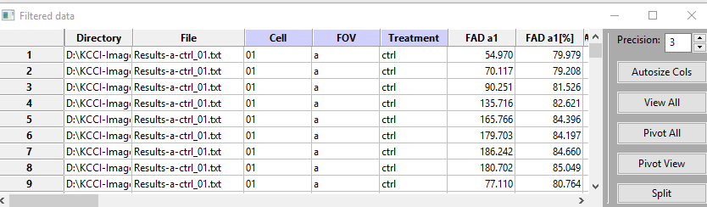
There is no fov_treatment parser. When using fov_treatment_cell, question marks turn up in the two pop-ups. It still seems to work…..But….
When a ‘Master’ was loaded (‘No Parser’) which was created in a previous code, FoV and treatment were reversed and analysis only showed ‘treatment’
When adding 01 to the FoV data (this was not segmented cell data) it scrambled the headings
NADPH/NADH heading did not turn up in the FLIM Data Analyzer, neither in the Master. BUT when the preview button was used BEFORE ‘Import’ it shows up

