Slide 1



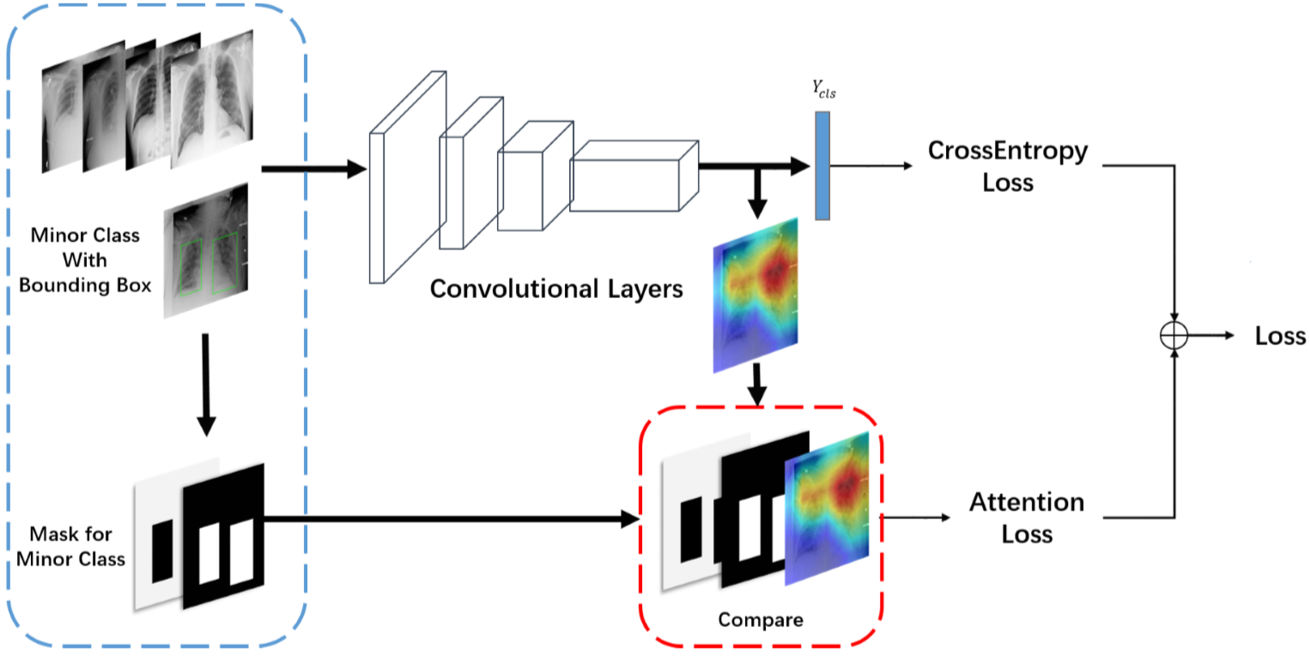
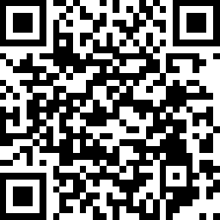
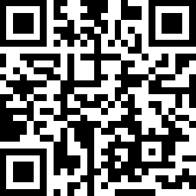
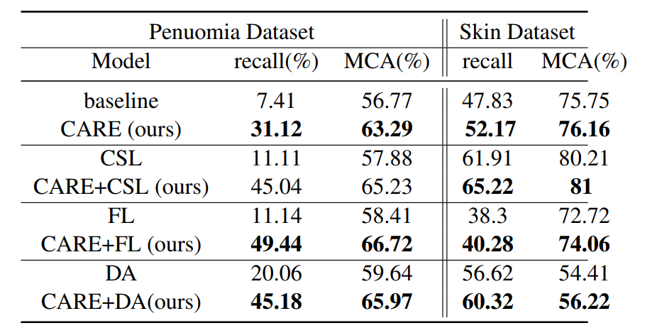
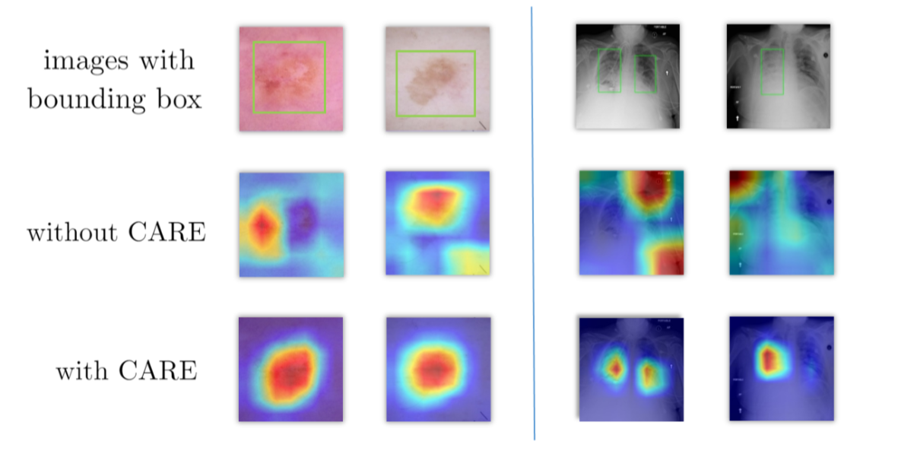
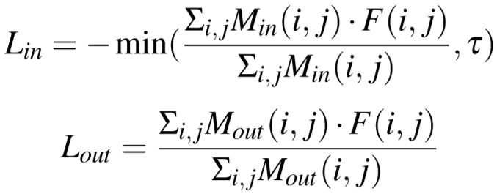
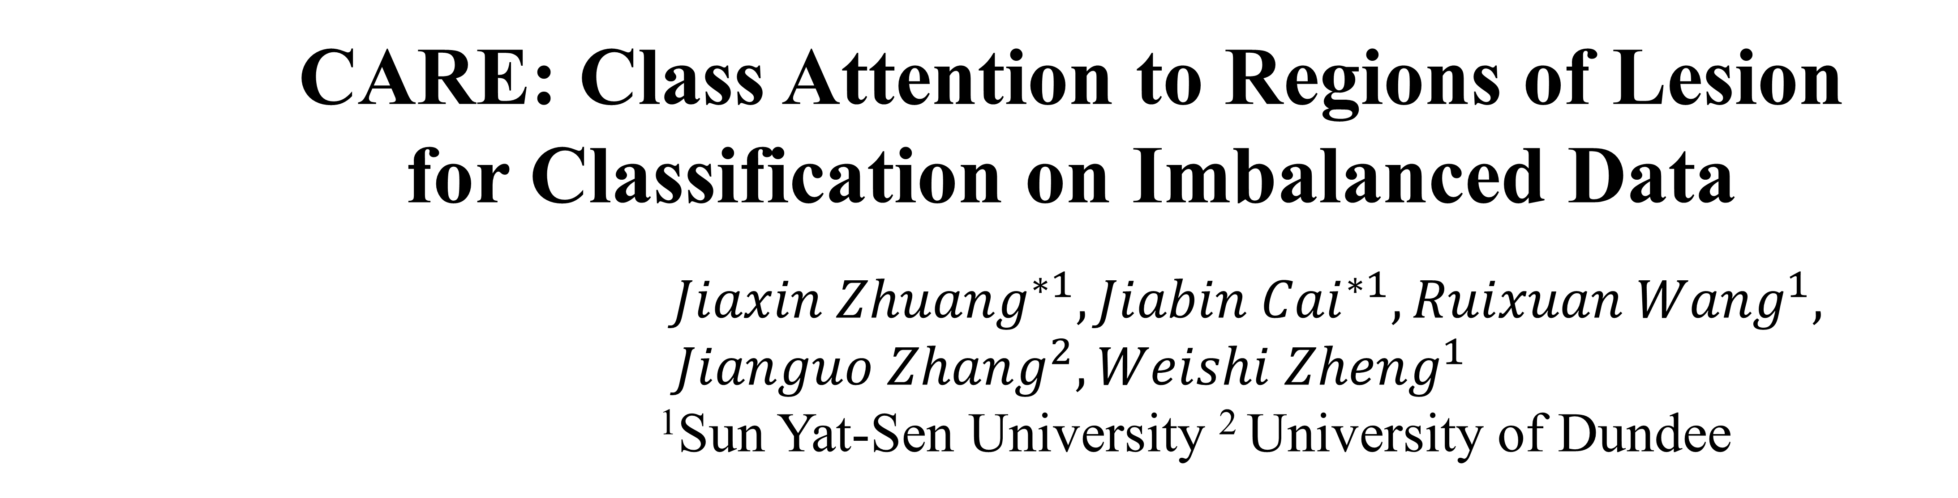
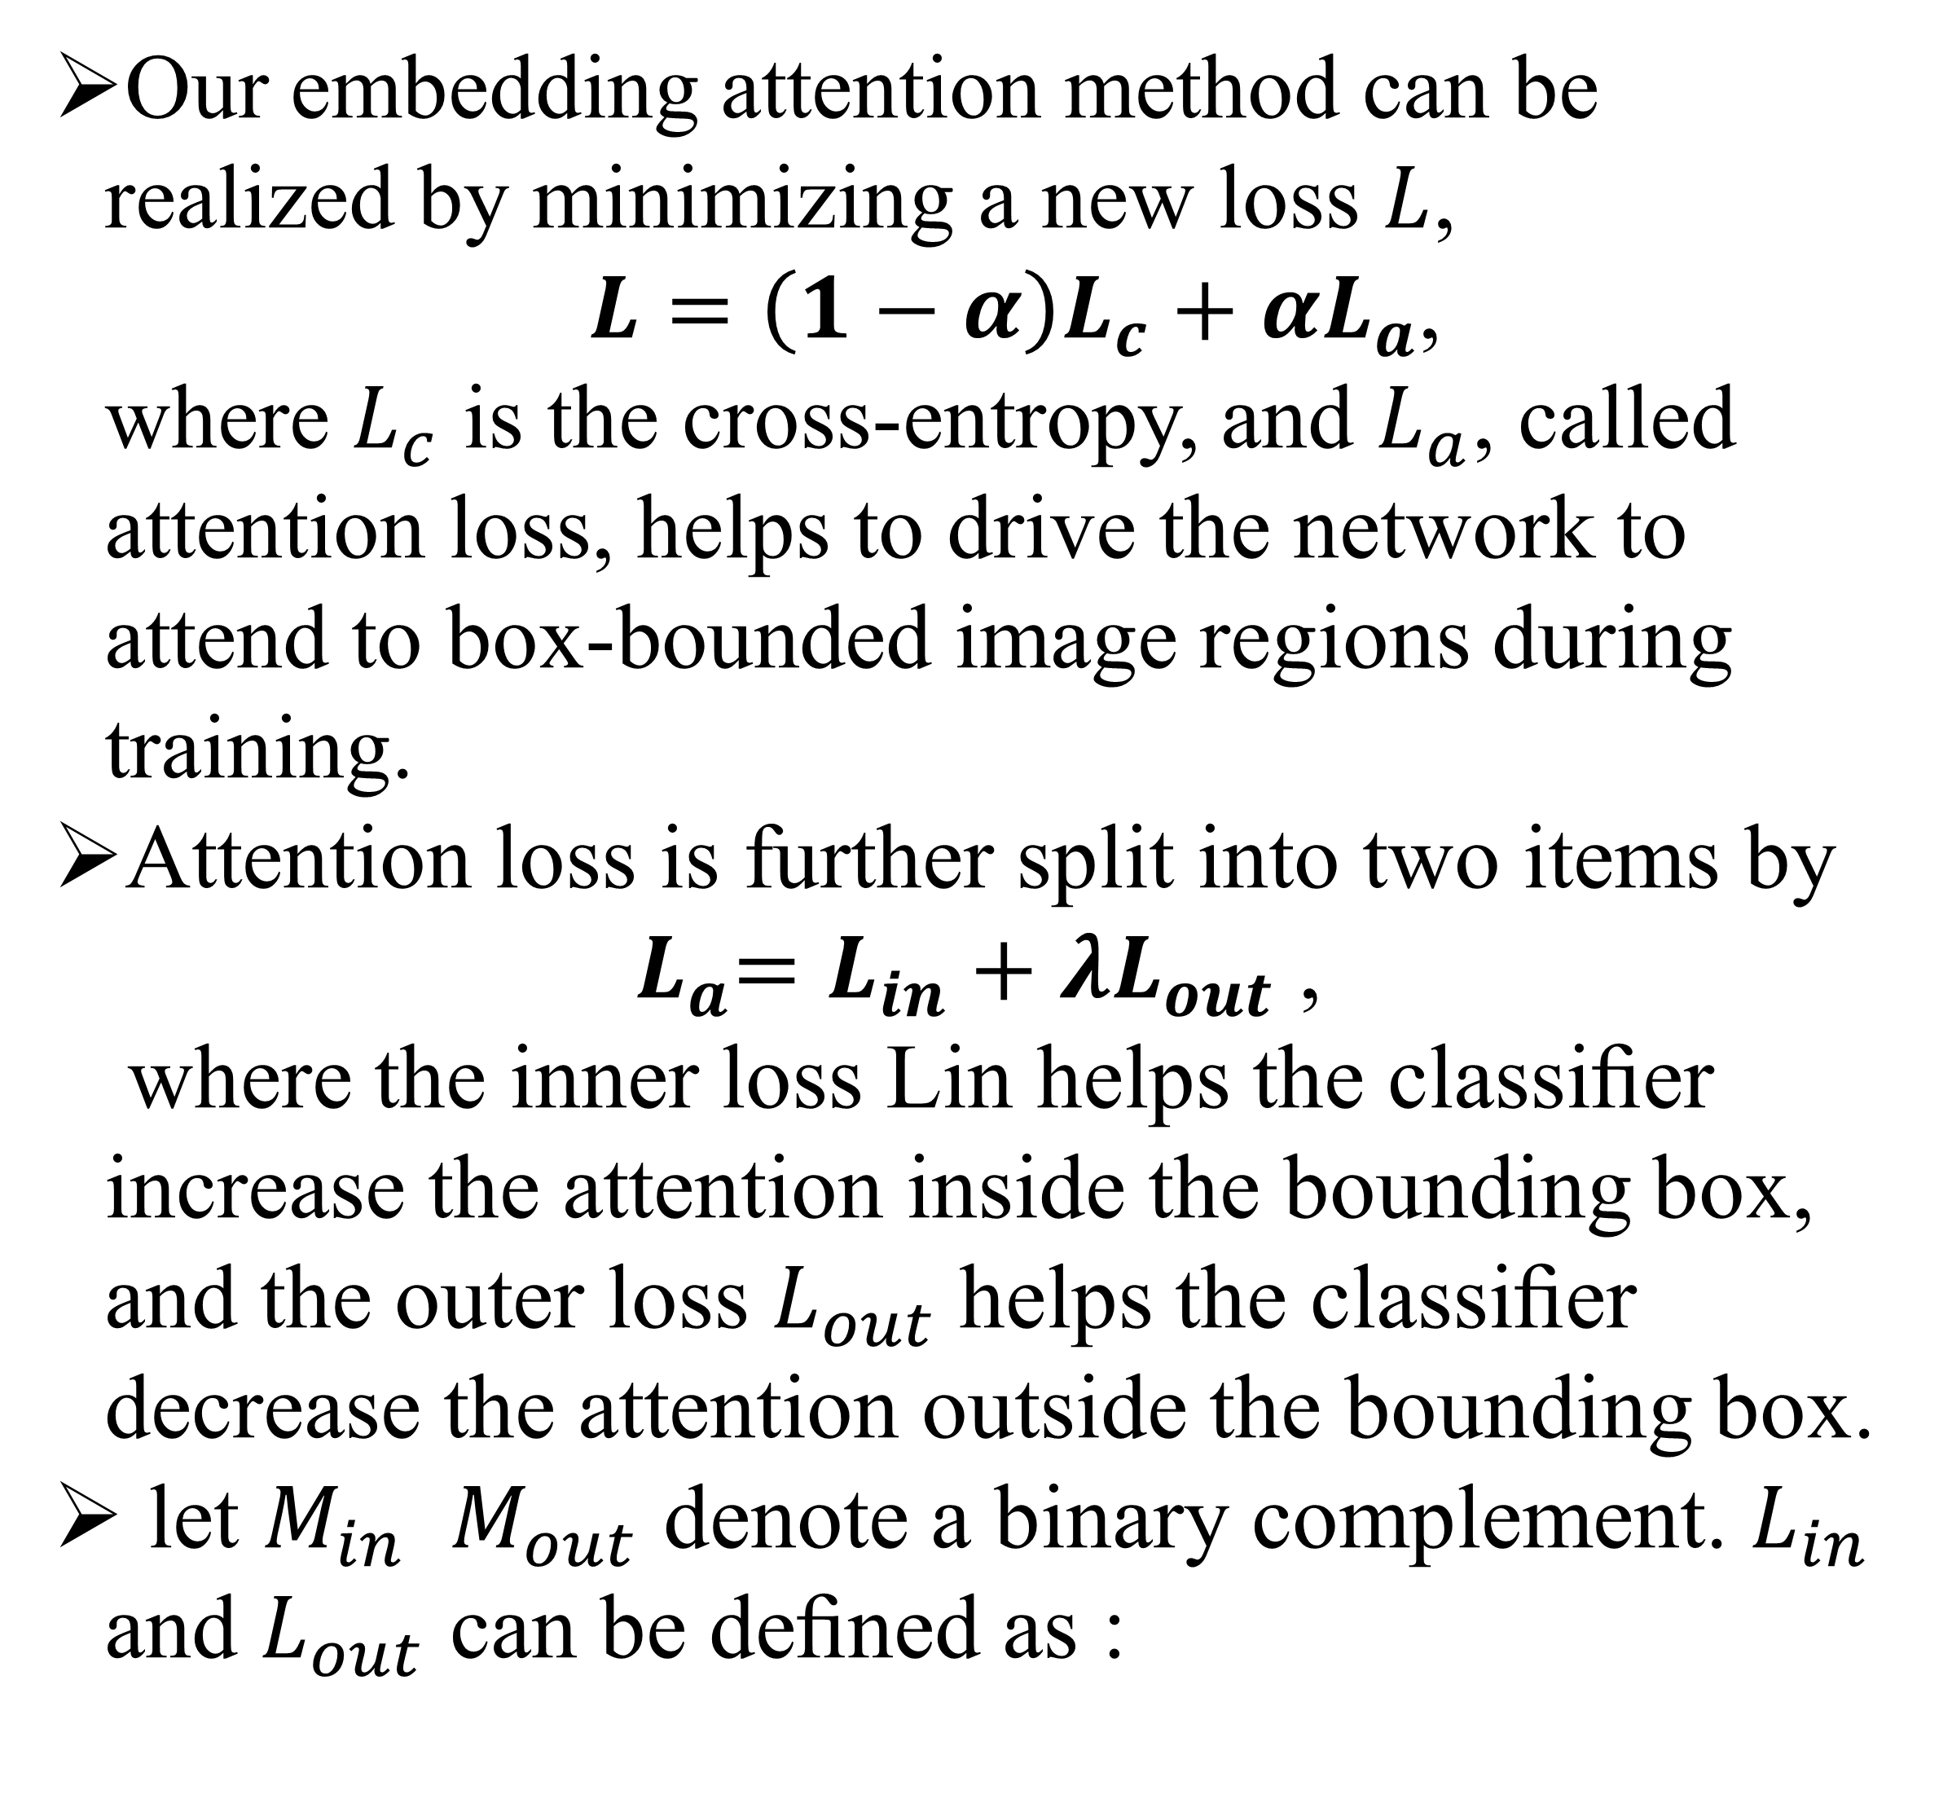
CARE: Class Attention to Regions of Lesion for Classification on Imbalanced Data ${Jiaxin Zhuang}^{∗1}, {Jiabin Cai}^{∗1}, {Ruixuan Wang}^{1},$ $${Jianguo Zhang}^{2}, {Weishi Zheng}^{1}$$ ¹Sun Yat-Sen University ² University of Dundee
Introduction
Limited available data for rare diseases is usually imbalanced, we propose a novel approach to data imbalance problems by delving into images and considering the high-level semantics of images, i.e, Class Attention to REgions of lesion (CARE).
Get paper
Contact us
Methods
Experiments & Analysis
Our embedding attention method can be realized by minimizing a new loss $L$, $L=\left(1−α\right)L_{c}+αL_{a}$, where $L_{c}$ is the cross-entropy, and $L_{a}$, called attention loss, helps to drive the network to attend to box-bounded image regions during training.
Attention loss is further split into two items by ${ L}_{a}=L_{in}+λL_{out}$ , where the inner loss Lin helps the classiﬁer increase the attention inside the bounding box, and the outer loss $L_{out}$helps the classiﬁer decrease the attention outside the bounding box.
let $M_{in}$ $M_{out}$ denote a binary complement. $L_{in}$ and $L_{out}$ can be deﬁned as :
Comparison with existing methods
Visualization of activation maps with and without using CARE

