Slide 1

Analysis of Review Length and Sentiment
JiaxinG He

Slide 2
Introduction
Objective:
Analyze relationship between review length and sentiment
Datasets:
Amazon, IMDb, Steam
Methods:
Review length
Sentiment label (0: negative; 1: positive)
Correlation analysis (point-biserial correlation)

Slide 3
Data Source
# | Name | Source URL | Type | Fields | Format | Data Size
1 | Amazon Fine Food Reviews | https://www.kaggle.com/datasets/snap/amazon-fine-food-reviews | File | Review, Scoring | csv | 500,000
2 | IMDB Movie Reviews | https://www.kaggle.com/datasets/lakshmi25npathi/imdb-dataset-of-50k-movie-reviews | File | Review, Sentiment | csv | 50,000
3 | Steam Reviews (ID: 2868840) | https://store.steampowered.com/appreviews/2868840 | API | Review, Label | JSON | 600
4 | Steam Reviews (ID: 570) | https://store.steampowered.com/appreviews/570 | API | Review, Label | JSON | 600
5 | Steam Reviews (ID: 1172470) | https://store.steampowered.com/appreviews/1172470 | API | Review, Label | JSON | 600

Slide 4
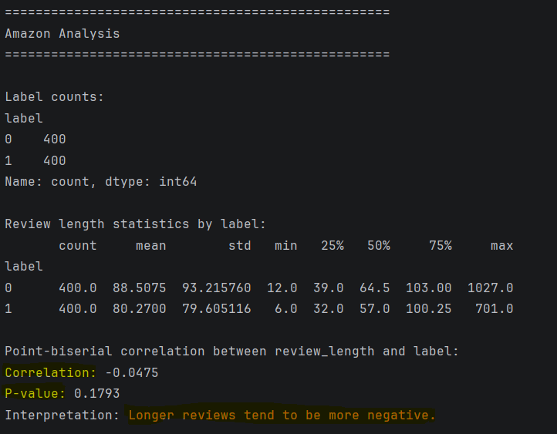
Results(Amazon)
Correlation: close to 0
p-value: > 0.05
Not statistically significant

Slide 5
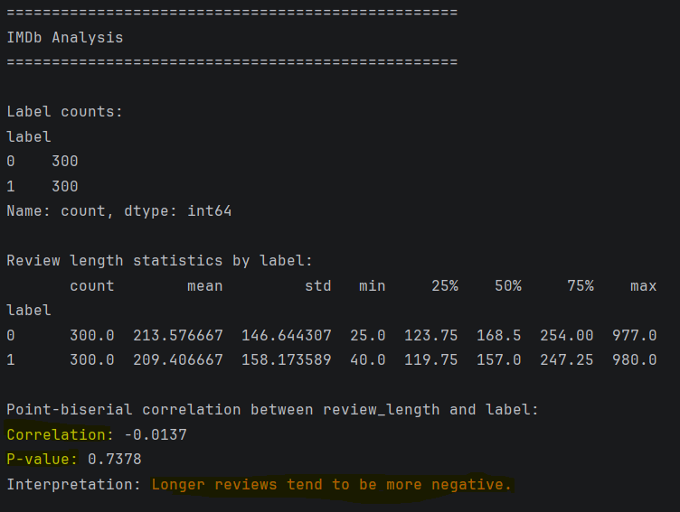
Results(IMDB)
Correlation: close to 0
P-value: >0.05
Not statistically significant

Slide 6
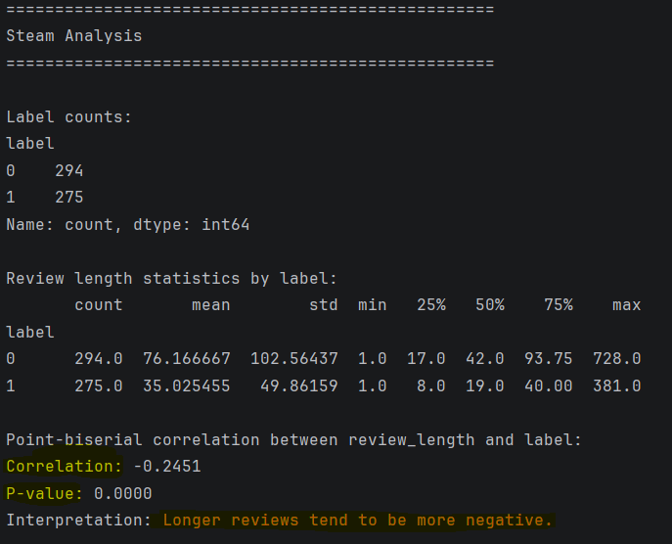
Results(Steam)
Correlation: -0.2451
P-value: < 0.05
Longer reviews tend to be more negative.

Slide 7
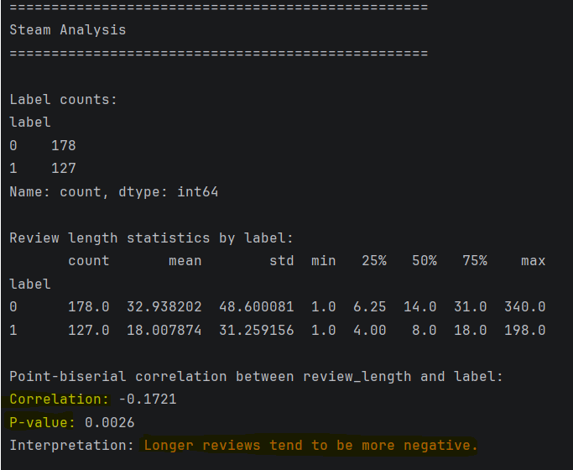
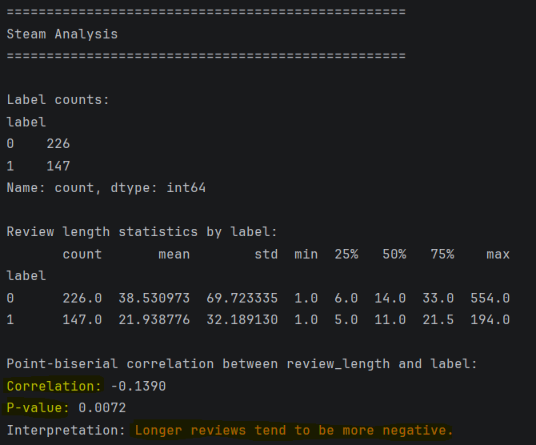
Results(Steam)
User behaviors may be different across platforms. For steam particularly, longer reviews tended to be more negative.

Slide 8
Challenges
Scraping Steam Data:
Languages
Data

Slide 9
Thank You!

