Slide 1
Distributed Systems
(4th edition, version 01)
https://www.distributed-systems.net/
Chapter 02: Architecture

Slide 2
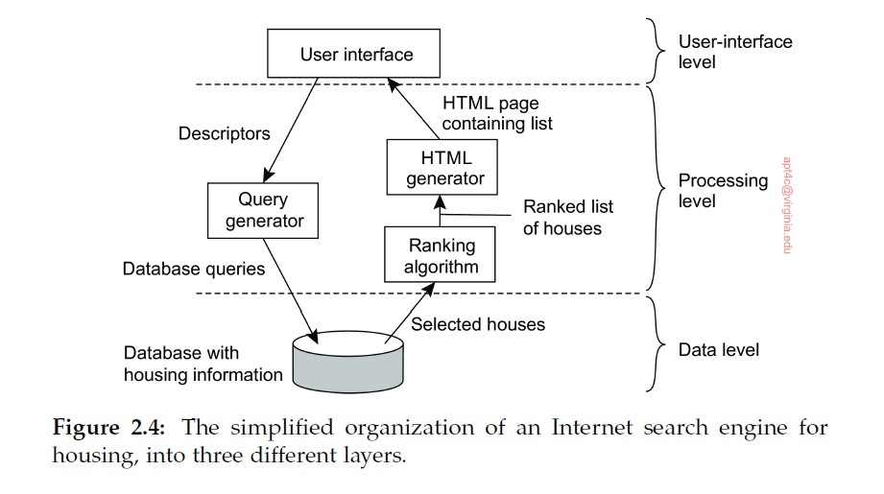
Three-Tier Architecture Diagram
Introduction From networked systems to distributed systems
Distributed versus decentralized systems

Slide 3
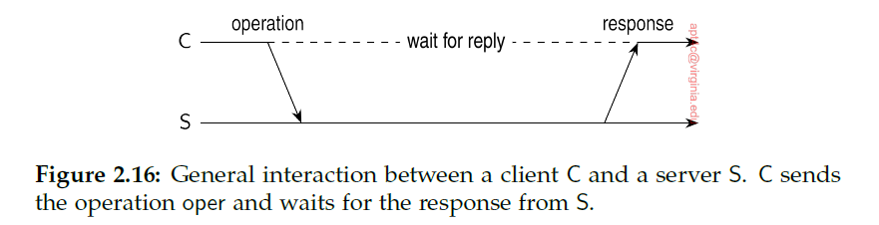
Simple Client-Server Architecture (No connection)
Introduction From networked systems to distributed systems
1) Client packages message for server,
identifying the service it wants,
along with necessary input data
2) Message sent to server
3) Server will wait for incoming request, process it, and package results in a reply message sent to client
Distributed versus decentralized systems

Slide 4
Simple Client-Server Architecture (No connection), contd.
Introduction From networked systems to distributed systems
When it works, this is efficient
What if the result doesn’t come back?
1) was original request lost?
2) did transmission of response fail?
We won’t know
In first case, might resend. In second case, don’t want to resend.
Transaction that can safely be repeated is called idempotent
Distributed versus decentralized systems

Slide 5
Simple Client-Server Architecture (No connection), contd.
Introduction From networked systems to distributed systems
Examples:
Request 1: transfer $10K from bank account
Not safe to resend
Request 2: Tell me bank account balance
Safe to resend
Distributed versus decentralized systems

Slide 6
Connection-Oriented Protocol
Introduction From networked systems to distributed systems
Alternatively, many client-server systems use a reliable connection-oriented protocol.
Nearly all internet application protocols use TCP/IP connections
Before client requests service, connection set up w/server
Server uses same connection to send reply message
When communication finished, connection torn down
Distributed versus decentralized systems

Slide 7
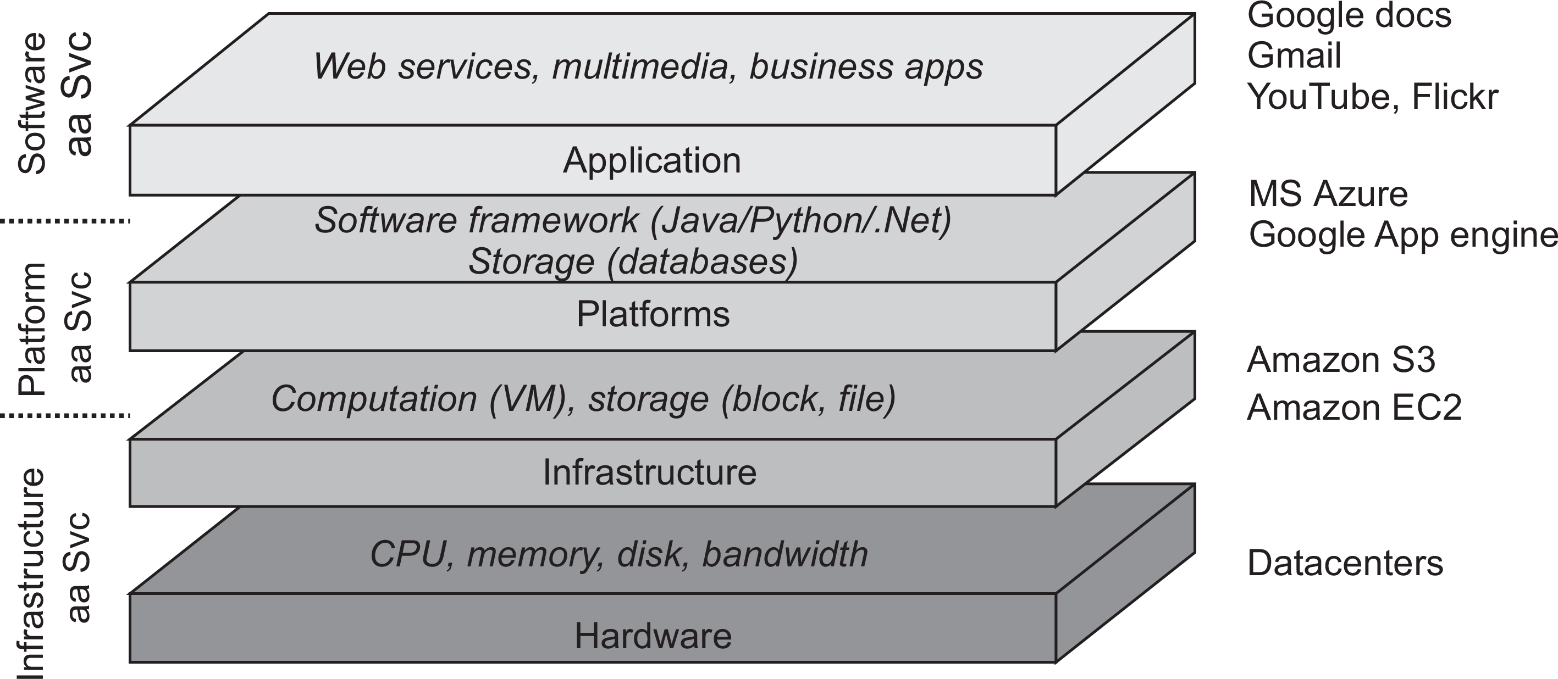
Architectures
Hybrid system architectures
Cloud computing
Cloud computing

Slide 8
Cloud computing
Architectures Hybrid system architectures
Make a distinction between four layers
Hardware: Processors, routers, power and cooling systems. Customers normally never get to see these.
Infrastructure: Deploys virtualization techniques. Evolves around allocating and managing virtual storage devices and virtual servers.
Platform: Provides higher-level abstractions for storage and such. Example: Amazon S3 storage system offers an API for (locally created) files to be organized and stored in so-called buckets.
Application: Actual applications, such as office suites (text processors, spreadsheet applications, presentation applications). Comparable to the suite of apps shipped with OSes.
Cloud computing

