Slide 1
Distributed Systems
(4th edition, version 01)
https://www.distributed-systems.net/
Chapter 01: Introduction

Slide 2
Brief Computing History
Introduction From networked systems to distributed systems
1945: modern computer era begins
1945-1985: computers large and expensive. no way to connect them.
mid-1980s:
- powerful microprocessors
- invention of high-speed computer networks
Distributed versus decentralized systems

Slide 3
Brief Computing History - Networks
Introduction From networked systems to distributed systems
Local-area networks (LANs) Allow thousands of machines within building to be connected
Wide-area network (WANs) Allow hundreds of millions of machines all over the earth
to be connected
Speeds varying from tens of thousands to hundreds of millions bps and more.
Distributed versus decentralized systems

Slide 4
Brief Computing History
Introduction From networked systems to distributed systems
Now: miniaturization of computer systems, with perhaps the smartphone as the most impressive outcome.
The size of a networked computer system may vary from a handful of
devices, to millions of computers.
Most networked computer systems can be accessed from
anywhere in the world because they are connected to Internet.
Distributed versus decentralized systems

Slide 5
Alternative approach
Introduction From networked systems to distributed systems
Two definitions
A decentralized system is a networked computer system in which processes and resources are necessarily spread across multiple computers.
A distributed system is a networked computer system in which processes and resources are sufficiently spread across multiple computers.
Distributed versus decentralized systems

Slide 6
Distributed System – Example 1
Introduction From networked systems to distributed systems
Gmail
Close to 2 billion users as of 2022
Seems to use two servers: inbox and outbox
Behind the scenes, the entire Google Mail service has been implemented and spread across many computers
Distributed versus decentralized systems

Slide 7
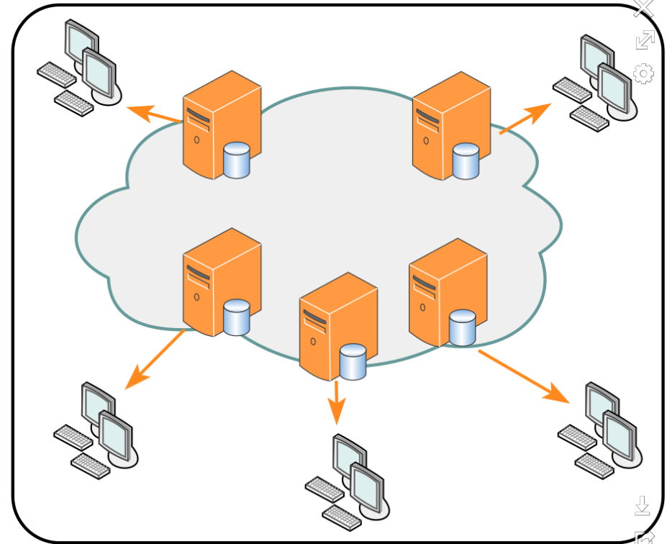
Distributed System – Example 2
Introduction From networked systems to distributed systems
Content Delivery Networks (CDNs)
Geographically distributed network of servers and their data centers
Content copied and spread across various servers of the CDN
When visiting a website, user is redirected to nearby server that holds relevant content.
Source: Wikipedia
Distributed versus decentralized systems

Slide 8
Perspectives on distributed systems
Introduction From networked systems to distributed systems
Distributed systems are complex: take perspectives
Architecture: common organizations
Process: what kind of processes, and their relationships
Communication: facilities for exchanging data
Coordination: application-independent algorithms
Naming: how do you identify resources?
Consistency and replication: performance requires of data, which need to be the same
Fault tolerance: keep running in the presence of partial failures
Security: ensure authorized access to resources
Studying distributed systems

Slide 9
Introduction
Design goals
What do we want to achieve?
Overall design goals
Support sharing of resources
Distribution transparency – a bit of a confusing term, means that users don’t realize the system is distributed (details are abstracted away)
Openness – includes extensibility
Scalability

Slide 10
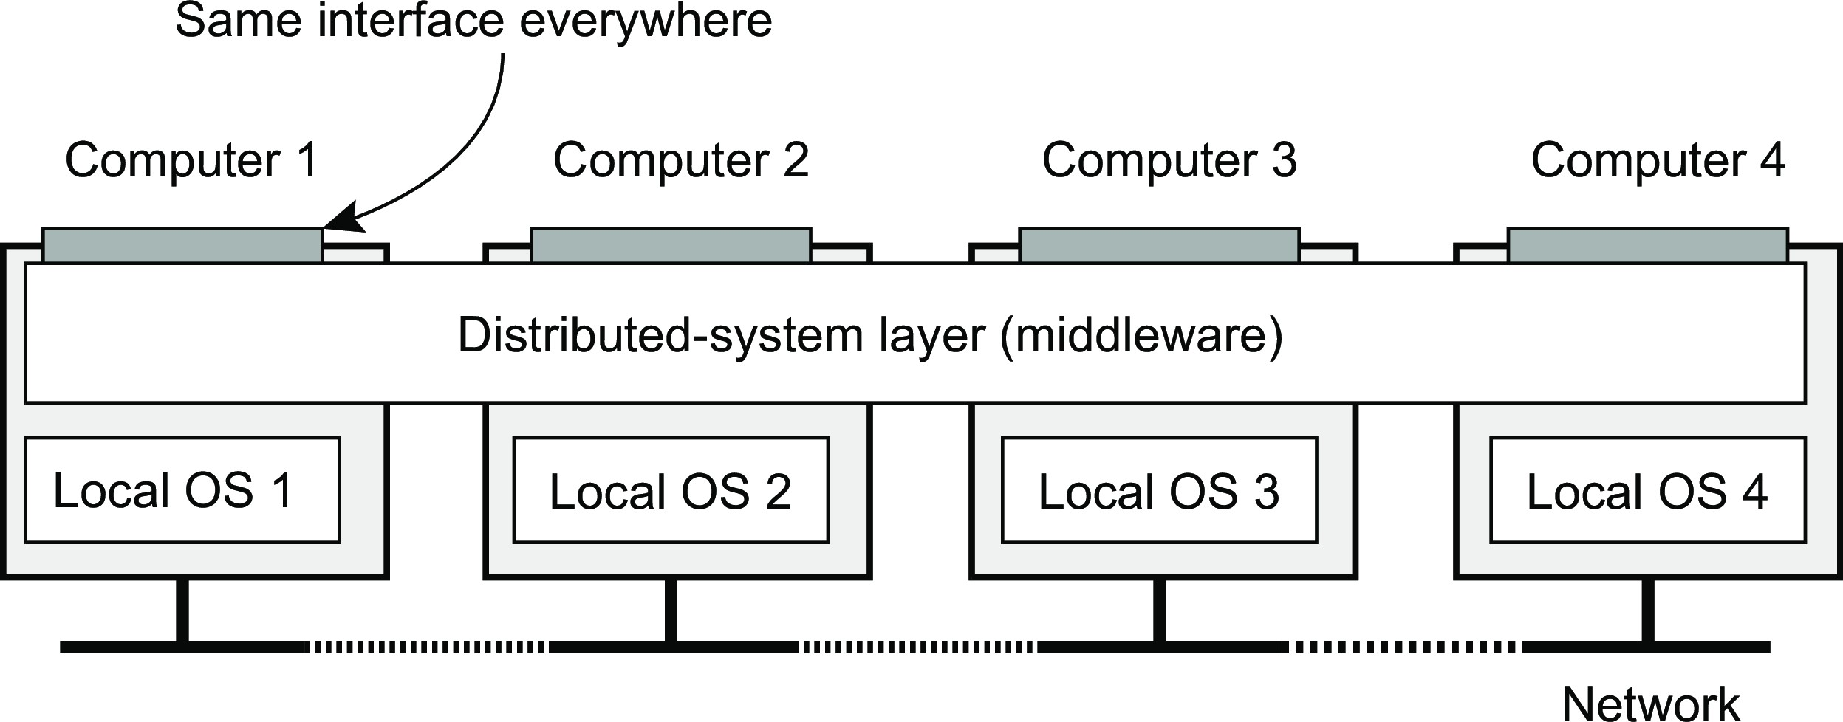
Introduction
Design goals
Distribution transparency
What is transparency?
The phenomenon by which a distributed system attempts to hide the fact that its processes and resources are physically distributed across multiple computers, possibly separated by large distances.
Distribution transparency

Slide 11
Introduction
Design goals
Distribution transparency
What is transparency?
The phenomenon by which a distributed system attempts to hide the fact that its processes and resources are physically distributed across multiple computers, possibly separated by large distances.
Observation
Distribution transparancy is handled through many different techniques in a layer between applications and operating systems: a middleware layer
Distribution transparency

