Slide 1
Distributed Systems
(4th edition, version 01)
https://www.distributed-systems.net/
Chapter 02: Architecture

Slide 2
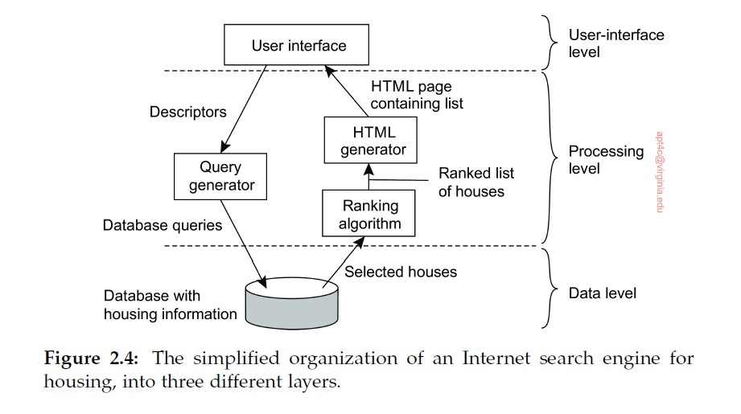
Three-Tier Architecture Diagram
Introduction From networked systems to distributed systems
Distributed versus decentralized systems

