Slide 1
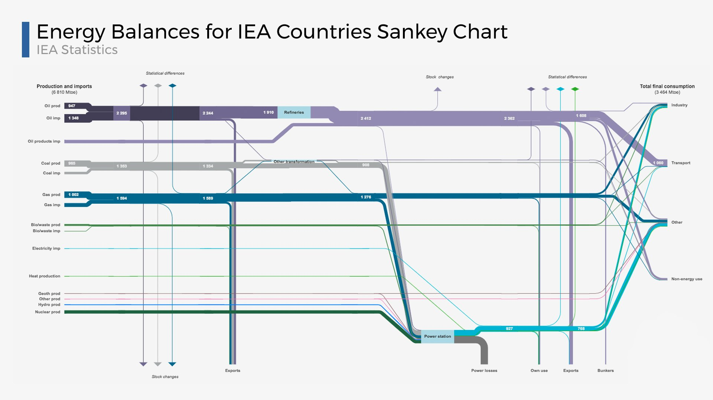
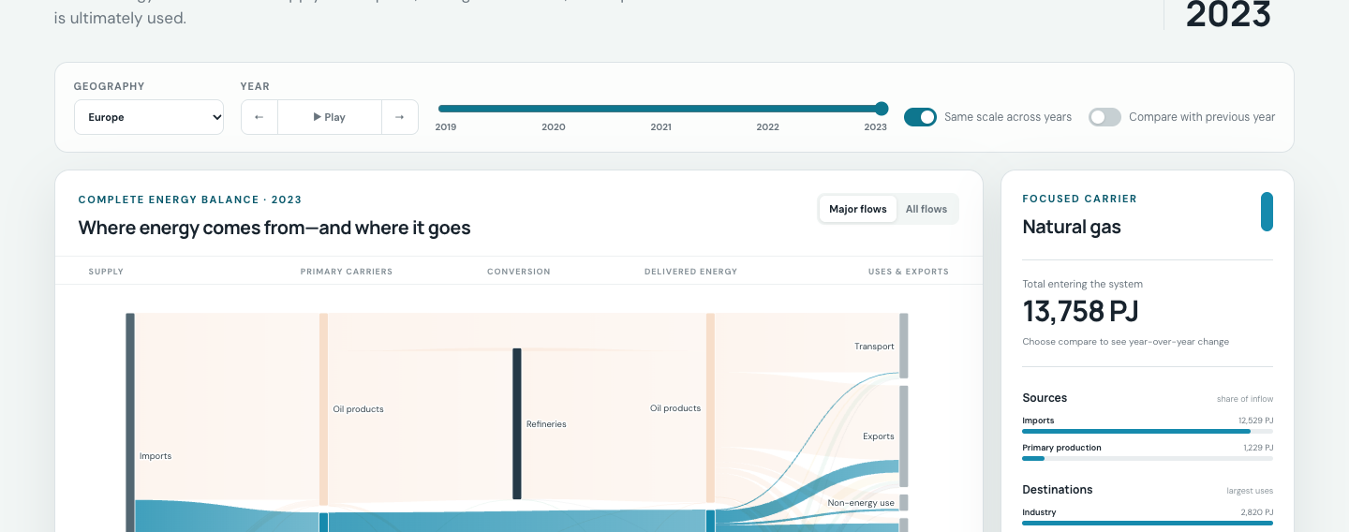
IEA ENERGY SANKEY
From a complete balance to a readable exploration
One-minute visualization critique and redesign
ORIGINAL · IEA ENERGY BALANCE
REDESIGN · D3 + EUROSTAT
WHAT WORKS
WHAT BREAKS DOWN
REDESIGN RESPONSE
Flow width preserves the energy-balance structure. One canvas connects supply, conversion, losses and end use.
Thin links disappear. Categories compete for attention. Year changes are hard to compare without a persistent reference.
High-contrast carrier roles, Major / All flows, click-to-focus details, and a 2019–2023 year player make targeted questions visible.
Takeaway: keep the Sankey grammar, then make focus, time and explanation persistent on the same page.
Original: IEA Energy Sankey · Redesign data: Eurostat nrg_bal_c · Values in the redesign are not IEA data
Notes:
One-minute script: The original IEA Sankey succeeds because flow width preserves the energy-balance structure and the whole system fits in one view. But thin links disappear, categories compete for attention, and year-to-year change is difficult to hold in memory. My redesign keeps the Sankey grammar, increases carrier contrast, adds Major and All flows, keeps a clicked carrier in a persistent detail panel, and makes 2019–2023 playback explicit. The public prototype uses open Eurostat data, so the interaction design is comparable but the values are not IEA data. Sources: IEA Energy Sankey; IEA Understanding and using the Energy Balance; Eurostat nrg_bal_c.

