Slide 1
Cancer cells
Agent
Observation
Reward
Action
Human body
Environment
State: nucleotide sequence
Action: cell division and death

Slide 2

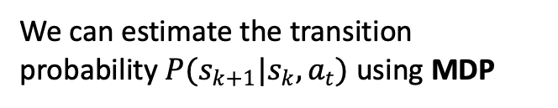
Agent
Data: Mutation trees
State: nucleotide sequence
Action: Nucleotide mutation
Transition of the state
We can estimate the transition probability $P(s_{k+1}|s_{k},a_{t})$ using MDP
Assume the optimal policy
Behaviour: Paths: {${(s}_{1},a_{1}) …(s_{k},a_{t})$}

Slide 3
Path and policy
IRL algorithm
Tree mutation data
learn
Reward function that maximize the probability of the policy
Estimate the quality of the reward function

Slide 4
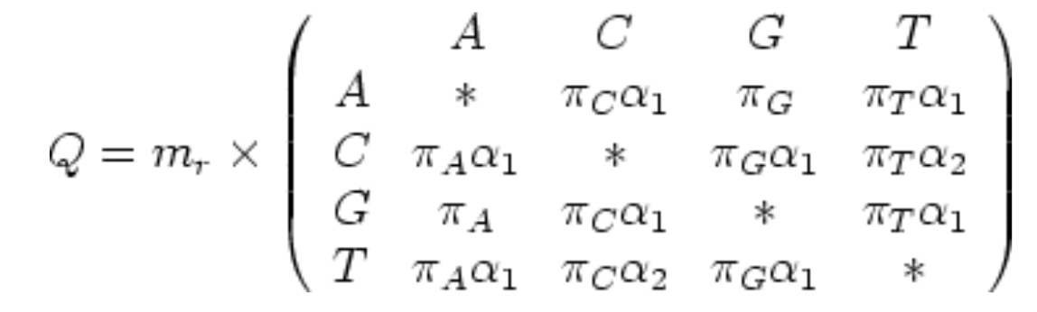
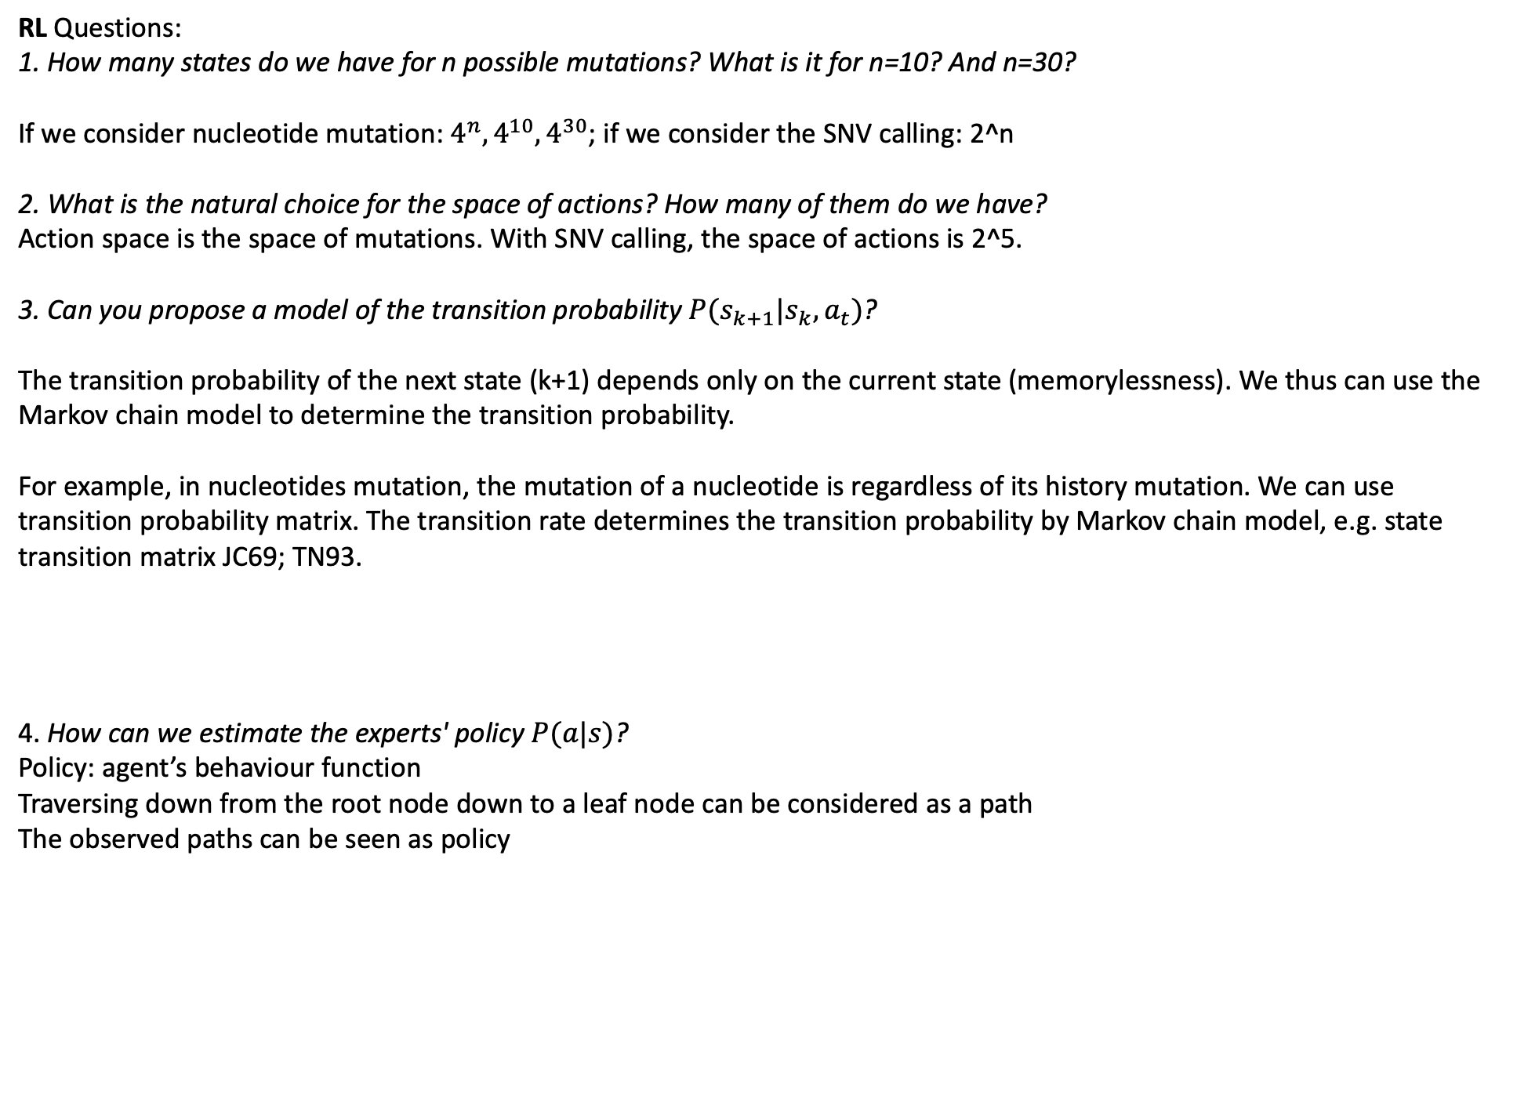
RL Questions:
1. How many states do we have for n possible mutations? What is it for n=10? And n=30?
If we consider nucleotide mutation: $4^{n}, 4^{10}, 4^{30}$; if we consider the SNV calling: 2^n
2. What is the natural choice for the space of actions? How many of them do we have?
Action space is the space of mutations. With SNV calling, the space of actions is 2^5.
3. Can you propose a model of the transition probability $P(s_{k+1}|s_{k},a_{t})$?
The transition probability of the next state (k+1) depends only on the current state (memorylessness). We thus can use the Markov chain model to determine the transition probability.
For example, in nucleotides mutation, the mutation of a nucleotide is regardless of its history mutation. We can use transition probability matrix. The transition rate determines the transition probability by Markov chain model, e.g. state transition matrix JC69; TN93.
4. How can we estimate the experts' policy $P(a|s)$?
Policy: agent’s behaviour function
Traversing down from the root node down to a leaf node can be considered as a path
The observed paths can be seen as policy

Slide 5
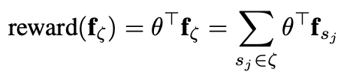
IRL
How can we model possible features for the reward design? How many of them will we have for n mutations?
The reward is modelled as the sum of the state features along the path:
There will be 2^n states
2. How can we evaluate the quality of the (learned) reward function?
EPIC way (equivalent policy invariant comparison)? They are used in RL
Can we use the learned reward function to do RL and to see whether the learned policy is similar to the given policy?

Slide 6
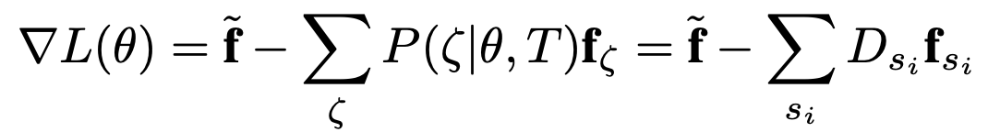
MaxEnt IRL
For how many mutations would this approach be feasible?
2. How can you use Jax to get the required graident?
Graident is the difference between expected empirical feature counts and the learner’s expected feature counts, which can be expressed in terms of expected state visitation frequencies:
Jax is not required.
Having the gradient, how can you optimize the parameters to get the MLE?
At the maxima, the feature expectations match, guaranteeing that the learner performs equivalently to the agent’s demonstrated behaviour.
We can use exponentiated gradient descent algorithm or any other gradient based optimization technique to find MLE as the objective function is convex.

