Slide 1
HOOK + PROBLEM
ChartAccess Audit
A lightweight AI-augmented workflow that verifies whether charts, tables, and presentation graphics are readable, inclusive, and presentation-ready.
4
3
10
accessibility requirements checked
unit tests run in CI
minutes to explain the workflow
SYSEN 5493 final project / 1
Notes:
0:00-1:00. Open with the idea that visuals are part of decision systems. If a graph, table, or poster visual is inaccessible, the system excludes people and weakens decisions.

Slide 2
STAKEHOLDER NEED
Unreadable visuals create hidden system failures.
Students and engineers often choose colors and fonts by taste, not verifiable requirements.
Low contrast, tiny type, and missing labels exclude users and weaken decisions.
The project converts inclusive design advice into checks that can run before a visual is shared.
Bad chart spec
#ffff99 on white
9 pt font
missing axis labels
"Chart of results."
FAILS 4 / 4 CHECKS
SYSEN 5493 final project / 2
Notes:
1:00-2:00. Frame this as a human-centered systems problem: a graph is an interface in a decision system.

Slide 3
APPROACH
The workflow turns inclusive design guidance into verification logic.
Visual input
Audit engine
Report + tests
JSON metadata or uploaded PNG image
contrast, readability, color usability, context
PASS/FAIL output, unit tests, CI gate
SYSEN 5493 final project / 3
Notes:
2:00-2:45. Explain the repo architecture and why the project supports both precise JSON checks and quick PNG upload checks.

Slide 4
REQUIREMENTS
Four simple requirements make inclusive visual review testable.
Readable colors
Each data color reaches 3.0:1 contrast against background
Readable text
Font size is at least 12 pt
Clear context
Title, x-axis label, and y-axis label are present
Plain-language access
Alt text has at least 8 words
SYSEN 5493 final project / 4
Notes:
2:45-3:30. Show that the system has explicit requirements, not just a subjective accessibility score.

Slide 5
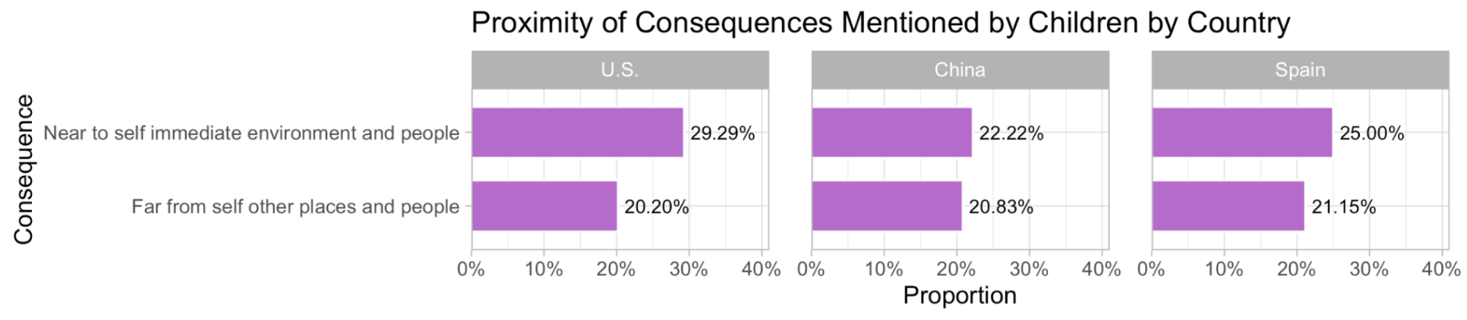
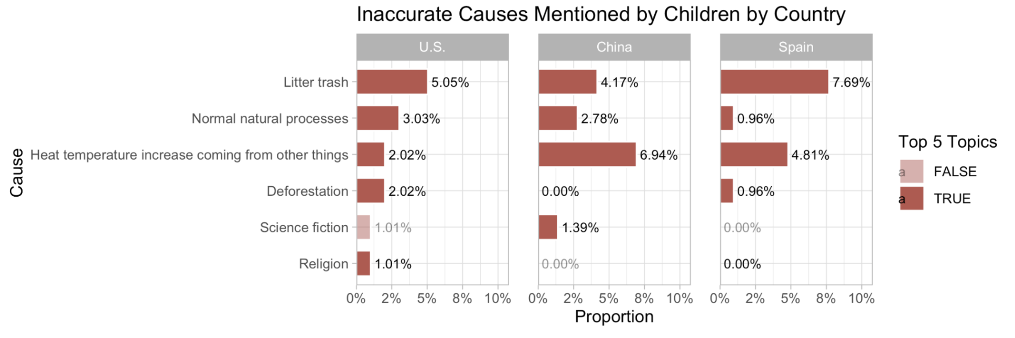
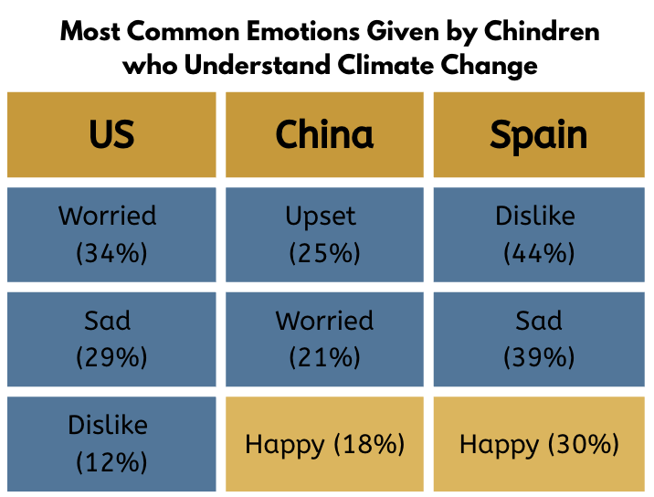
REAL VISUAL AUDIT
The upload workflow passes three real thesis and poster visuals.
Thesis: Consequence Proximity
PASS 4/4 | text/marks 2.2% | low-contrast share 47.9%
Human review still matters
The pixel audit checks readability signals. A human should still improve semantic labels such as TRUE/FALSE legends and confirm the visual tells the intended story.
Thesis: Inaccurate Causes
PASS 4/4 | text/marks 5.7% | low-contrast share 56.4%
Poster: Emotions Table
PASS 4/4 | text/marks 45.5% | low-contrast share 38.0%
SYSEN 5493 final project / 5
Notes:
3:30-5:30. Live demo commands: python -m chartaccess --image examples/thesis_proximity_consequences.png; python -m chartaccess --image examples/thesis_inaccurate_causes.png; python -m chartaccess --image examples/poster_emotions_table.png. Explain that all three pass automated readability checks, while human review still catches semantic improvements such as legend wording.

Slide 6
GIT HYGIENE
The commit history tells the project story.
docs: initialize project
Conventional commits read like a changelog.
A feature branch was merged with --no-ff.
A deliberate conflict forced a human policy choice.
feat(color): add contrast utilities
feat(audit): evaluate requirements
test(audit): cover requirements
ci: add unit test workflow
merge: resolve font-size policy conflict
SYSEN 5493 final project / 6
Notes:
5:30-6:20. Emphasize that the conflict was not random: it represented a real policy choice about minimum font size.

Slide 7
AI COLLABORATION
AI drafted options; I kept the requirements accountable.
Prompt
Accepted: JSON metadata instead of image parsing.
Accepted: requirement checks that are easy to test.
Rejected: vague AI accessibility score.
Rejected: heavy computer-vision scope.
"Help me design a simple systems-engineering final project that checks whether graphs meet ADA and inclusivity requirements for color and font choices."
SYSEN 5493 final project / 7
Notes:
6:20-7:15. Be honest: AI helped scope and review, but the final requirement decisions are human-owned.

Slide 8
CI/CD PROOF
CI makes the accessibility checker repeatable after every push.
Push / PR
Checkout
Python 3.11
Unit tests
Demo audit
README BADGE: GREEN AFTER GITHUB ACTIONS PASS
SYSEN 5493 final project / 8
Notes:
7:15-8:00. After the repo is pushed, show the Actions tab or README badge if time allows.

Slide 9
REFLECTION
The hardest decision was policy, not syntax.
The merge conflict forced a judgment call: what minimum font size should the checker enforce?
AI was useful as a second opinion, but the final standard needed to be explainable.
The better project was smaller: measurable checks beat an overbuilt black-box model.
12 pt
0 deps
resolved minimum font size
required to run local tests
4/4
requirements checked by good demo
SYSEN 5493 final project / 9
Notes:
8:00-8:45. This is the honest reflection slide. Say what surprised you and what you would improve next.

Slide 10
TAKEAWAYS + Q&A
A small checker can make inclusive visual design part of the workflow.
The project is cloneable, testable, CI-ready, and now supports PNG upload.
The Git history demonstrates branching, merging, conventional commits, and conflict resolution.
AI accelerated planning and review, but human judgment set the requirements.
Question to discuss
Which inclusive-design checks should become automated gates before reports, posters, or slides are shared?
SYSEN 5493 final project / 10
Notes:
8:45-10:00. Land the plane. Invite one real question and be ready to show the repo, tests, and README.

