Slide 1
Removal of Batch Effects with Matched Mutual Nearest neighbors in Single-cell Sequencing data
Fall Lab Rotation
Jessie Tong
Advisor: Prof. Mingyao Li
1:15–1:30 PM 12/04/2019

Slide 2
Background
Batch effects is one of the most challenging problems in single-cell RNA-sequencing data.
Batch effects are the variations caused by different technical sources and time in data collection process.

Slide 3
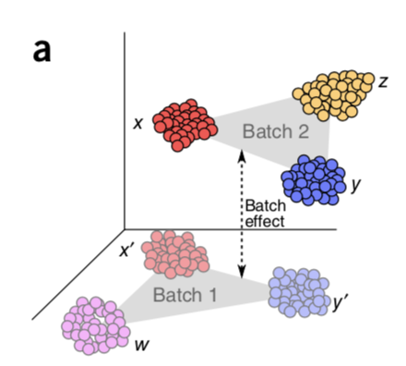
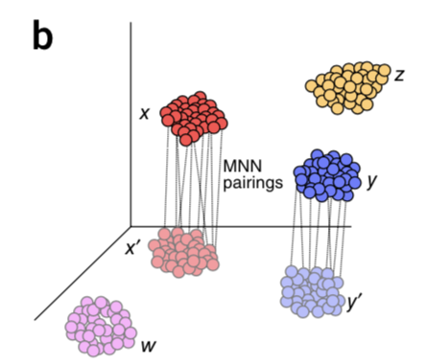
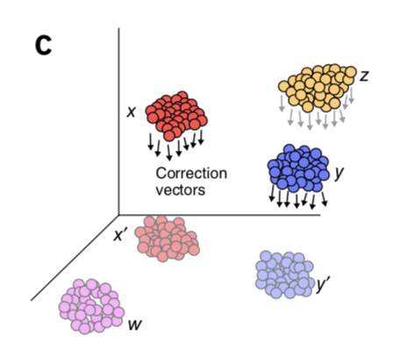
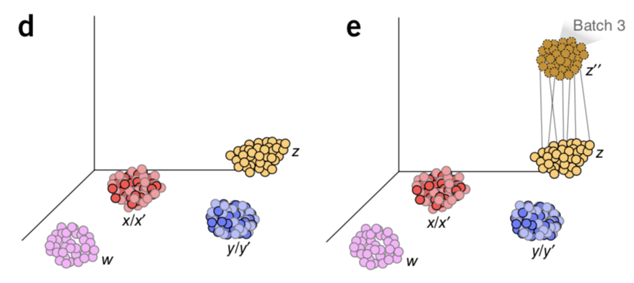
Current/existing method
Haghverdi et al. 2018 proposed a matching mutual nearest neighbors (MNN) method to conduct batch correction.
[simply introduce the method

Slide 4
Limitation
However, one limitation we observed is that the order of pairwise matching two batches to get the MNN pairs is not clarified in the paper.

Slide 5
Objective
Therefore, we would like to conduct a simulation study to explore the possible limitation.
We would like to study if the order of the batches used to get MNN pairs would make an impact on the results.
Specifically, we would like to
Create several batches (e.g., four batches)
Each batch has different numbers of cell types (e.g., 3, 4, 5, 7)
Treat each batch as reference
Compare all the possible pairwise combinations of the batches

Slide 6
Simulation Study Design
Batch 1
Batch 2
Batch 3
Batch 4
Week 0
Week 8
Week 16
Week 24
1
1
1
1
Batch effect
Batch effect
Batch effect
2
3
2
3
2
3
2
3
4
4
5
4
5
6
7
Notes:
4 and 5 are the same cell populations

Slide 7
Different matching methods
Method 1
(Algorithm)
Method 2
Batch 1
Reference
Batch 1
First matching
Batch 2
Batch 2
Second matching
Batch 3
Batch 3
Third matching
Batch 4
Batch 4
Q1: Method 1 and Method 2 are two different matching methods? Do we need to consider Method 2 in simulation?
Q2: When getting the MNN pairs pairwise between Batch 1 & Batch 2, do you think the reference matters (or if the order of Batch and Batch 2 matters)?
[I don’t think this matters, because we are calculating the distance.]

Slide 8
Simulation Design (cont.) – Method 1
Reference | First matching | Second matching | Third matching
Batch 1 | Batch 2 | Batch 3 | Batch 4
 |  | Batch 4 | Batch 3
 | Batch 3 | Batch 2 | Batch 4
 |  | Batch 4 | Batch 2
 | Batch 4 | Batch 2 | Batch 3
 |  | Batch 3 | Batch 2
Batch 2 | Batch 3 | Batch 1 | Batch 4
 |  | Batch 4 | Batch 1
 | Batch 4 | Batch 1 | Batch 3
 |  | Batch 3 | Batch 1
Batch 3 | Batch 4 | Batch 1 | Batch 2
 |  | Batch 2 | Batch 1
Total number of possible combinations:
12

Slide 9
Simulation Design (cont.) – Method 2
Reference | First matching | Second matching
Batch 1 | Batch 2 | Batch 3 + Batch 4
 | Batch 3 | Batch 2 + Batch 4
 | Batch 4 | Batch 2 + Batch 3
Batch 2 | Batch 3 | Batch 1 + Batch 4
 | Batch 4 | Batch 1 + Batch 3
Batch 3 | Batch 4 | Batch 1 + Batch 2
Total number of possible combinations:
6

Slide 10
Example
Batch 1
Batch 2
Batch 3
Batch 4
Week 0
Week 8
Week 16
Week 24
1
1
1
1
Batch effect
Batch effect
Batch effect
2
3
2
3
2
3
2
3
4
4
5
4
5
6
7
Reference
First matching
Second matching
Third matching
Notes:
Proportion are different in each batch
Proportions across the batches are also different
Also the cell sizes are different within the batch
Cell size (similar to mean) should be the same across the batches

Slide 11
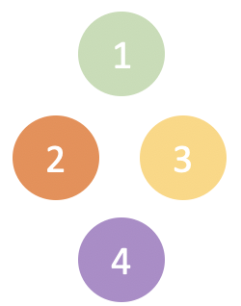
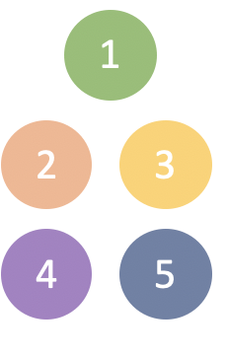
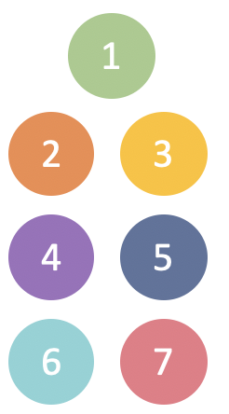
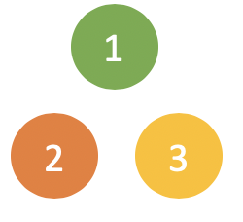



Example (cont.)
For example (using time order to find MNN):
When clustering in the final step
Without batch correction, there will be 3+4+5+7 = 19 clusters.
With batch correction, we will get only 3+1+1+2 = 7 clusters.
+
+
+
+
+
+

Slide 12
Simulation Design (cont.)
Ce
Cell Type 1
Batch 1
Batch 2
Batch 3
Batch 4
Week 0
 | Cell 1 | Cell 2 | Cell 3 | Cell 4 | Cell 5 | … | Cell n
Gene 1 | 0 | 0 | 0 | 0 | 0 | … | 0
Gene 2 | 1 | 1 | 1 | 1 | 1 | … | 1
Gene 3 | 1 | 0 | 1 | 1 | 1 | … | 1
Gene 4 | 0 | 1 | 1 | 0 | 0 | … | 0
Gene 5 | 0 | 0 | 0 | 0 | 1 | … | 0
… | … | … | … | … | … | … | …
Gene n | 1 | 1 | 1 | 0 | 1 | … | 0
Week 8
Week 16
Week 24
1
2
3

Slide 13
Simulation Study Results
Notes:
What figures to present? Do we need to present the Tsne plot & clustering analysis results both?
Show

Slide 14
Conclusion

