Slide 1
An Augmented Estimation Procedure for EHR-based Association Studies with Multiple Surrogate Outcomes
Department of Biostatistics, Epidemiology and Informatics
Yiwen Lu, Jiayi Tong, Rebecca Hubbard, Yong Chen
JSM 8/7/2023

Slide 2
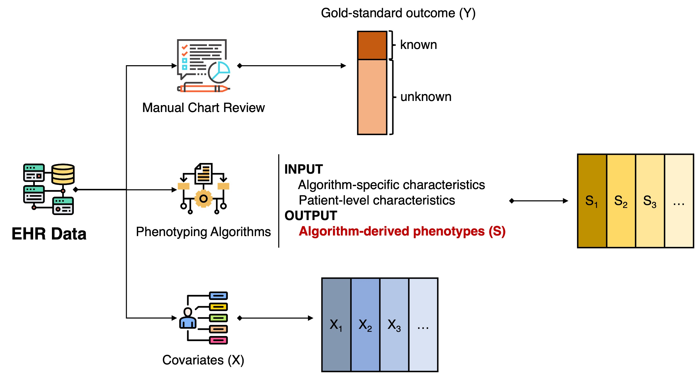
Overview
Objective
Use multiple surrogates to conduct augmented procedure
Why do we study it?
Too expensive to conduct manual chart review for all the patients
Cannot get true estimation directly
Existing methods
Method 1: use validation set only – inefficient
Method 2: use full surrogate only – biased
Method 3 (Tong2019): Augmented estimation with single surrogate – unbiased but we want more efficiency

Slide 3
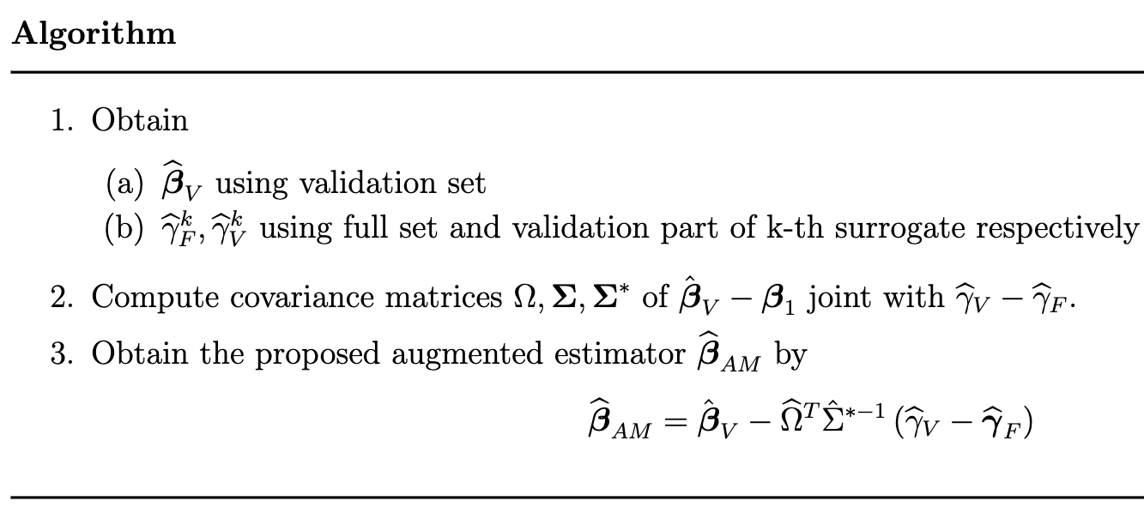
Proposed Method
Proposed method
Augmented estimation with all surrogates available
Unbiased and most efficient

Slide 4
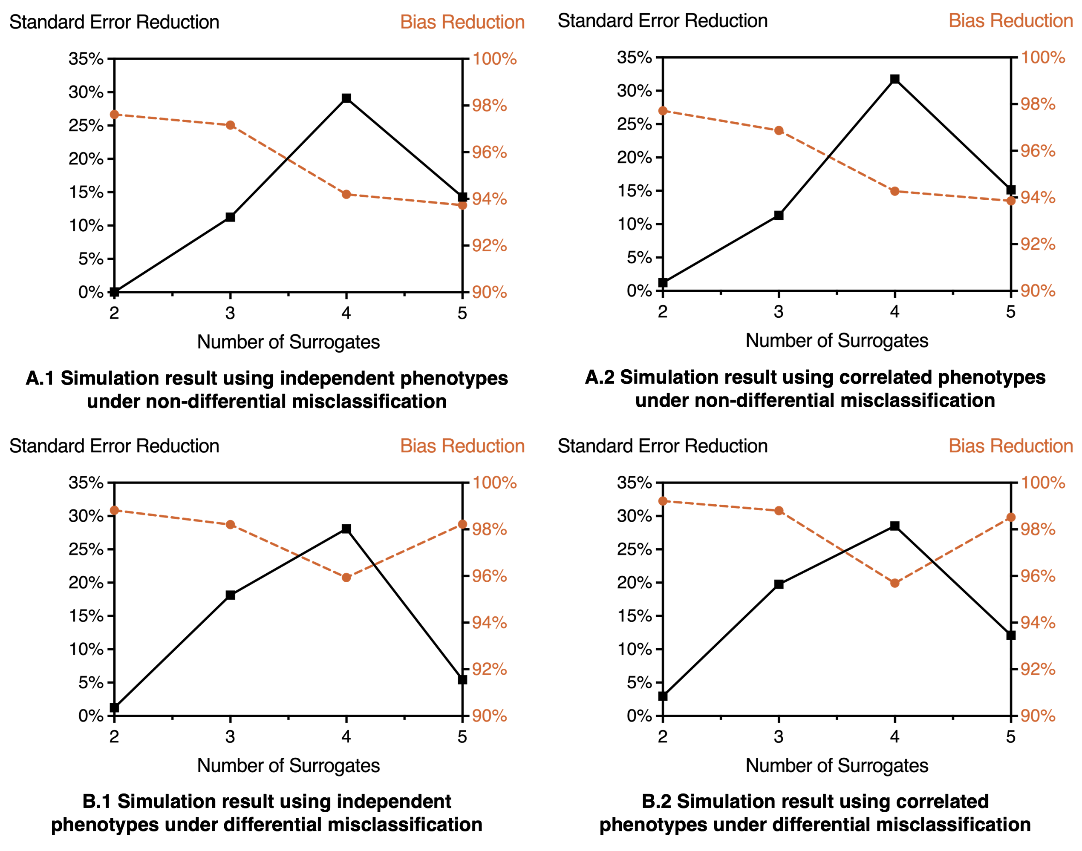
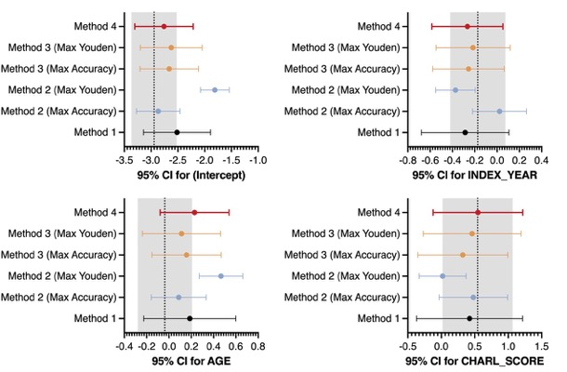
Results
Simulation
Real data evaluation
Two settings
Two cases
Validation ratio range
Number of surrogates
Data source
Colon cancer diagnosed and treated in the Kaiser Permanente Washington (KPW) healthcare system
Non-differential/differential misclassification
Independent/correlated surrogates
0.04~0.4
2~5

Slide 5
Summary
Better estimator
Maintain asymptotically zero bias
More efficient than augmented estimation using single surrogate
Widely applicable
Works well in both non-differential and differential misclassification settings
Works well with both independent surrogates and correlated surrogates
Limitation and future study
Restricted by the performance of surrogates

