Slide 1
PDA Use Case Exploration: OHDSI Forum Pipeline

Slide 2
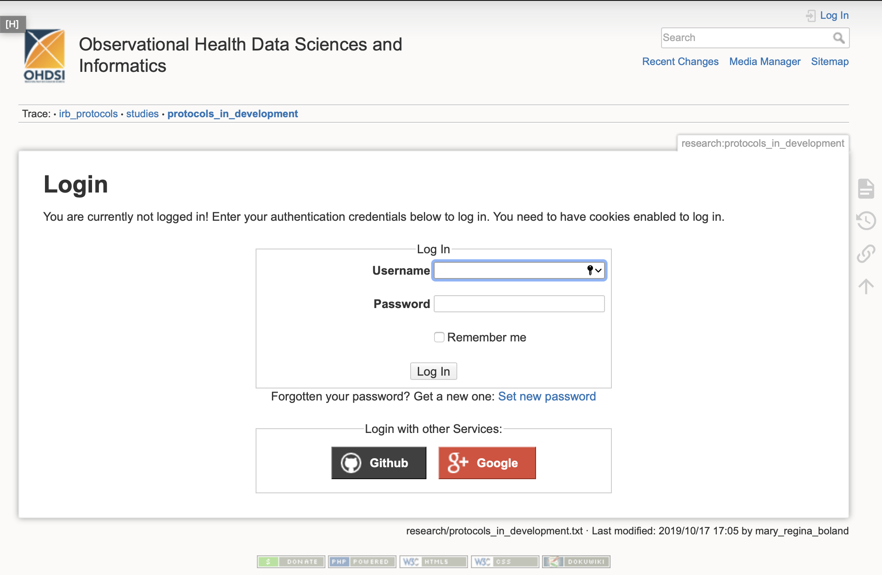
Step One
Sign up OHDSI forum account
Can directly use Google account to login

Slide 3
Step One
Should we create a PennCIL account and individual account at the same time?
Problem met when use Google to login: “Self-Registration is currently disabled or conf/users.auth.php is not writable. Please ask your DokuWiki administrator to create your account manually.”
Jessie will contact the administrator

Slide 4
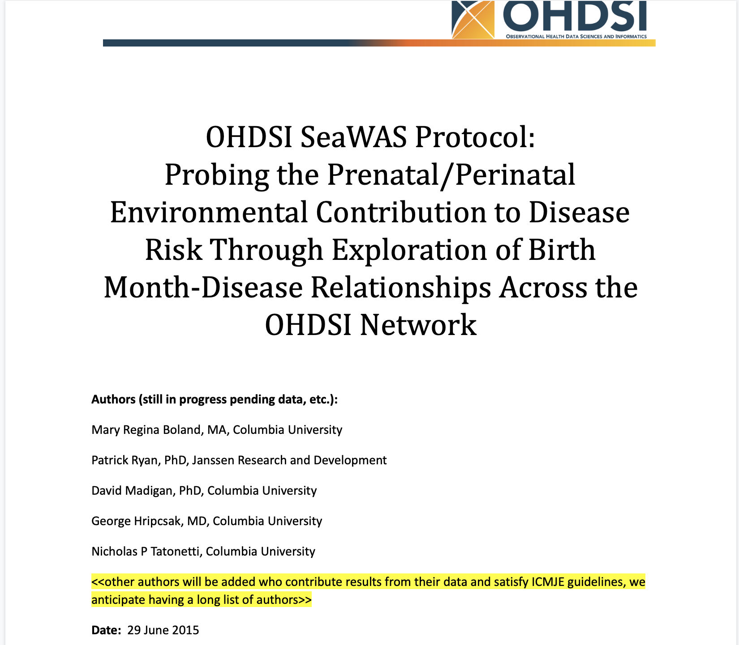
Step Two
Create a protocol in google drive.
https://docs.google.com/document/d/18kizSxfKgBQU-BYDVNqDgolBBPK57kRKcONudXjTBzo/edit

Slide 5
Step Two (Cont.)
Population is the most important section.
Cohort can be defined in Atlas
http://www.ohdsi.org/web/atlas/#/estimation/cca/81
We can add the GitHub link into the protocol file
Code example from Mary
https://github.com/bolandlab/SeaWAS/
We can ask Martijn for help to run the first site results and put the results into the protocol

Slide 6
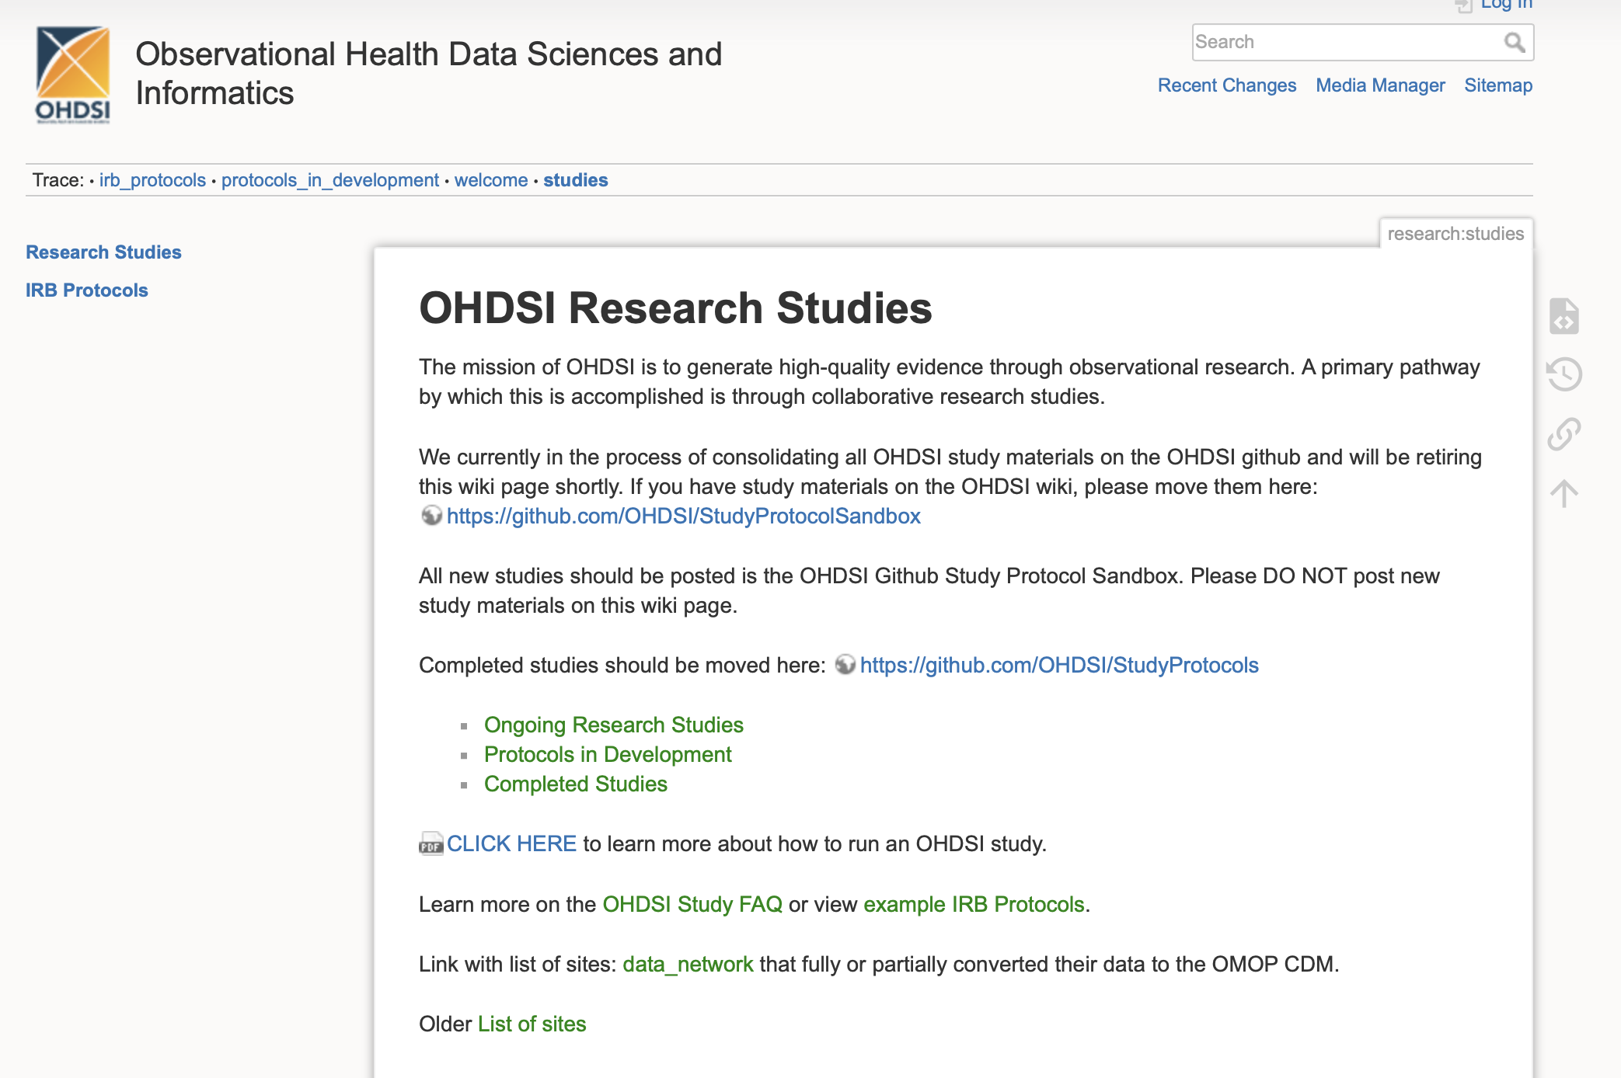
Step Three
Go to page on the right, then click “Protocols in Development”

Slide 7
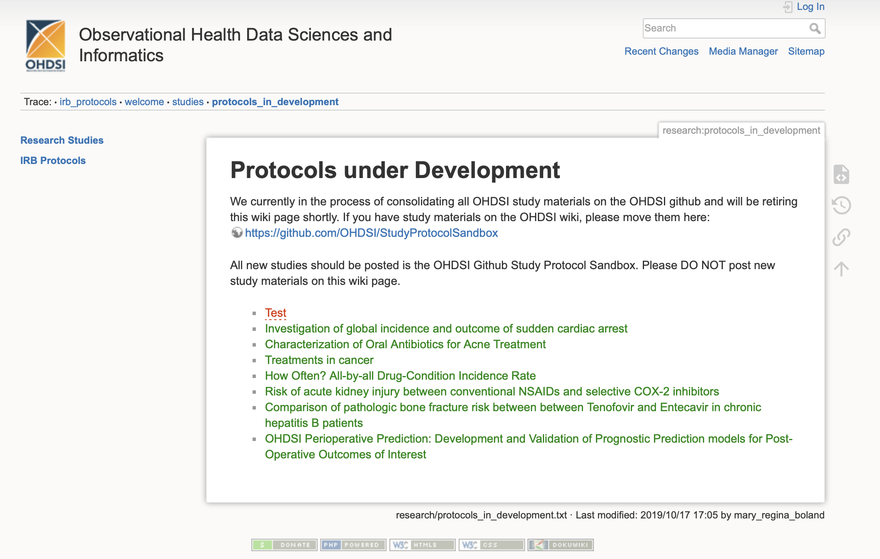
Step Four
Create new study
New study can be created here
Mary created this “Test” to show Rui and Jessie how to create a new study here.

Slide 8
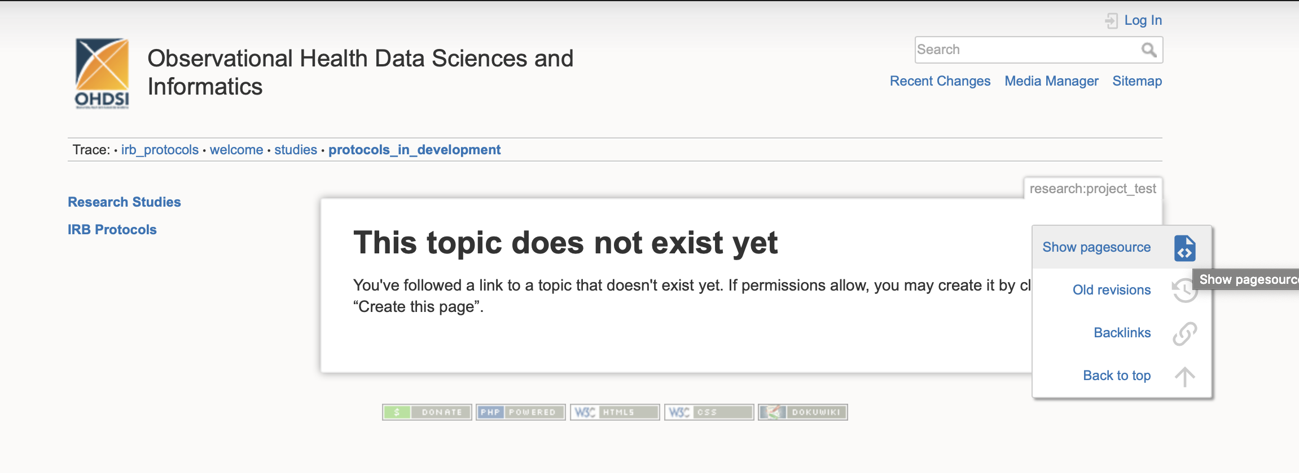
Step Five
Create wiki page
When logged-in, “Create this page” should be here

Slide 9
Step Five (Cont.)
Study the following template
https://www.ohdsi.org/web/wiki/doku.php?id=research:protocols_in_development

Slide 10
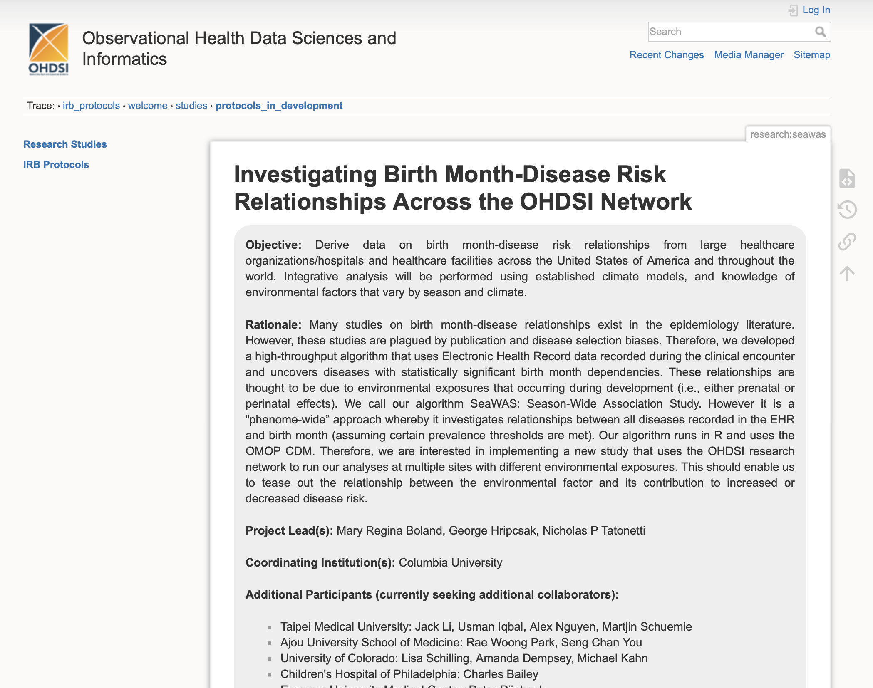
Can be added later

Slide 11
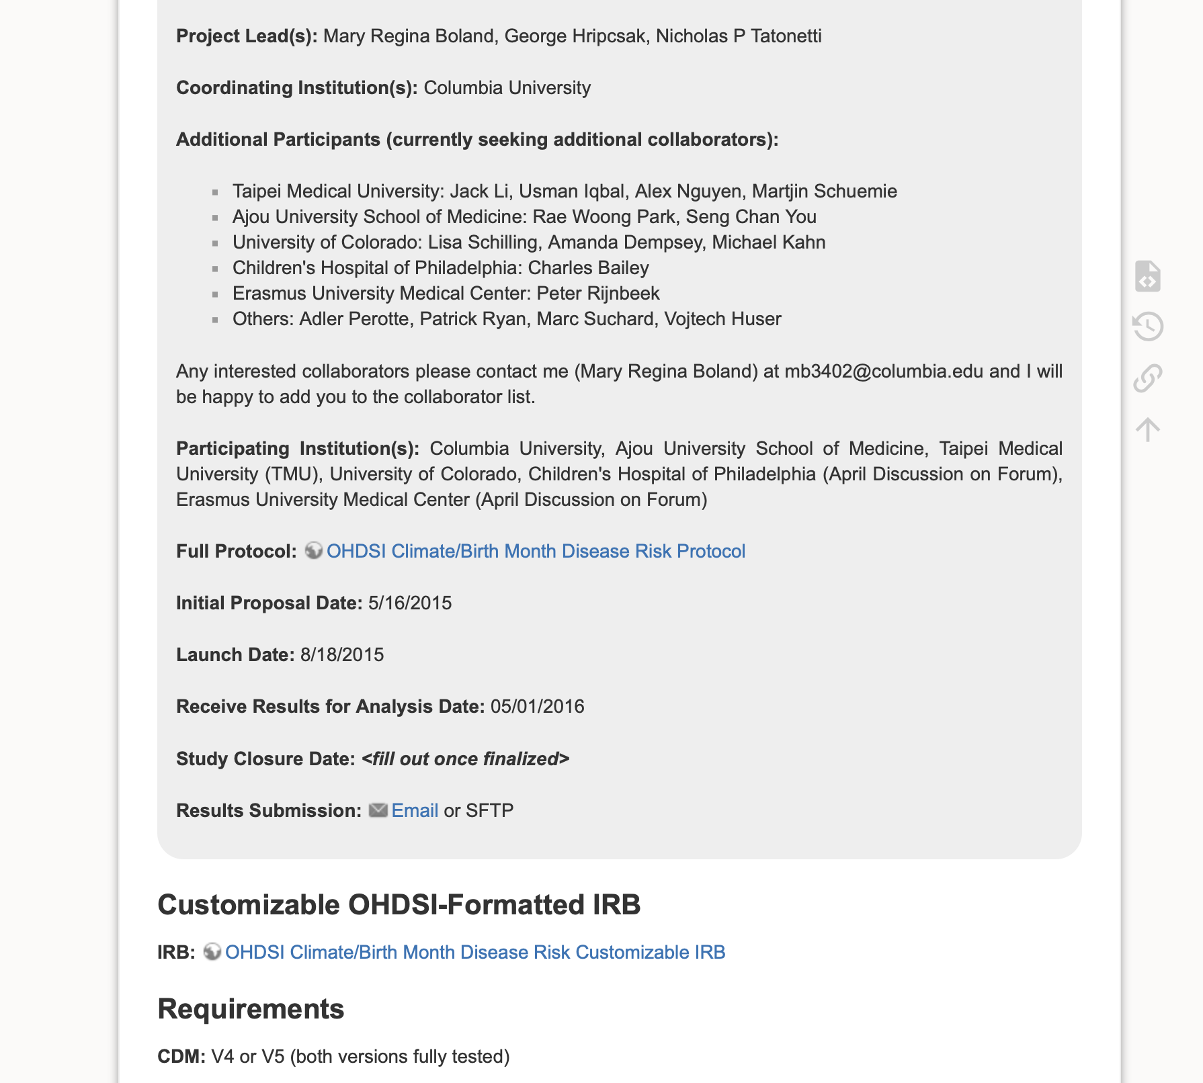
Add the prepared protocol here

Slide 12
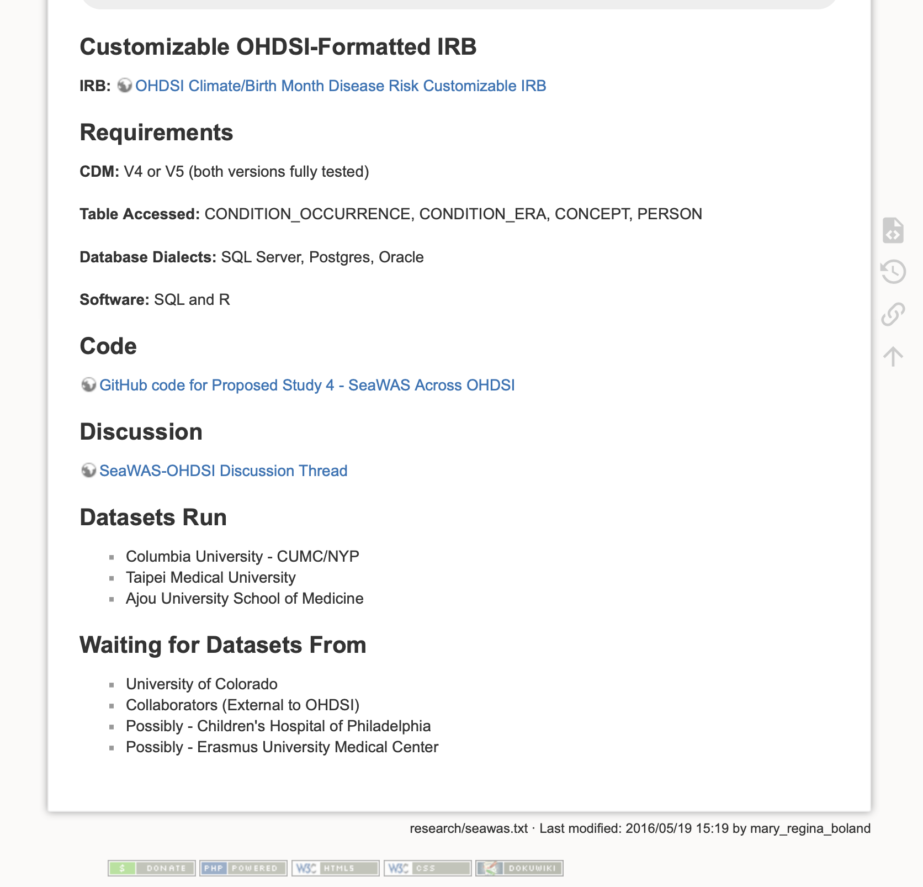

Slide 13
Step Six
Post a thread on OHDSI forum
Examples from Mary
https://forums.ohdsi.org/t/potential-network-study-inpatient-sedation-characterization-study/7973
https://forums.ohdsi.org/t/3d-rendering-prior-to-an-arthroplasty-procedure/6920

