Slide 1
TEXT ANALYTICs AND NATURAL LANGUAGE PROCESSING WEEK 3
Action Items:
As a heads up, you’ll have two exercises today: one on distance/similarity, and one on regular expressions.
Install spacy (pip install spacy)
Optional: Install Tableau Desktop (use your student email)
Update your course repository:
Download the new files for week 3
If you forked the repo, https://help.github.com/en/articles/syncing-a-fork

Slide 2
MAKE SURE YOUR RECOMMENDATION FITS YOUR AUDIENCE
So from both good reviews and poor reviews above, we see toys are mainly bought for sons , thus, sons'marketing messages tends to outperform other segments, and this toy store should choose parents who buy toys for their sons as their target customers to do promotion.

Slide 3
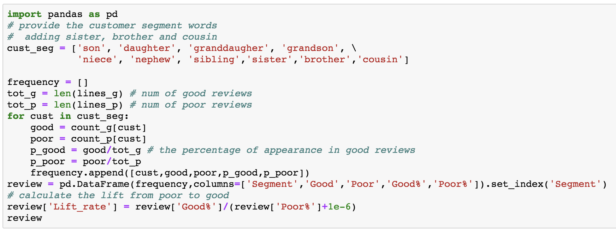
USE COMMENTS

Slide 4
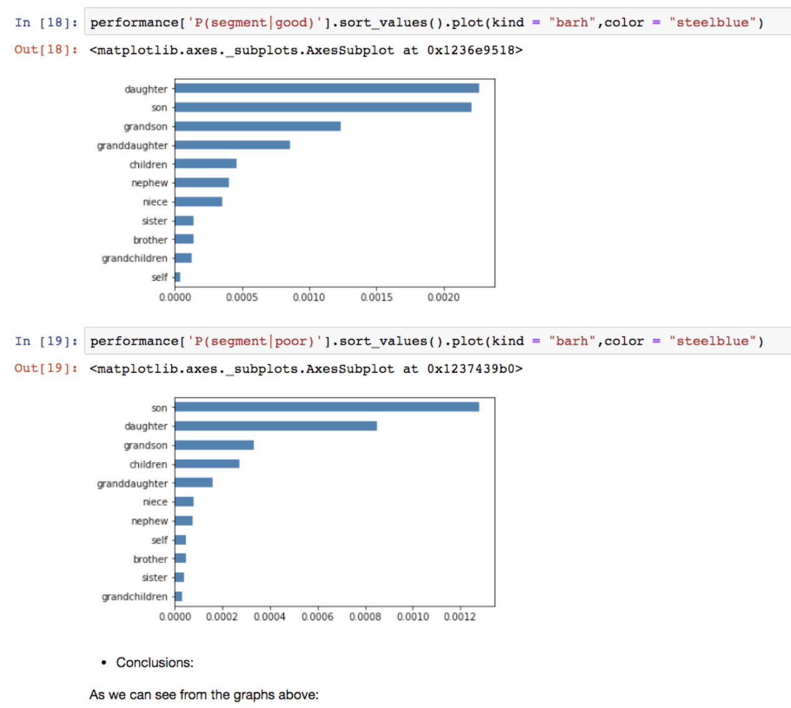
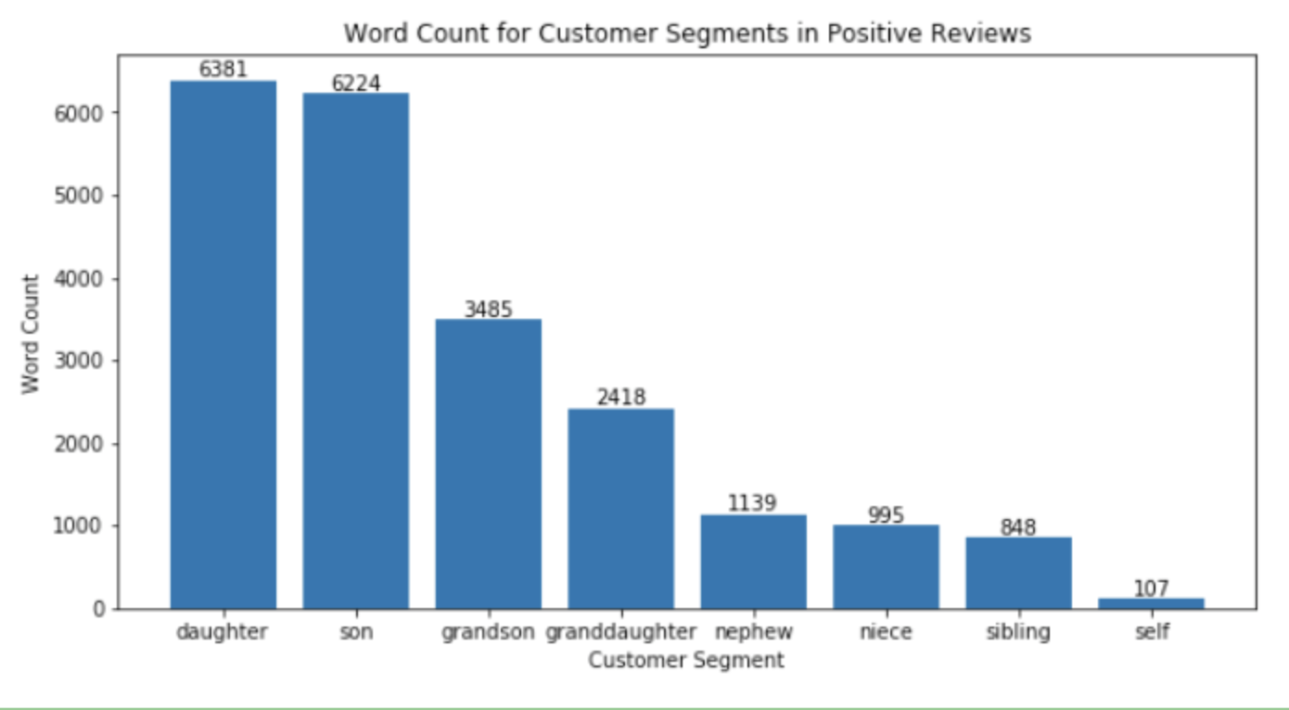
Use visualizations

Slide 5
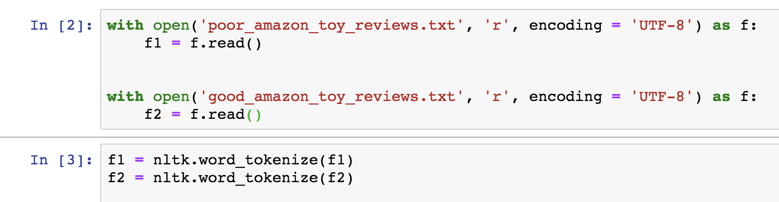
DON’t ASSUME FULL BAG OF WORDS MODEL

Slide 6
PRESENTATION IS STILL IMPORTANT!

Slide 7
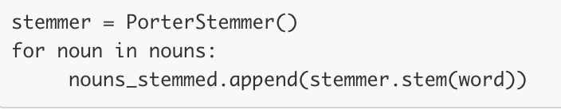


Avoid costly operations inside loops

Slide 8
Statistical testing
Among X good reviews, there are Y reviews mentioning batteries. Among A poor reviews, there are B reviews mentioning batteries. If we do a two population percentages test with a null hypothesis stating that there is no difference in the proportions, we will reject the null hypothesis with a p-value as small as ___ . We may conclude that there indeed is a difference between the proportion of battery-related reviews among good reviews and bad reviews.

Slide 9
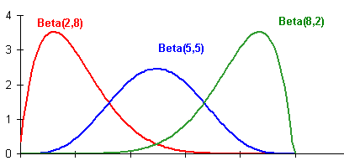
Bayesian A-B Testing
Online systems – need quick decisions, can live with uncertainty: Data streams in over time.
Uses conjugate prior / posteriors to update belief in % good versus % bad reviews.

Slide 10
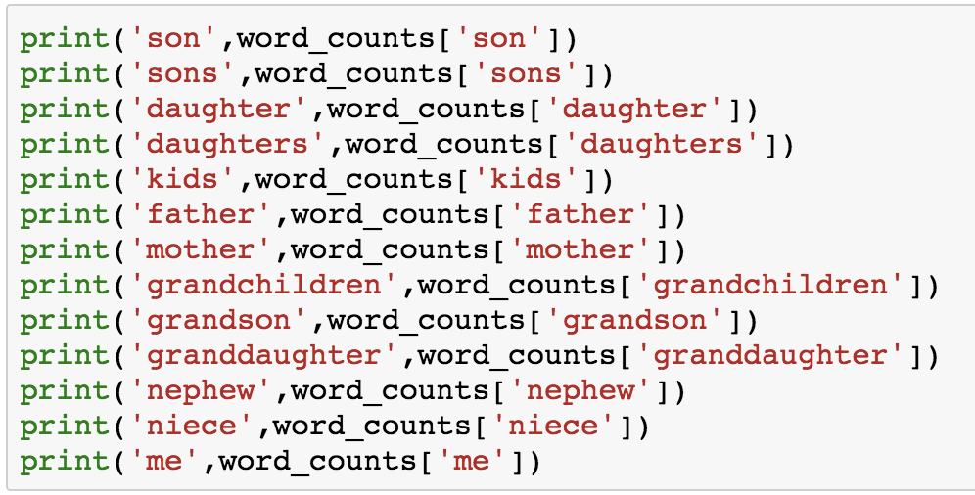
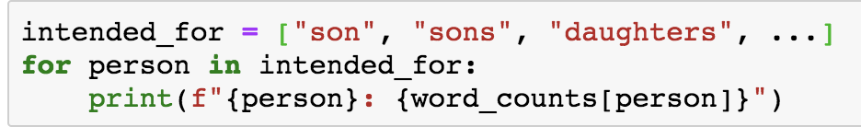
USE FOR LOOPS

Slide 11
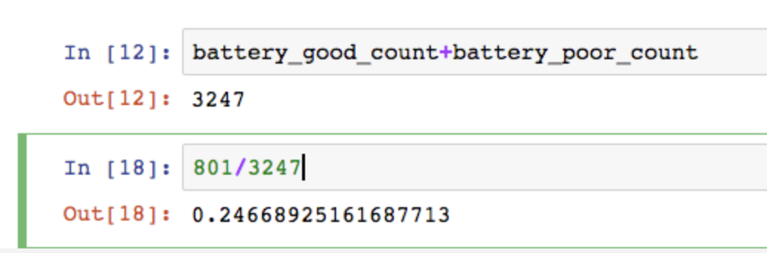
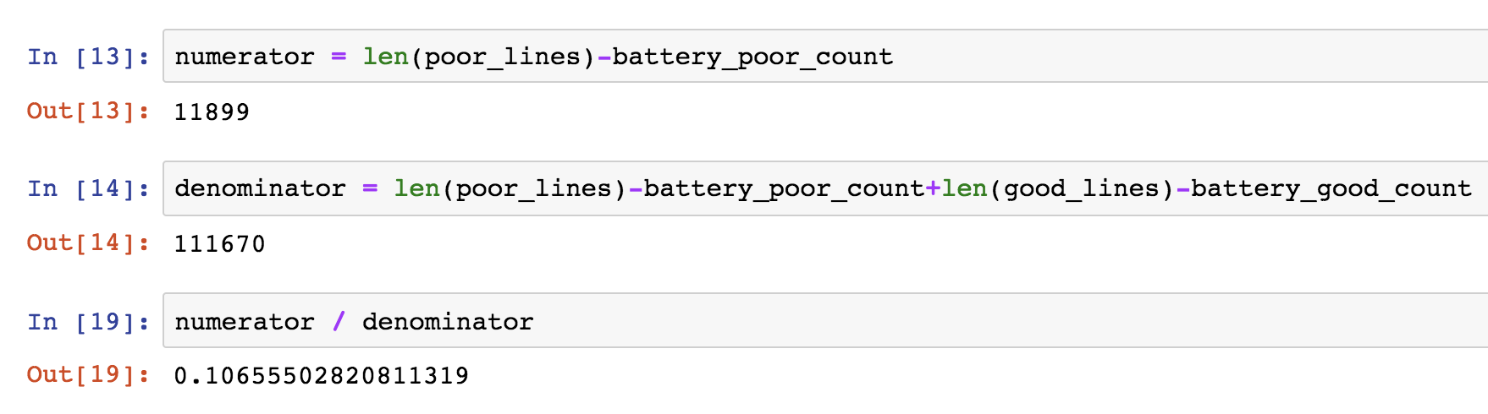
DON’t HARDCODE IN NUMBERS

Slide 12
Agenda (Mar. 26th, 2019)
6:30 – 6:45
Review HW1
6:45 – 7:15
Similarity, Distance, PMI
7:15 – 7:25
Exercise 1: Distance / Similarity
7:30 – 8:00
Regular Expressions
8:00 – 8:15
Exercise II: Regex Parsing
8:15 – 8:20
Break
8:20 – 8:50
Perplexity and Likelihood, N-Grams
9:10 – 9:20
HW
7:25-7:30
Break
8:50-9:10
TF-IDF

Slide 13
Logistics
Check/post #questions for class questions.
HW2 will be graded by 11:59pm PST, Sunday Mar. 31st.
Office hours this week are Sunday 9am-12pm PST.
Class exercises today need to be submitted via Slack to me for classwork grade.
Midterm exam will be 80 minutes on Tuesday, April 9th

Slide 14
Similarity / Distance Exercises (10 minutes)
Document:
A.
B.
C.
Compute norm of these documents.
Compute Euclidean distance.
Compute cosine similarity.
New Document D is introduced: _____. Compute cosine distance of Document C and D.

Slide 15
Regular Expressions (15 minutes)
Work in pairs on the exercise. Submit only one copy of your code to me via Slack.

