Slide 1
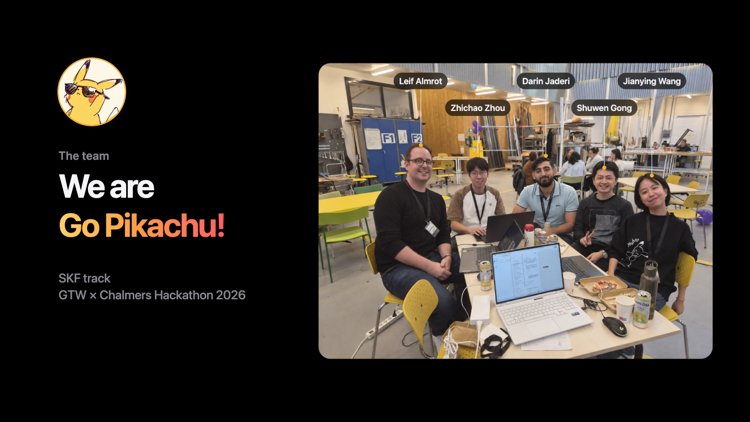
Notes:
We are team Go Pikachu: Leif, Zhichao, Darin, Shuwen and Jianying.

Slide 2
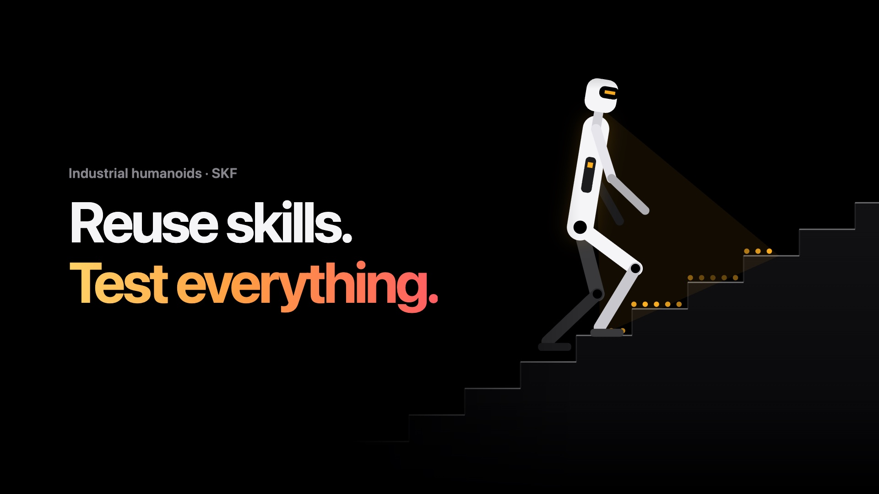
Notes:
Reuse skills, test everything. SKF asked us: how do we make training humanoids easier and more efficient? We are Go Pikachu.

Slide 3
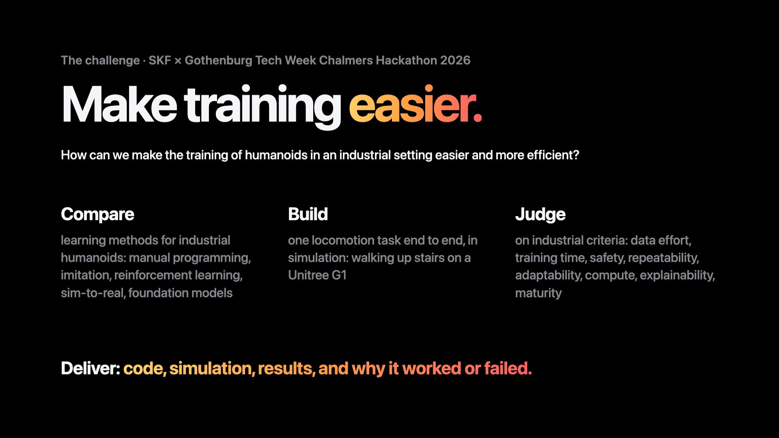
Notes:
The challenge from SKF: how can we make the training of humanoids in an industrial setting easier and more efficient? Compare the learning methods, build one locomotion task end to end in simulation, and judge it on industrial criteria.

Slide 4
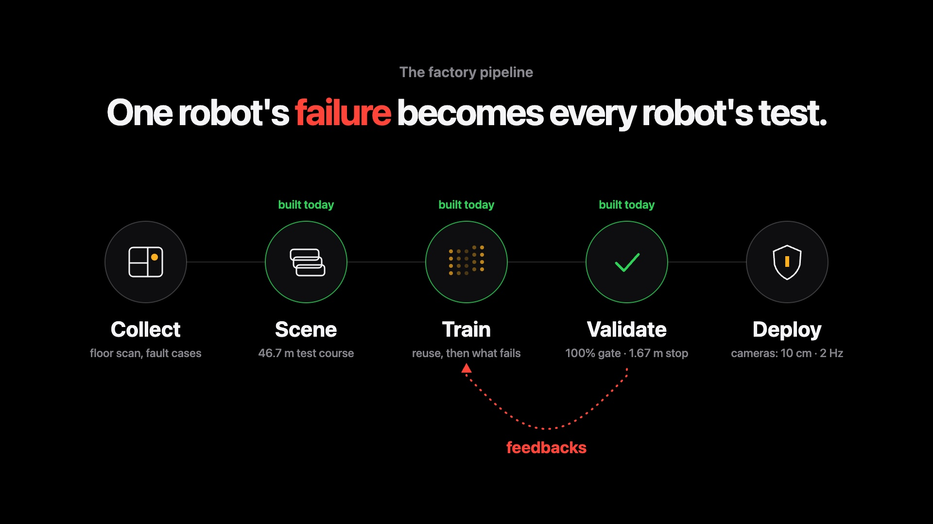
Notes:
Our approach is one factory pipeline: collect, build the scene, train, validate, deploy, with specs from our tests. One robot's failure becomes every robot's test.

Slide 5
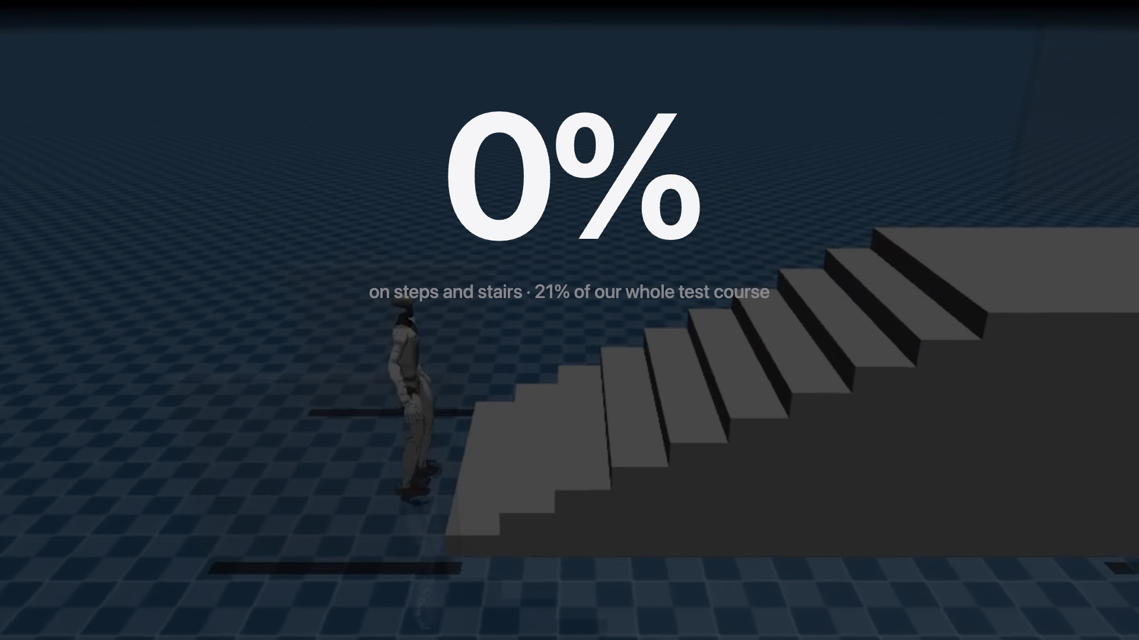
Notes:
Small brain, version zero: Unitree's own policy, trained only on flat ground. The toe hits the step. Zero percent on steps and stairs.

Slide 6
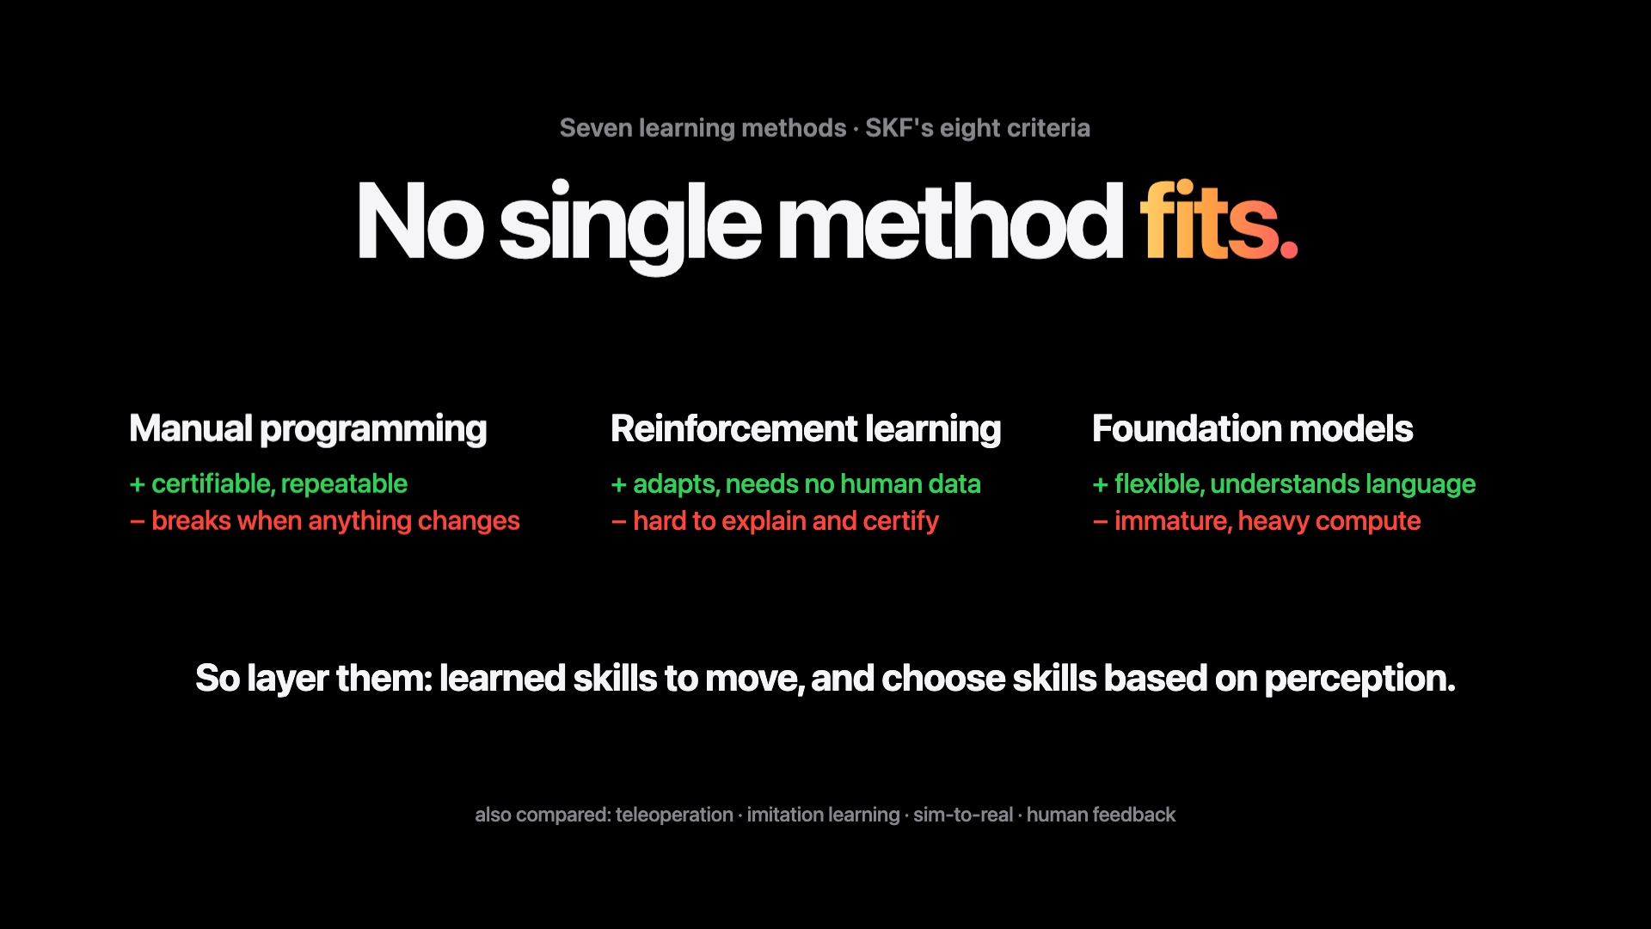
Notes:
We compared seven learning methods on SKF's criteria. What is certifiable does not adapt; what adapts is hard to certify. So we layer them, starting from trained skills.

Slide 7
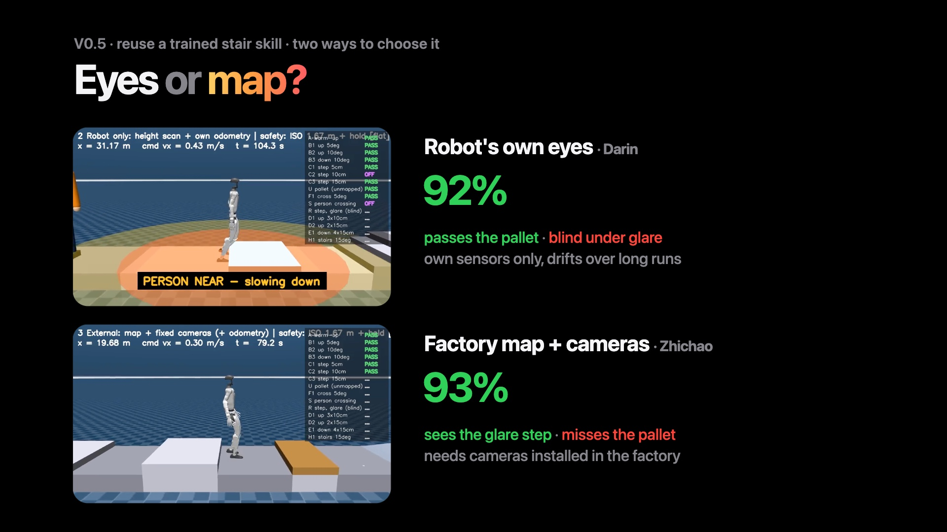
Notes:
Version zero-point-five: reuse a stair skill someone already trained, and choose when to use it. Darin's robot uses its own eyes: 92 percent, but blind under glare. Zhichao's uses the factory map and cameras: 93 percent, but it walks into a pallet the map doesn't show.

Slide 8
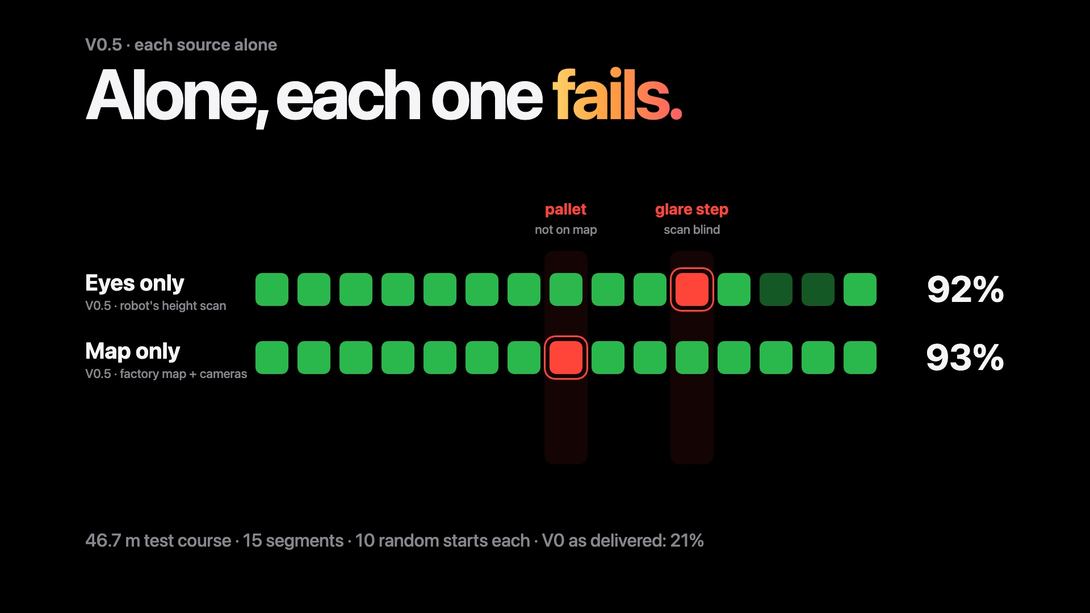
Notes:
On our 46.7 metre course we added two faults: a pallet missing from the map, and a step under glare. Each alone fails one.

Slide 9
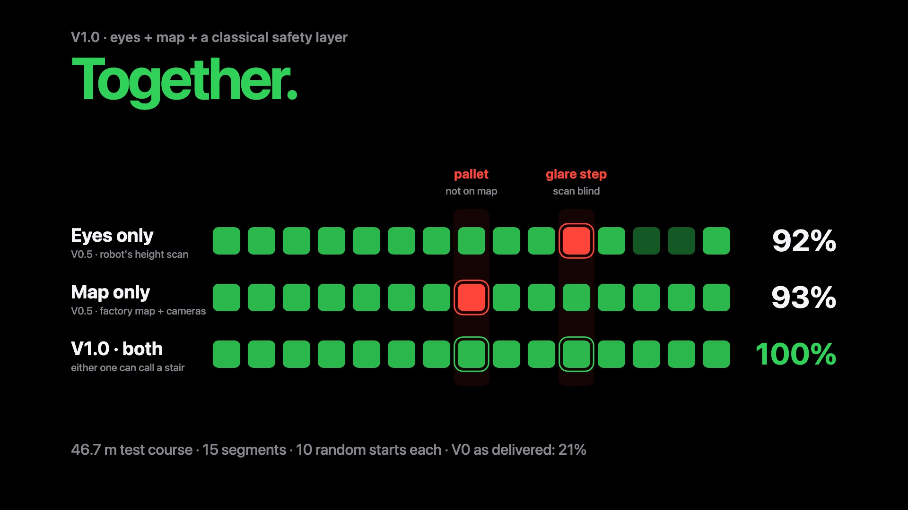
Notes:
Version one uses both: 100 percent.

Slide 10
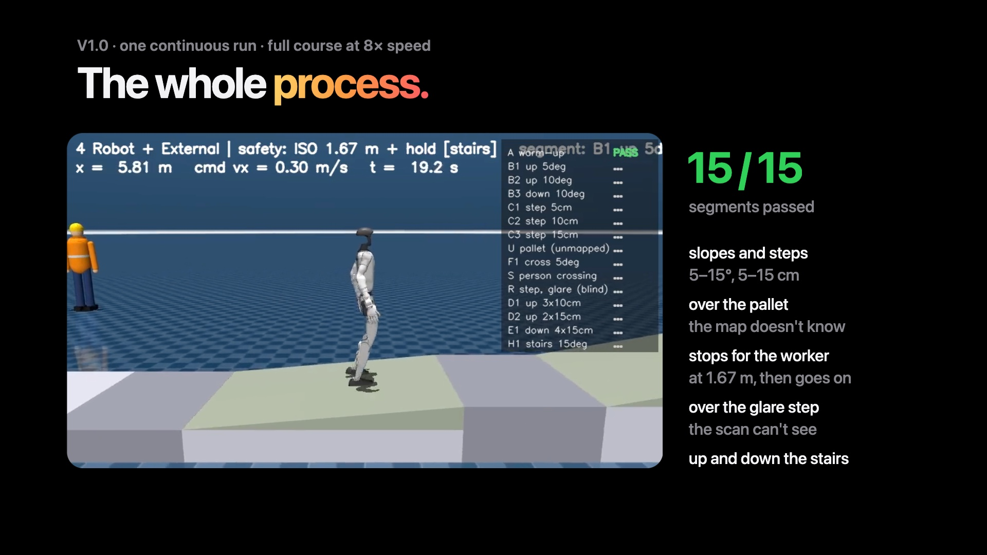
Notes:
Here is V1.0 on the whole course in one go, at eight times speed: slopes and steps, over the pallet the map doesn't know, stopping for the worker, over the glare step, up and down the stairs. 15 of 15.

Slide 11
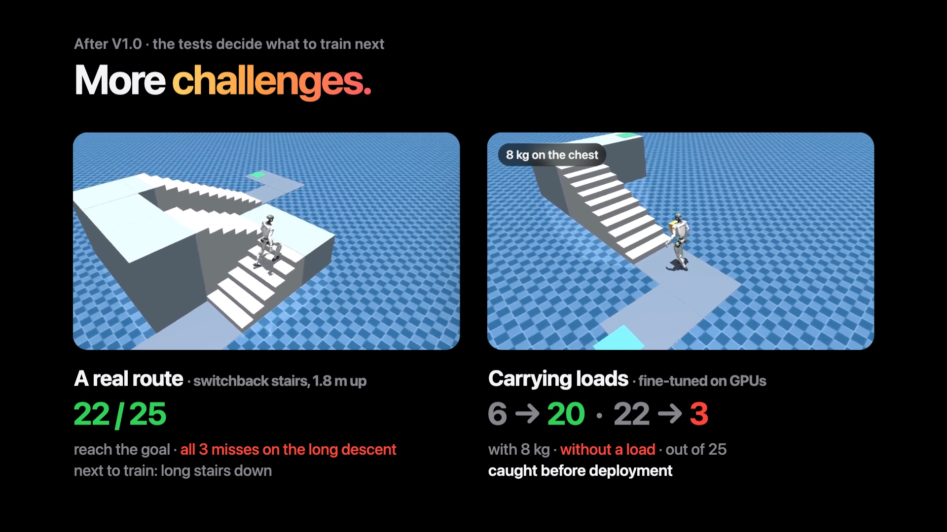
Notes:
After V1.0, the tests show us the next challenges. On a real factory route with switchback stairs, 22 of 25 reach the goal; all misses are on the long descent. Carrying loads was the other gap, so we fine-tuned for it. With 8 kilos, 6 became 20. Without a load, 22 fell to 3. Caught before deployment.

Slide 12
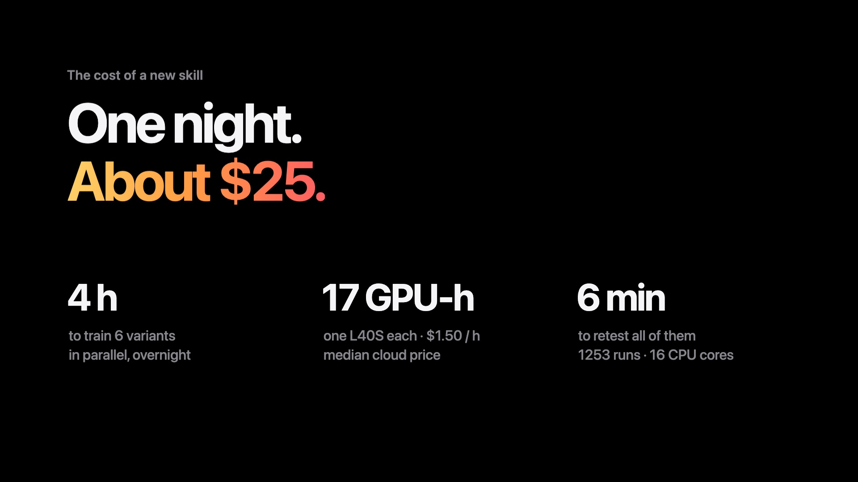
Notes:
What does a new skill cost SKF? Our six load fine-tunes ran overnight in parallel: under four hours, 17 GPU hours, about 25 dollars at cloud prices. Retesting all of them, 1253 runs, took six minutes.

Slide 13
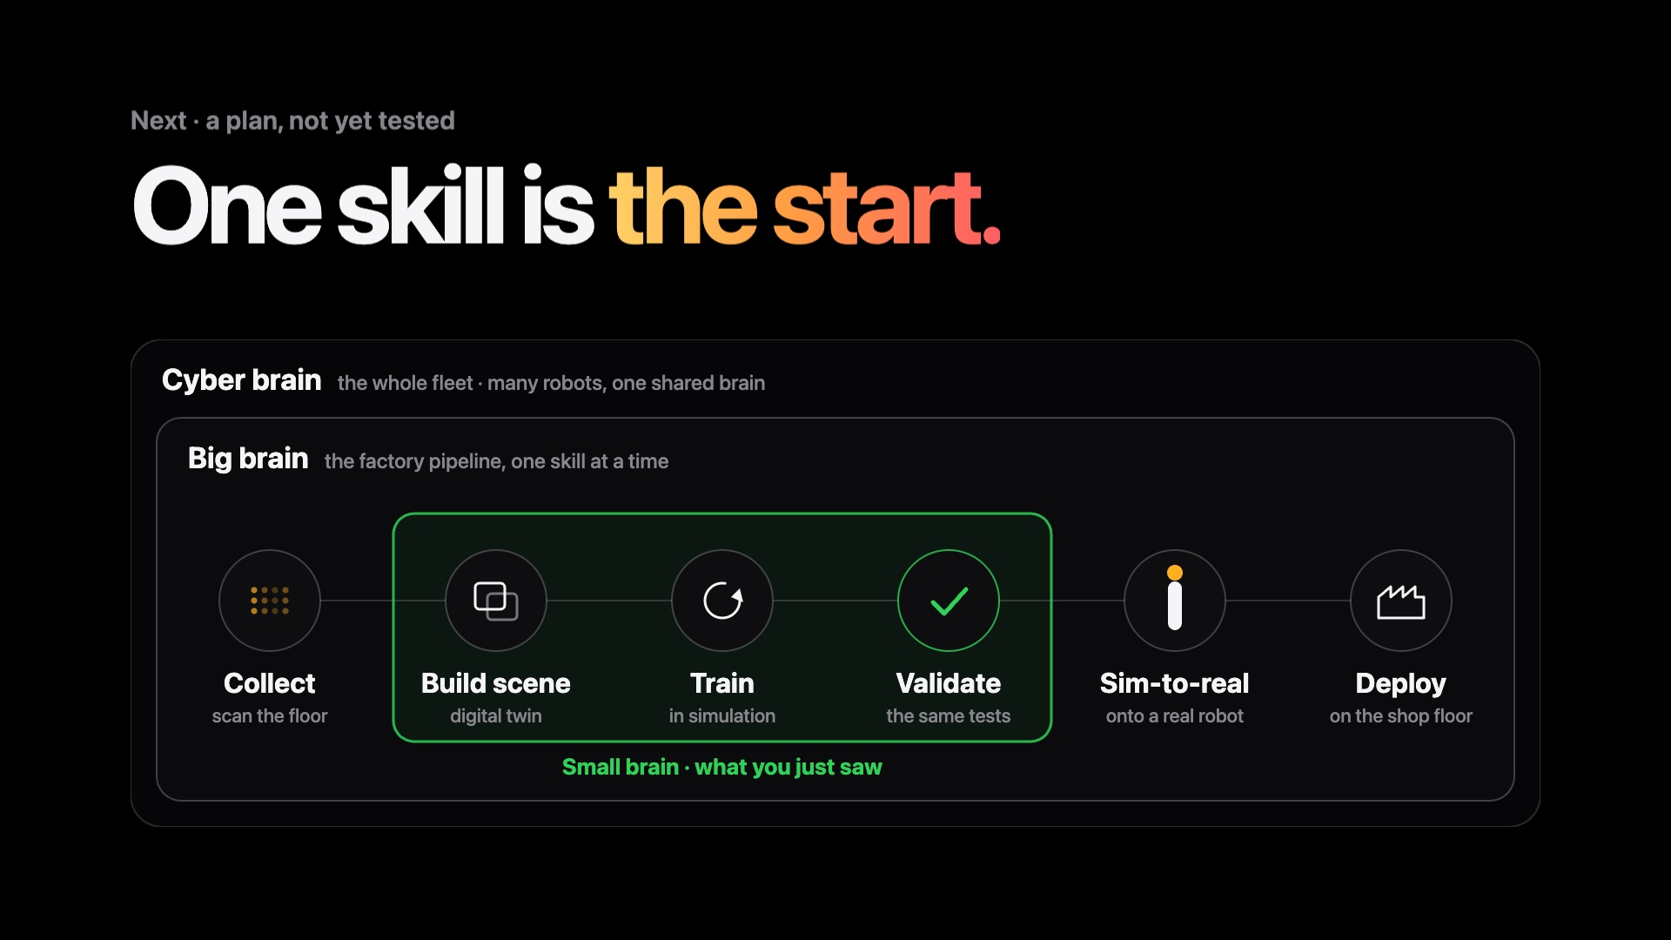
Notes:
So far, one skill: stairs. That is our small brain. The big brain runs the same loop for every skill in a factory, the cyber brain for a whole fleet. From here on, it is a plan.

Slide 14
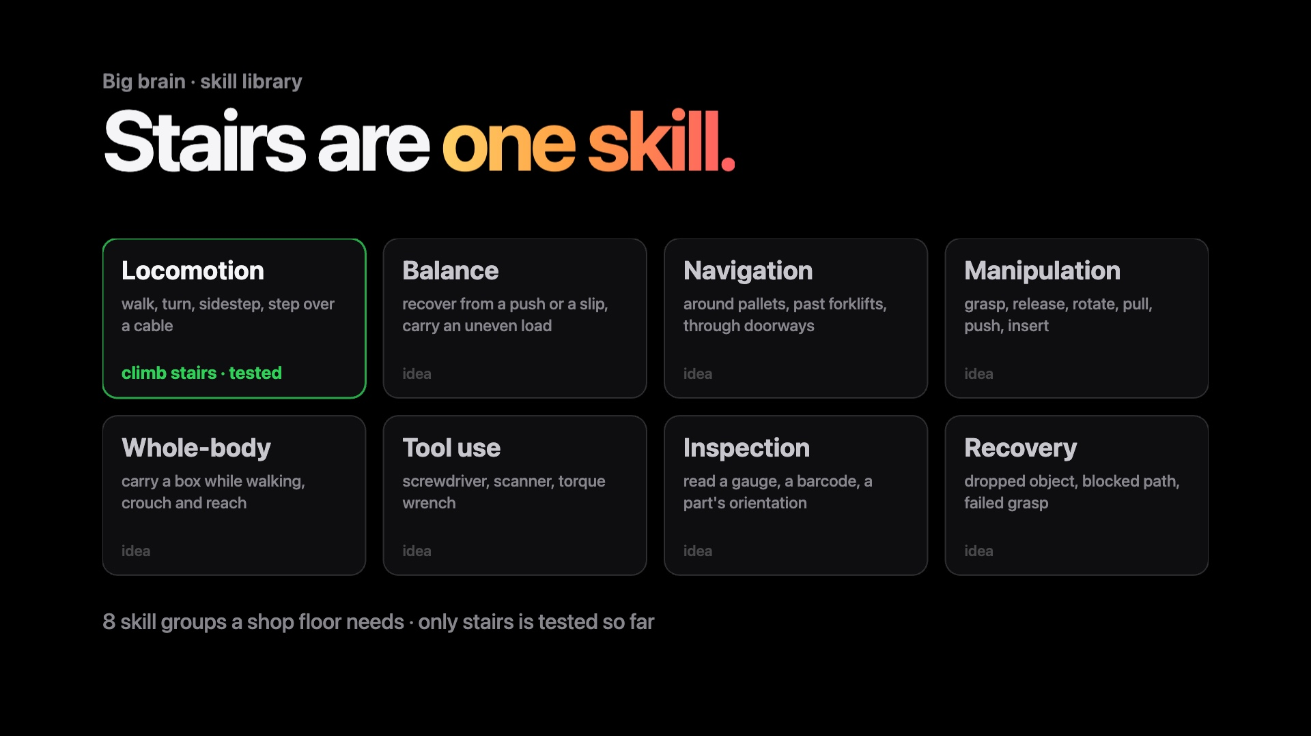
Notes:
A shop floor needs far more skills: carrying, grasping, reading a gauge. Each one passes the same tests before it reaches a robot.

Slide 15
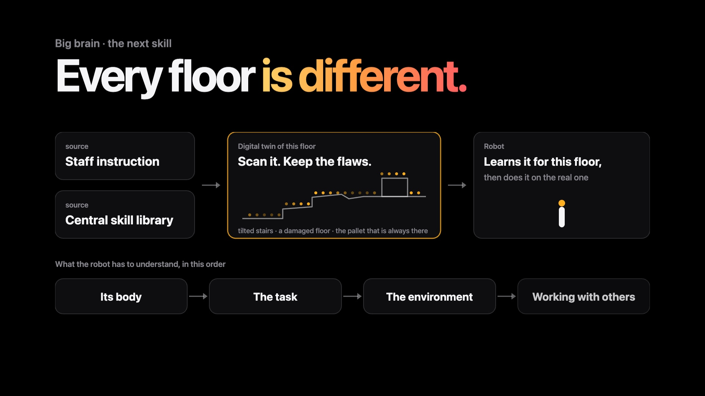
Notes:
A new skill comes from staff or from the library. The big brain fits it to this floor's digital twin, flaws included, before a real robot tries it.

Slide 16
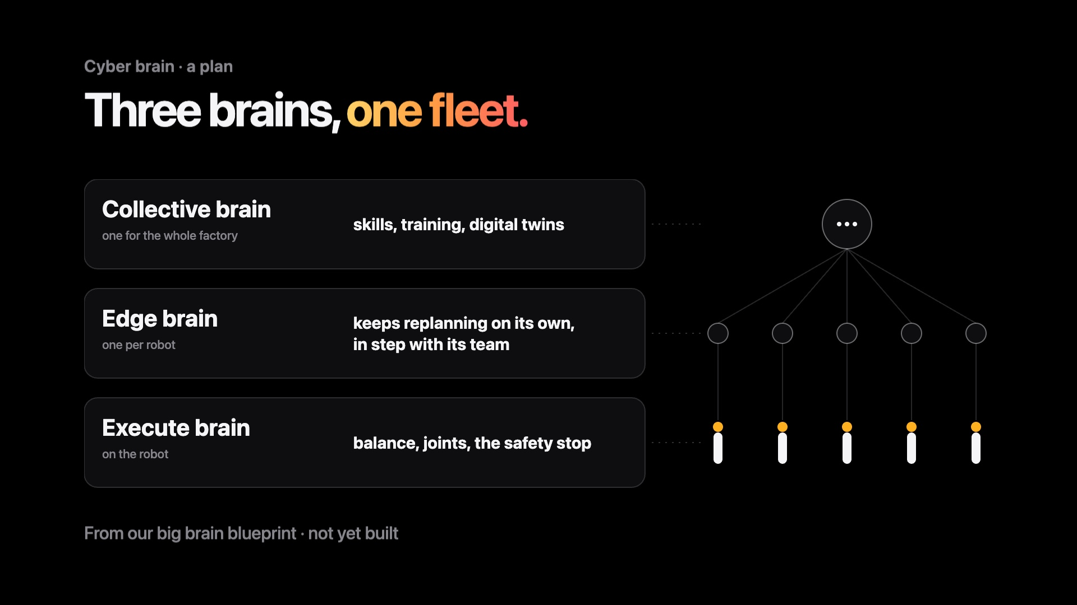
Notes:
Three brains: one on each robot keeps it safe, one per robot plans the next seconds, one for the whole factory runs the skill library.

Slide 17
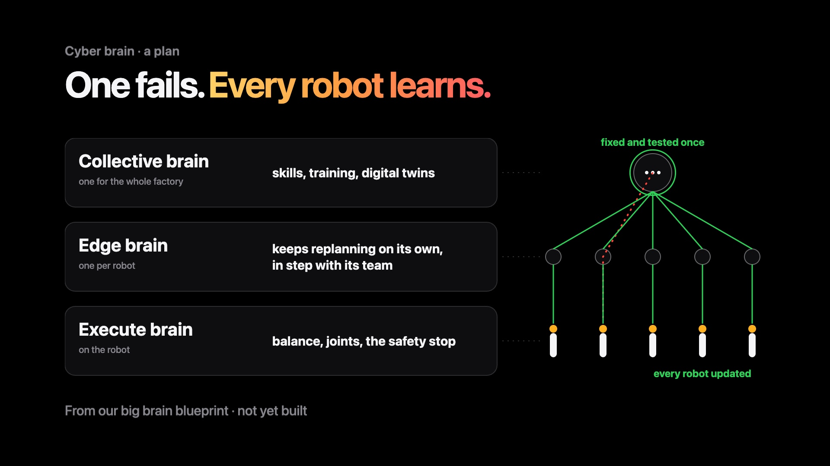
Notes:
One robot fails, the fix is tested once, and every robot gets it. Open question: how long may a robot act alone? We will try ten seconds.

Slide 18

Notes:
That's us, team Go Pikachu. Thank you.

