Slide 1
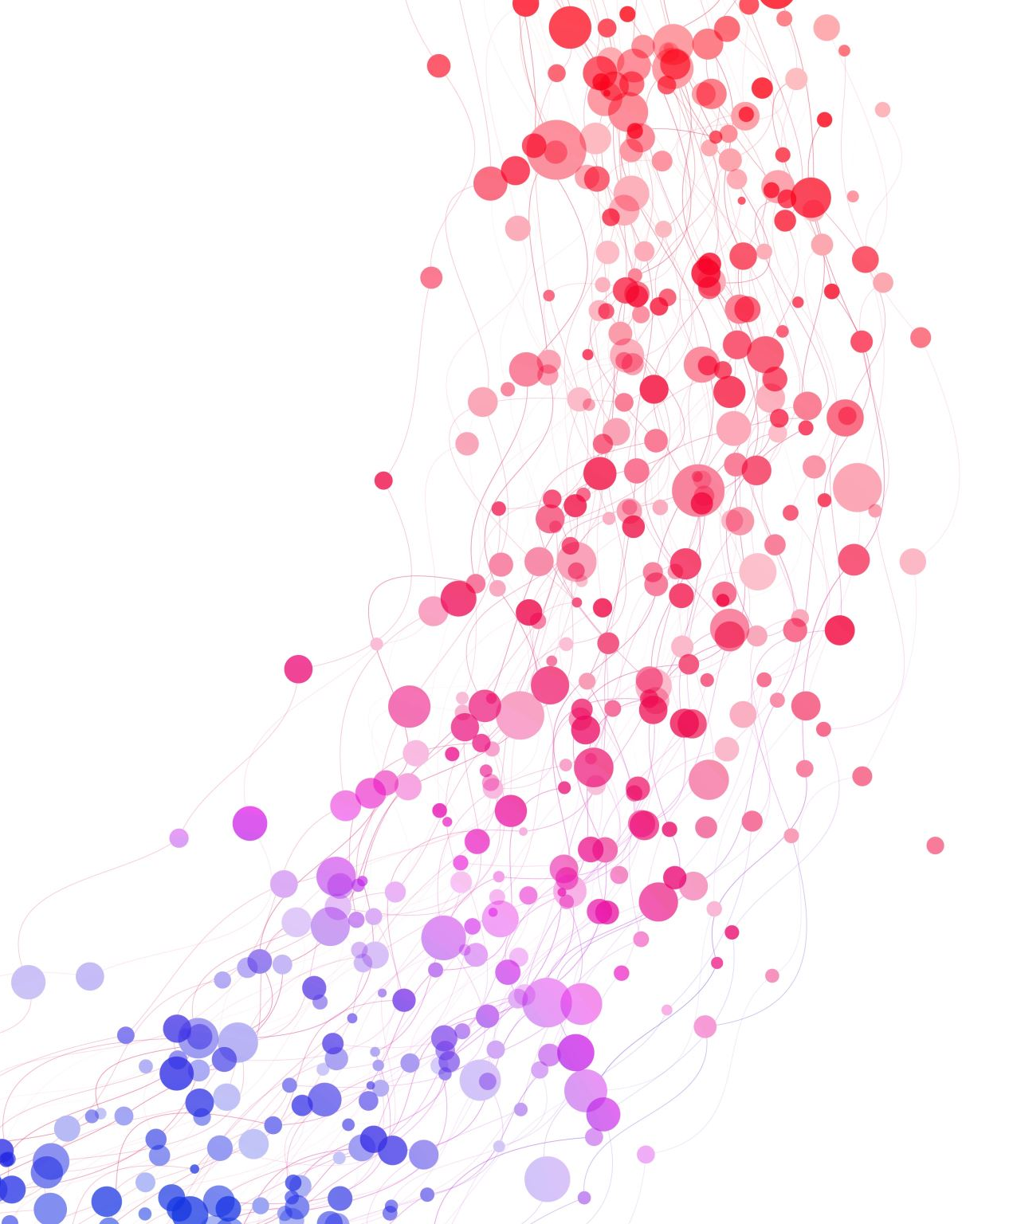
About me
Jiayu Liu

Slide 2
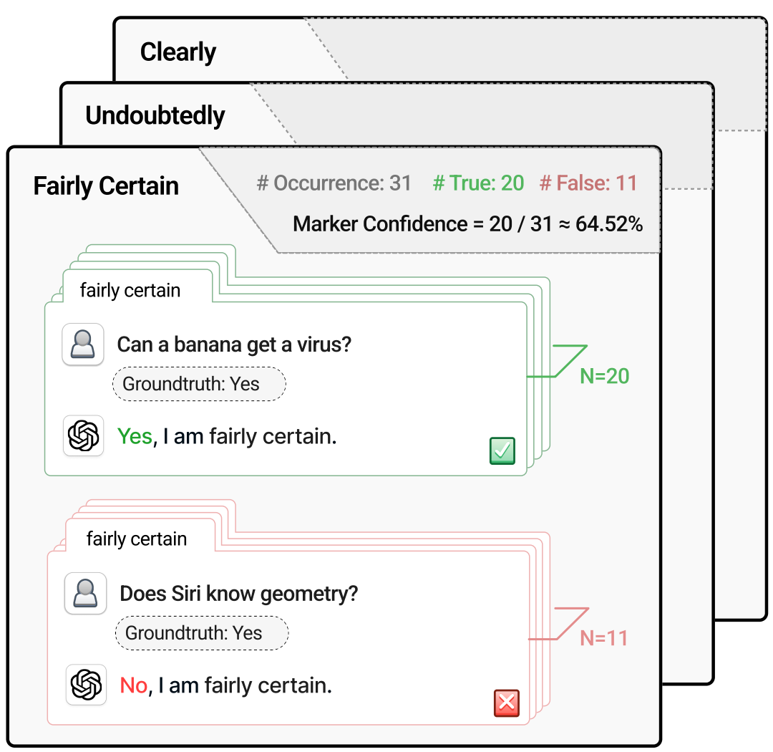
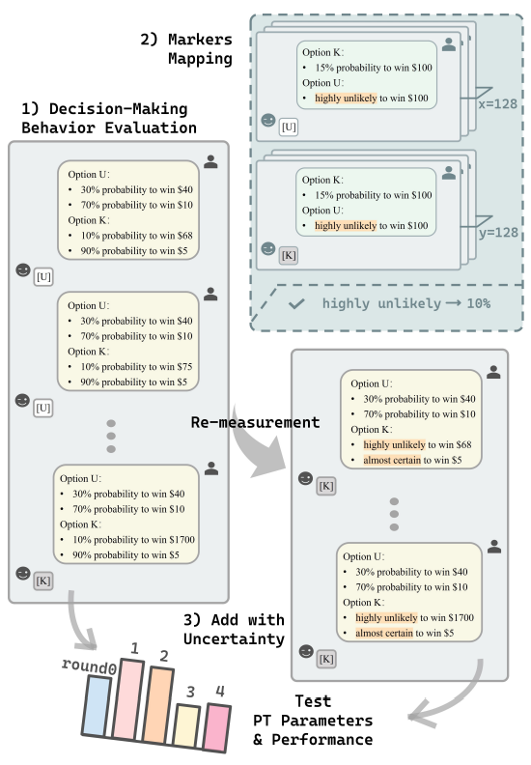
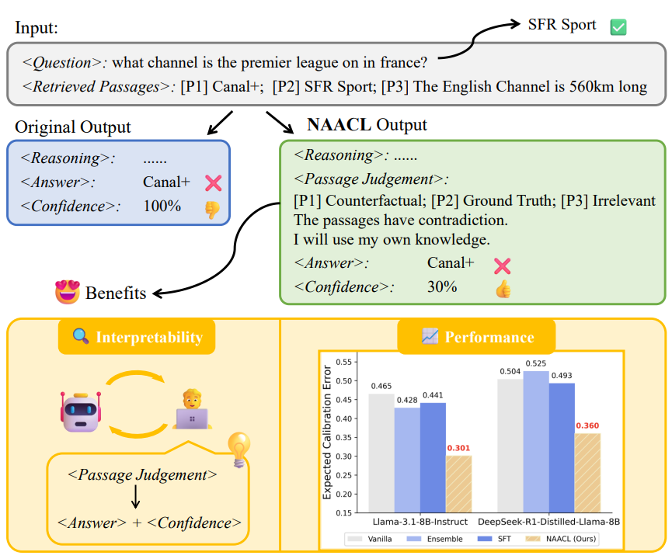
Research: Truthworthiness-related
Revisiting Epistemic Markers in Confidence Estimation: Can Markers Accurately Reflect Large Language Models' Uncertainty?
Prospect Theory Fails for LLMs: Revealing Instability of Decision-Making under Epistemic Uncertainty
NAACL: Noise-AwAre Verbal Confidence Calibration for LLMs in RAG Systems

Slide 3
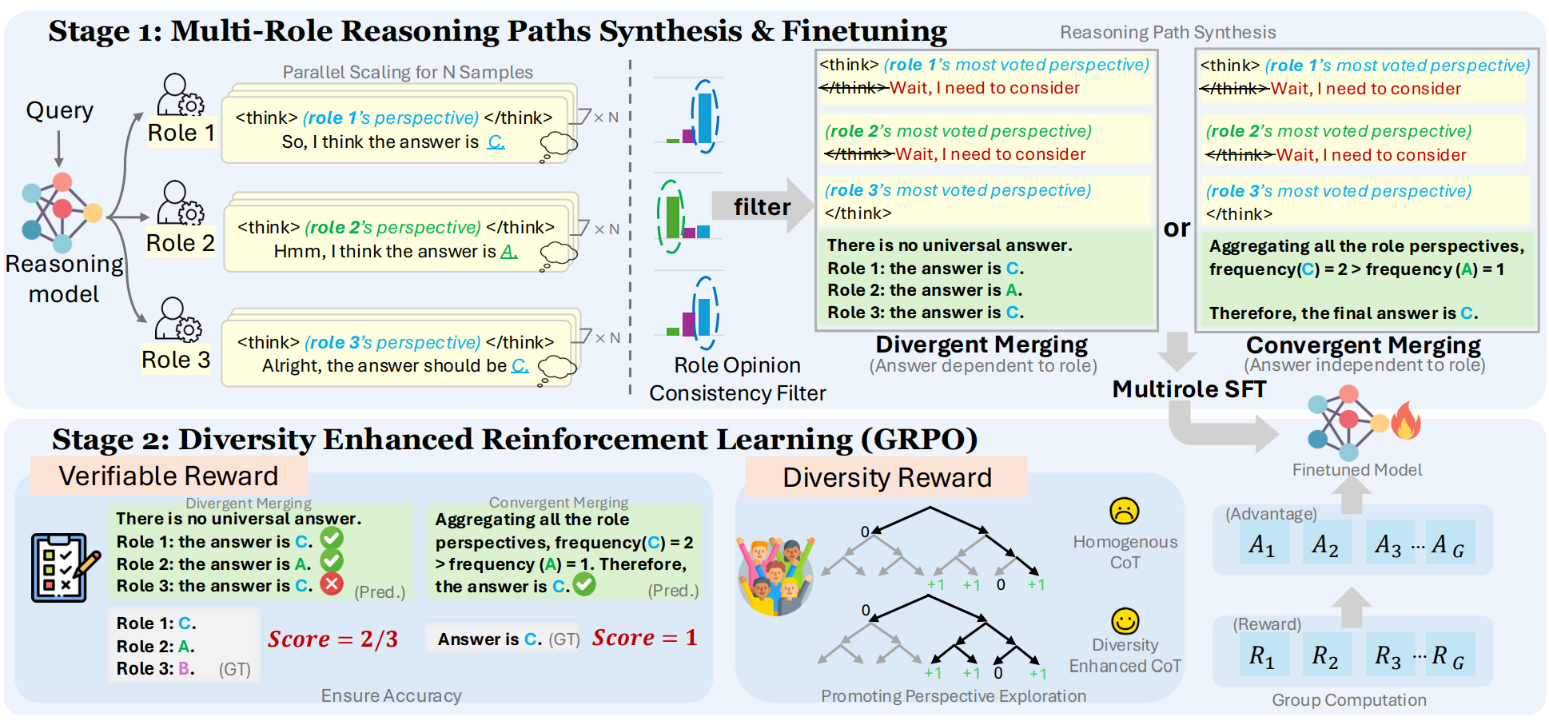
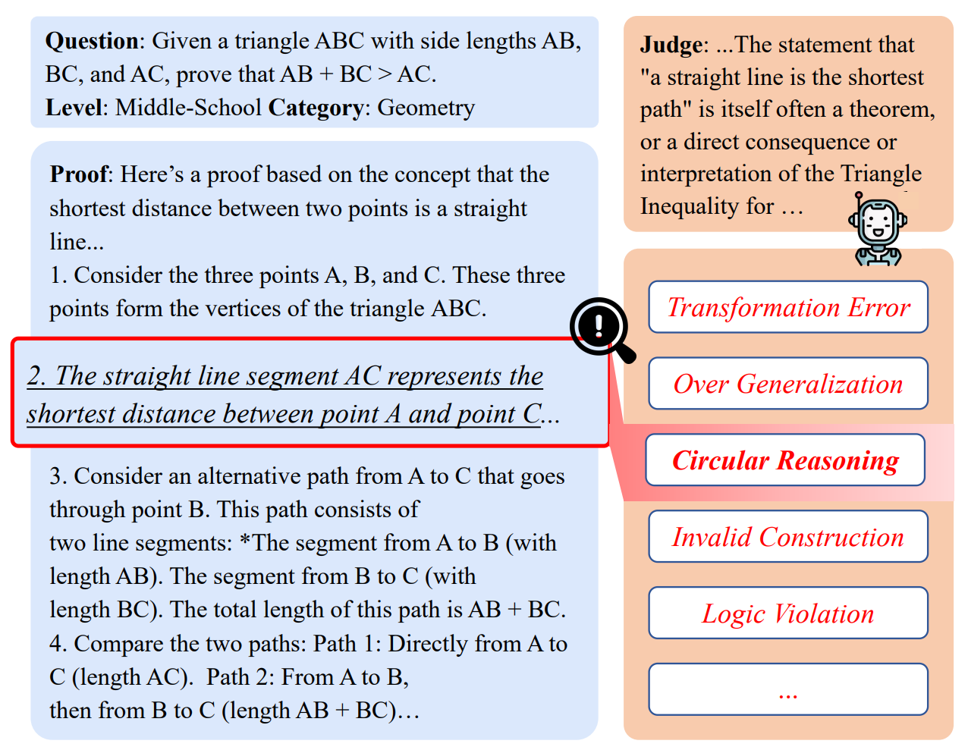
Research: Reasoning-related
Diversity-Enhanced Reasoning for Subjective Questions
Mathematical Proof as a Litmus Test: Revealing Failure Modes of Advanced Large Reasoning Models

Slide 4
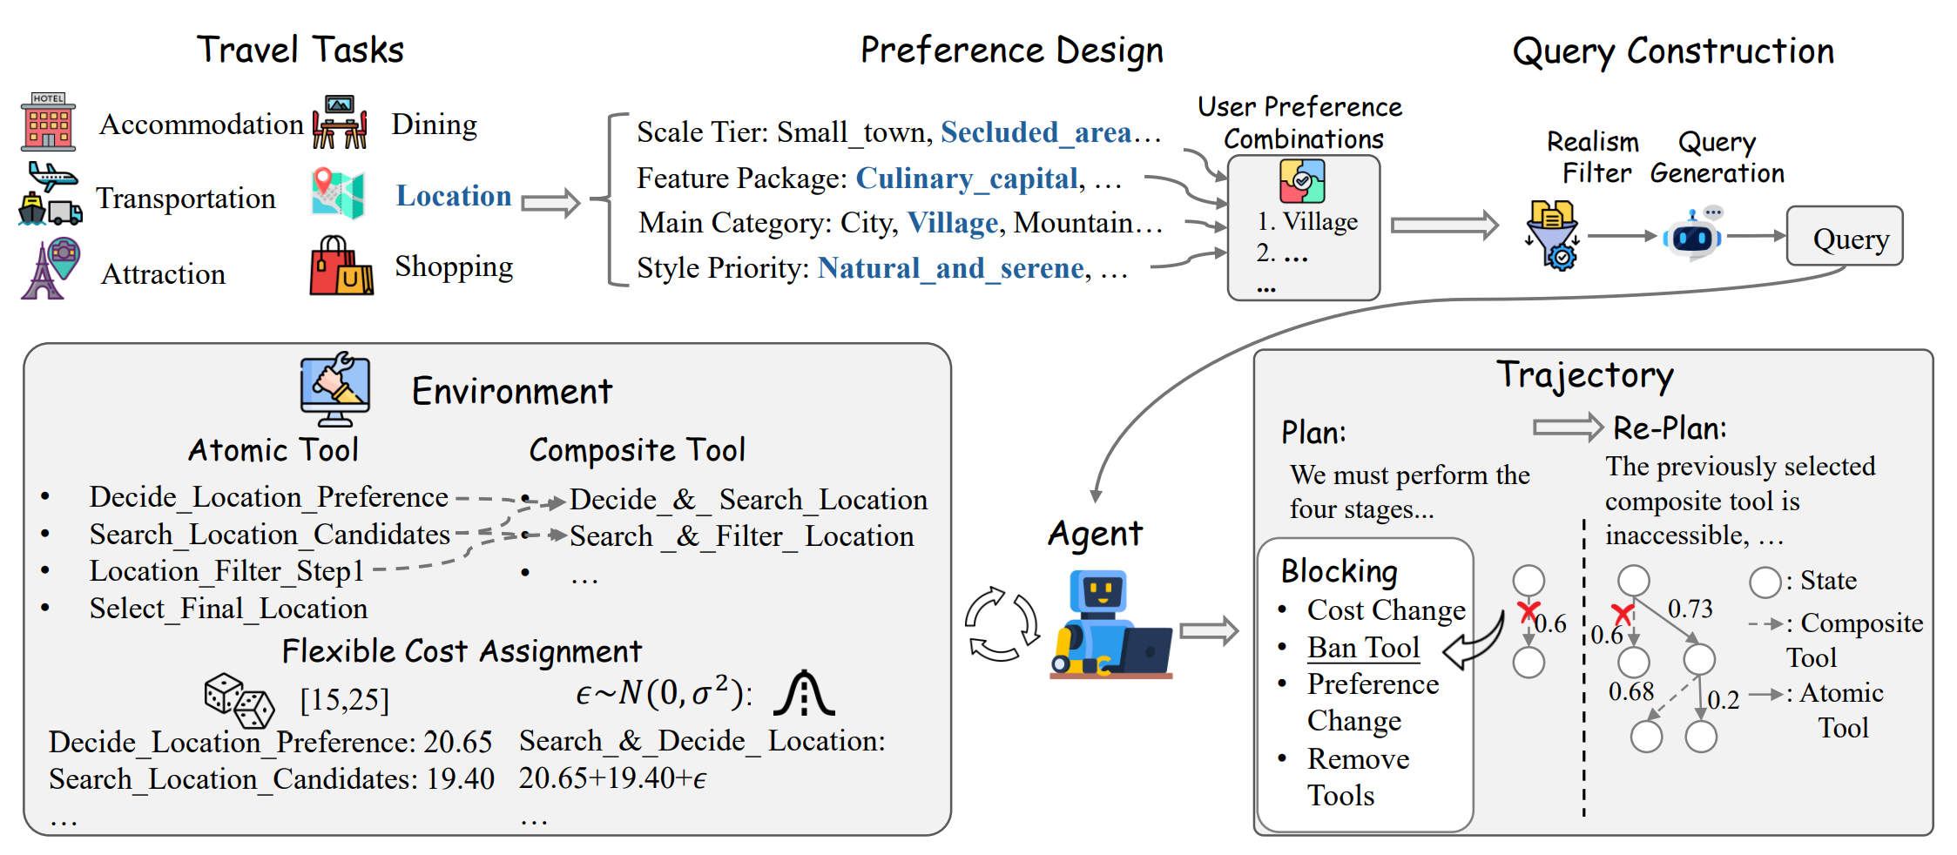
Research: Agent-related
CostBench: Evaluating Multi-Turn Cost-Optimal Planning and Adaptation in Dynamic Environments for LLM Tool-Use Agents

Slide 5






Research (My Personal Website!)
Foundation: Reliability/Robustness
Static QA tasks ->Out-of-distribution robustness/generalizability:
Confidence calibration (via Epistemic Markers [ACL 2025], in RAG scenarios [arXiv], in decision framework under uncertainty [arXiv])
Reasoning tasks (diversity-enhanced subjective reasoning [ICLR 2026], math reasoning [arXiv])
Dynamic Agentic tasks ->robustness under complex/changeable environments:
Cost awareness in tool use [arXiv] (mentored by Cheng and Prof. May Fung)
And more! Eager and Excited to learn from everyone
Future works
Also love/open to any exciting topics!
Note: Listed are my first/co-first author works.
X (twitter)
Linkedin

Slide 6
Thank you!

