Slide 1
- DIRECT Project -
EASE (Electricity Analysis Suggestion Ensemble)
Technology Review
github.com/danielfather7/EASE-Project
Team 6
Ivan Cui
Daniel Pan
Yongquan Xi
Jiayuan Guo

Slide 2
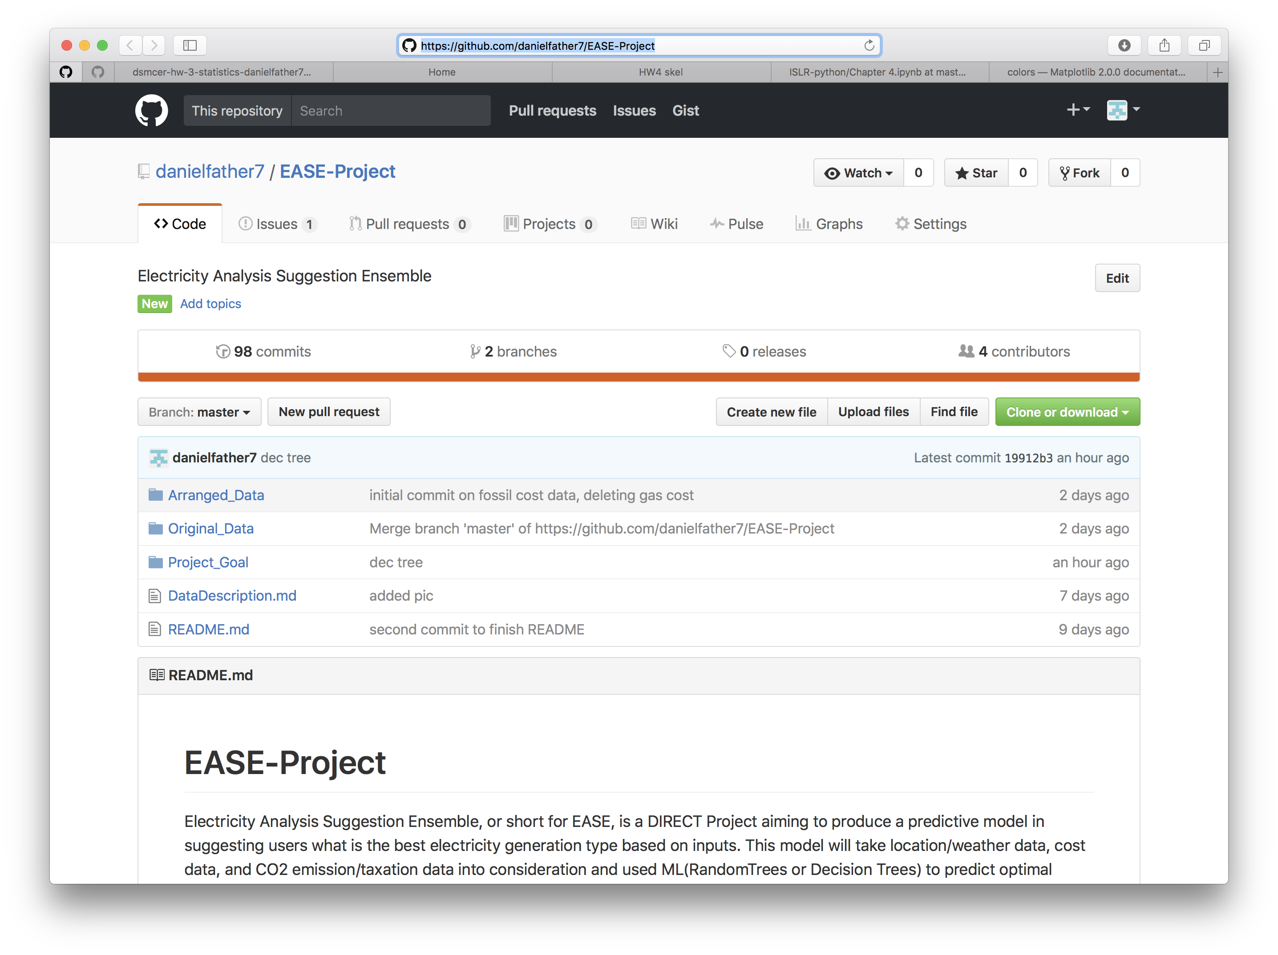

Slide 3
Background-Project
Electricity is one of the major energy which can be generated through different resources:
Conventional Resources: Coal, Natural gas, Petroleum, etc. Limitation: High CO₂ emission & accordingly high CO₂ taxation
Clean Energy Resources: Solar, Wind, Hydro, Biofuel etc. Limitation: Technology & Distributive location of particular resources
Electricity generation source model to provide suggestion on the electricity generation type:
Factor 1: Weather (including Temperature, Precipitation, Wind speed)
Factor 2: Financial Cost (Cost per watt by different resources)
Factor 3: CO₂ Tax per year depending on different states

Slide 4
Project Objective
Develop a predicative model using ML to provide users suggestions on the best electricity generation source type.
Model trained through
Weather Database
Model trained through
Energy source Database
Random
Forest
Decision Trees
MODEL OUTPUT
USER INPUT
Best Electricity Generation Source
Most Economical
Lowest CO₂ Emission
Most Weather Suitable
Most Efficient
Relative location
Budget
Electricity Demand
(optional)
Model trained through
Cost Database
Model trained through
CO₂ Database

Slide 5
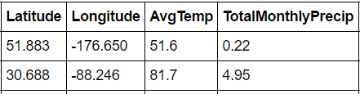
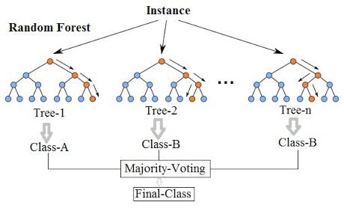
Package & Algorithm
Package: Scikit-learn
Open-source machine learning modules
Built-in dataset and various algorithm for classification & regression
Useful for dataset loading, transformation, features selection, etc.
Learning Algorithm: Random Forest
One of the most popular and accurate learning algorithms available
Combine Bagging method and random decision trees, outputs the class that is the majority voting by individual trees

Slide 6
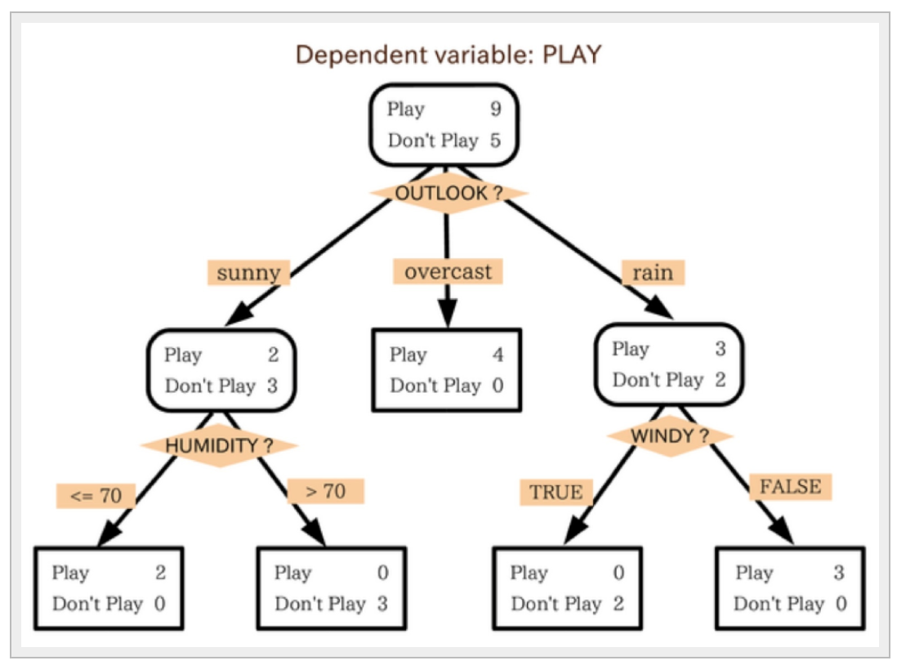
How it works
Decision trees are individual learners that are combined. They are one of the most popular learning methods commonly used for data exploration.

Slide 7
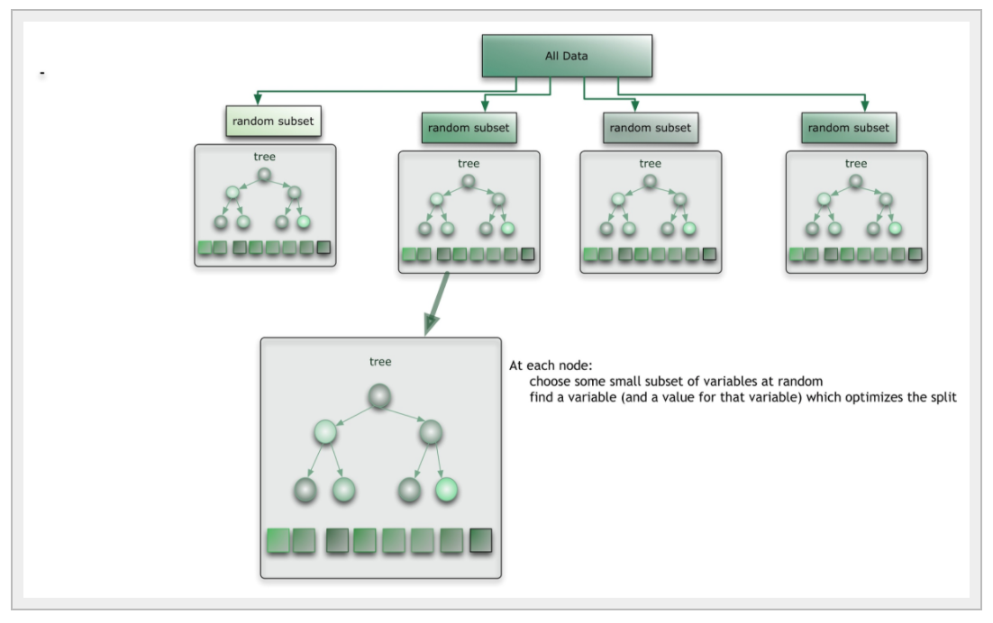
How it works
RandomForests consists of an ensemble of classification decision trees, and outputting the mode of the classes of the individual trees.
Corrects Decision Tree’s overfitting and inaccuracy by voting.

Slide 8
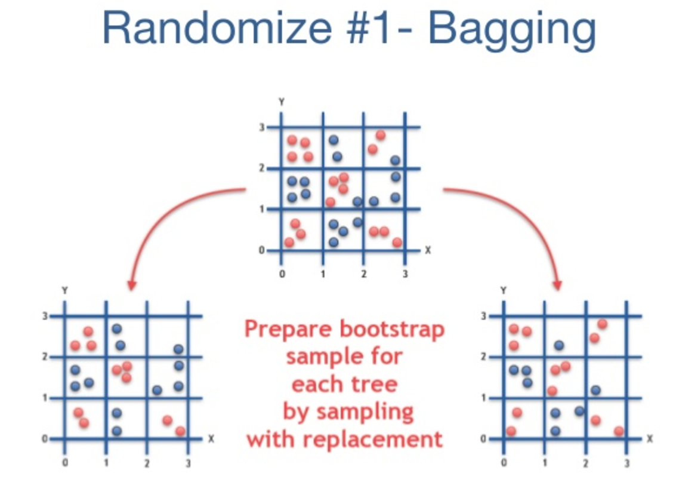
How it works
Tree-bagging is an algorithm that selects a random subset of the features at each candidate split in the learning process, a build-in feature to de-correlate individual trees.
Decrease variance of the model without increasing bias.

Slide 9
Appeal
Easy to learn, fast to build.
Project limitation.
One of the most accurate learning algorithms.
Run efficiently on large databases, and able to maintain accuracy even when a large proportion of the data are missing.
Our weather data （262477 rows × 8 columns)
Give estimates of what variables are important in the classification.
Generate an internal unbiased estimate of the generalization error as the forest building progresses.
Out of bootstrap (OOB) samples.
Estimated test error is very accurate in practice, with reasonable N.
Another validation set or cross-validation is not required, speeds up training.

Slide 10
Drawbacks (RandomForests)
Fast to train data, but slow to predict
More trees are required to generate a higher accuracy, which provides poor run-time performance. It becomes an issue when faster algorithm is preferred
A predictive modelling tool instead of a descriptive tool – hard to interpret the information extracted from the trained forest
The situation of overfitting when you have large number of categorical variables with different levels - Larger the tree, more overfitting for training data

Slide 11
User Case Example
USER INPUT
*City in the States*
PIN-POINT
*Longitude/Altitude*
CHECK
*user-input city longitude/altitude in STATES*
CITY VERIFIED IN STATES
*Proceed to identify city longitude and altitude*
SEARCH
*user-input city’s related database*
CITY INFORMATION IDENTIFIED IN STATES
*Create input parameter matrix*
PROCEED TO MODEL
RETURN ERROR
*Prompt user to input city in the States*
CITY NOT VERIFIED IN STATES
*Raise Error*
RETURN
*list of closest city location (within certain mileage)*
CITY INFORMATION NOTIDENTIFIED
*Raise Error*
USER RETURN
*city choice in the return list*

Slide 12
USER INPUT
Main DataFrame
......
subset 1
Subset 2
Subset n-1
Subset n
K(1)
K(2)
K(n-1)
K(2)
Voting
K (output)

