Slide 1
- DIRECT Project -
EASE
- Electricity Analysis Suggestion Ensemble -
Team 6
Ivan Cui
Daniel Pan
Yongquan Xi
Jiayuan Guo

Slide 2
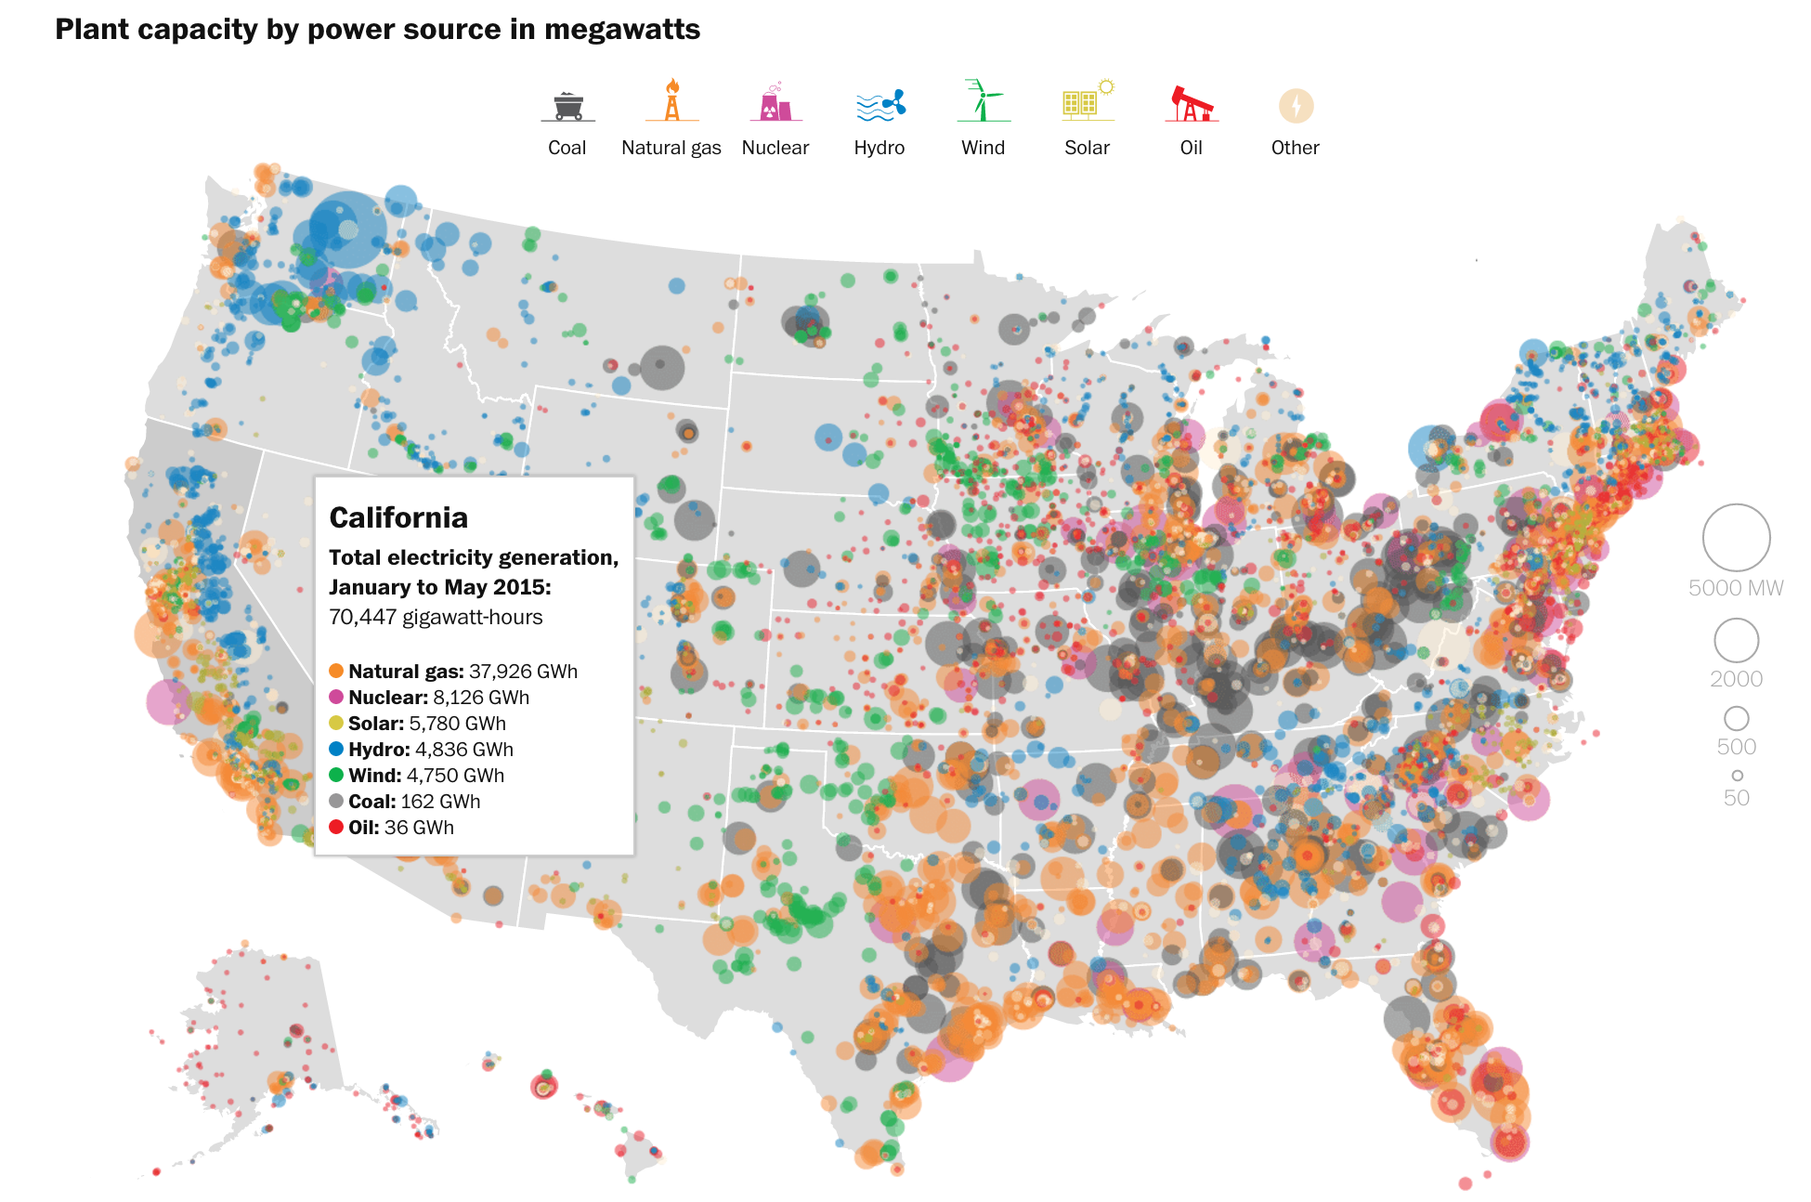
Project Background

Slide 3
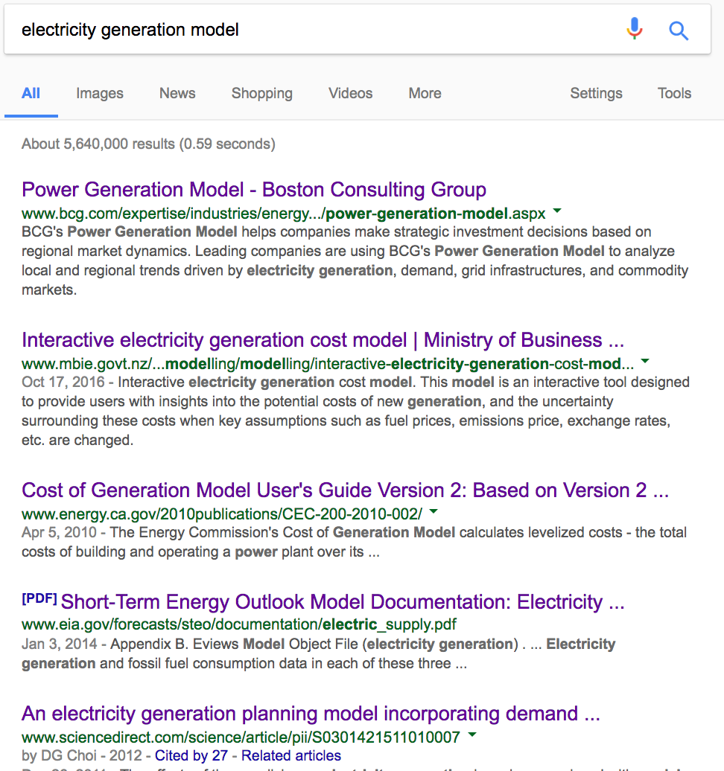
Project Background
No electricity generation source model existed that incorporates weather, cost, and CO₂ emission as consideration combined.
Several separated models existed at high cost
New Zealand Interactive Electricity Generation Cost Model 2010
U.K. Gov. Electricity Generation Cost Model

Slide 4
Project Proposal
Electricity is one of the major energies being utilized in all sectors (Governmental, Residential, Industrial)
Electricity is generated through different sources
Conventional (Petroleum, Coal, Natural Gas, etc.)
Unconventional (Wind, Hydro, Solar, Nuclear, Biofuel, etc.)
Conventionally generated electricity is accompanied by high CO₂ emission, often associated with different levels of CO₂ taxation depending on the state.
Unconventionally generated electricity is often accompanied with various degree of costs and limitations
Weather, location, technology as limitations
Installation and maintenance costs, revenue

Slide 5
Project Objective
Develop a predicative model using ML to provide users suggestions on the best electricity generation source type.
Model trained through
Weather Database
Model trained through
Energy source Database
Decision Trees
RandomForest
MODEL OUTPUT
USER INPUT
Best Electricity Generation Source
Most Economical
Lowest CO₂ Emission
Most Weather Suitable
Most Efficient
Relative location
Budget
Electricity Demand
(optional)
Model trained through
Cost Database
Model trained through
CO₂ Database

Slide 6
User Case Example
USER INPUT
*City in the States*
PIN-POINT
*Longitude/Altitude*
CHECK
*user-input city longitude/altitude in STATES*
CITY VERIFIED IN STATES
*Proceed to identify city longitude and altitude*
SEARCH
*user-input city’s related database*
CITY INFORMATION IDENTIFIED IN STATES
*Create input parameter matrix*
PROCEED TO MODEL
RETURN ERROR
*Prompt user to input city in the States*
CITY NOT VERIFIED IN STATES
*Raise Error*
RETURN
*list of closest city location (within certain mileage)*
CITY INFORMATION NOTIDENTIFIED
*Raise Error*
USER RETURN
*city choice in the return list*

Slide 7
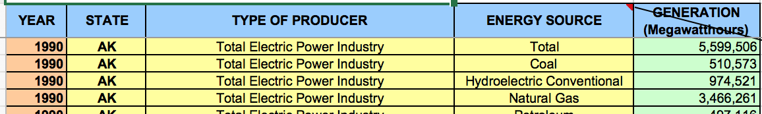
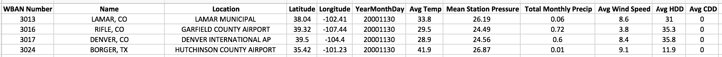
Database in hands
Electricity Usage / Generation Source Database (link)
Annual Weather Information Database (link)
Financial Cost Dataset (link)
Installation cost and maintenance cost vary greatly by states, database is in search*

