Slide 1
DIRECT Capstone Project -
Neural networks for fast analysis of complex chemical reaction mechanisms
- 1 Slide Updates -
Ivan Cui
Daniel Pan
Jiayuan Guo
Yu Liu

Slide 2
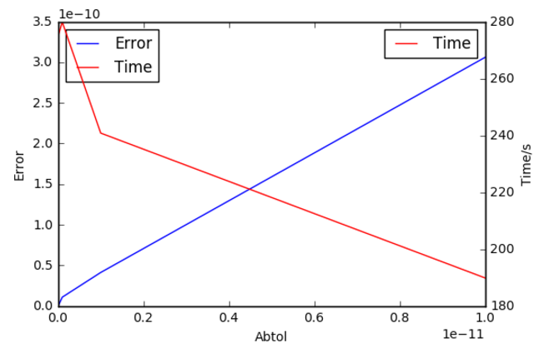
Neural networks for fast analysis
of complex chemical reaction mechanisms
Project sponsors: David Beck, Jim Pfaendtner
Tasks and Methods: Mathematical analysis and implementation of ODE solvers for lignin pyrolysis in both Cantera and scipy.integrate packages
Data description: 3 files defining kinetic parameters in 406 reactions, and the initial composition of 93 lignin species
Preliminary results: Using LSODA in scipy.integrate to solve ODE sets and find the running time is long.
Figure. Error-Time tradeoff for LSODA ODE Solver

