Slide 1
The Data Incubator Project Building Permits Analysis
Jiayuan Guo
University of Washington
Aug. 7th, 2017

Slide 2
Motivation & Data
Building permits data
Providing an estimate on the number of buildings planning to be constructed
Offering insight for regional economic conditions and potential opportunities
Data Description:
Building Permits Data
2012 – 2017, Seattle
Categories: Commercial, Industrial, Institutional, Multifamily, and Single Family/Duplex
Commercial Building Licenses Data
2012 – 2017, Seattle
Mainly Groceries & Convenience Stores for following commercial prediction

Slide 3
Analysis & Goals
Analysis
Temporal analysis
Regional analysis
Goals:
Finding potential relationship between business factors
Predicting business activities, eg. Groceries and convenience stores arrangements, roadwork planning
Find specific pattern of building permits data

Slide 4
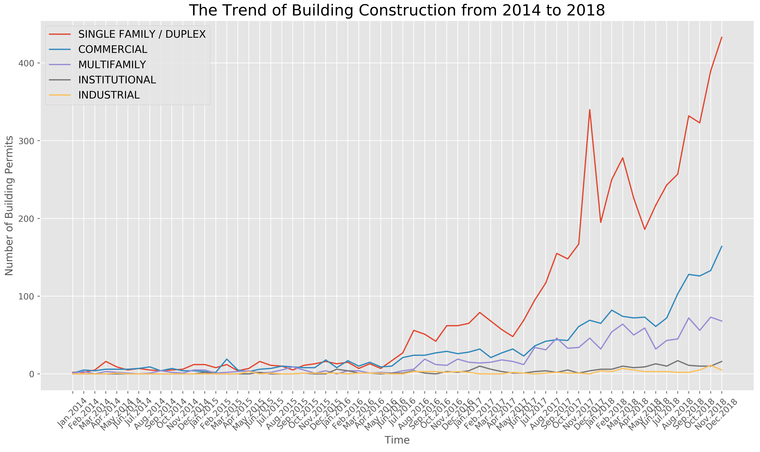
Temporal Analysis

Slide 5
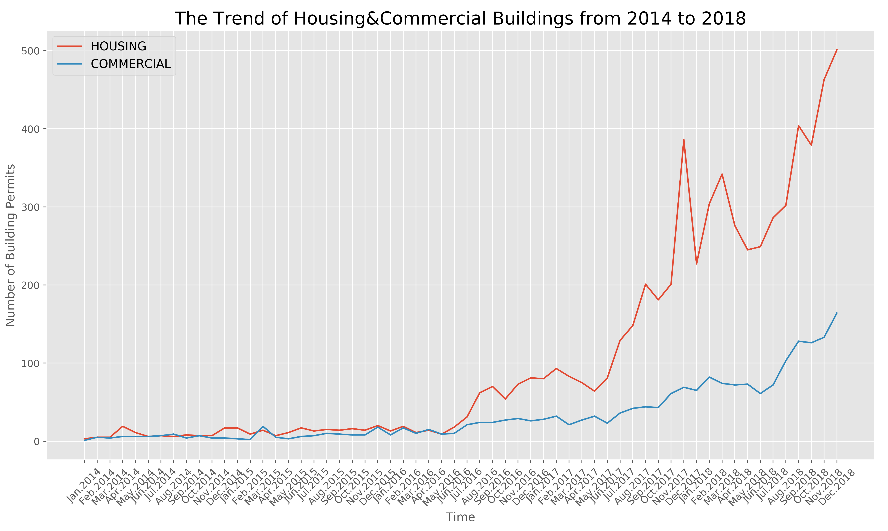
Temporal Analysis
Pearson’s correlation coefficient = 0.97;
P-value = 3.9e-37, much less than 0.01
From the temporal analysis above, the trend of housing buildings and commercial buildings have a significant correlation.

Slide 6
Let’s take a small step…
Housing Buildings
Permits
Predict
Groceries & Convenience stores
Arrangements

Slide 7
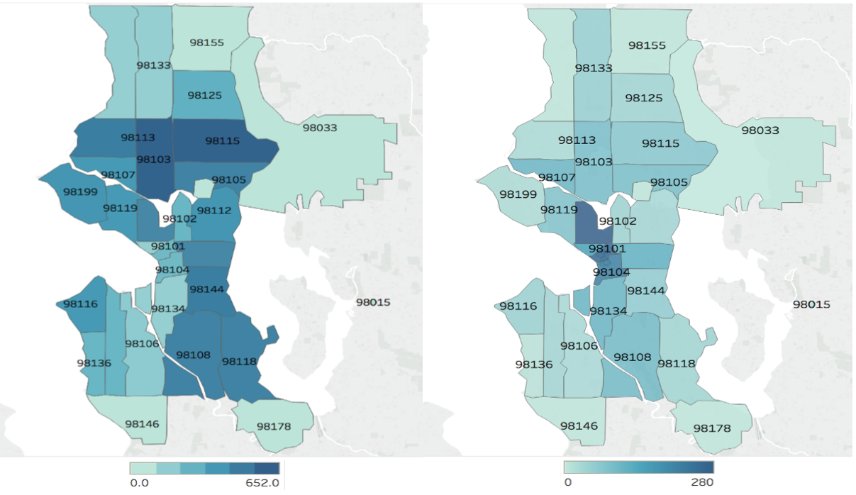
Regional Analysis
Zip code: 98115
Zip code: 98109
Housing
Commercial
Find two areas that have strong potential for housing and commercial building construction as examples for following analysis.

Slide 8
Regional Analysis
Assumption: The construction of housing buildings have great influence on the the construction of neighboring commercial buildings in a certain period.
Table.1 T-test Results in different period
Zip Code |  | 3 Months | 6 Months | 9 Months | 12 Months
98115 | T-statistic | 4.94 | 5.39 | 5.79 | 6.19
 | P-value | 2.58e-6 | 3.66e-7 | 5.88e-8 | 8.91e-9
98109 | T-statistic | 3.65 | 5.97 | 5.49 | 4.43
 | P-value | 0.0093 | 7.02e-5 | 2.38e-5 | 8.23e-4
The construction of housing buildings and neighboring groceries & convenience stores in the following 6 months have a significant correlation.

Slide 9
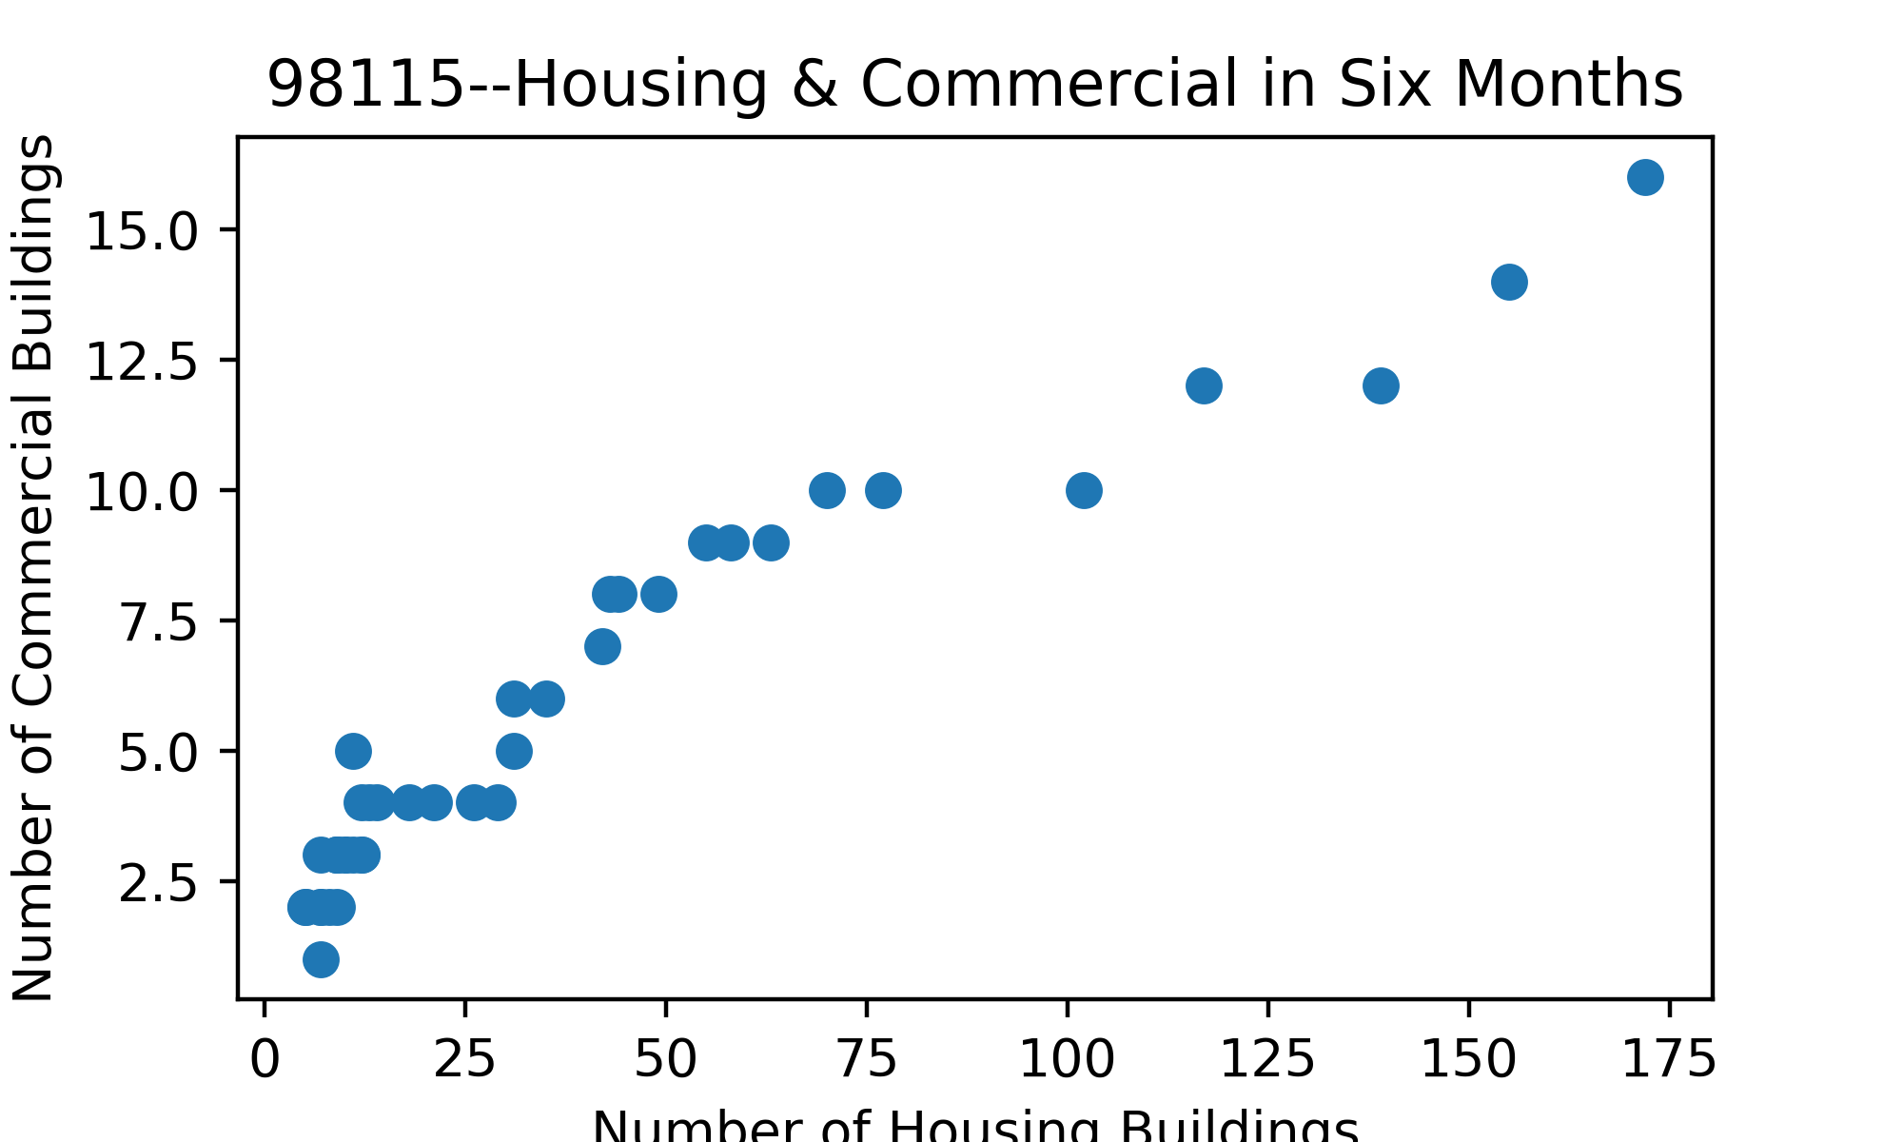
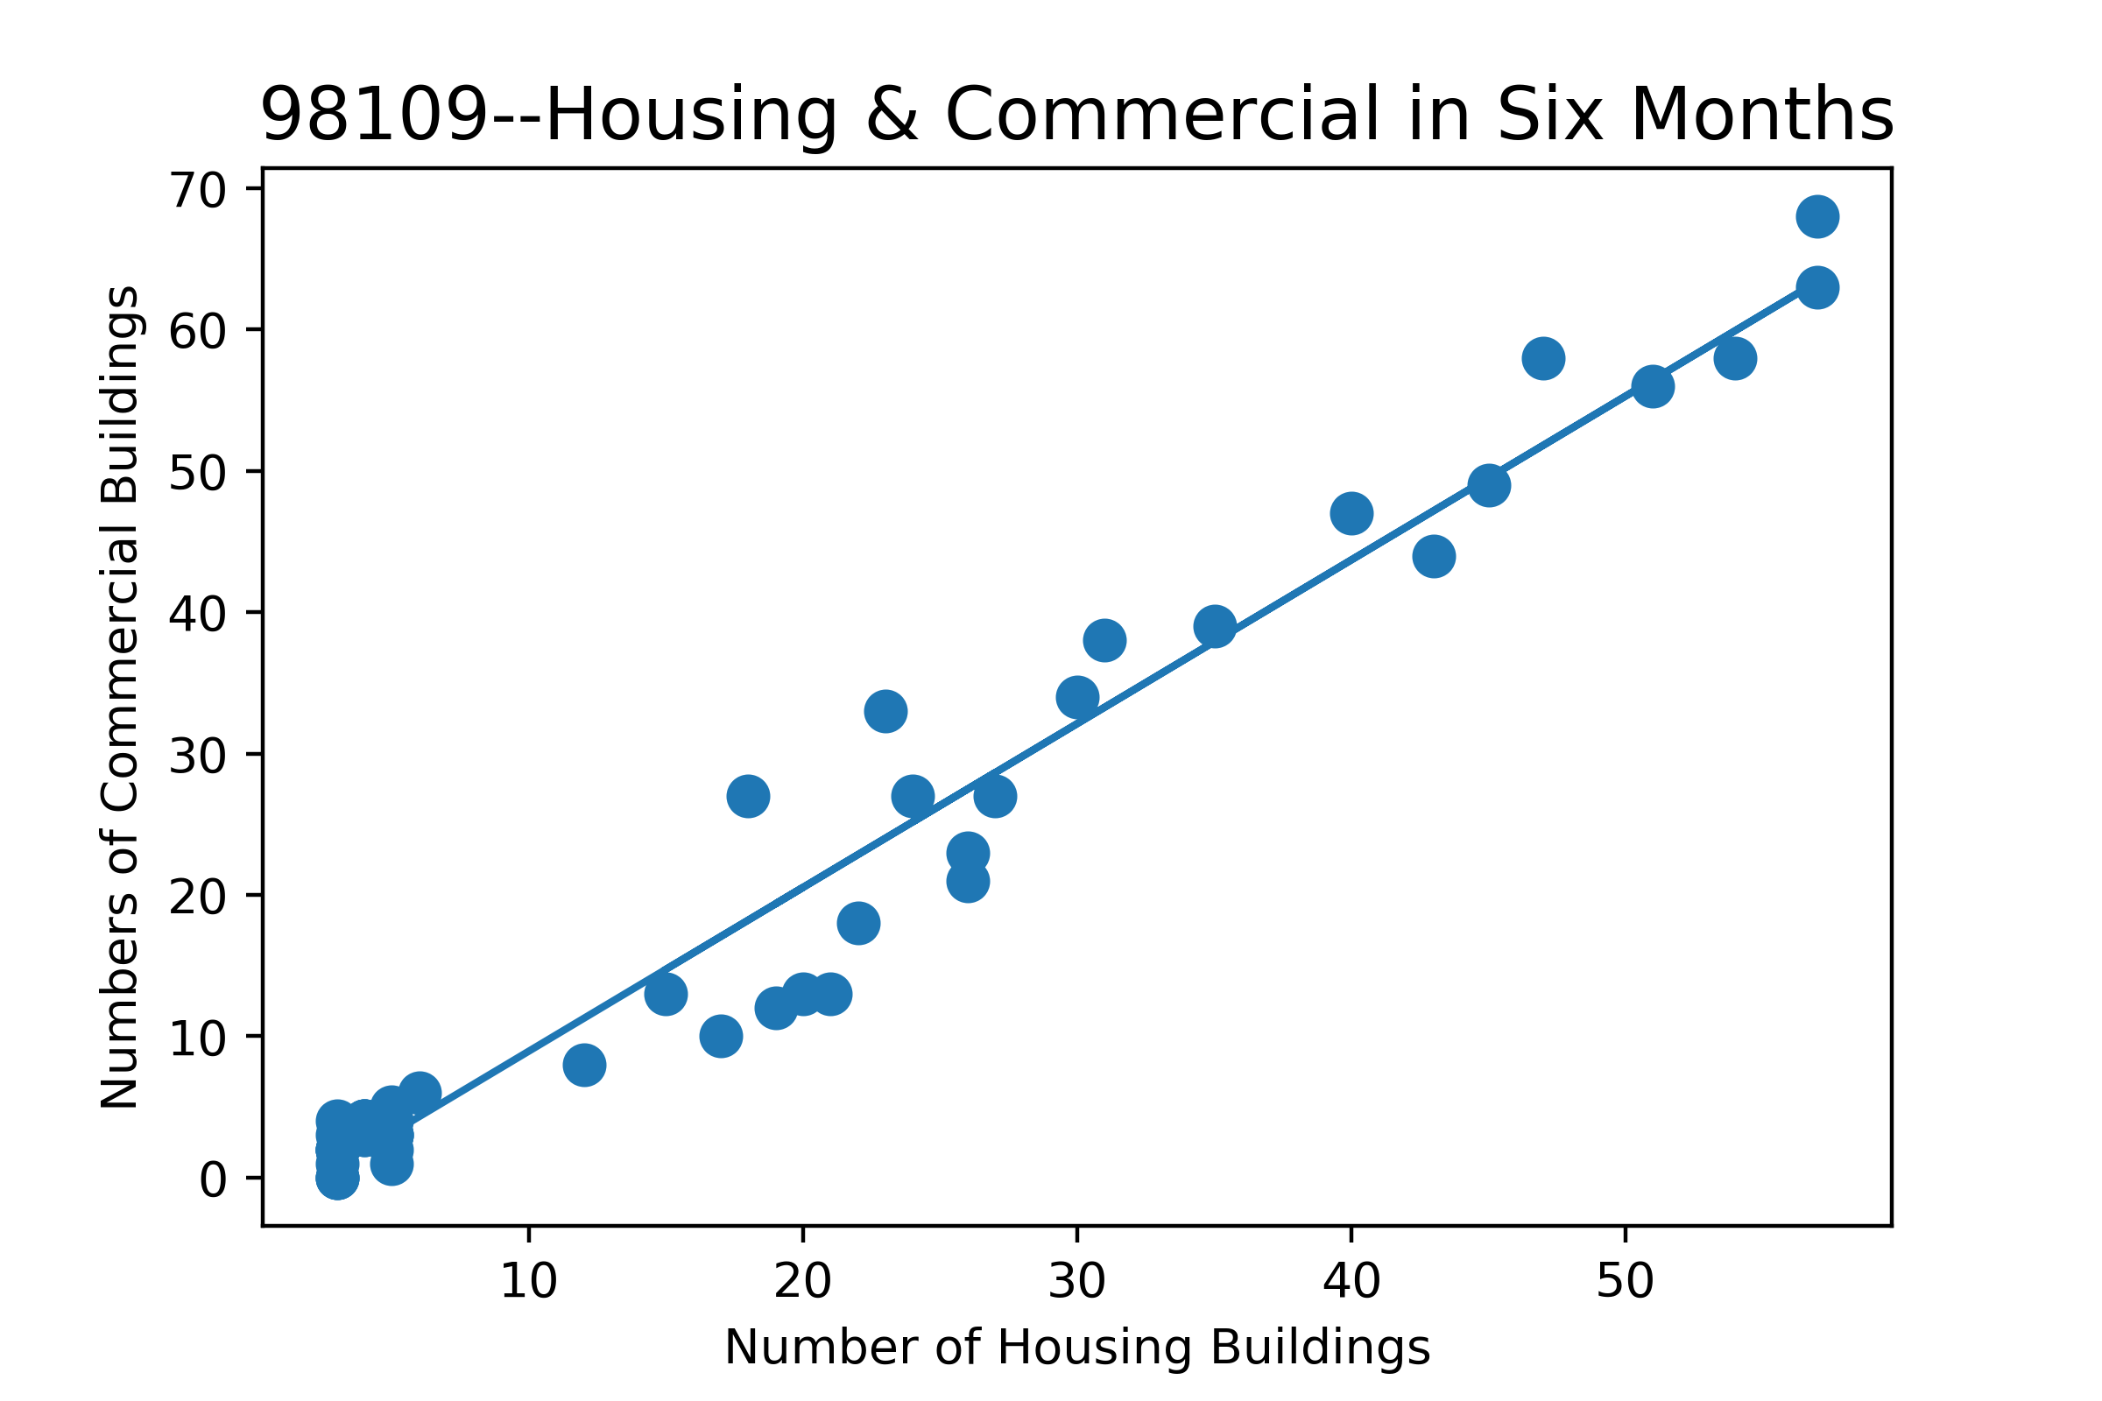
Regional Analysis
Assumption: The construction of housing buildings have great influence on the the construction of neighboring commercial buildings in the following six months.
R² = 0.8781
R² = 0.9654

Slide 10
Future Work
Evaluating more data source to improve the accuracy of prediction model
Adding more factors into building permits model
Location: Residential Areas & Business Area
Type and Number of existing markets: Supermarkets or Small convenience store
Issue periods for different permit types
Building a website to show regional business opportunities and offer suggestions on business activities based on existing building permits data and regional information

Slide 11
Thank You!

