Slide 1



Software Engineering for Data Scientists
Knowledge and solutions for a changing world
Advancing data-intensive discovery in all fields
Be boundless
UW DIRECT
(Did I Really Electively Choose This?)
David A. C. Beck (dacb)
Chemical Engineering & eScience Institute

Slide 2
Who is that guy Dave?
Computer Science, BS
Accounting and contact management software
Biomolecular Structure & Design /
Medicinal Chemistry, PhD
Scalable parallel software for molecular sims
Director of Research – Life Sciences, eScience Institute
Reproducible computational research
Research Assistant Professor, ChemE
Software and Data Science methods at the intersection of chemistry, biology, energy, health & environment
Not open source! ☹

Slide 3
Who are you?
How many of you have written some code?
Matlab? Did you create .m files?
C / C++?
R?
Python?
Did you use functions?
Did you use version control during development?
Did you work in a team?
Did you write documentation or tests?

Slide 4
What is this class?
If you answered ‘No’ to any of the previous questions you are in the right place!
Software Engineering for Data Scientists
Software Engineering
Application of engineering to the design, development, implementation, testing and maintenance of software in a systematic method
Data Science
Data Science Methods for Clean Energy Research

Slide 5
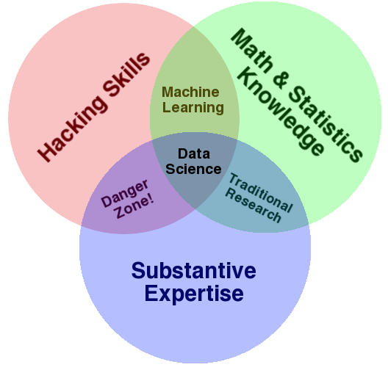
What is Data Science?
Software Engineering
DSMCER
http://www.forbes.com/sites/gilpress/2013/05/28/a-very-short-history-of-data-science

Slide 6
What is Software Engineering?
Engineering principles
Design
Development
Implementation
Testing
Maintenance
Documentation
Engineering vs. Programming
Solo vs. group? Programming is implementation?

Slide 7
What this class isn’t
A grad level CSE Software Engineering (SE) class
Full of SE theory
(Yes, there is theory in SE)
Assuming you have a lot of background in software development in Python
Boring!

Slide 8
What this class is!
Experience in creating reusable software artifacts for science, engineering & industry
Experience doing collaborative software development using real world tools
Elevates software engineering to the level of an engineering skill like technical writing, process engineering, etc.
Elevates software to a first class research product like publications, patents, and data

