Slide 1
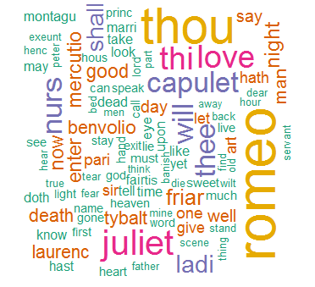
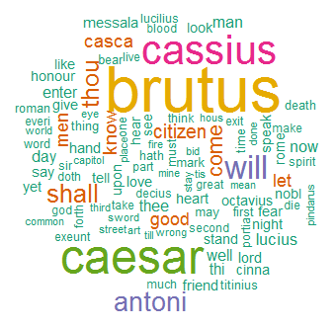
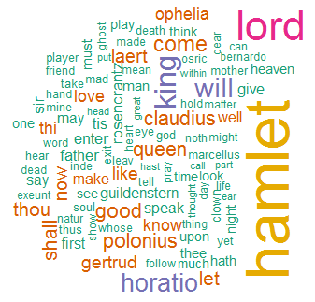
HW5：Q1
Romeo and Juliet
Julius Caeser
Hamlet

Slide 2
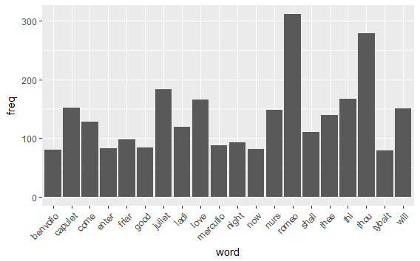
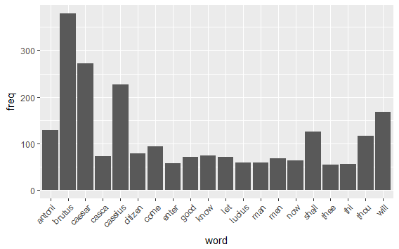
HW5：Q2
Romeo and Juliet
Julius Caeser

Slide 3
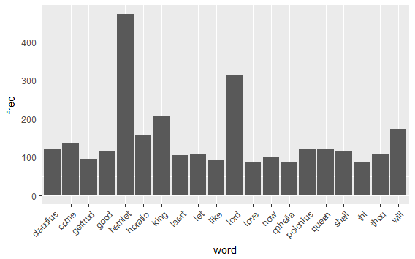
HW5：Q2
Hamlet

Slide 4
HW1：Q3
#Romeo and Juliet

