Slide 1
Bleecker Alexander
Serenity
Humor
General Love Friend + Romantic
Intellectualism
Make a Difference
Accomplishment
Organization
Discipline

Slide 2
Bleecker Alexander
Serenity
Humor
General Love Friend + Romantic
Intellectualism
Make a Difference
Accomplishment
Organization
Discipline

Slide 3
Cameron Eskandari
Stength
Bliss
Beauty
Honor
Wisdom
Congeniality
Pleasure
Dreaming

Slide 4
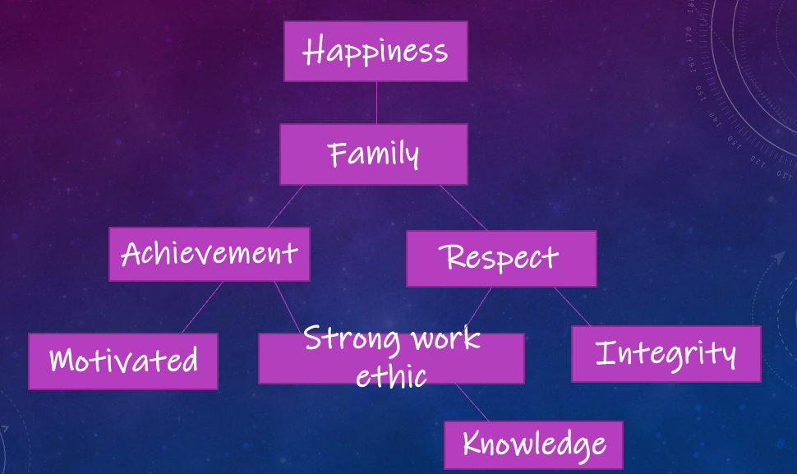
Laura Tejeda

Slide 5
