Slide 1


读取文件
第七章
Python for Informatics: Exploring Information
www.pythonlearn.com
Notes:
Note from Chuck. If you are using these materials, you can remove the UM logo and replace it with your own, but please retain the CC-BY logo on the first page as well as retain the entire last page.

Slide 2

是时候找一些数据来处理了!
下一步?
软件
输入/输出设备
中央处理器CPU
你的文件
辅助存储
if x < 3: print
主内存
From stephen.marquard@uct.ac.za Sat Jan 5 09:14:16 2008
Return-Path: <postmaster@collab.sakaiproject.org>
Date: Sat, 5 Jan 2008 09:12:18 -0500To: source@collab.sakaiproject.orgFrom: stephen.marquard@uct.ac.zaSubject: [sakai] svn commit: r39772 - content/branches/Details: http://source.sakaiproject.org/viewsvn/?view=rev&rev=39772
...

Slide 3
文件处理
一个文本文档可以被看做是“行”的序列
From stephen.marquard@uct.ac.za Sat Jan 5 09:14:16 2008
Return-Path: <postmaster@collab.sakaiproject.org>
Date: Sat, 5 Jan 2008 09:12:18 -0500
To: source@collab.sakaiproject.org
From: stephen.marquard@uct.ac.za
Subject: [sakai] svn commit: r39772 - content/branches/
Details: http://source.sakaiproject.org/viewsvn/?view=rev&rev=39772
http://www.py4inf.com/code/mbox-short.txt

Slide 4
打开一个文件
在读取文档之前，我们必须告诉Python将要处理哪个文件，以及将要怎样处理
这可以使用 open() 函数来实现
open() 的返回值是 “file handle” – 一个用来对文件执行操作的变量
类似于文字（如Word）处理器中的 “文件 -> 打开”

Slide 5
使用 open()
句柄 = open(文件名, 模式)
句柄是函数的返回值，用来处理文档
文件名是字符串变量
模式是可选项，’r’ 代表读，’w’代表写
fhand = open('mbox.txt', 'r')

Slide 6
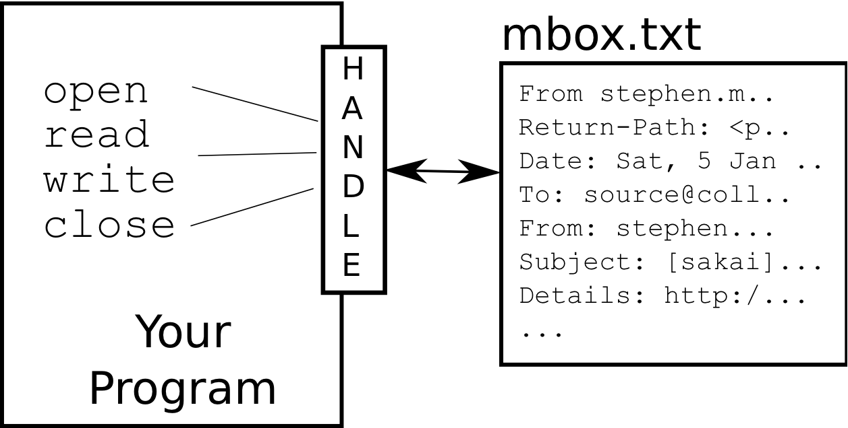
什么是句柄（Handle）?
>>> fhand = open('mbox.txt')
>>> print fhand
<open file 'mbox.txt', mode 'r' at 0x1005088b0>

Slide 7
当文件丢失的时候
>>> fhand = open('stuff.txt')
Traceback (most recent call last): File "<stdin>", line 1, in <module>IOError: [Errno 2] No such file or directory: 'stuff.txt'

Slide 8
换行符
“换行符” 标志一行文本的技术
换行符以 \n 的形式保存在字符串中
换行符 是一个字符 – 而不是两个
>>> stuff = 'Hello\nWorld!'
>>> stuff
'Hello\nWorld!'
>>> print stuff
Hello
World!
>>> stuff = 'X\nY'
>>> print stuff
X
Y
>>> len(stuff)
3

Slide 9
文件处理
一个文本文档可以被看做是“行”的序列
From stephen.marquard@uct.ac.za Sat Jan 5 09:14:16 2008
Return-Path: <postmaster@collab.sakaiproject.org>
Date: Sat, 5 Jan 2008 09:12:18 -0500
To: source@collab.sakaiproject.org
From: stephen.marquard@uct.ac.za
Subject: [sakai] svn commit: r39772 - content/branches/
Details: http://source.sakaiproject.org/viewsvn/?view=rev&rev=39772

Slide 10
File Processing
文本文档中，每一行的末尾都有 换行符
From stephen.marquard@uct.ac.za Sat Jan 5 09:14:16 2008\n
Return-Path: <postmaster@collab.sakaiproject.org>\n
Date: Sat, 5 Jan 2008 09:12:18 -0500\n
To: source@collab.sakaiproject.org\n
From: stephen.marquard@uct.ac.za\n
Subject: [sakai] svn commit: r39772 - content/branches/\n
\n
Details: http://source.sakaiproject.org/viewsvn/?view=rev&rev=39772\n

Slide 11
文件句柄作为一个序列
读取文件时可以把 文件句柄 当做一个字符串 序列 。文件中的每一行对应序列中的每一个字符串
可以使用 for 语句来从 序列 中读取元素
切记 – 一个 序列 是一个有序的集合
xfile = open('mbox.txt')
for cheese in xfile:
print cheese

Slide 12
计算文件的行数
打开一个只读 文档
使用 for 循环来读取行
计算 行数并输出
fhand = open('mbox.txt')
count = 0
for line in fhand:
count = count + 1
print 'Line Count:', count
$ python open.py
Line Count: 132045

Slide 13
读取 *整个* 文档
我们可以 读取 整个文档 (包括换行符) 并把它保存到 单个字符串
>>> fhand = open('mbox-short.txt')
>>> inp = fhand.read()
>>> print len(inp)
94626
>>> print inp[:20]
From stephen.marquar

Slide 14
在文件中搜索
我们可以在 for 循环中使用 if 语句来输出满足特定规则的行
fhand = open('mbox-short.txt')
for line in fhand:
if line.startswith('From:') :
print line

Slide 15
卧槽!
From: stephen.marquard@uct.ac.za
From: louis@media.berkeley.edu
From: zqian@umich.edu
From: rjlowe@iupui.edu
...
那些空行是什么鬼?

Slide 16
卧槽!
那些空行是什么鬼?
From: stephen.marquard@uct.ac.za\n
\n
From: louis@media.berkeley.edu\n
\n
From: zqian@umich.edu\n
\n
From: rjlowe@iupui.edu\n
\n
...
文档中的每一 行 末尾都有一个 换行符
print 函数会在每一行的末尾添加一个 换行符

Slide 17
在文件中搜索（修复）
我们可以使用字符串库中的 rstrip() 函数来清除字符串右边的空格
换行符被视为空格，因此可以被 清除
fhand = open('mbox-short.txt')
for line in fhand:
line = line.rstrip()
if line.startswith('From:') :
print line
From: stephen.marquard@uct.ac.za
From: louis@media.berkeley.edu
From: zqian@umich.edu
From: rjlowe@iupui.edu
....

Slide 18
使用 continue 来跳跃
fhand = open('mbox-short.txt')
for line in fhand:
line = line.rstrip()
if not line.startswith('From:') :
continue
print line
使用 continue 我们可以很方便地跳过某一行

Slide 19
使用 in 来选取 lines
根据 in 的选取规则，我们可以在一行（line）的任意位置寻找一条给定的字符串
fhand = open('mbox-short.txt')
for line in fhand:
line = line.rstrip()
if not '@uct.ac.za' in line :
continue
print line
From stephen.marquard@uct.ac.za Sat Jan 5 09:14:16 2008
X-Authentication-Warning: set sender to stephen.marquard@uct.ac.za using –f
From: stephen.marquard@uct.ac.za
Author: stephen.marquard@uct.ac.za
From david.horwitz@uct.ac.za Fri Jan 4 07:02:32 2008
X-Authentication-Warning: set sender to david.horwitz@uct.ac.za using -f...

Slide 20
文件名输入提示
fname = raw_input('Enter the file name: ')
fhand = open(fname)
count = 0
for line in fhand:
if line.startswith('Subject:') :
count = count + 1
print 'There were', count, 'subject lines in', fname
Enter the file name: mbox.txt
There were 1797 subject lines in mbox.txt
Enter the file name: mbox-short.txt
There were 27 subject lines in mbox-short.txt

Slide 21
无效的文件名
fname = raw_input('Enter the file name: ')
try:
fhand = open(fname)
except:
print 'File cannot be opened:', fname
exit()
count = 0
for line in fhand:
if line.startswith('Subject:') :
count = count + 1
print 'There were', count, 'subject lines in', fname
Enter the file name: mbox.txt
There were 1797 subject lines in mbox.txt
Enter the file name: na na boo boo
File cannot be opened: na na boo boo

Slide 22
小结
搜索行
读取文档名称
处理无效文件
辅助存储
打开一个文件 – 文件句柄
文件结构 – 换行符
使用 for 循环，依行读取文件

Slide 23
Acknowledgements / Contributions
These slidee are Copyright 2010- Charles R. Severance (www.dr-chuck.com) of the University of Michigan School of Information and open.umich.edu and made available under a Creative Commons Attribution 4.0 License. Please maintain this last slide in all copies of the document to comply with the attribution requirements of the license. If you make a change, feel free to add your name and organization to the list of contributors on this page as you republish the materials.
Initial Development: Charles Severance, University of Michigan School of Information
… Insert new Contributors and Translators here
Translated by Paul by 2016-03
...

