Slide 1
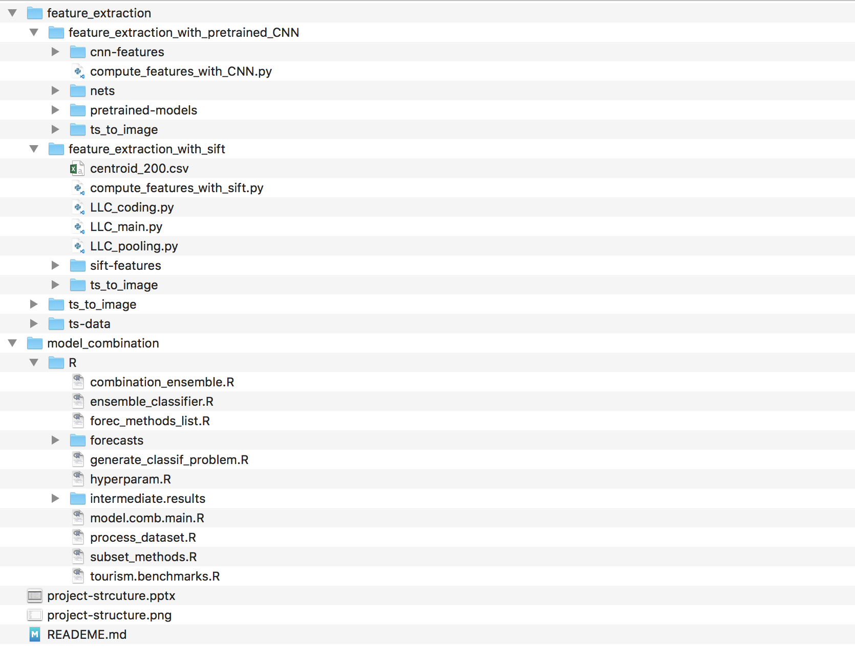
Feature extraction
File for saving extracted CNN features in ‘csv’ format
Main function for feature extraction with CNN
File for saving pretrained CNN models in ‘ckpt’ format
Main function for feature extraction with sift
File for saving extracted sift features in ‘csv’ format
File for saving time series data in ‘csv’ format
Model combination
Forecasts of 9 methods in ‘rda’ format
Main function for model combination

