Slide 1
Inventory Management System
Jabril Yusuf

Slide 2
Introduction
I am a QA consultant trainee.
Using diverse types of software applications like MySQL , Java and git as my introduction as a QA consultant.
I started to feel a lot of improvement from week 4 with my technical skills, as I grasped more of the coding side of the tasks which support my understanding on how deal with my project.

Slide 3
Approach
Firstly I had to identify what was the requirements needed for the project, also the software needed to complete my project.
Furthermore I progressed on to build my ERDs (entity relationship diagram) and my UML diagram (Unified Modeling Language) to form structure when creating my classes.
I started to input my codes and my database to test all its functions.
Finally upload all my work to the master (Main) branch to git hub.

Slide 4
Consultant Journey
The technologies used:
GitHub
Git
MySQL
Java
Maven
Junit Mockito
Jira

Slide 5
Continuous Integration
I started this Project by forking an IMS Starter package as well as generating my own branches off it, to give my project structure. I used Github for version control to run commits to my local database. In addition after creating my new branches of my previous branches to have a clear structure of my progress in the project.

Slide 6
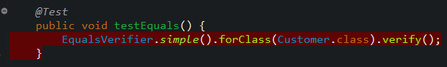
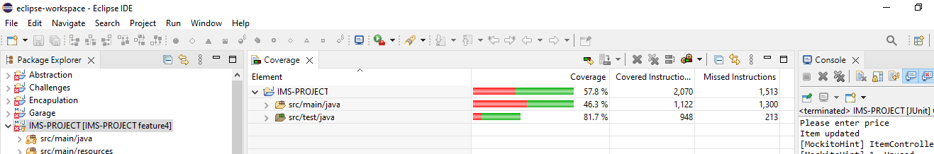
Testing
I had to cover 80% for my testing which ran through Junit and Mockito on the other hand I had problems with a few bugs locating errors so initially my test covered. I had issues trying to get over the 80% benchmark as I had problems with my build and runtime as they were not compatible. This caused the EqualsVerifier to fail in majority of classes. My testing gave me 57.8%.

Slide 7
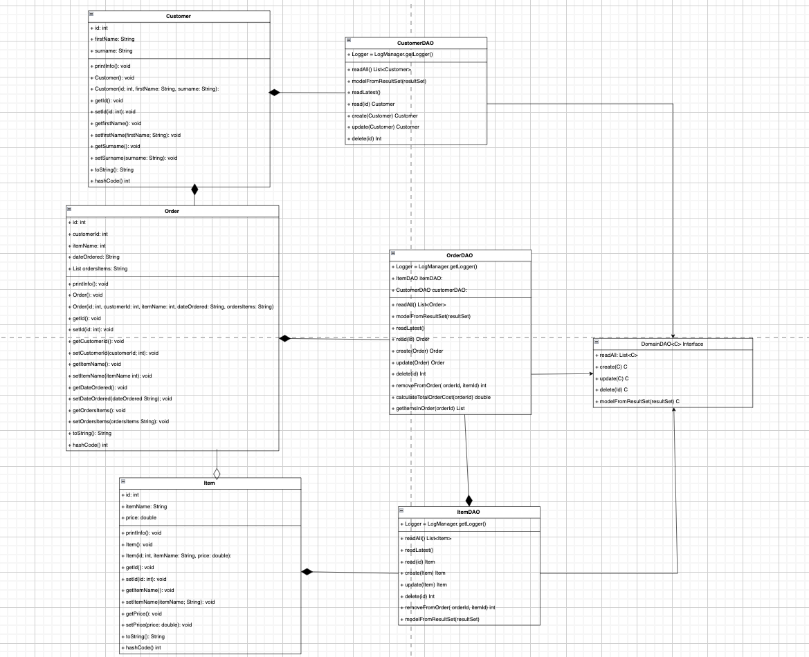
ERD

Slide 8
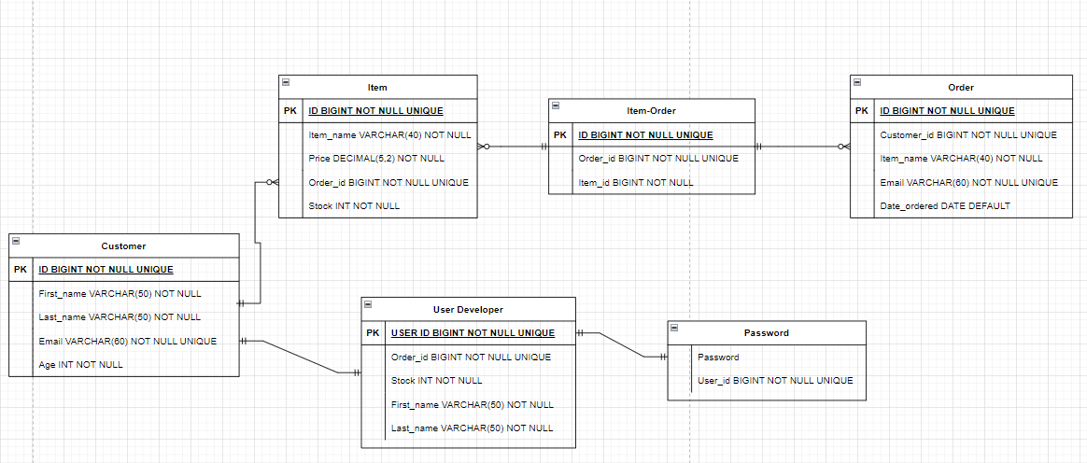
UML

Slide 9
My SQL
In this projected i integrate MySQL with my Maven project through the SQL data and SQL schema files. As a result I can pile my data into MySQL when interacting with the CLI.

Slide 10
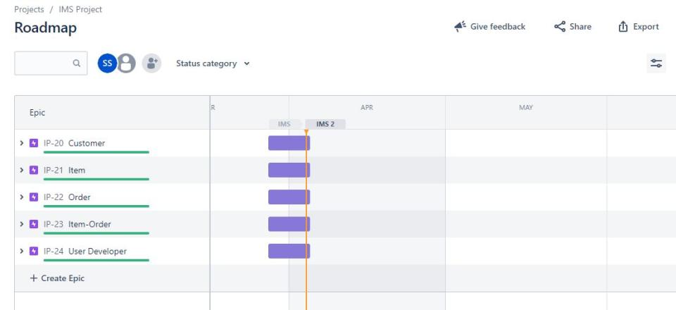
Project Management Board (JIRA)
I planned my project using Jira as my board it , I first started my customer classes to set targets for myself to help organise the structure of my project when I initiate coding.

Slide 11
Sprint Review
What did I complete?
I accomplished to achieve all of the user stories in the specification. My user stories for my customer, item and orders were to create/read/update/delete customers/items/orders. In addition my application can interact with an end user via CLI (command-line interface).
What got left behind?
I had many problems with testing in general. The EqualsVerifier was not working due to version issues. I had a few issues were tests returned null objects and I was uncertain why It occured. After spending numerous hours fixing bug issues through debugging and using my coverage for support by using compare on failure trace , I was still unable to fix every issue I had with testing. Preferably, I would’ve liked to achieve 80% coverage, however was able to reach 57.8%.

Slide 12
Sprint Retrospective
What went well?
I had a time zone issue in my db properties as it would connect to my sql database if was not solved. Creating my braches on GitHub and how well it is organized. Furthermore Creating the item classes (Item, ItemDAO, ItemController) was relatively straight forward. As the forked source code had already pre-built customer classes, I used them as a template to create my item classes. Also implementing the CrudController and Dao interfaces to the classes allowed for easier application to the classes.
What could be improved?
I think I should have a more in depth plan specially for my testing.
I essential need to progress on my testing, especially the OrderDAO and OrderController classes. As I ran into failures from testing, I expected to receive a complete object, but unfortunately receiving null objects a few times. Until now I am unsure as MySQL seemed to be working fine.

Slide 13
Conclusion
Reflections on the project, future steps, any other relevant info
my main reflections is certainly time management for the project.I need to give my self more time on fixing bugs and errors.
Also taking breaks when spending time on my project. I noticed when I did take the breaks, it cleared my mind and helped me recognize issues more rapidly. I learnt that my knowledge for technologies is expanding and I'm getting better with time whilst practicing, also my understanding on coding has definitely improved since I started this project.

