Slide 1

Retail-Giant Sales Forecasting Time Series Statistical Model
Think Data

Slide 2
Company background
Company business objective
Problem Statement
Company Background
‘Global Mart’ is an online store super giant having worldwide operations. It takes orders and delivers across the globe and deals with all the major product categories - Consumer, Corporate & Home Office.
Company Business Objectives
To forecast sales and demand for the next 6 months
Per demand, they need to manage their inventory
Problem Statement
Company deals in 7 different market segments and 3 major categories
Given dataset needs to get divided into 21 subset of main data based on different market segments and category
Need to find out 5 most profitable segments out of these 21 and forecasting for sales and demand need to be performed only for those5 segments.

Slide 3
Problem Solving Methodology
Model Evaluation
Data Preparation
Model Building
Data Understanding
Business Understanding
Result Interpretation

Slide 4
Business Understanding
“Global Mart” is an online store super giant having worldwide operations. It takes orders and delivers across the globe and deals with all the major product categories - consumer, corporate & home office.
As Sales Manager of Global Mart , we want to finalise the plan for the next 6 months. Therefore we want to forecast the sales and the demand for the next 6 months, that would help us manage the revenue and inventory accordingly.
The store caters to 7 different market segments and in 3 major segments i.e in all we have 21 sets of market-segment data sets. We want to find out 5 most profitable (and consistent) market-segment from these 21 and forecast the sales and demand for these.

Slide 5

Data Understanding
Identified the column for Market and Segments on which we need to perform analysis
Following is the list of 7 different markets - ‘US’, ’APAC’, ’EU’, ’Africa’, ’EMEA’, ’LATAM’, ’Canada’
Following is the list of 3 segments - ‘Consumer’, ‘Corporate ‘, ‘Home Office ‘

Slide 6

Data Preparation
Converted the entire data into 21 different data sets based on 7 different markets and 3 segments
Calculated the coefficient of variance of each of those 21 data sets
Based on the value of coefficient of variance, picked top 5 most profitable maket-segments data which is stated below
1) EU_consumer
2) APAC_consumer
3) APAC_corporate
4) LATAM_consumer
5) EU_corporate
10 Time series is eventually built on these 5 most profitable market-segments for two variables each – Sales and Quantity

Slide 7
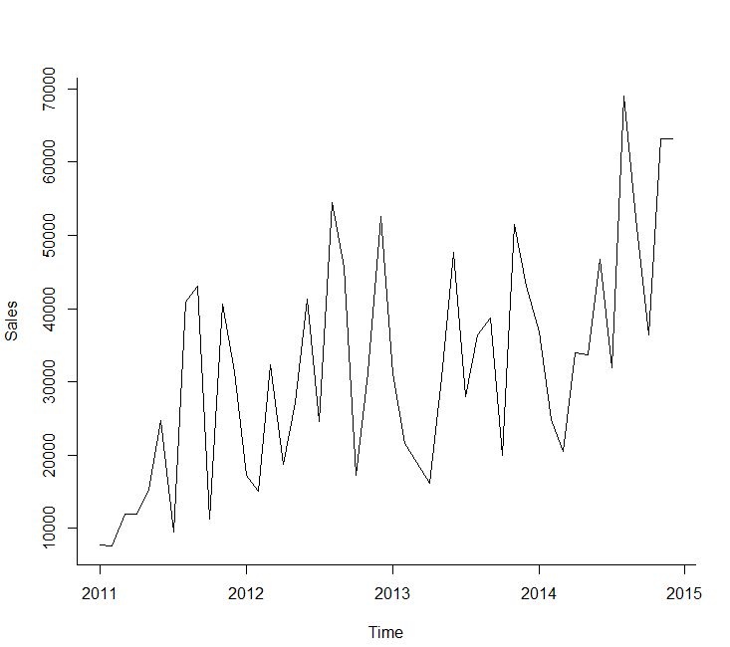
Model building
For each of the 5 market-segments identified in the step above, follow the below model building step :
Step 1 : Plot the time series for sales/quantity.

Slide 8
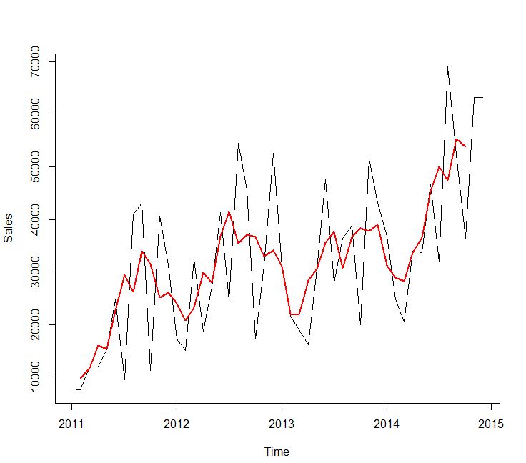
Step 2 : Smoothen the time series to identify the trend and seasonality component.
Following figure depicts the smoothen curve over the original curve

Slide 9
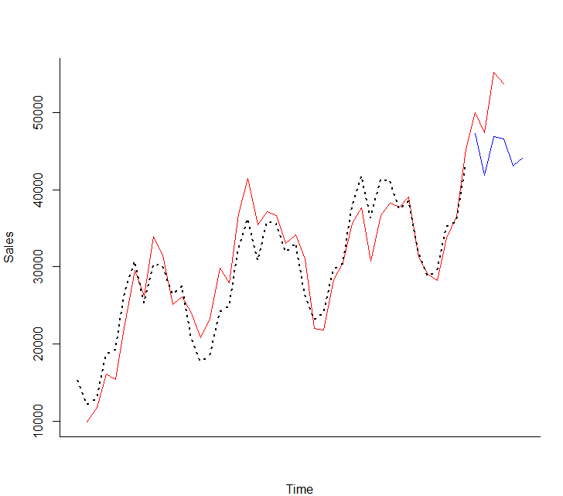
Step 3 : Create a linear regression model and plot it . This is created by looking at the graph of time series and identifying that which particular function will be suitable and thereafter using that function for performing regression

Slide 10
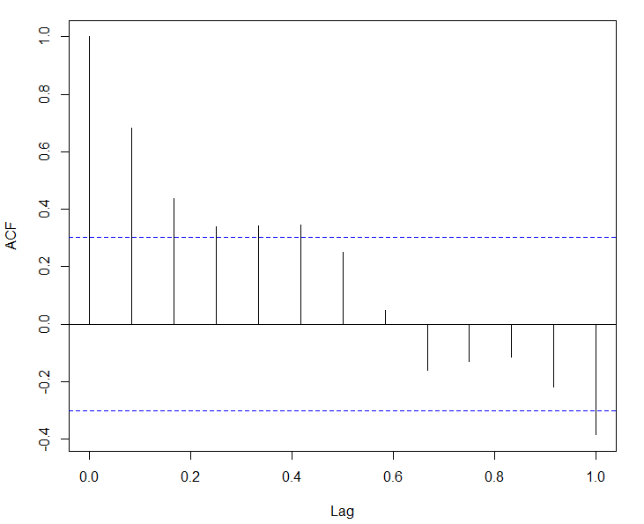
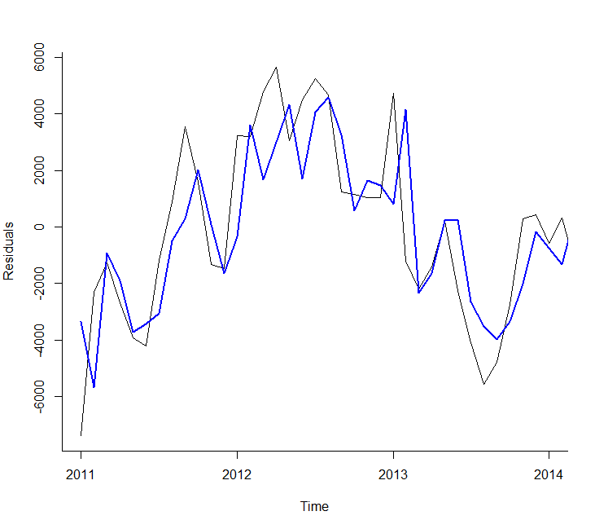
Calculate MAPE and other performance metrics. Plot the ACF graph
Model the Auto Regressive component and plot it

Slide 11
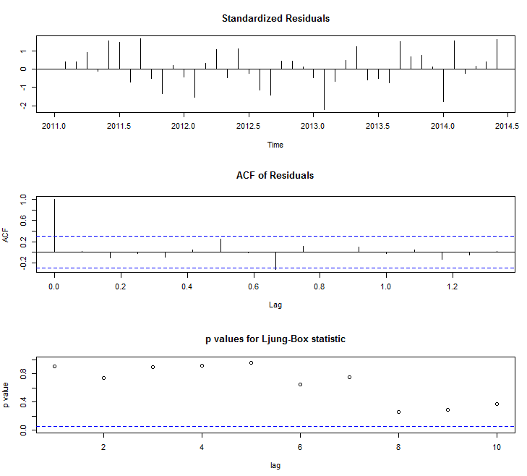
Once manual regression is carried out , try creating auto ARIMA model to see if it is better
Select the model which has a better MAPE value

Slide 12
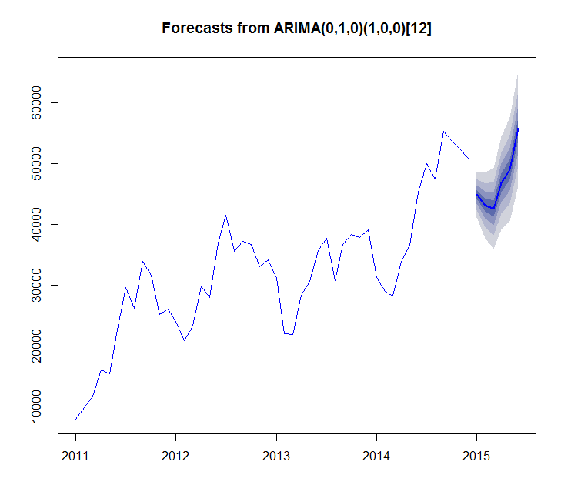
Step 4 : Predict the values of the series using this model and build a new series from the difference between the original and the predicted series.
Step 5 : Residual series should be close to pure noise. Carried out auto.arima fit to confirm this
Same procedure is applied to all the 10 time series.
Next slide shows the results of the prediction.

Slide 13
Model Evaluation
Model Name | MAPE (Regression) | MAPE (ARIMA)
EU_consumer_sales | 12.22 | 10.45
EU_consumer_quantity | 16.77 | 19.28
APAC_consumer_sales | 10.37 | 25.37
APAC_consumer_quantity | 16 | 16.78
APAC_corporate_sales | 7.93 | 15.68
APAC_corporate_quantity | 13.01 | 10.74
LATAM_consumer_sales | 20.86 | 22.93
LATAM_consumer_quantity | 14.07 | 9.74
EU_corporate_sales | 21.33 | 18.57
EU_corporate_quantity | 19.64 | 12.13
In Model name, name before _ represents market and name after _ represents segments
If model name ends with sales then it is related to forecasting of sales, if it ends with quantity then it is related to forecasting of quantity
All these MAPE values are on test data.
Depending upon which model MAPE value is lower, we should select that model for Prod deployment
By looking at MAPE for all the models we can say all the models are behaving fine

Slide 14
Result Interpretation
By looking at most profitable segment, recommendation is company should focus on consumer market segments followed by corporate from demand and customer retention perspective as these two are the most profitable segments
As home office is not at all present in the 5 most profitable segments – It is very important to revise marketing strategy to increase demand in these segments
From market wise – Out of 7 markets only 3 came in the five most profitable segments which is EU, APAC, LATAM
From logistics and manpower wise company should focus on these markets but at the same time company needs to ascertain where other markets are lacking and what sort of strategy they should have in place to make even this markets as much profitable as other three.
Five Most Profitable Segments
EU_consumer
APAC_consumer
APAC_corporate
LATAM_consumer
EU_corporate

