Slide 1
Oracle Fusion Cloud Applications: General Ledger
Presented By:
Jibin

Slide 2
Agenda
Understanding General ledger and its need
Key General Ledger Flows and Processes
Configuring Enterprise Structure
Processing Data Within Enterprise Structure
Ledger Processing and Reporting Flow
Benefits of General Ledger
General Ledger Beneficiaries
Conclusion

Slide 3
Understanding the General Ledger and Its Need
Imagine you’re running a small store. Every day, you buy stock, sell products, pay rent, and maybe even give discounts
You keep a notebook to track all income and expenses, that notebook is your General Ledger
General Ledger is where all your transaction are recorded, posted and reported. It provides a complete picture of your financial health
It can be used to generate balance sheets, profit & loss, cash flows, etc.

Slide 4
Now imagine your store becomes a chain, operating in multiple cities or countries, with thousands of transactions and multiple bank accounts
A notebook won’t cut it anymore, right?
That’s where Oracle Fusion Cloud General Ledger comes in
It automates, organizes, and secures your financial data, in real time
With built-in analytics, dashboards, and reporting tools, you gain clear visibility and control over your finances to make faster, smarter decisions

Slide 5
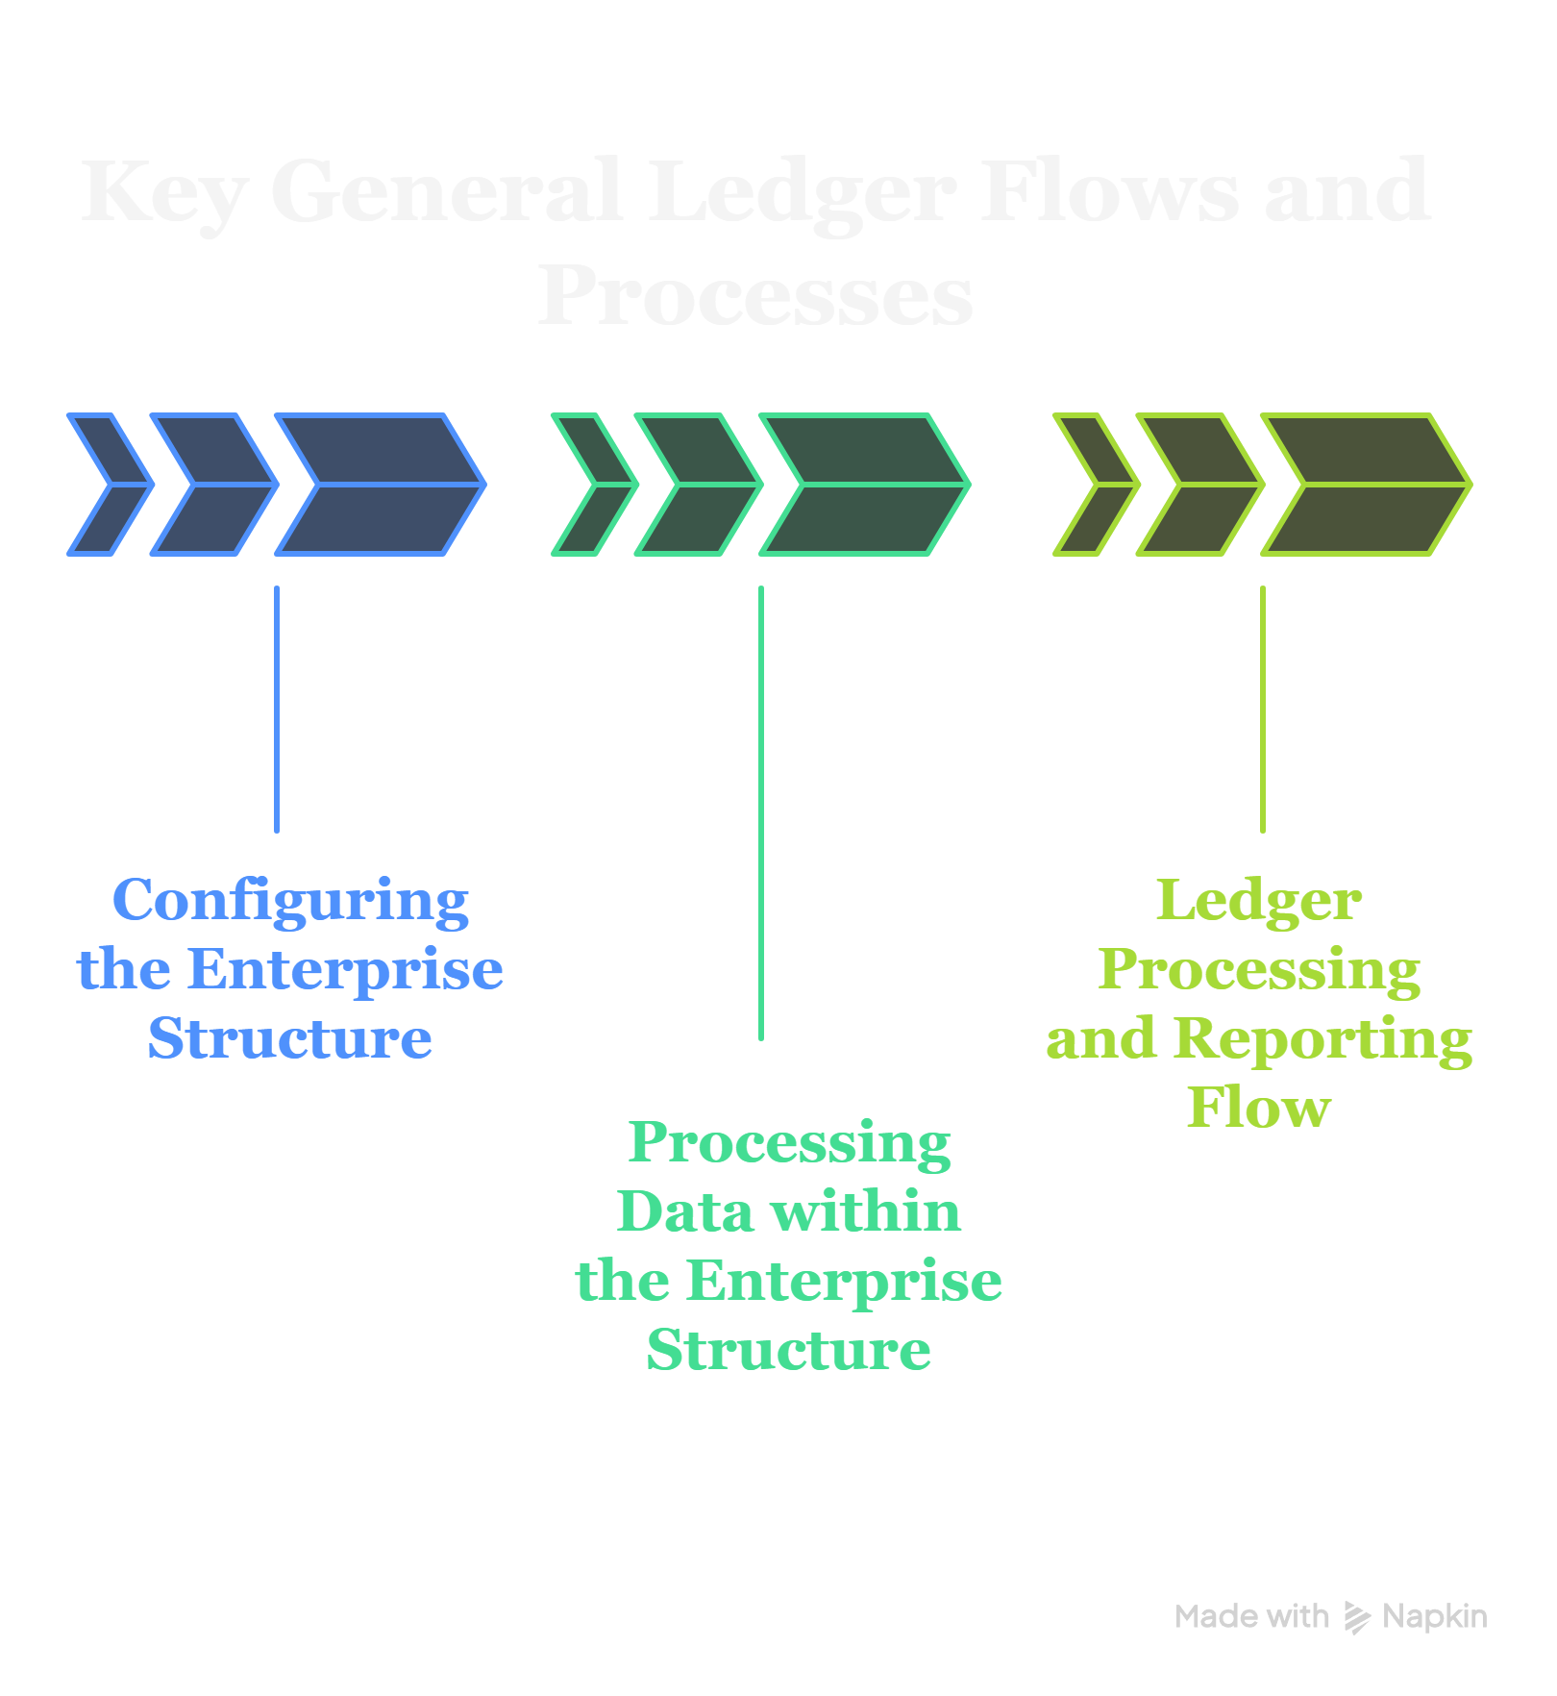

Slide 6
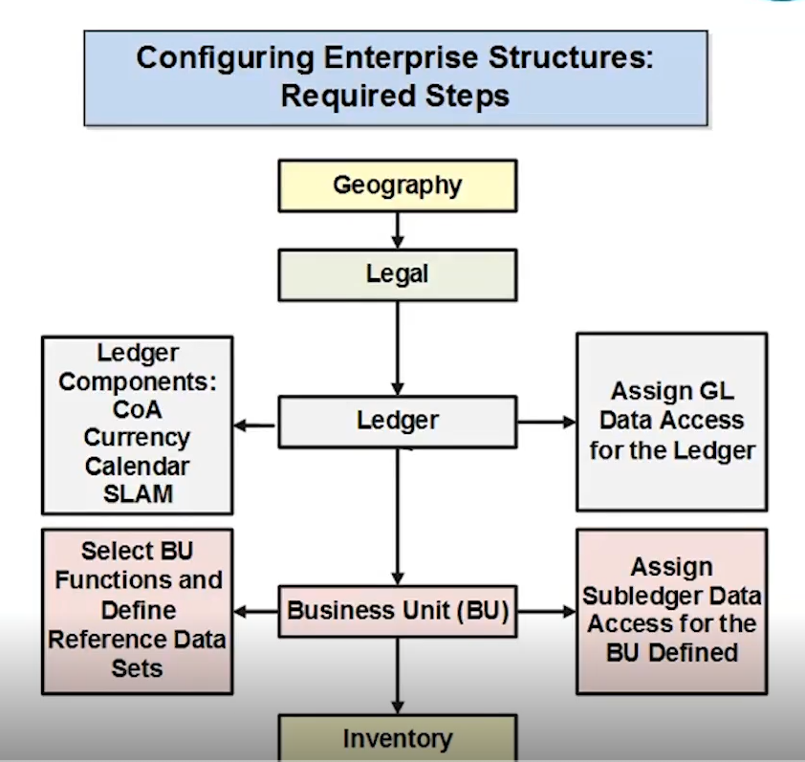

Slide 7
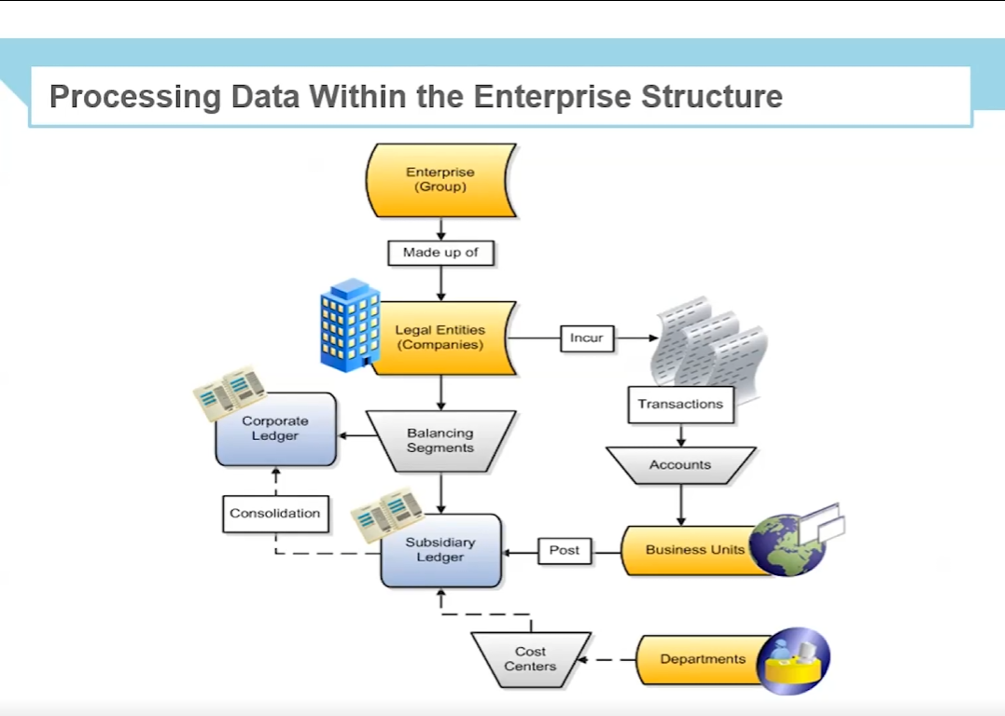

Slide 8
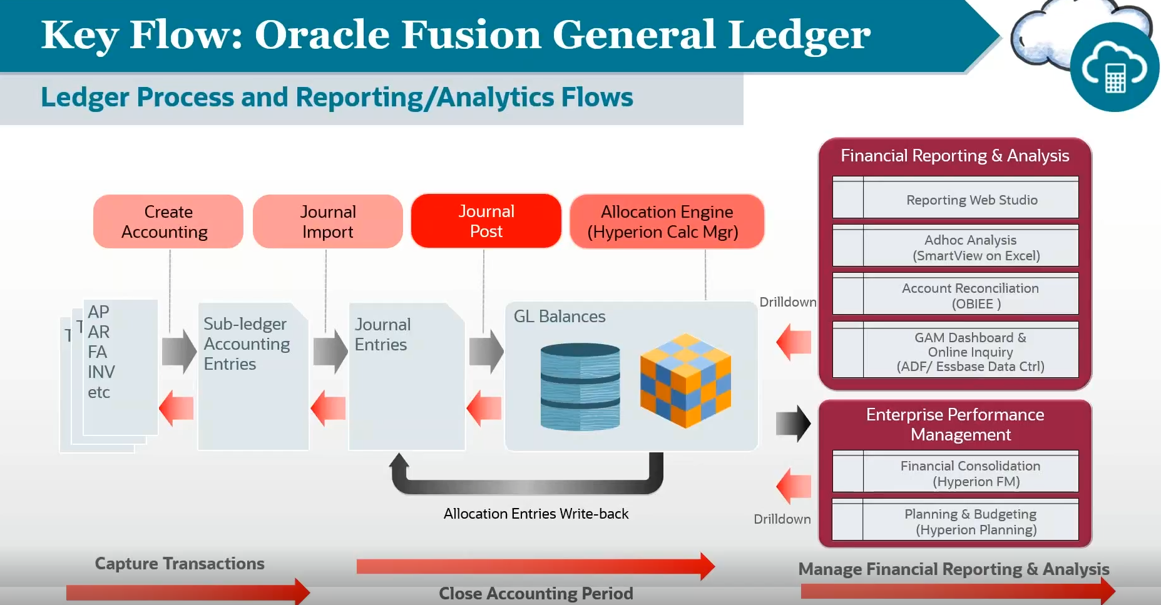

Slide 9
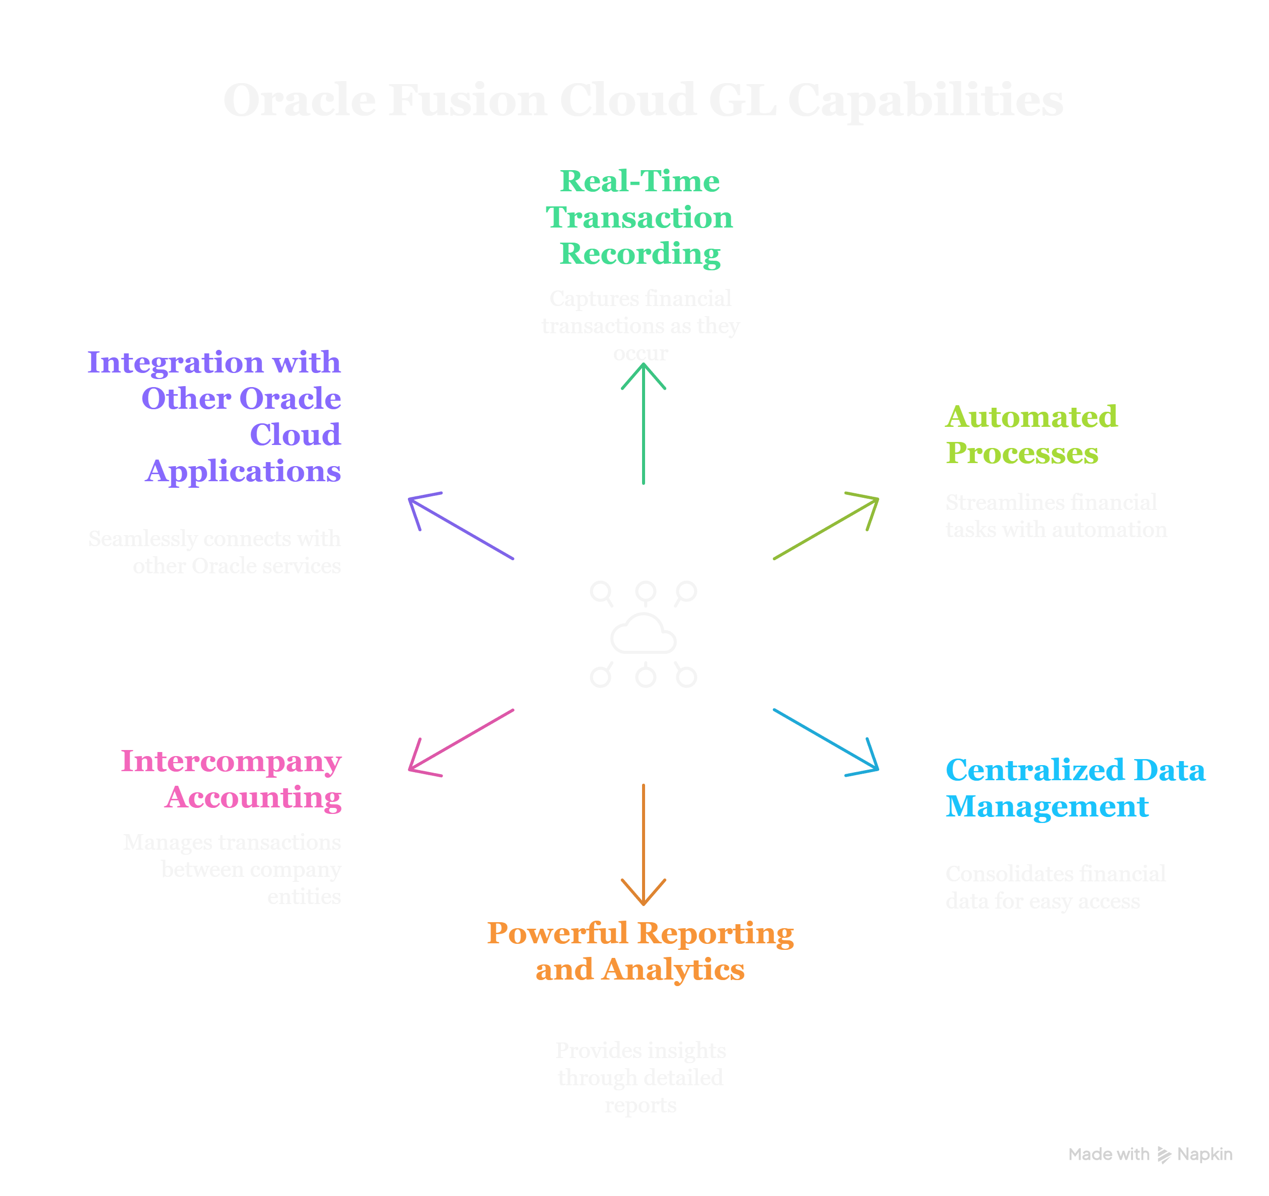

Slide 10
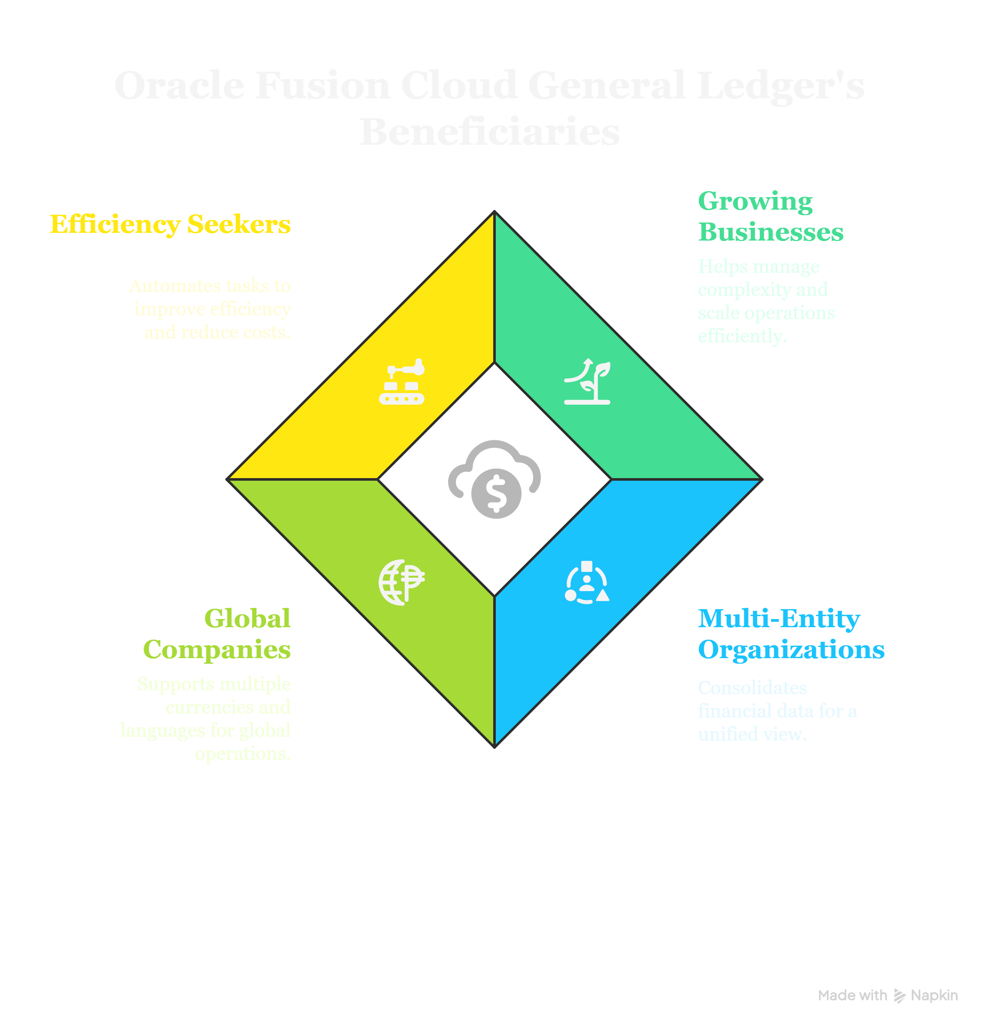

Slide 11
Conclusion
Oracle Fusion Cloud General Ledger is a powerful and comprehensive solution for managing financial accounting and reporting. Its key features, functionalities, and benefits make it an essential tool for organizations looking to streamline their accounting processes, improve financial visibility, and ensure compliance. By leveraging the capabilities of General Ledger, organizations can gain valuable insights into their financial performance and make better-informed business decisions.

Slide 12
Thank you

