Slide 1
CashFlow

Slide 2
Personal Finance Management
Simplified. Secure. Smart.

Slide 3
The Problem
Financial Disorganization: Tracking multiple accounts is chaotic.
Lack of Insight: Hard to know where money is going.
Privacy Concerns: Cloud-based apps often compromise data privacy.

Slide 4
The Solution: CashFlow
CashFlow is a modern, privacy-focused mobile application designed to bring clarity to your finances.
Centralized Dashboard: All accounts in one place.
Visual Analytics: Understand spending at a glance.
Local-First Security: Your data stays on your device.

Slide 5
Key Features
Transaction Tracking: Easy income & expense entry.
Budgeting & Goals: Plan for the future.
Multi-Currency: Global support.
Secure: App Lock & Biometrics.

Slide 6
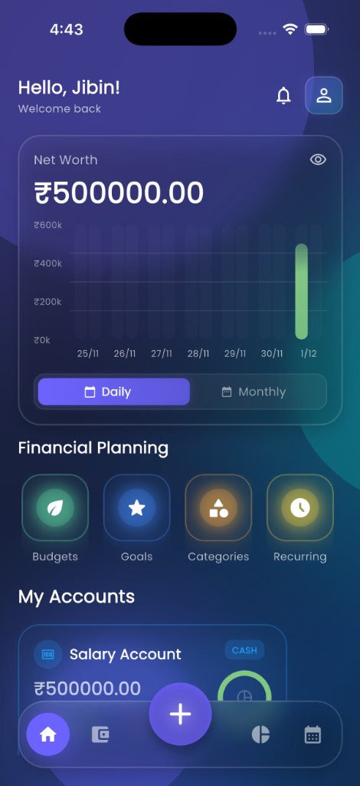
Visual Tour: Dashboard
Real-time overview of your net worth.
Dashboard

Slide 7
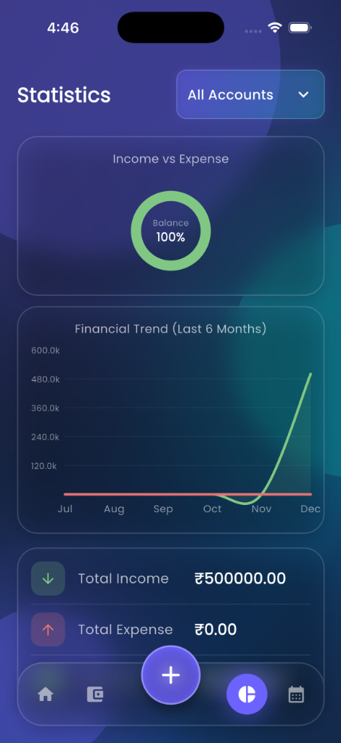
Visual Tour: Analytics
Interactive charts to track trends.
Statistics

Slide 8
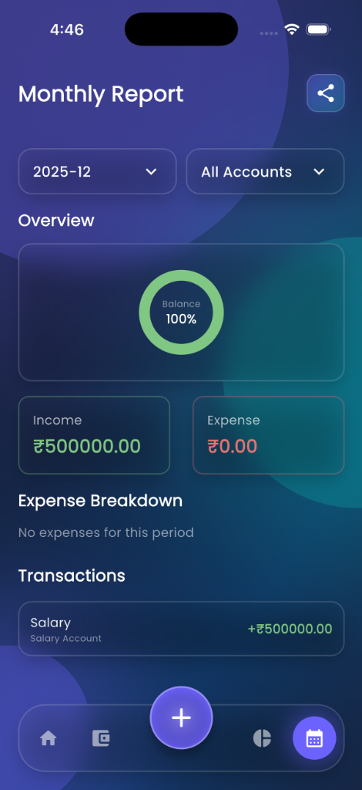
Visual Tour: Reports
Professional PDF reports for sharing and printing.
Monthly Report

Slide 9
Technical Highlights
Built with Flutter: High-performance, cross-platform.
Glassmorphism UI: Modern, premium aesthetic.
Secure Storage: Industry-standard encryption.
Offline Capable: No internet required for core features.

Slide 10
Roadmap
Q1 2026: Cloud Sync (Optional).
Q2 2026: AI-Powered Insights.
Q3 2026: Investment Portfolio Tracking.

Slide 11
Thank You!
Download CashFlow Today Take control of your financial future.

