Slide 1


Natural Language Processing with

Slide 2



About Me
Data Scientist at General Mills
Supporting Marketing
Founder of Social Data Science
Crowd Sourced Data Science for Nonprofits
https://www.linkedin.com/in/johnhogue
https://github.com/dreyco676
@dreyco676

Slide 3
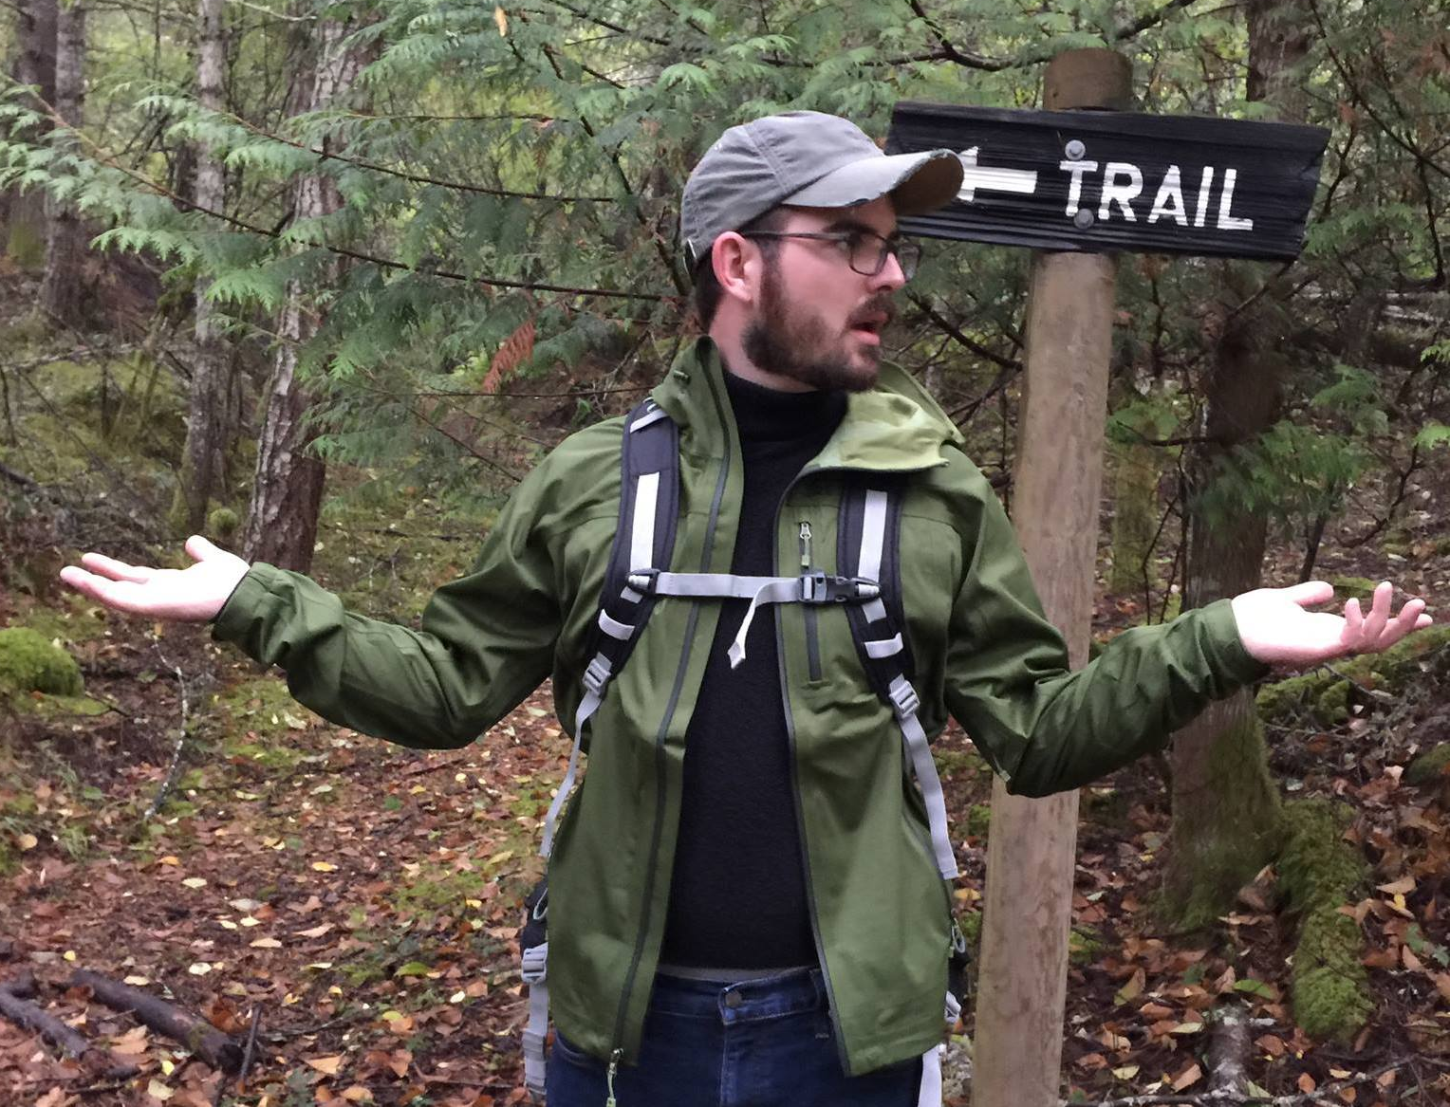
About Me (Caveats)
NLP is only a small part of my job
Code written for readability
Not optimization
I don’t know everything ☺
But that’s ok

Slide 4
Agenda
What is NLP?
Why Spark?
What is Spark ML?
Which algorithm to use?
How to prepare data for ML?
How to measure accuracy?
Where to go from here?
Text
Classification
Example

Slide 5
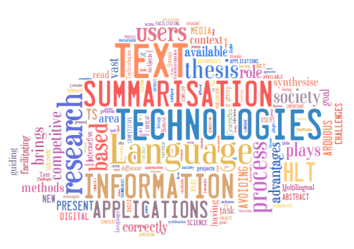
What is Natural Language Processing?
http://www.dlsi.ua.es/~elloret/

Slide 6
Natural Language Processing
Studies interactions between Computers & Human Language
How would a computer summarize a book?
How does a person ask a computer a question?
How does a computer understand speech?
http://www.dlsi.ua.es/~elloret/

Slide 7

Tonight’s Text Classification Example
Blah, blah, blah
Python
Hadoop
Data Science
Something else…
Notes:
Compare to Spam filtering

Slide 8

Tonight’s Data Set
Public Tweets
Everyone I follow on Twitter
149,254 tweets
Used Twython for API
Use Hive for JSON Parsing

Slide 9
Why Spark
NLP Preprocessing ideal for parallel processing
100x faster than MapReduce
Ideal for rapid data exploration
Great for high iteration machine learning
Code in what you know
Functional programming more suited for datasci
Industry Interest
Quickly becoming a core datasci tool
Standardized ways of working with data

Slide 10
Why PySpark
Access to great libraries
NLTK
“First Class” language on Spark
Scala implementation first, Python follows
When data munging less verbose is better
Notes:
Talk about downsides
-horrible debugging
-some features lag
-speed

Slide 11
Picking a ML Algorithm

Slide 12
Data Pipelining

Slide 13
Accessing Hive in Pyspark

Slide 14
Accessing Other Python Libraries In Pyspark

Slide 15
Text Data Transformation

Slide 16
Text Clean up

Slide 17
Featurization

Slide 18
Training

Slide 19
Evaluating

Slide 20
Saving Data & Model

Slide 21
Next Steps? LDA?

Slide 22
Visualizing Data

Slide 23
Where to go from here?
github

