Slide 1
Jibiri Software's architecture choice

Slide 2
Web service architecture
A Web service is a software system designed to support interoperable machine-to-machine interaction over a network. It has an interface described in a machine-processable format (specifically WSDL). Other systems interact with the Web service in a manner prescribed by its description using SOAP messages, typically conveyed using HTTP with an XML serialization in conjunction with other Web-related standards.

Slide 3
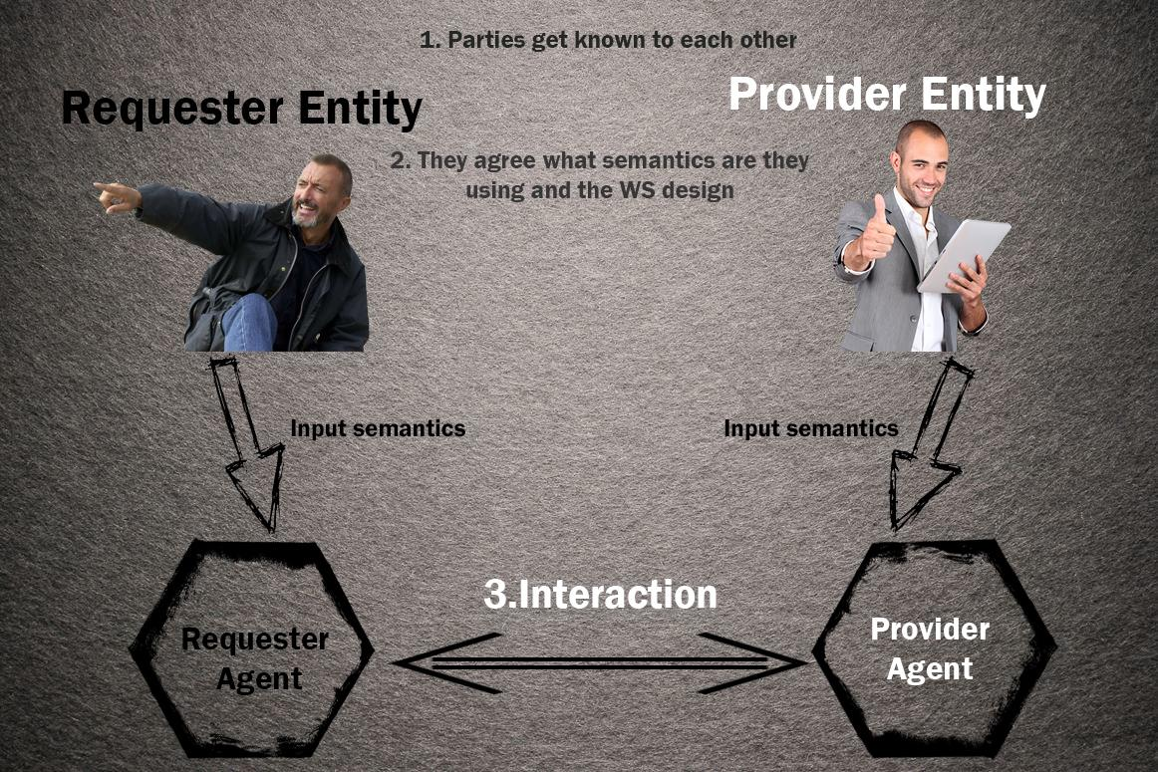
CAMBIA ESTA PUTA MIERDA DARÍO MY FRIEN
//soez

Slide 4
Components and connectors
The components our chosen architecture are:
Service provider: creates the web service and makes it available to the client application that want to use it.
Service requester: ask the provider for the registry and contacts the registry for some data.
Service Registry: validates the petition and sends a response with data on a XML format.
To connect this components, we will use the WSDL (Web Service Description Language) and the SOAP (Simple Object Access Protocol) protocols.

Slide 5
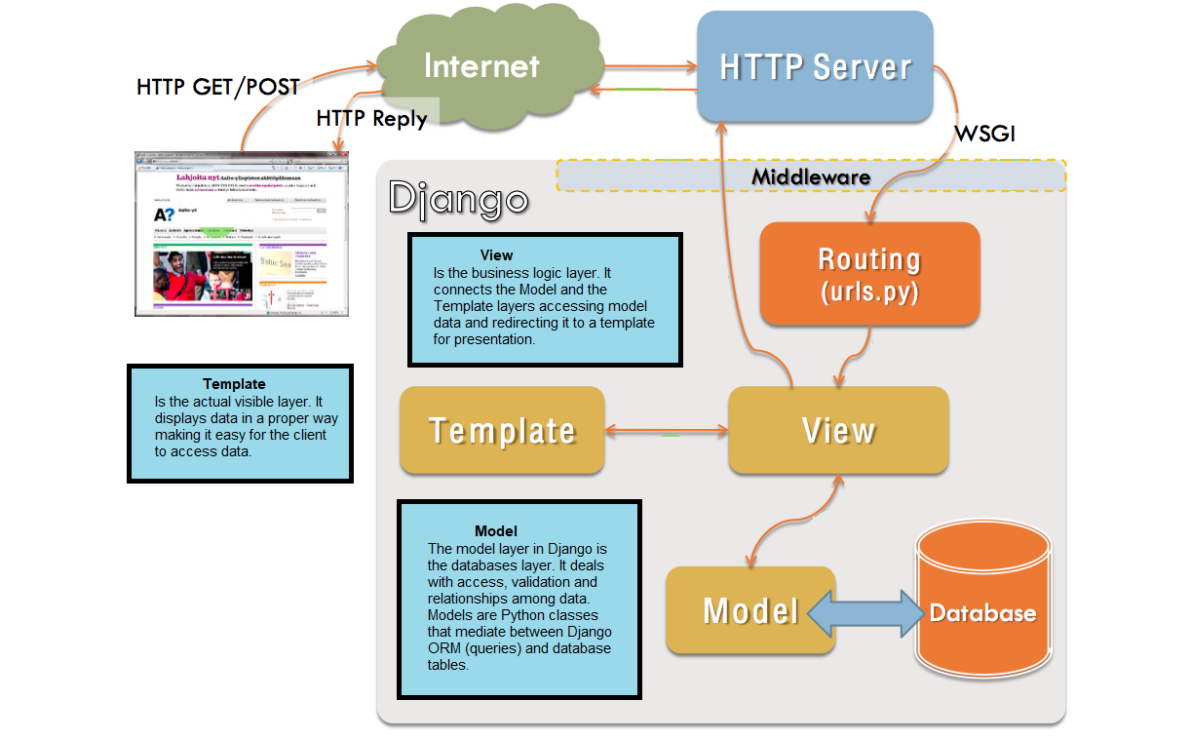
MTC EXAMPLE:
DJANGO

Slide 6
Advantages
They provide interoperability between different applications, independently of its properties and the platforms they are installed in.
Web services encourage the use of standards and protocols based on text, what makes it easier to access its content and get to know how it works.
They allow services and software from different companies, located in different points of the globe, to be easily combined in order to provide integrated services.

Slide 7
Disadvantages
In order to make transactions, its not possible to compare their grade of development with the standards of distributed computation (like CORBA, Common Object Request Broker Architecture).
Its performance is low if its compared with other distributed computational models, like Java Remote Method Invocation (RMI), CORBA or Distributed Component Object Model. It’s one of the inconvenients
that come from a text based format (In XML objects there is no conciseness or processing efficiency).
Since its supported on HTTP, security means based on firewall, which try to block the communication between programs from both sides of it, may be evaded.

Slide 8
Why have we chosen this style?
The most important reason of why have we chosen the web service architecture is because the are very useful due to the independency between the application (which use web-services) and the service itself. By this way, the changes in one of them shouldn’t affect the other; this flexibility will be more important in the future, because the popularity of building big applications from smaller distributed components is increasing.

Slide 9
Esquema general
Concept and philosophy (including a graphical representation) V 50%
Description of components and connector sX
Examples of application X
advantages V
disadvantages V
why have you chosen this style X

