Slide 1
Jibiri Software's architecture choice

Slide 2
What is model-view-controller (MVC)?
It is an architectural pattern used for developing user interfaces that divides an application into three parts, to separate the internal representation of the information from the representation that the user will see.
By decoupling these major components, MVC design pattern allows you for efficient code reuse and parallel development.
Here is a visual representation.

Slide 3
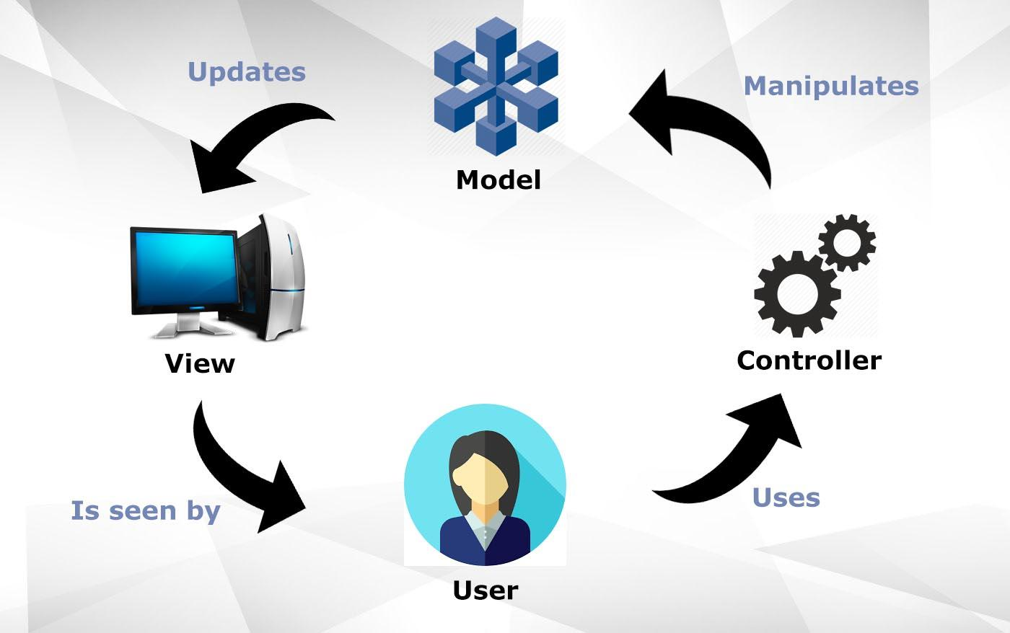
Visual Representation

Slide 4
Components and connectors
The components of the MVC architecture are:
The model: is the central part of the project, which manages all data and logic of our project.
The view: presents a subset of the data to the user, different views can be set for different kind of users.
To connect this components, we will use the controller which accepts inputs and converts it to changes in the model or the view.

Slide 5
Examples of use of MVC
Django
Controller. For a web framework, this means handling requests and responses, setting up database connections and loading add-ons.
Model. The model layer in Django is the database plus the Python code that directly uses it. You capture whatever your website needs in database tables.
View. The view layer is the user interface. Django splits this up in the actual HTML pages and the Python code (called views) that renders them.

Slide 6
Advantages
Simultaneous development
High cohesion (logical grouping of actions and views)
Low coupling among models, views or controllers
Ease of modification (due to the separation of responsibilities)
Multiple views for a model

Slide 7
Disadvantages
Code navigability: complex framework navigation due to the new layers that it introduces
Multi-artifact consistency: decomposing the code can cause consistency issues
Pronounced learning curve: necessity of knowledge on multiple technologies

Slide 8
Why have we chosen this style?
We have chosen this model because the “abstraction” this architecture proposes fits our idea of the project structure; making it easier for us to adapt the project to the model, as it is something hard to change as the development advances.

