Slide 1
POPULATION STRUCTURE VIA PCA
Principal Component Analysis of 1000 Genomes
Chromosome 1 Data
Self-Training Assignment | bcftools + PLINK 1.9 + Python, run in WSL (Ubuntu 24.04)

Slide 2
Aim & Tools Used
AIM
TOOLS USED
Download real population genetics data (1000 Genomes Project, chr1)
Clean and filter the data to a reliable, informative subset
Run PCA to compress genetic variation into 2 dimensions
Plot individuals and check whether ancestry groups separate
1
WSL 2 — Ubuntu 24.04
Linux environment running inside Windows
2
bcftools 1.19
Normalizes and cleans VCF variant files
3
PLINK 1.9
Format conversion, QC, pruning, and PCA
4
Python (pandas, matplotlib)
Merges results with ancestry labels and plots

Slide 3
Why WSL Instead of Windows PowerShell
Bioinformatics tools (bcftools, PLINK, gzip) assume a Linux environment — Windows doesn't have them natively.
1
PowerShell's "wget" isn't real wget
It's an alias for Invoke-WebRequest — a different tool with different, unreliable behavior for large file downloads.
2
No gunzip / Unix tools on Windows
Reference genome and mask files come gzip-compressed; Windows has no built-in decompression command.
3
bcftools & PLINK are Linux-native
Installing and running them directly is far simpler on Linux than on native Windows.
4
WSL = a real Ubuntu Linux system inside Windows
Gives access to apt, standard shell tools, and Linux file permissions — while still working from the same laptop.

Slide 4
Pipeline: Filtering Down to a Clean, Informative Set
Each step removes noise or redundancy — from 6.47 million raw variants to 17,840 high-quality markers for PCA.
After Normalization (bcftools)
6,471,910 variants
After Strict Mask (callable regions only)
4,851,384 variants
After QC — SNPs only, MAF > 10%
308,967 variants
After LD Pruning (final PCA input)
17,840 variants

Slide 5
Problems Faced Along the Way
Step | Problem | Fix
1. Download files | Windows PowerShell has no real wget/gunzip; large downloads kept timing out mid-transfer | Switched to WSL; used wget -c to resume interrupted downloads; verified with gzip -t
2. Normalize (bcftools) | None — ran cleanly on first attempt | —
3. Convert to PLINK | apt suggested the wrong package ("putty-tools") for the plink command | Installed the correct package: plink1.9
4. Strict mask download | 123 MB file kept losing connection partway through | wget auto-retried and resumed until the file completed intact
5. Python plotting | Ubuntu 24.04 blocks system-wide pip installs ("externally-managed-environment") | Created an isolated Python virtual environment (venv) and installed packages there

Slide 6
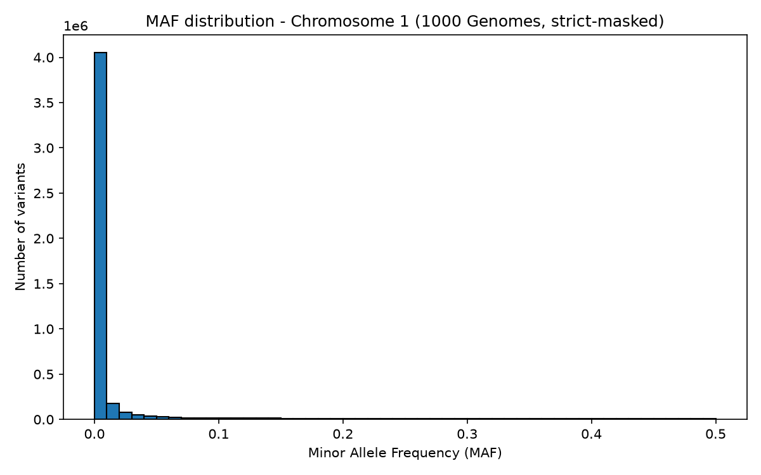
Minor Allele Frequency Distribution — Chr1
83.5%
Rare (MAF < 1%)
7.0%
Low-frequency (1–5%)
9.5%
Common (MAF > 5%)
Most variation is rare and recent; only older variants have spread widely enough to become common — why PCA used MAF > 10% only.

Slide 7
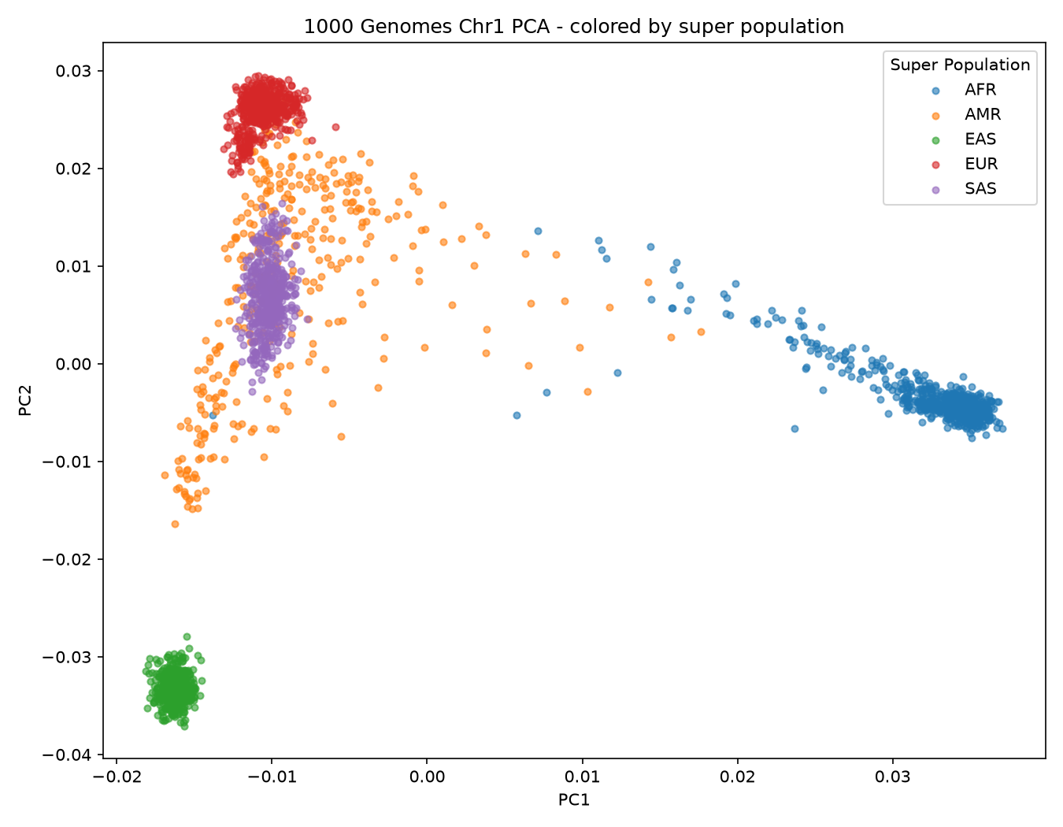
PCA Results — Ancestry Emerges from DNA Alone
PC1 = 51.9%, PC2 = 24.1%
of all variation — ~76% captured in just 2 numbers per person
EAS & EUR
tight, well-separated clusters — few ancestral founders each
AFR
spread out — deepest genetic diversity, humanity's origin
AMR
scattered between clusters — reflects admixed ancestry

Slide 8
Key Takeaways
1
Population structure is visible from DNA alone, no labels needed — PCA recovered continental ancestry from unlabeled genotypes
2
Data cleaning matters as much as the analysis: normalization, masking, QC, and pruning shaped the result at every step
3
Caveat: only chromosome 1 was used, so PC1/PC2 explain more variance (76%) than a whole-genome PCA typically would (~10–15%)

