Slide 1
Final Project-Group 8
Jichong Wu
Ethan Litman
Jia-Ern Pai

Slide 2
Introduction
Occupants in a rollover crash have greater likelihood of experiencing fatal injuries than occupants in non-rollover crash.
The National Highway Traffic Safety Administration indicated that 18.9 percent fatal crashes in 2014 involved rollovers.
Rollover became one of the significant safety problems.

Slide 3
Previous studies
The vehicle geometric properties, such as the height of the mass center and the track width are significantly related to the likelihood of rollover events.
Electronic Stability Control significantly reduced rollovers.
Model Year | Required ESC Installation Rate
2009 | 55% of vehicles
2010 | 75% of vehicles
2011 | 95% of vehicles
2012 | 100% of vehicles

Slide 4
Data source
Fatality Analysis Reporting System (FARS) provided by NHTSA.
FARS is a census of fatal traffic crashes that includes the 50 States, the District of Columbia and Puerto Rico since 1975.
The crashes in FARS must result in the death of at least one person within 30 days of the crash.
Accident dataset
Person dataset
Vehicle dataset

Slide 5
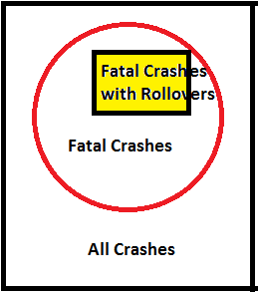
Limitations of data source
Use limited number of variables to describe complicated traffic crashes
Limited applications of analysis results

Slide 6
Target Population
FARS ranged from 2014 to 2018 with the restriction of MY ranged from 1989 to 2019
Number of vehicles in a fatal crash: the single-vehicle fatal crashes
Vehicle type: passenger vehicles (sedans, SUVs/CUVs, pickup trucks, and vans) with the weight less than or equal to 10,000 lbs.

Slide 7
Purpose of Studies
Predict the rollover status in fatal single-passenger vehicle crashes
Decision Tree
Random Forest
Logistic Regression
KNN

Slide 8
Exploratory Data Analysis
Target: Status of Rollover
Binary: Rollover and Non-Rollover

Slide 9
Exploratory Data Analysis
Features
Accident Dataset: Weather Condition
Clear/Normal, Fog/Cloudy, Rain/Sleet,
Snow, and Windy
Accident Dataset: Light Condition
Dark, Dawn/Dusk, and Light
Chi-square statistic | P-value
189.7558 | 5.980968829657794e-40
Chi-square statistic | P-value
500.5370 | 2.0406178824711528e-109

Slide 10
Exploratory Data Analysis
Features
Vehicle Dataset: Roadway Surface
Dry, Oil, and Wet
Vehicle Dataset: Roadway Grade
Grade and Level
Chi-square statistic | P-value
109.0826 | 2.0559171290468747e-24
Chi-square statistic | P-value
878.5009 | 4.629546644838622e-193

Slide 11
Exploratory Data Analysis
Features
Vehicle Dataset: Roadway Alignment
Curve and Straight
Vehicle Dataset: Vehicle Type
Car, SUV/CUV, Pickup Truck, and Van
Chi-square statistic | P-value
2664.3365 | 0.0
Chi-square statistic | P-value
1382.5924 | 1.763942124164862e-299

Slide 12
Exploratory Data Analysis
Features
Vehicle Dataset: Model Year
1989-2007, 2008-2010, and 2011-2019
Vehicle Dataset: Driver’s Gender
Male and Female
Chi-square statistic | P-value
1971.8730 | 0.0
Chi-square statistic | P-value
31.8556 | 1.6607267637296446e-08

Slide 13
Exploratory Data Analysis
Features
Vehicle Dataset: Driver’s Age
 | Sum of Square | Degree of Freedom | F-Statistic | P-value
ROLL | 1.466400e+05 | 1 | 439.6108 | 2.873407e-97
Residual | 2.062749e+07 | 61839

Slide 14
Exploratory Data Analysis
Nine Features:
Eight categorical features:
Weather, Light, Roadway Surface,
Roadway Grade, Roadway Alignment,
Vehicle Type, Model Year, and Driver’s
Gender
One numerical feature:
Driver’s age

Slide 15
Missing values
Missing completely at random
The missing rates are around 5 percent
The target population is large: 61,841 data observations

Slide 16
Algorithms
70 percent of the analytical dataset was used as the training dataset, and 30 percent of the analytical dataset was used as the testing dataset
10-fold cross validation to generate a sequence of accuracy scores in each algorithm

Slide 17
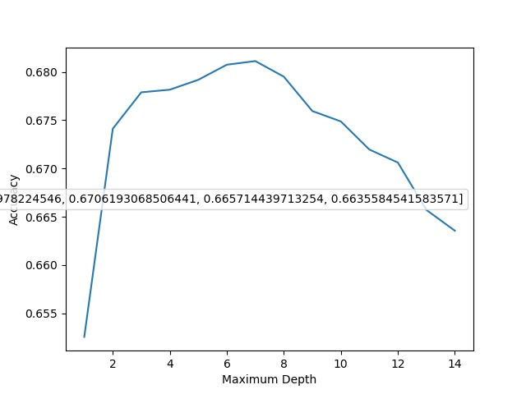
Algorithms
Decision Tree

Slide 18
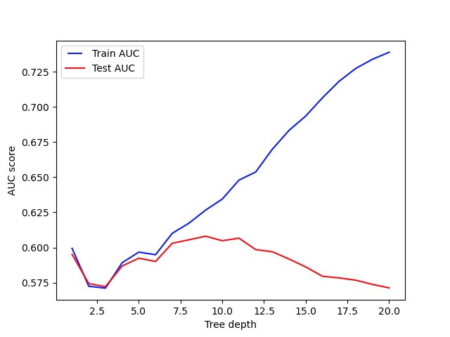
Algorithms
Decision Tree

Slide 19
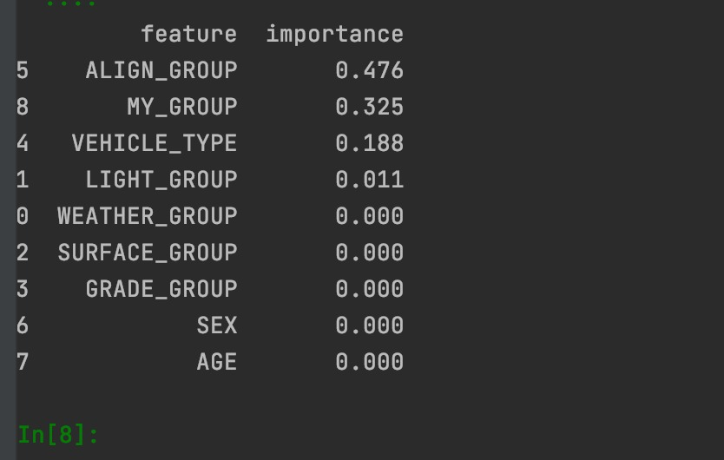
Algorithms
Decision Tree

Slide 20
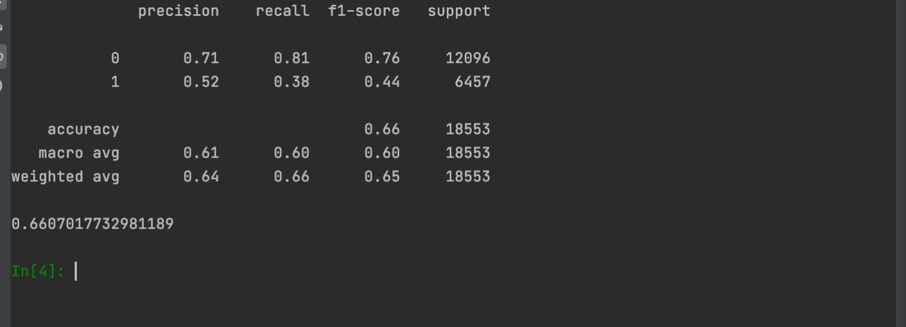
Algorithms
Random Forest

Slide 21

Algorithms
Logistic Regression
The categorical variables in the analytical dataset were presented by using dummy variables.
$$GENDER_FEMALE=\left\{\begin{aligned}1, if a female driver \\ 0, otherwise\end{aligned}\right.$$

Slide 22
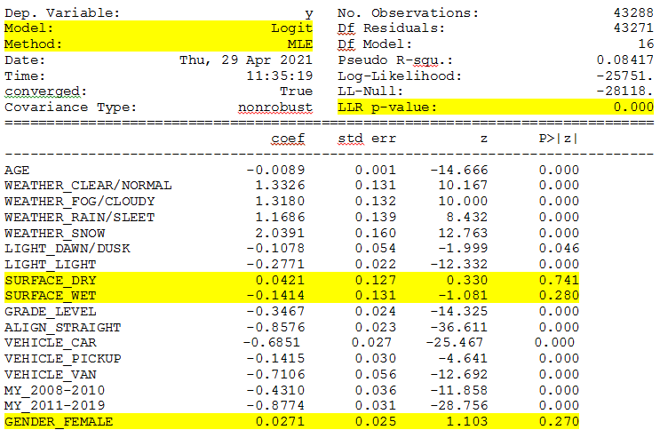

Slide 23
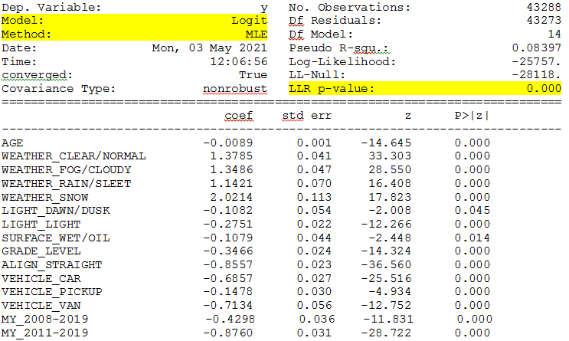

Slide 24
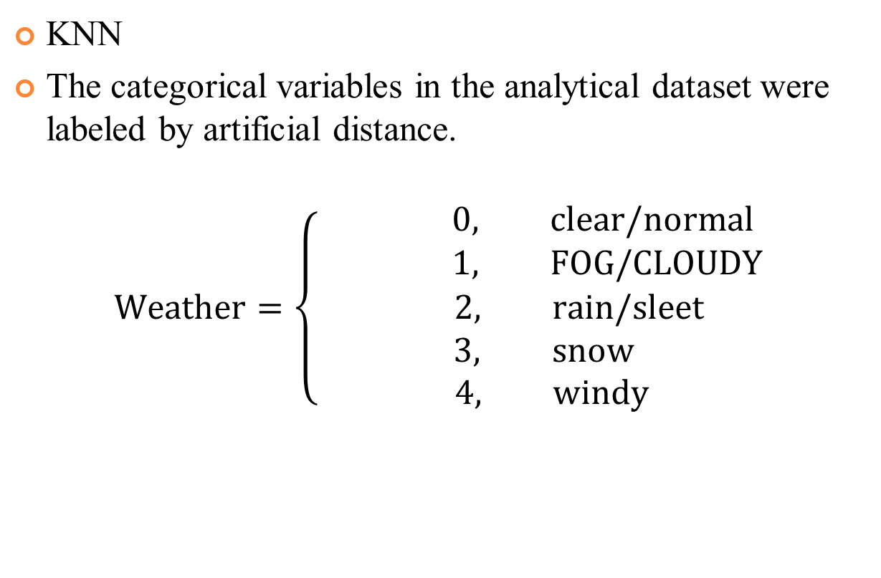
Algorithms
KNN
The categorical variables in the analytical dataset were labeled by artificial distance.
$$Weather=\left\{\begin{aligned} 0, clear/normal \\ 1, FOG/CLOUDY \\ 2, rain/sleet \\ 3, snow \\ 4, windy\end{aligned}\right.$$

Slide 25
Algorithm Comparison
Wilcoxon signed-rank test
Small sample size
Unknown probability distribution

Slide 26
Algorithm Comparison
Decision Tree vs. Random Forest
Decision Tree
1st fold | 2nd fold | 3rd fold | 4th fold | 5th fold | 6th fold | 7th fold | 8th fold | 9th fold | 10th fold
0.6417 | 0.6299 | 0.6392 | 0.6156 | 0.6560 | 0.6396 | 0.6415 | 0.6475 | 0.6428 | 0.6456
Mean: 0.6399
Random Forest
1st fold | 2nd fold | 3rd fold | 4th fold | 5th fold | 6th fold | 7th fold | 8th fold | 9th fold | 10th fold
0.6711 | 0.6655 | 0.6713 | 0.6713 | 0.6801 | 0.6764 | 0.6752 | 0.6738 | 0.6703 | 0.6874
Mean: 0.6742
Test Statistic | P-value
0.0 | 0.001953125

Slide 27
Algorithm Comparison
Random Forest vs. Logistic Regression
Random Forest
1st fold | 2nd fold | 3rd fold | 4th fold | 5th fold | 6th fold | 7th fold | 8th fold | 9th fold | 10th fold
0.6711 | 0.6655 | 0.6713 | 0.6713 | 0.6801 | 0.6764 | 0.6752 | 0.6738 | 0.6703 | 0.6874
Mean: 0.6742
Logistic Regression
1st fold | 2nd fold | 3rd fold | 4th fold | 5th fold | 6th fold | 7th fold | 8th fold | 9th fold | 10th fold
0.6750 | 0.6768 | 0.6791 | 0.6787 | 0.6863 | 0.6791 | 0.6824 | 0.6808 | 0.6733 | 0.6973
Mean: 0.6809
Test Statistic | P-value
0.0 | 0.001953125

Slide 28
Algorithm Comparison
Logistic Regression vs. KNN
Logistic Regression
1st fold | 2nd fold | 3rd fold | 4th fold | 5th fold | 6th fold | 7th fold | 8th fold | 9th fold | 10th fold
0.6750 | 0.6768 | 0.6791 | 0.6787 | 0.6863 | 0.6791 | 0.6824 | 0.6808 | 0.6733 | 0.6973
Mean: 0.6809
KNN
1st fold | 2nd fold | 3rd fold | 4th fold | 5th fold | 6th fold | 7th fold | 8th fold | 9th fold | 10th fold
0.6738 | 0.6713 | 0.6787 | 0.6734 | 0.6863 | 0.6699 | 0.6741 | 0.6715 | 0.6668 | 0.6874
Mean: 0.6753
Test Statistic | P-value
20.0 | 0.4921875

