Slide 1

Tidyverse
Introduction to tidy data and managing multiple models
Köln R User Group meetup 14 Oct 2016

Slide 2
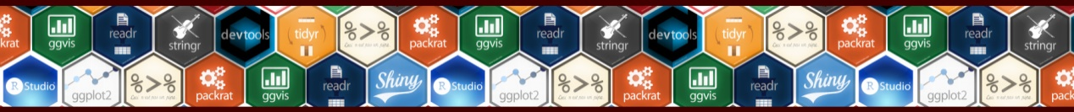
Who is this guy?

Slide 3
Overview
Tidy Data
Packages in the Tidyverse
Managing Multiple Models
Learning Curves
Other bits

Slide 4
Tidy Data
See the paper Tidy Data by Hadley Wickham in Journal of Statistical Software (2014)
Each variable forms a column
Each observation forms a row
Each type of observational unit forms a table

Slide 5
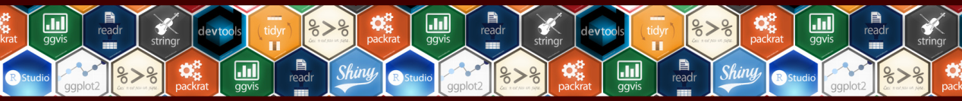
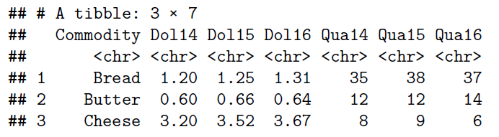
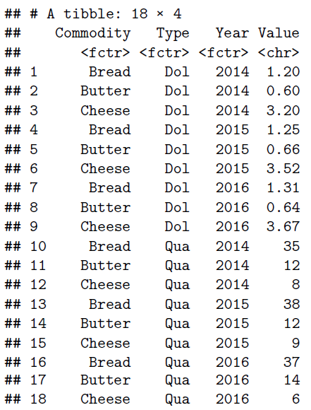
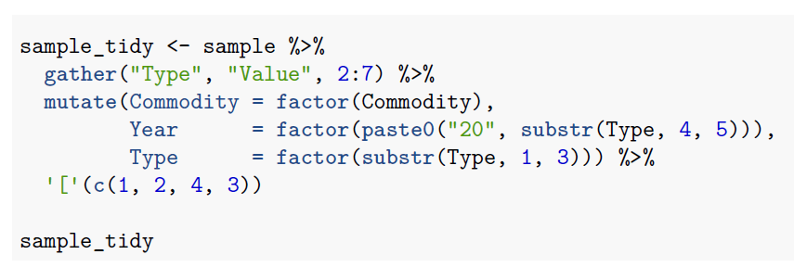
Tidy Data
Example of common untidy data
Tidy it
I prefer to have only one column with a value. Instead of a dollar value and a quantity value column
Resulting tidy data set

Slide 6
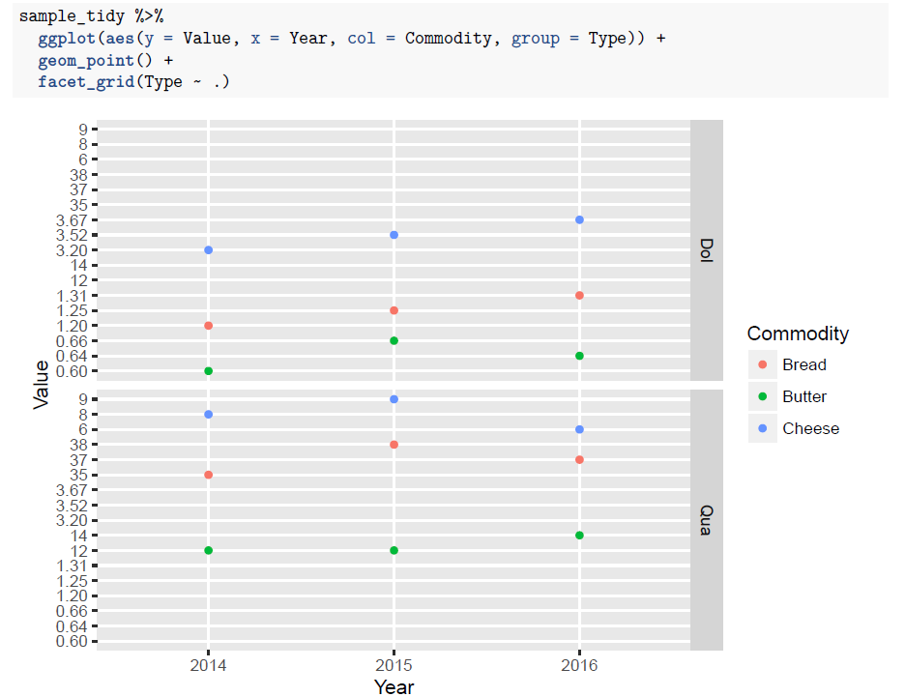
Tidy Data
ggplot2 loves tidy data!

Slide 7
Tidyverse Packages
Core packages
tidyverse
tibble
purrr
tidyr
dplyr
readr
ggplot2
Modelling
modelr (modelling with pipeline)
broom (tidying models)
Also recommended
feather
Vector operations
hms (times)
stringr (strings)
lubridate (dates)
forcats (factors)
Data import
DBI (databases)
haven (SAS, SPSS, Stata)
httr (APIs)
jsonlite (JSON)
readxl (Excel)
rvest (Web scraping)
xml2 (XML)

Slide 8
Packages – Tidyverse and Tibble
Tidyverse
Easily install and load packages from the tidyverse
Tibble
Data frames have some quirks. Use tibbles instead. Tibbles are data frames too.
Subset a tibble gives a tibble (not suddenly a vector)
stringasfactors = FALSE
prints nicely, first ten lines of data frame
strict rules on subsetting
never changes the names of variables
never creates row names

Slide 9
Packages - Tidyr and Dplyr
Tidyr and Dplyr are great for making data tidy, and also for manipulating tidy data.
Functions that I use most:
Tidyr
gather
spread
separate
unite
nest / unnest
Dplyr
select
filter
arrange
group_by / ungroup
mutate
summarise
tbl_df
glimpse
%>%
*_join
bind_rows / bind_cols

Slide 10
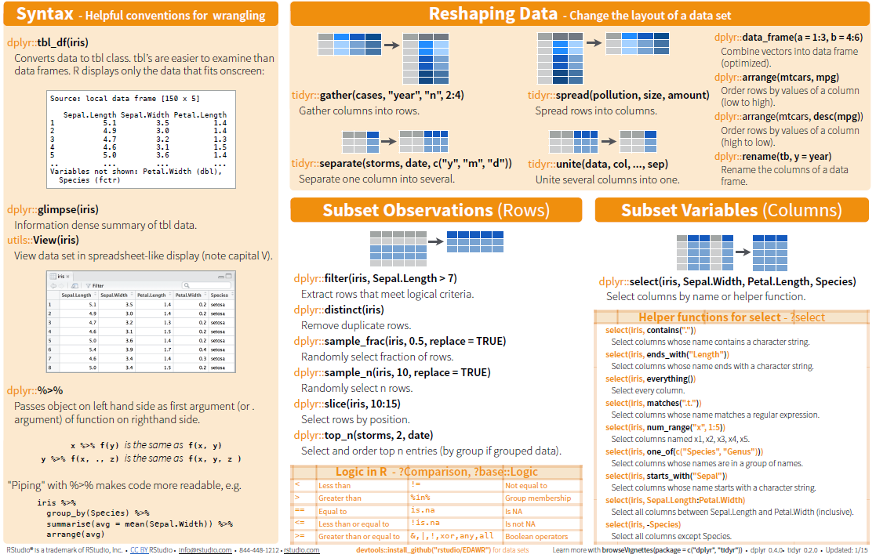
Packages - Tidyr and Dplyr
Rstudio Data Wrangling Cheatsheet (page 1 of 2)
Also available for:
Base R
Advanced R
Data Table
Devtools
ggplot2
R Markdown
Regular Expressions
Rstudio IDE
Shiny

Slide 11
Packages - Purrr
Make your pure functions purr with the 'purrr' package. This package completes R's functional programming tools with missing features present in other programming languages.
map is like lapply, but more consistent, with handy helpers, and more tools.
map() returns a list or a data frame; map_lgl(), map_int(), map_dbl() and map_chr() return vectors of the corresponding type (or die trying); map_df() returns a data frame by row-binding the individual elements.
map2(), and pmap() for looping across multiple items.

Slide 12
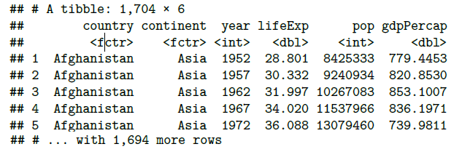
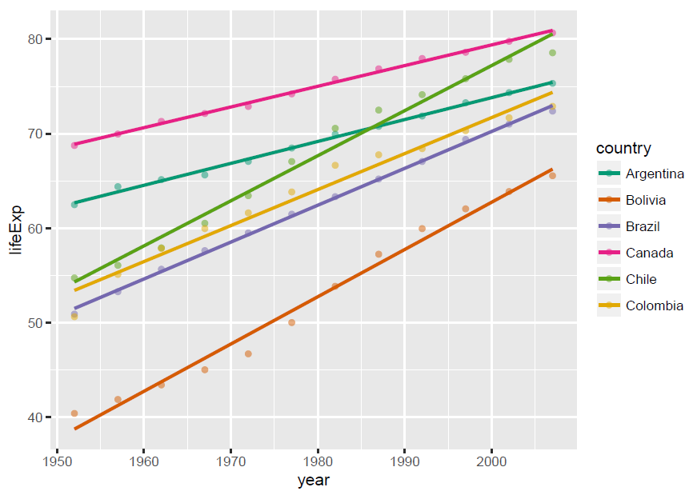
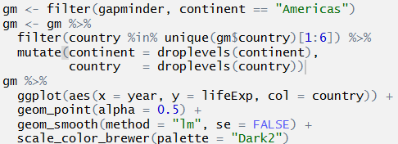
Managing Multiple Models
Gapminder data (from gapminder package)
Plotting multiple models. Sure. But that is not managing multiple models!

Slide 13
Managing Multiple Models
Managing is not doing something new, it is doing something you already did in a new way which improves your work. To actually manage multiple models we will turn to the following functions:
See www.youtube.com/watch?v=rz3_FDVt9eg
group_by (dplyr)
nest (tidyr)
mutate (dplyr)
map (purrr)
tidy, glance and augment (broom)

Slide 14
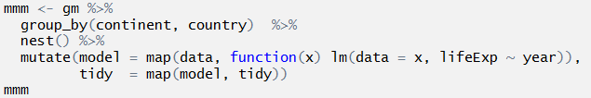
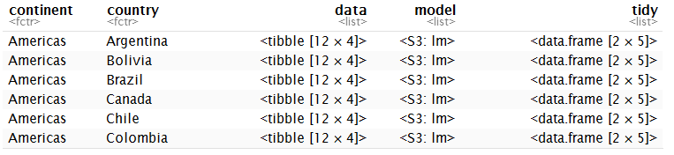
Managing Multiple Models
So what happened here? And what is so 'managing' about this?

Slide 15
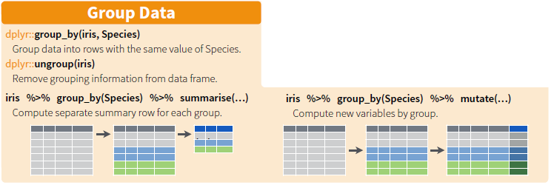
Managing Multiple Models group_by and nest
group_by is well known in combination with summarise and mutate. It groups a data frame according to the levels of a factor variable.
The nest function takes all the data of each group into data frames. And stores all grouped data frames together in a list that makes a new variable called Data.

Slide 16

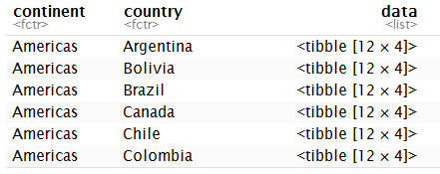
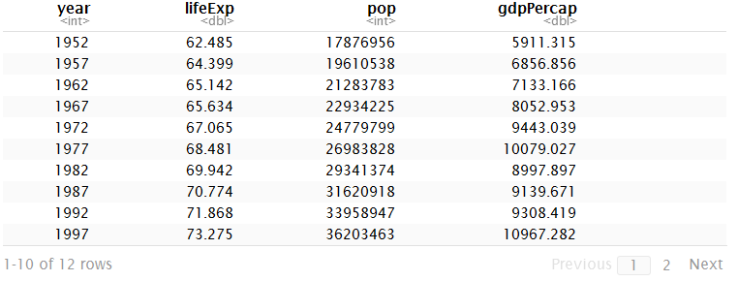
Managing Multiple Models group_by and nest

Slide 17
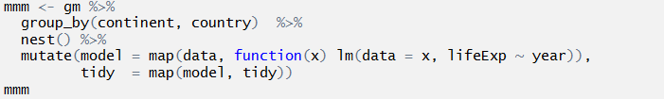
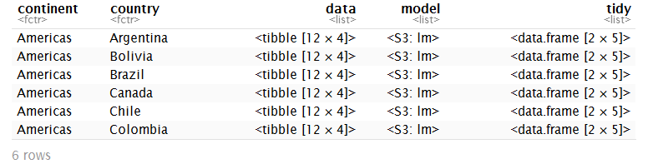
Managing Multiple Models mutate and map
Mutate adds new variables and preserves existing.
Map loops over elements and applies a function on each element.

Slide 18
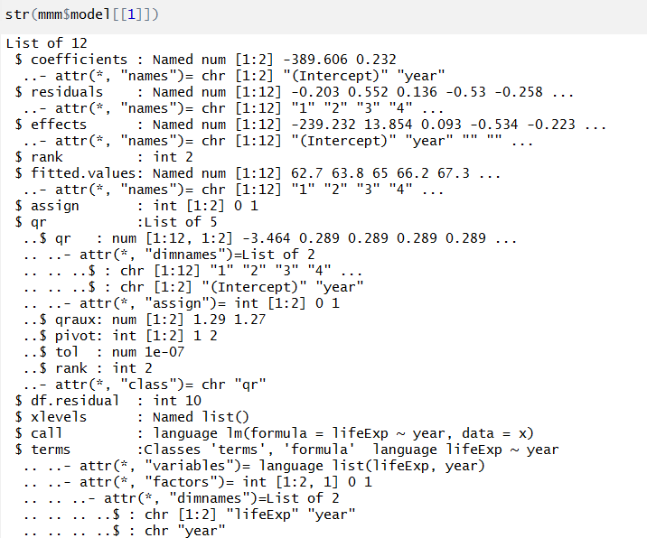
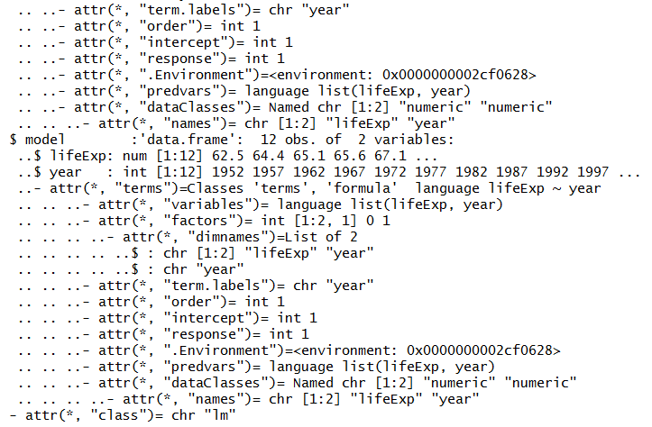
Managing Multiple Models tidy, augment and glance (broom)

Slide 19


Managing Multiple Models tidy, augment and glance (broom)
The broom package has three functions that create tidy data from model results.
tidy: component level statistics (one row per estimated parameter, cluster, etc.)
augment: observation level statistics (one row per original data, residuals, fits, assigned cluster, etc.)
glance: model level statistics (one row per model)

Slide 20
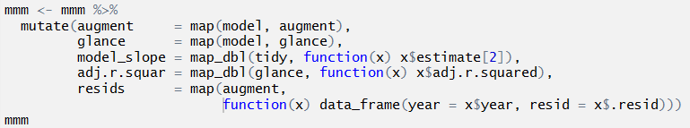
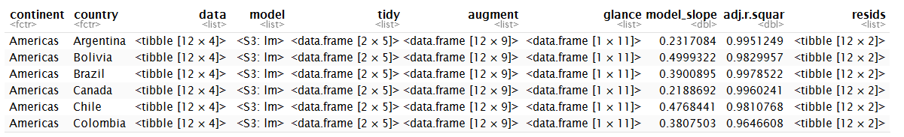
Managing Multiple Models tidy, augment and glance (broom)

Slide 21

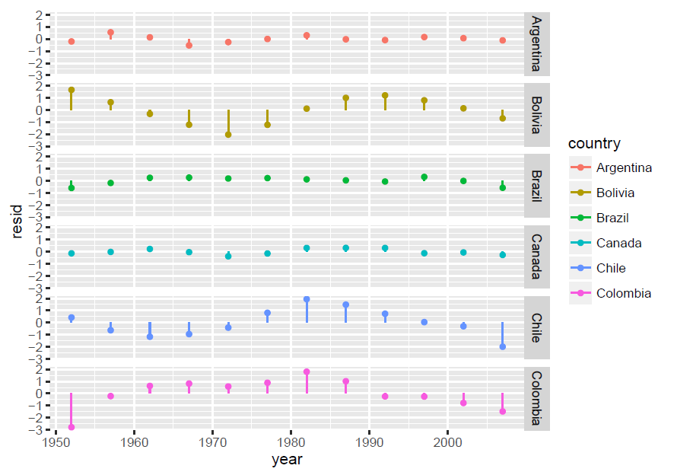
Managing Multiple Models tidy, augment and glance (broom)

Slide 22
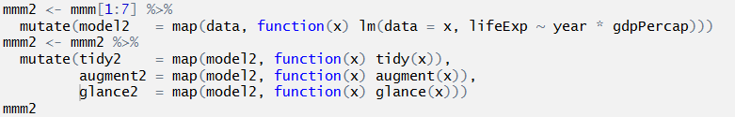
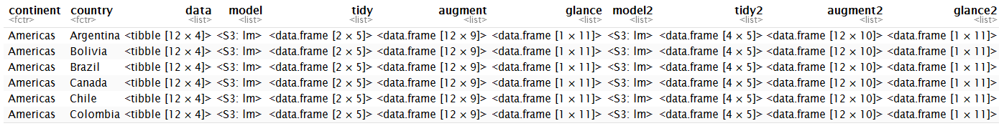
Managing Multiple Models
So far there was just one model. What’s multiple about it?
Next column, next model. This is great because it means you can keep different models structured. You can’t mix up your models.

Slide 23
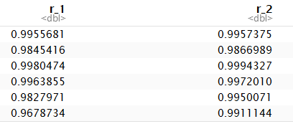
Managing Multiple Models

Slide 24
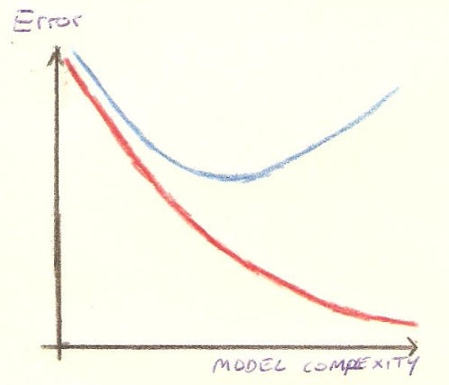
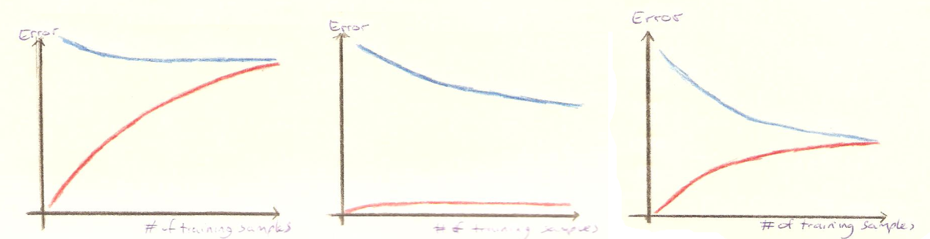
Managing Multiple Models Learning Curves
Learning curves are plots of training and
cross validation error over training sample
size.
If training error is good and cross validation error is approaching, keep going. More data will lower your cross validation error.
If training error is high, and cross validation is the same. Make your model more complex.
If training error is very low and cross validation doesn’t get anywhere near. Make your model simpler.
Training error
Cross validation error
Learning Curves

Slide 25
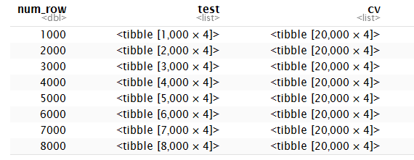
Managing Multiple Models Learning Curves - Example
Generate data:
Random letters (A to J) for X1, X2, and X3.
y <- 100 + ifelse(X1 == X2, 10, 0) + rnorm(N, sd=2)
Example data is 100,000 rows
Nest random samples of the data. Unfortunately the data duplicates. You can also use row indications, but I’m afraid I will lose the data.

Slide 26
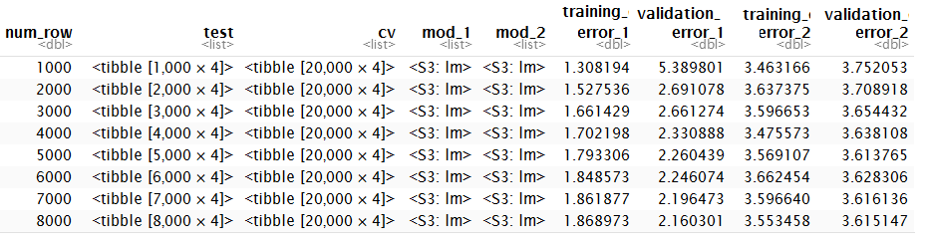
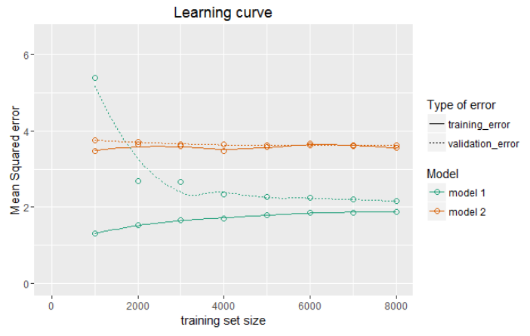
Managing Multiple Models Learning Curves - Example
Train models:
lm(data = x, y ~ X1*X2*X3)
lm(data = x, y ~ X1*X3)

Slide 27
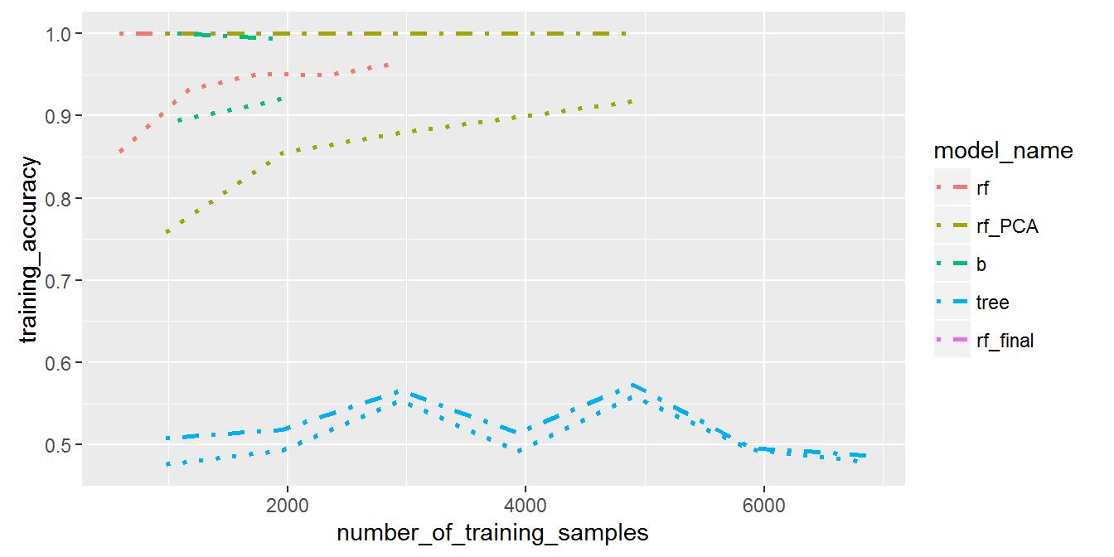
Managing Multiple Models Learning Curves - Applied
Training several models on the Kaggle Digit Recogniser challenge:
Learning curves

Slide 28
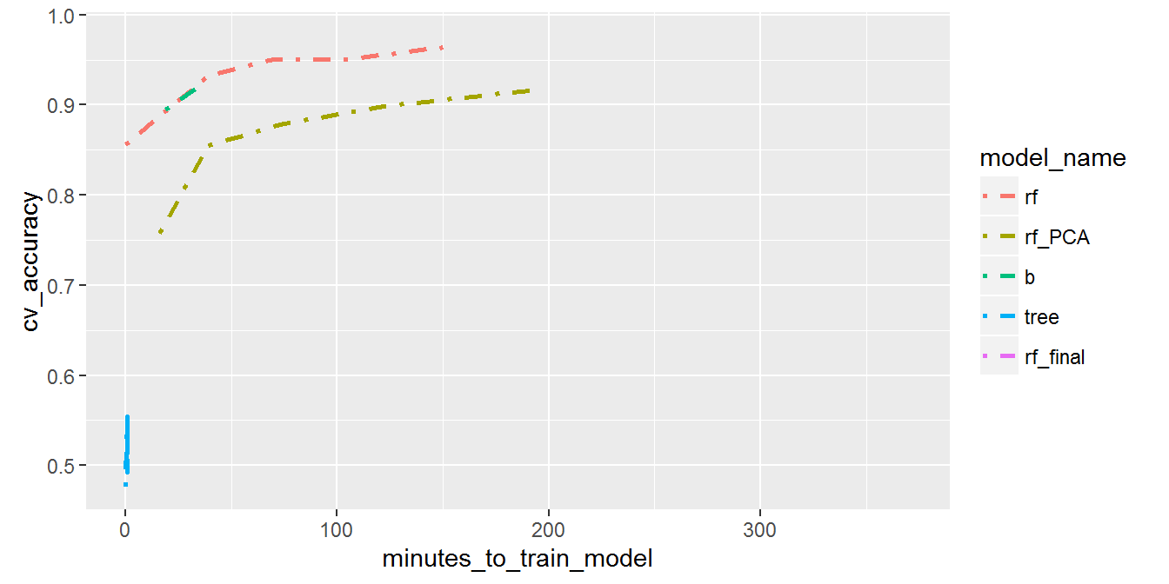
Managing Multiple Models Learning Curves - Applied
This graph shows the cross validation accuracy of a model compared to how long it took to learn. Lines that lie higher on the graph are more time efficient when learning, this might make a difference for you if several models have equal overall accuracy.

Slide 29
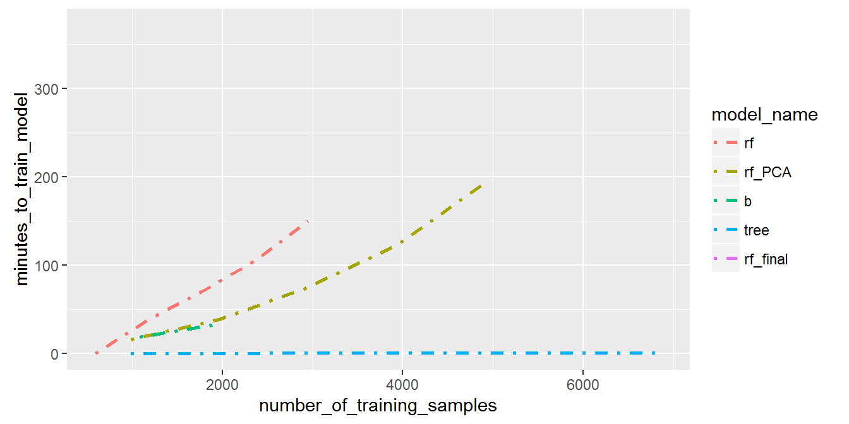
Managing Multiple Models Learning Curves - Applied
Time it takes to train a model for the number of training samples used. From this data I estimated that in 6 hours I could train a RandomForest on about 5000 samples. It turned out training 4907 samples took 6 hours and 11 minutes.

Slide 30

Managing Multiple Other Things
Please note that this nested structured is useful for way more than just models. You can store anything in those columns. The beauty is in keeping the right subsets of data organised with the correct information.
Examples
summary statistics
plots
presentation slides
information text

Slide 31
Extra’s
Some of my favourites:
Rstudio cheatsheets
Feather
R Notebooks
Combine feather and R notebooks to use R and Python both
R for Data Science, Hadley Wickham's upcomming book
varianceexplained.org - David Robinson's Blogs

Slide 32
Thank you for your time.
www.jiddualexander.com
info@jiddualexander.com

