Slide 1

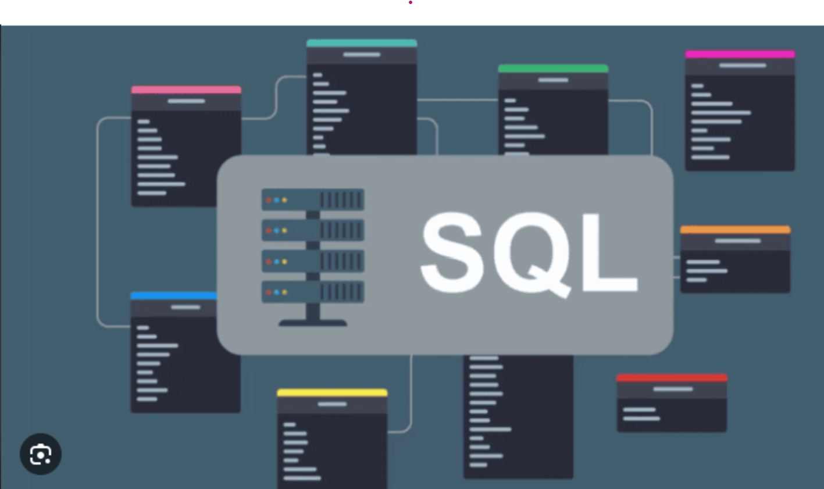
Team 2 Select Star From Warriors
SQL Hackathon June 2026
Team Members
Sandhya Lomety
Vishakha Pawar
Kavita Pakhale
Lakshmi D Kalavakolanu
Jidhiya Vijayan
Notes:
1

Slide 2
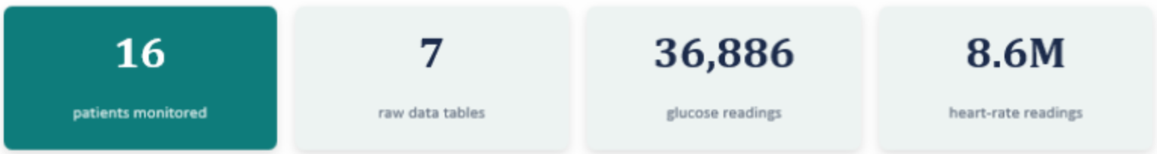
Glycemic Variability and Wearable Device Data Set
SDET Perspective
All 7 tables verified for completeness.
3 timestamp formats detected and fixed.
Duplicate readings removed across all tables
NULL vs zero decision documented.
Future timestamps flagged in food log.
DA Perspective
7 tables across 2 devices + food log .
36,886 glucose readings analyzed.
8.6M heart rate readings down sampled.
Clean schema with indexes and constraints.
Foreign keys enforcing data integrity.
Notes:
1

Slide 3
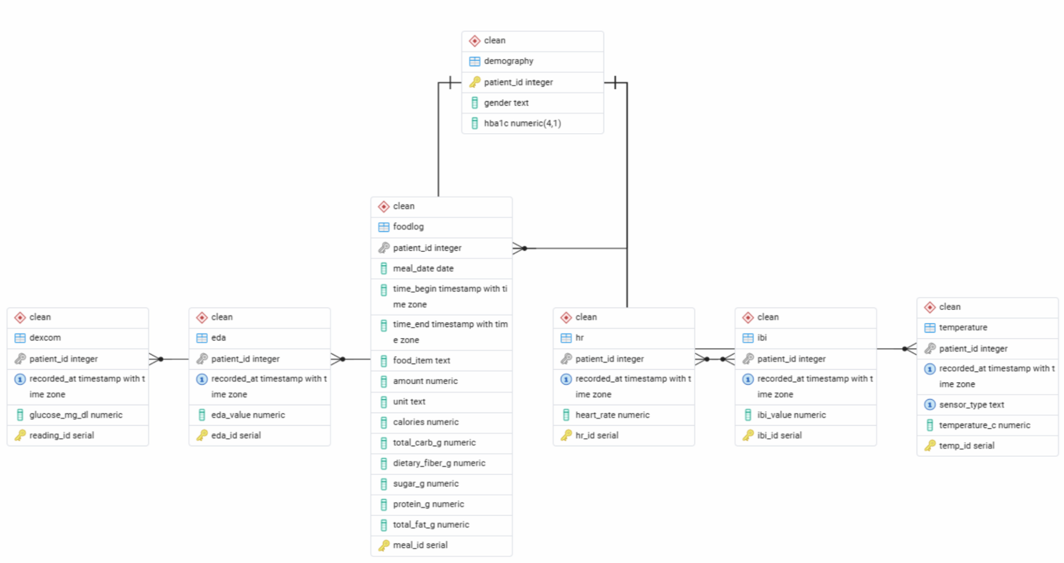
ER Diagram
The ERD below was generated directly from pgAdmin reflecting the actual live clean schema. All six sensor and log tables reference clean.demography via patient_id as the universal foreign key.
Notes:
1

Slide 4
Best Techniques Used
LAG(): Returns the previous rows value in the result set.
LEAD(): Returns the next rows value in the result set.
NTILE() : Divides ordered rows into a specified number of equal-sized buckets.
DENSE_RANK(): Ranks rows within a group with no gaps in the ranking, even when there are ties..
STDDEV (Standard Deviation) / STDDEV_POP(): Measures how spread-out values are from the mean — the foundation of glycemic variability metrics like CV% (STDDEV ÷ MEAN × 100).
CTE: It is a temporary result set that is defined within the execution of a single SQL statement.
RECURSIVE CTE: A CTE that references itself, building results step by step until no more rows qualify — used for sequential/hierarchical problems a normal GROUP BY can't solve.
CROSS TAB: Pivots rows into columns — turning a "one row per category" result into a spreadsheet-style grid with one row per entity and one column per category.
Notes:
1

Slide 5
Best Techniques Used
JOINs :JOINs combine rows across tables (INNER, LEFT, time-range JOINs)
SUBQUERIES: They nest one query inside another, either in the SELECT list, WHERE clause, or FROM clause. THE PRETTY FUNCTION: pg_size_pretty converts raw byte counts into human-readable units (KB/MB/GB) instead of a huge unformatted number.
REUSABLE FUNCTION: A named, callable block of code that returns a value — used in a SELECT exactly like AVG() or ROUND(). Written once, called everywhere.
STORED PROCEDURES: A named block of code that performs an action (not necessarily returning a value), called with CALL. Used for batch jobs that write results into a table.
TRIGGERS: Code that fires automatically on INSERT/UPDATE/DELETE — no manual call needed. Used for real-time automation.
Notes:
1

Slide 6
Key Insights
SDET Findings:
Checked that all 16 patients had data in every single table- For Patient ID 3, data was missing in Food log table.
Found 3 different date formats in the raw data and converted them into one standard format.
Found duplicate readings- turned out the sensors were just recording fast (multiple times per second), not actually broken.
Found and corrected incorrect meal log timestamps, including records with impossible future dates, to improve data accuracy.
Created a check that detects when body temperature goes down while heart rate suddenly goes up at the same time. This usually means the wristband was loose, not that the patient had a real health problem.
Analyst Findings:
Based on HbA1c analysis, pre-diabetes was more prevalent among female participants (55.6%) than males (42.9%).
Many participants struggled to maintain healthy blood glucose levels consistently.
Higher glucose variability was strongly associated with poorer glycemic control.
Nighttime blood glucose levels were consistently higher than morning and afternoon levels.
Notes:
1

Slide 7
Summary
Processed and transformed 11M+ healthcare sensor records across 7 integrated datasets, including 36K+ CGM, 8.6M Heart Rate, 1M+ EDA, 622K+ IBI, 1M+ Temperature, and Food Log records into a unified analytical database.
Performed end-to-end ETL and data quality validation by standardizing data types, normalizing multiple timestamp formats, removing duplicates, handling missing values, and validating physiological data to improve analytical accuracy.
Designed an optimized relational data model using Primary Keys, Foreign Keys, Check Constraints, Indexes, and Patient ID-based relationships to ensure data integrity and improve query performance.
Developed 80+ business-driven SQL queries utilizing JOINs, CTEs, CASE Statements, Window Functions, Aggregations, Ranking Functions, and Date-Time Analytics to uncover patient health trends, glucose variability, nutritional impact, cardiovascular risk, and physiological stress.
Integrated Continuous Glucose Monitoring (CGM), Heart Rate, EDA, IBI, Temperature, Nutrition, and Demographic data to generate patient-level risk profiles and clinically meaningful healthcare insights.
Delivered scalable, high-performance healthcare analytics by optimizing SQL execution through indexing, schema normalization, and efficient query design, enabling accurate reporting and evidence-based clinical decision-making.
Notes:
1

Slide 8

Notes:
1

