Slide 1
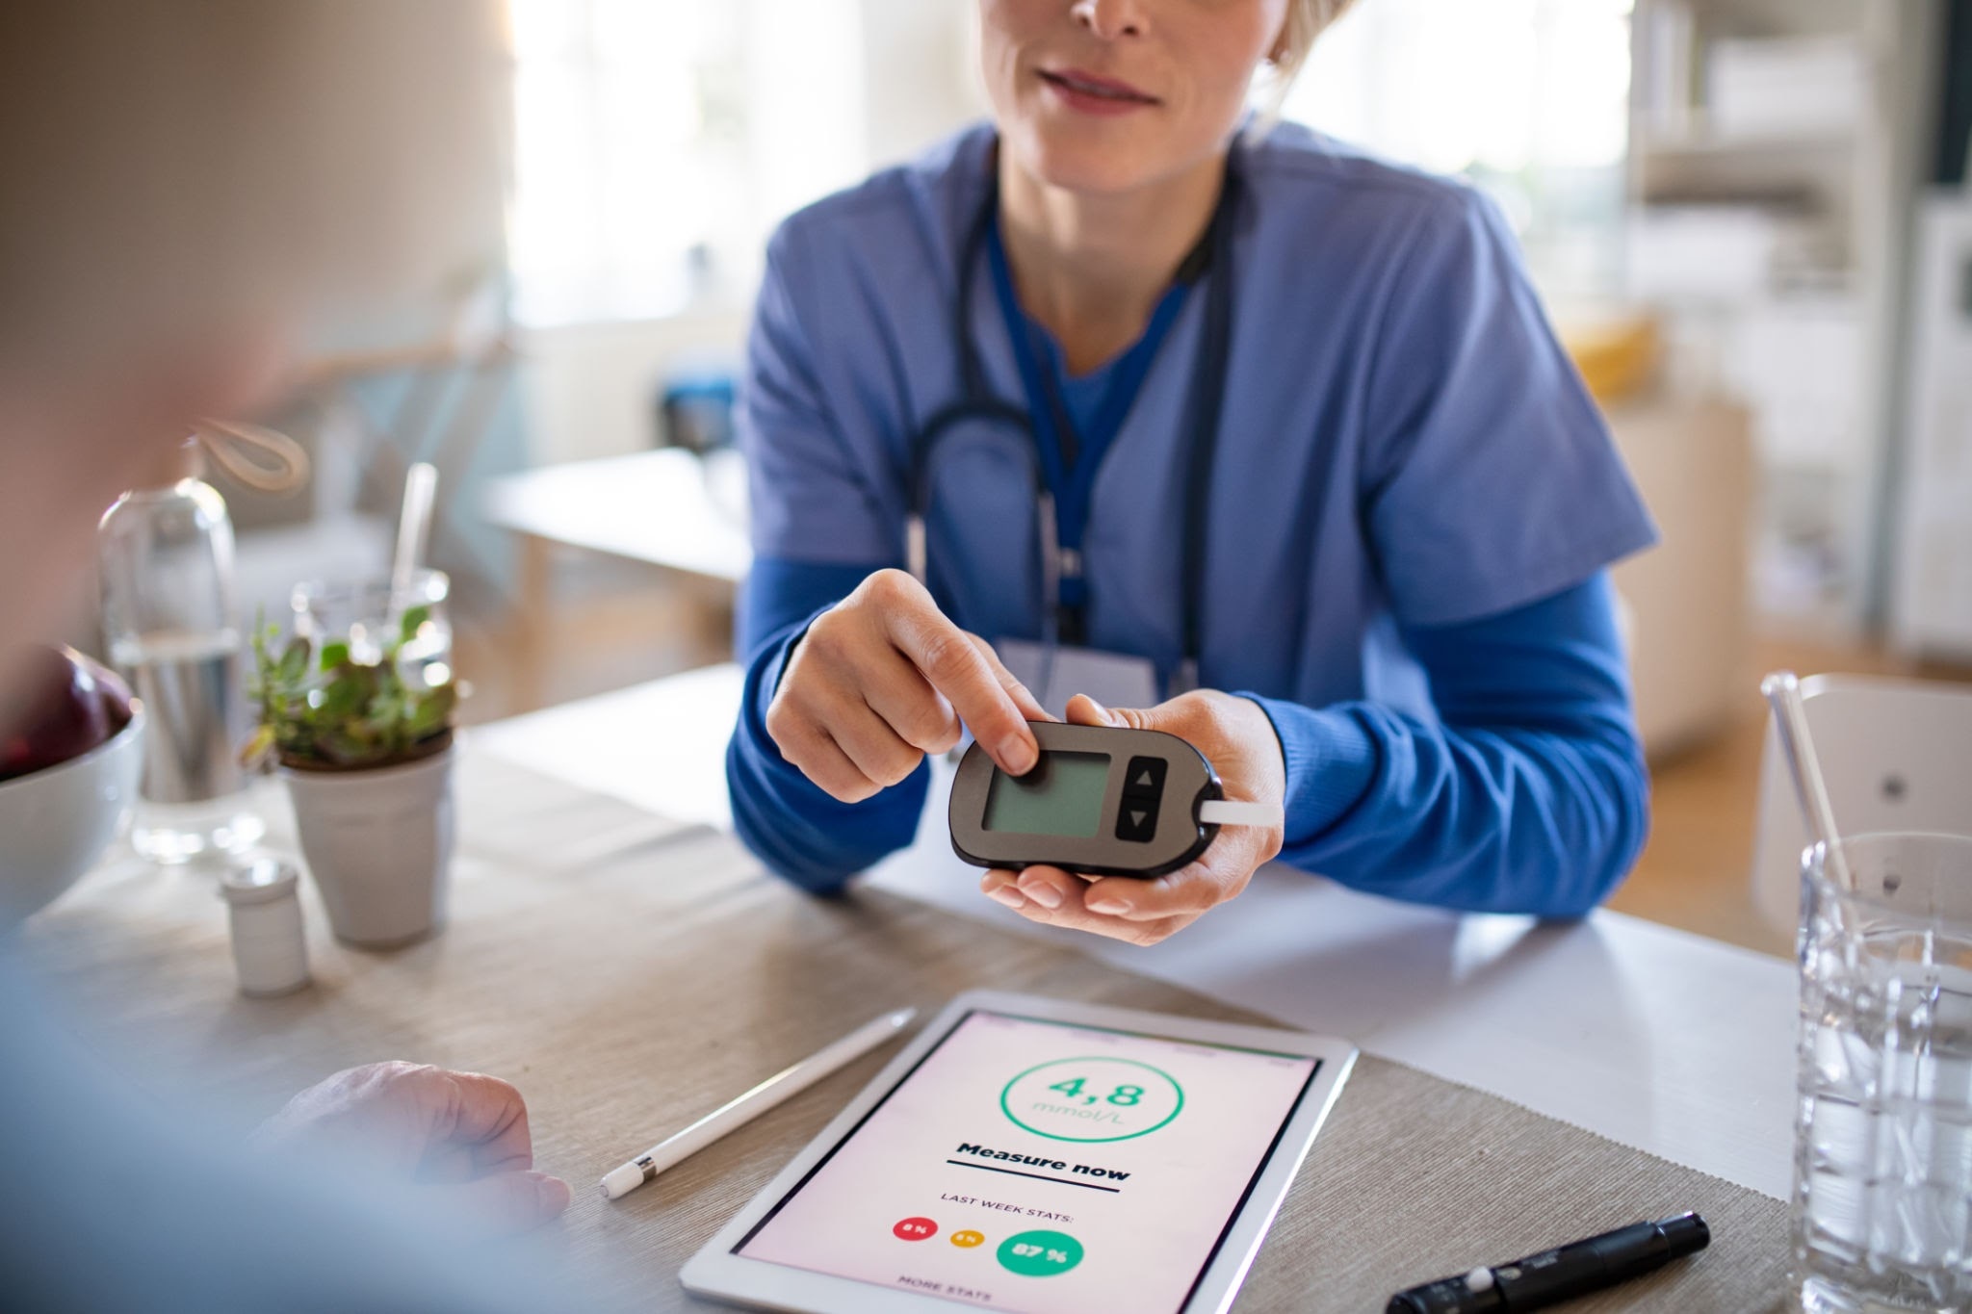
GlucoTwin
An explainable, personalized glucose Digital Twin for type 2 diabetes care
Digital Twin Challenge 2026
Team Name : Coffee & Panic
Institution : Marathwada Mitra Mandal’s College of Engineering , Pune
Team Members : Jidnyasa Patil , Sajiree Damle
All demonstration patients and all reported results are SYNTHETIC. Not clinically validated. Not a medical device.

Slide 2
Healthcare problem: diabetes at national scale
Type 2 diabetes dominates; day-to-day glucose between clinic visits is largely invisible
~101 million
~136 million
113,043
people with diabetes in India (11.4% of the population), ICMR-INDIAB estimate
people with prediabetes (15.3%), a pool that can convert to diabetes
survey participants across states and UTs, 2008-2020
Why forecasting + a twin?
Continuous glucose monitors produce a reading every few minutes, but clinicians see snapshots. A continuously updated, explainable patient state with honest uncertainty could help a clinician review where a patient is heading. This is our motivation, not a demonstrated benefit.
Source: Anjana et al., Lancet Diabetes Endocrinol 2023 (DOI 10.1016/S2213-8587(23)00119-5), figures as reported by secondary coverage and a Natl Med J India commentary; verify against the paper.
SYNTHETIC data | research prototype | not clinically validated
2

Slide 3
Existing solutions and literature
What we found - and what we could not verify
Digital twins for health
CGM forecasting
Scoping reviews (e.g. Katsoulakis et al., npj Digit Med 2024) survey health digital twins and their applications. We use the working idea of a personalised, continuously updated, predictive patient model.
Published work forecasts glucose from CGM history (e.g. GARNN, arXiv 2402.16230; a Bayesian T2DM approach, arXiv 2409.07315). We did not reproduce them; we benchmark only against persistence and ridge.
Open datasets
Other challenge entries
DiaTrend: type 1, controlled access. ShanghaiT2DM: type 2, 15-min CGM, public but licence terms conflict across sources. Glucose-ML (2025) surveys these collections.
Public repositories exist for this challenge, including one already named 'GlucoTwin' and one 'ThaliTwin'. We did not audit their claims; we flag the name conflict.
SYNTHETIC data | research prototype | not clinically validated
3

Slide 4
Research gaps and our contribution
A small, carefully evaluated proof of concept
Gaps we target
What this repository contributes
Leakage-resistant, patient-level evaluation against simple baselines
Explicit behaviour for stale, missing and corrupt input (abstain, not guess)
Explanations that are faithful to the model, with causal limits stated
What-if tools that do not invent physiology
Twin state engine: validation, quarantine, forecast history, audit, restart-safe
Per-horizon forecasts (15-120 min) with conformal intervals
Exact additive explanations and revision tracking
Scenario lab limited to supported inputs
54 tests; reproducible results with ablations reported even when negative
SYNTHETIC data | research prototype | not clinically validated
4

Slide 5
Problem statement and intended outcome
One localised outcome, not the whole body
Primary task
Given the last 60 minutes of CGM readings (15-min grid) plus patient history, forecast glucose for the next 15-120 minutes with an uncertainty interval, an explanation and a data-quality status.
Intended outcome
Explicitly out of scope
A working data-to-forecast loop that a clinician-facing dashboard can show, test and audit - and an honest benchmark.
Diagnosis, treatment or insulin/medication advice. Alarms. Any claim of clinical validation.
SYNTHETIC data | research prototype | not clinically validated
5

Slide 6
Data sources, privacy and limitations
Research found hard limits; we documented a safe fallback
Dataset | Population | Access finding | Used?
DiaTrend | Type 1, CGM | Controlled access (Synapse + agreement); no redistribution | No
ShanghaiT2DM | Type 2, 15-min CGM | Public, but licence terms conflict across sources; host unreachable from the build sandbox | Adapter only (untested on real files)
Synthetic cohort | T2D-like, 100 pts x 14 d | Generated here, seeded, MIT, labelled SYNTHETIC on every record | Yes - all results
No real patient data in the repository, logs or figures
Static-to-glucose links in the synthetic data exist by construction: they cannot validate physiology
Real-data results must be produced and reported separately
No result in this deck says anything about real patients.
SYNTHETIC data | research prototype | not clinically validated
6

Slide 7
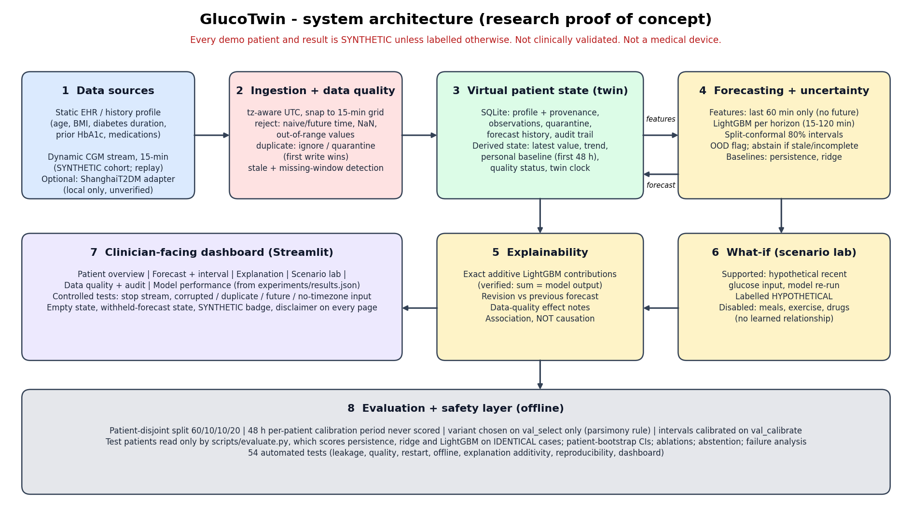
Architecture and data fusion
History + stream -> quality gate -> twin state -> forecast -> explanation -> dashboard
SYNTHETIC data | research prototype | not clinically validated
7

Slide 8
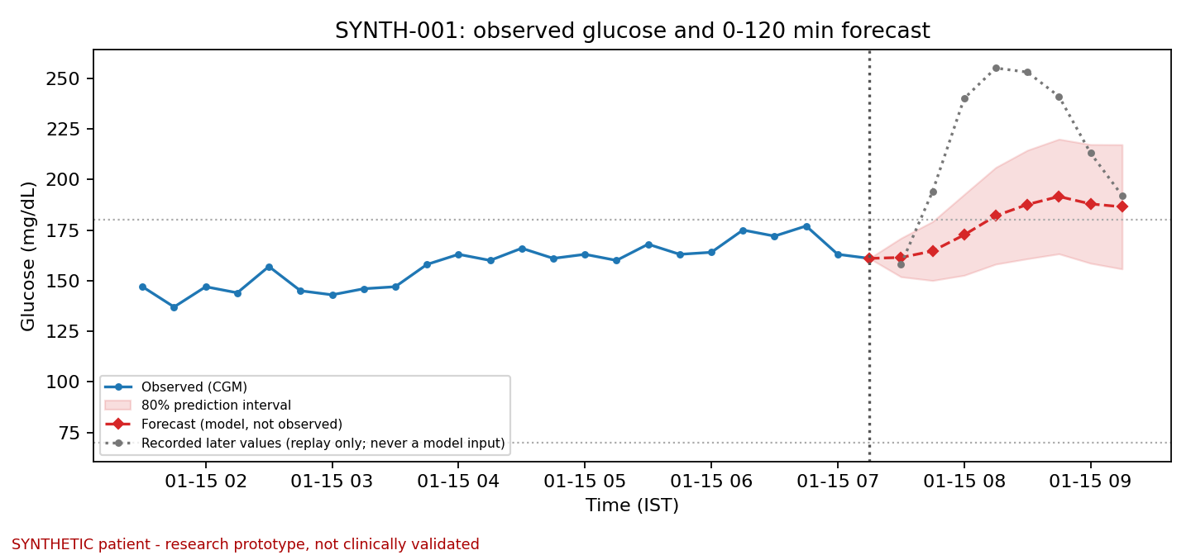
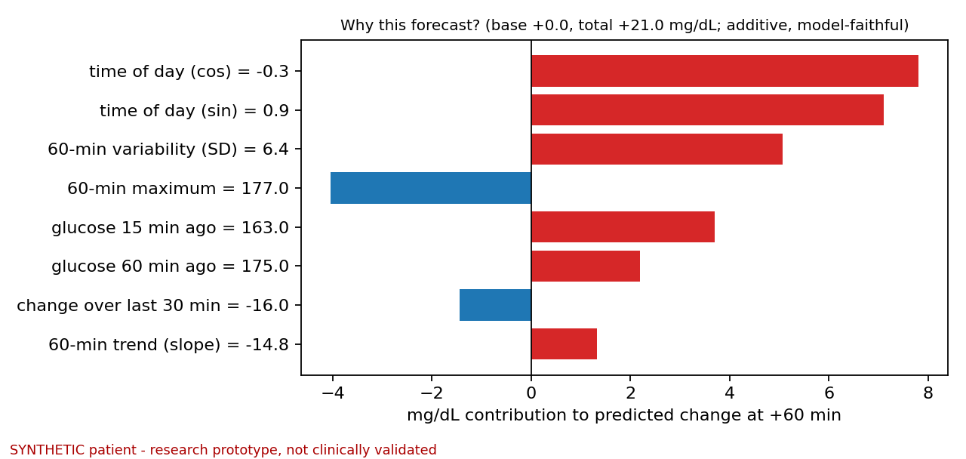
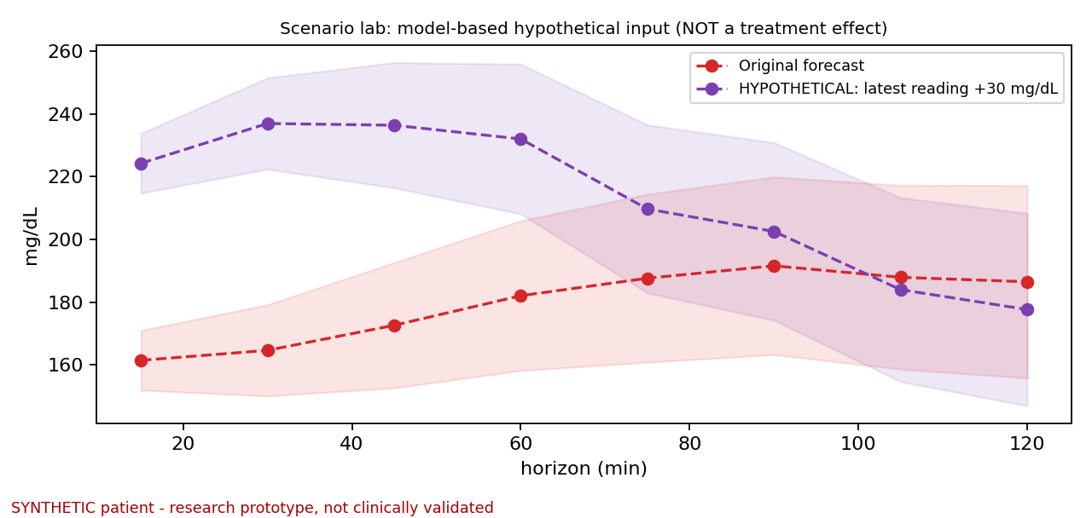
Dynamic update workflow and dashboard
Every new reading updates state, forecast, explanation and audit trail
1
2
3
4
5
6
New reading
Validate
Append / quarantine
Quality check
Forecast or withhold
Explain + audit
Six tabs: overview, forecast, explanation, scenario lab, quality + audit, model performance
Explanations are exact additive terms of the model output; scenario lab is labelled HYPOTHETICAL, meal/exercise/drug controls disabled
Replay of a recorded SYNTHETIC stream; there is no live-device connection
SYNTHETIC data | research prototype | not clinically validated
8

Slide 9
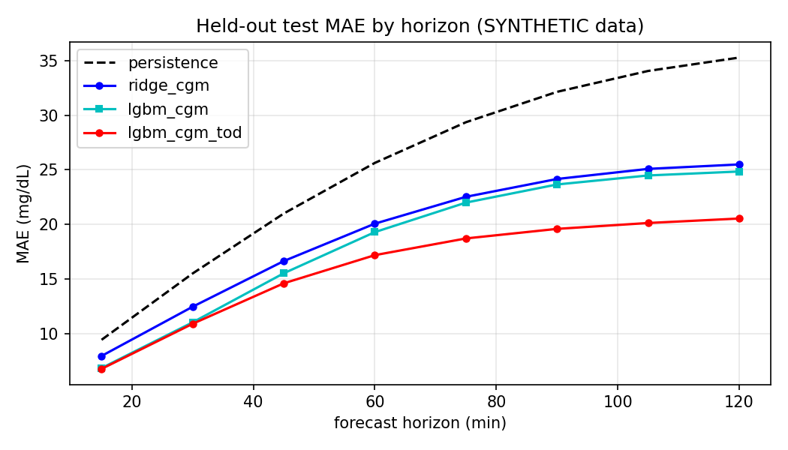
Model evaluation and baseline comparison
Held-out SYNTHETIC test: 20 patients, 20,825 windows, identical cases for all models
MAE mg/dL | +15 min | +30 min | +60 min | +120 min
Persistence | 9.5 | 15.5 | 25.6 | 35.3
Ridge | 8.0 | 12.5 | 20.1 | 25.5
LightGBM (CGM only) | 6.9 | 11.1 | 19.3 | 24.8
LightGBM + time of day | 6.8 | 10.9 | 17.2 | 20.5
Primary vs persistence at +60 min: -8.44 [-11.12, -6.24] mg/dL (95% patient-bootstrap CI); better for 20 of 20 patients
Ablations vs CGM-only at +60 min: time of day -2.11 [-2.70, -1.47] (expected by construction: synthetic meals are scheduled); personal baseline -0.05 [-1.02, 1.04]; static EHR +0.05 [-0.73, 0.86] - no reliable gain at +60 min (personal baseline helps only ~0.3 mg/dL at +15 min)
Synthetic data: shows the pipeline works and recovers the generator's dynamics - not clinical accuracy. Preliminary.
SYNTHETIC data | research prototype | not clinically validated
9

Slide 10
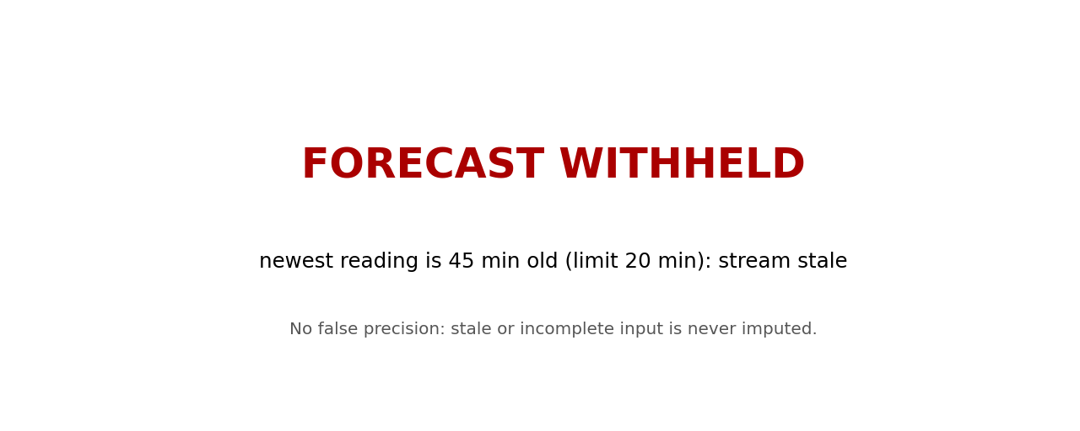
Tests, data-quality behaviour and uncertainty
Fail safe, show uncertainty, admit misses
Stale (> 20 min) or incomplete 60-min window: forecast withheld; 6.4% of observed test origins (synthetic missingness)
Rejected / quarantined: naive or future timestamps, NaN, out-of-range values, conflicting duplicates
80% intervals: coverage 78-80% on test; per patient 71-85% (marginal guarantee only)
Hardest case: flat glucose before a meal (MAE 22.6 vs 12.1 mg/dL rising, +120 min); bottom-left: a breakfast spike escaping the interval
54 automated tests incl. leakage, restart, offline, additivity, dashboard; mutation-checked
SYNTHETIC data | research prototype | not clinically validated
10

Slide 11
Limitations, responsible use and next steps
Not claimed
Next steps
Clinical validation or real-patient accuracy
Benefit for type 2 populations (data are synthetic)
Causal effects of food, exercise or drugs
Use for diagnosis, treatment or medication decisions
That time-of-day or EHR gains transfer to real data
1. Run the ShanghaiT2DM adapter locally; verify columns, units, licence
2. Re-train and evaluate; report real-data results separately
3. Add meal/activity inputs only if real data support them
4. Clinician review and prospective evaluation before any clinical use
5. Resolve the project-name conflict
SYNTHETIC data | research prototype | not clinically validated
11

Slide 12
Conclusion
A reproducible twin pipeline: fused history + stream, versioned forecasts, explanations, safe withholding
On held-out synthetic patients it beats persistence and ridge; value on real patients is untested
Negative and null findings are reported alongside positives
Repository: https://github.com/Jidnyasa-P/GlucoTwin
Demo video (unlisted): https://youtu.be/1czyEqa0aPc
Team : Coffee & Panic
Institute : Marathwada Mitra Mandal’s College of Engineering , Pune
Research proof of concept. Synthetic data. Not clinically validated. Not a medical device.

