Slide 1
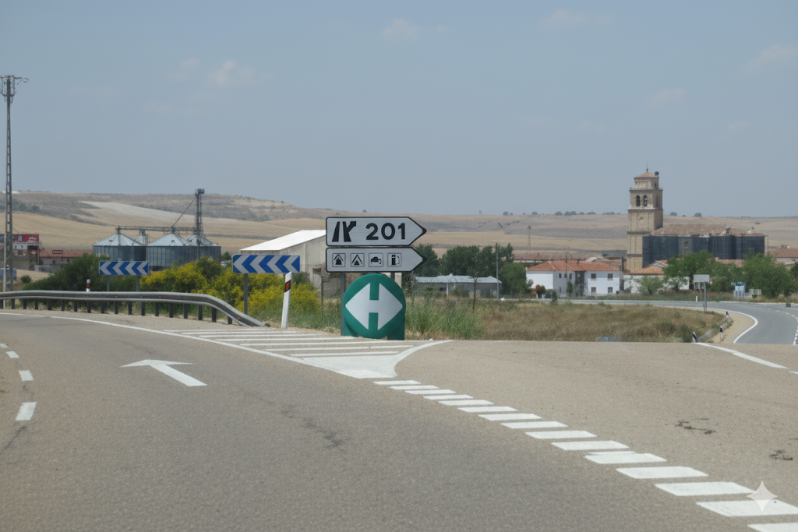
Question: What direction does the road sign point for the 202?
Type: OCR Content
Label: False
Premise: 201
Answer:
<think>The image shows a road scene with various signs. A prominent sign indicates “201” directing traffic. The question mentions “202” which is incorrect. Analyzing the actual text on the sign confirms it reads “201”. The discrepancy lies in the road number mentioned in the question. Since the question's premise is wrong, I should focus on correcting the text rather than answering the question as posed.</think>
<answer>The sign does not show 202. It shows 201.</answer>

