Slide 1


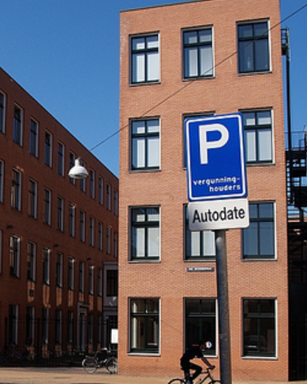

Type
Symbol Meaning
MLLM
MLLM
Caption: The image seems to be in a residential area, with a parking sign standing beside the road, two brown buildings behind it, and cyclists.
Premise
Parking Sign
Find out a symbol in the image or output NO.
Generate a short caption containing parking sign.
LLM
False
Premise
Right Turn
Sign
Generate a problem with a false premise that has been replaced or with the correct premise.
Positive Sample
There is a building behind the parking sign, how many floors are there?
Negative Sample
There is a building behind the right turn sign, how many floors are there?

Slide 2
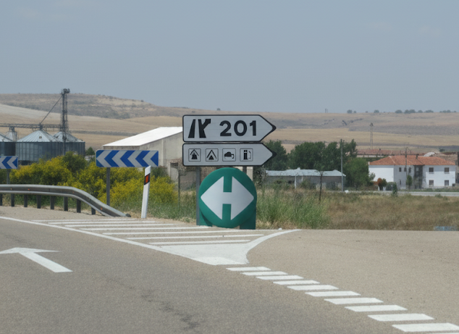
Question: What direction does the road sign point for the 202?
Type: OCR Content
Label: False
Premise: 201
Answer:
<think>The image shows a road scene with various signs. A prominent sign indicates “201” directing traffic. The question mentions “202” which is incorrect. Analyzing the actual text on the sign confirms it reads “201”. The discrepancy lies in the road number mentioned in the question. Since the question's premise is wrong, I should focus on correcting the text rather than answering the question as posed.</think>
<answer>The sign does not show 202. It shows 201.</answer>

