Slide 1


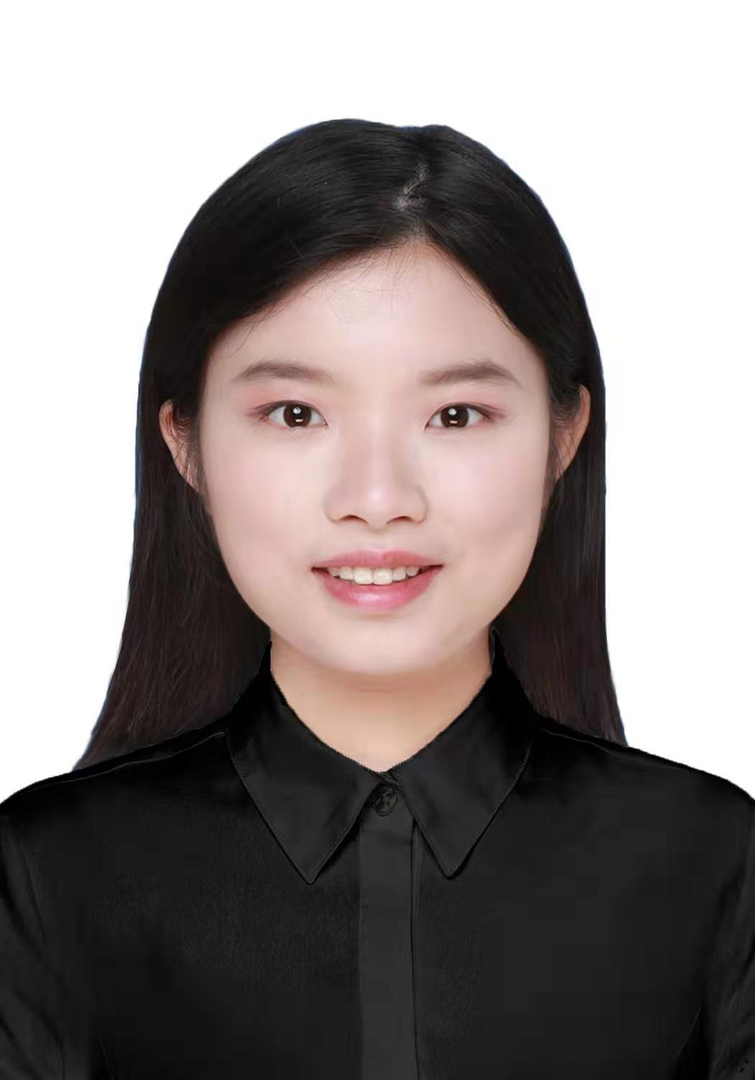
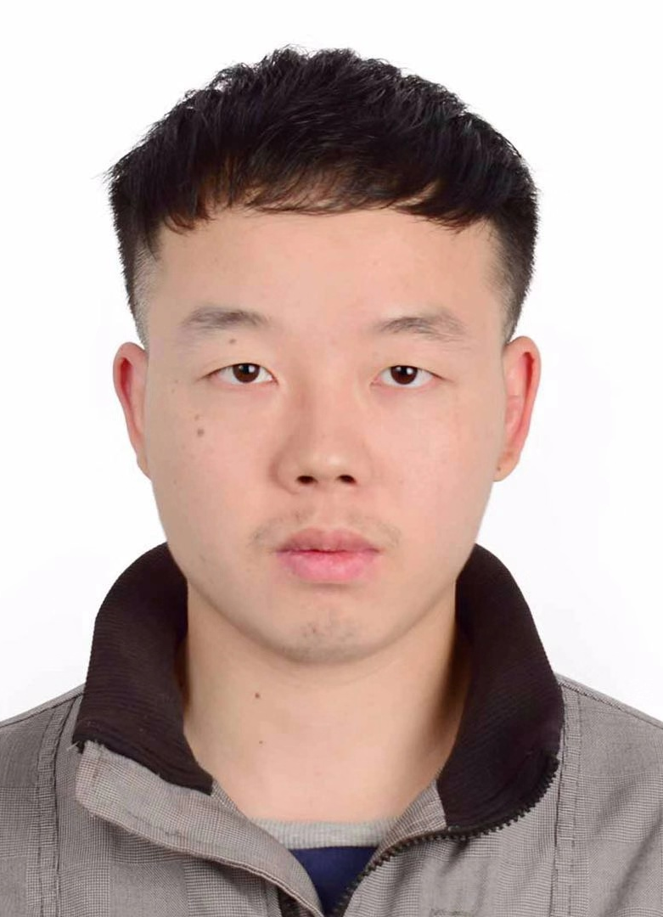
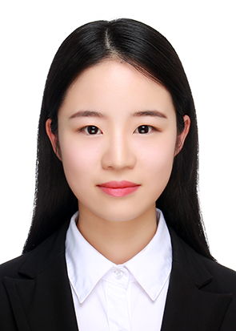
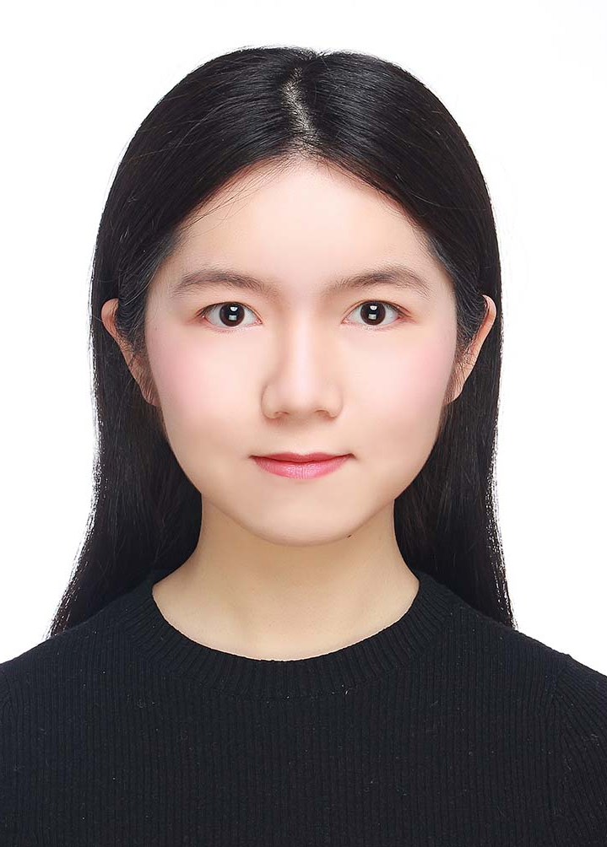
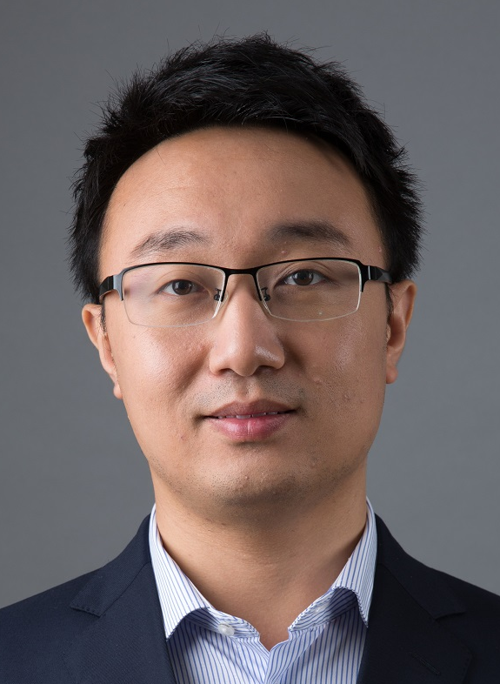
Explaining Neural Networks
Semantically and Quantitatively
Runjin Chen*, Hao Chen*, Jie Ren, Ge Huang, Quanshi Zhang
John Hopcroft Center,
Shanghai Jiao Tong University, China
( * equal contribution)

Slide 2
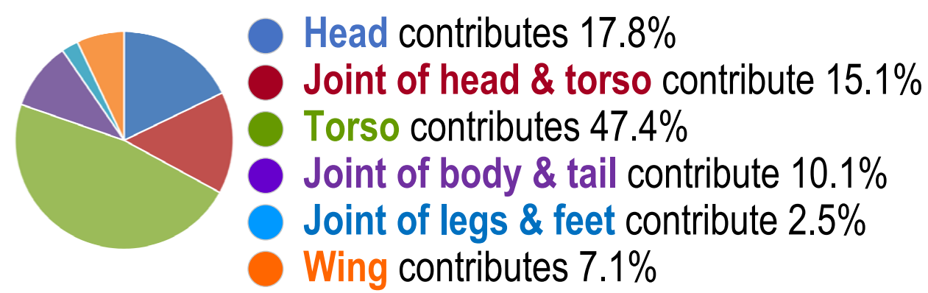
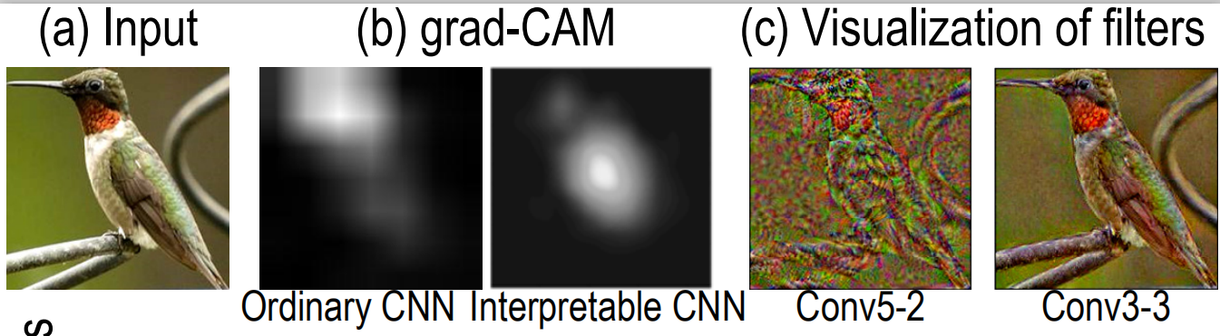
Overview of the Task
Input
pre-trained neural network
pre-defined visual concepts
Output: contributions of visual concepts to the final predictions
Semantic : using clear visual concepts
Quantitative : analyzing the contribution of visual concepts
our explanation
semantic level
trustworthiness
safety
quantitative
previous explanation
pixel-level
. . .
qualitative
Grad-CAM^{[1]}
Visualization of filters^{[2]}
[1] Ramprasaath R. Selvaraju, Michael Cogswell, Abhishek Das, Ramakrishna Vedantam, Devi Parikh, and Dhruv Batra. Grad-cam: Visual explanations from deep networks via gradient-based localization. In ICCV, 2017.
[2]Aravindh Mahendran and Andrea Vedaldi. Understanding deep image representations by inverting them. In CVPR, 2015.

Slide 3
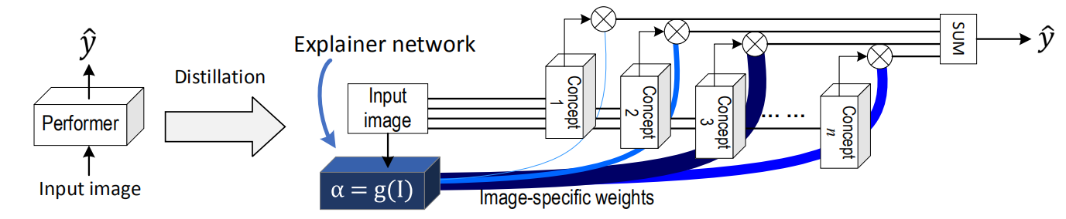
Overview of the Task
Performer: the pre-trained network for a certain task, i.e. classification
Explainer: decompose the overall prediction score into scores of compositional visual concepts
Distillation:

Slide 4
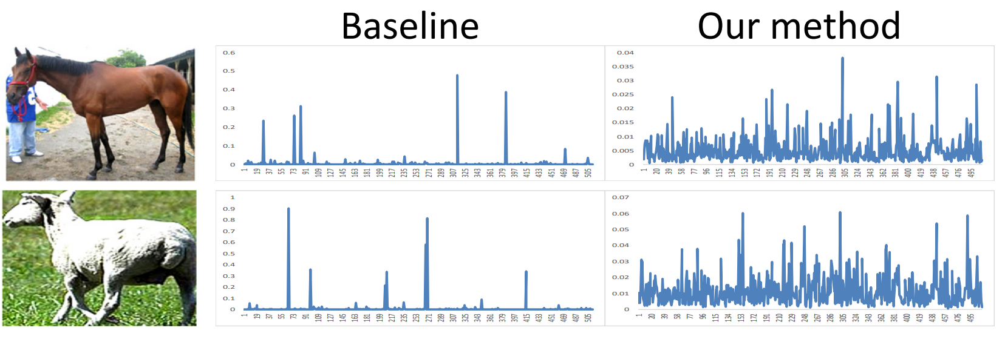
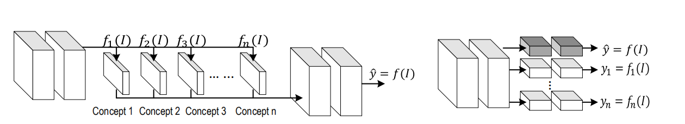
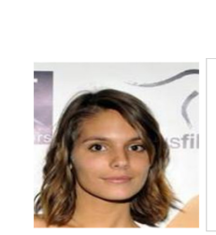
Visual Concepts
How to get pre-defined visual concepts?
manually defined
train models to represent the visual concepts
Case 1.
horse
head
front torso
rear torso
legs and feet
Case 2.
attractive
young
female
Notes:
how to train models

Slide 5
Bias-interpreting Problem
Problem:
Bias-interpretation
The ideal result
y-axis:
contribution value
x-axis:
visual concepts
Given a large number of visual concepts, very few are used.
What we want: almost all visual concepts are used.
Notes:
bias讲不清楚

Slide 6
Bias-interpreting Problem
Solution: priors of contribution:
Add a loss for priors:
learned contributions
priors
prior loss penalizes the dissimilarity between learned contributions and priors
Type 1. The visual concept should be positively related to the prediction
Type 2.
Notes:
how to calculate w

Slide 7
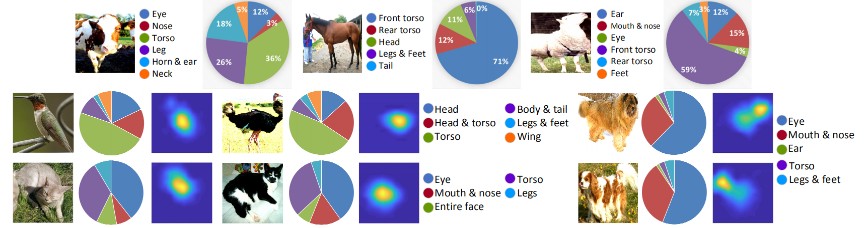
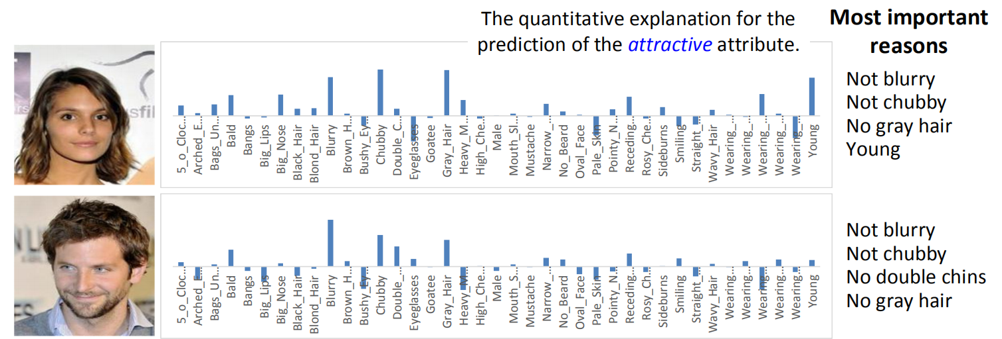

Slide 8
Contribution
Explaining networks semantically and quantitatively.
Distillation from a pre-trained performer into an explainer.
a novel loss to overcome the bias-interpreting problem
A generic solution to various tasks and networks.
THANK YOU !
POSTER #4

