Slide 1
help.html figure

Slide 2
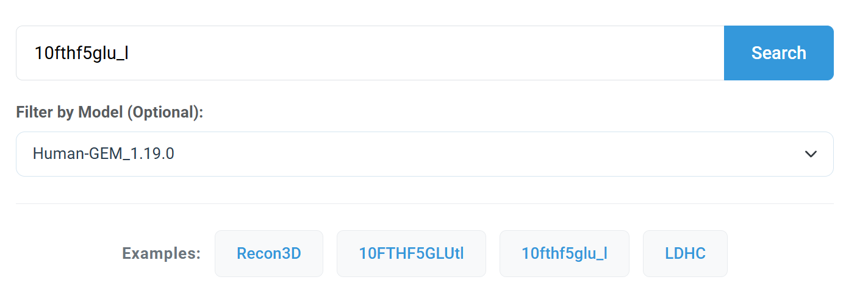
Search box
（e.g. 10fthf5glu_l)
choose model
（e.g. Human-GEM_1.19.0)
Load examples

Slide 3
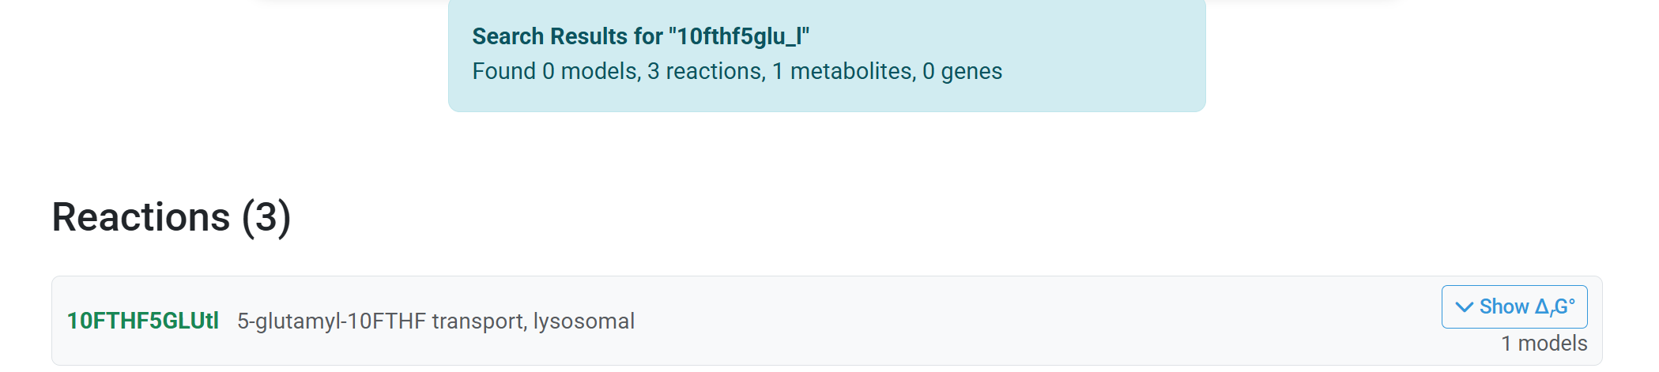
Search results summary box
View Δ_{r}G° values

Slide 4
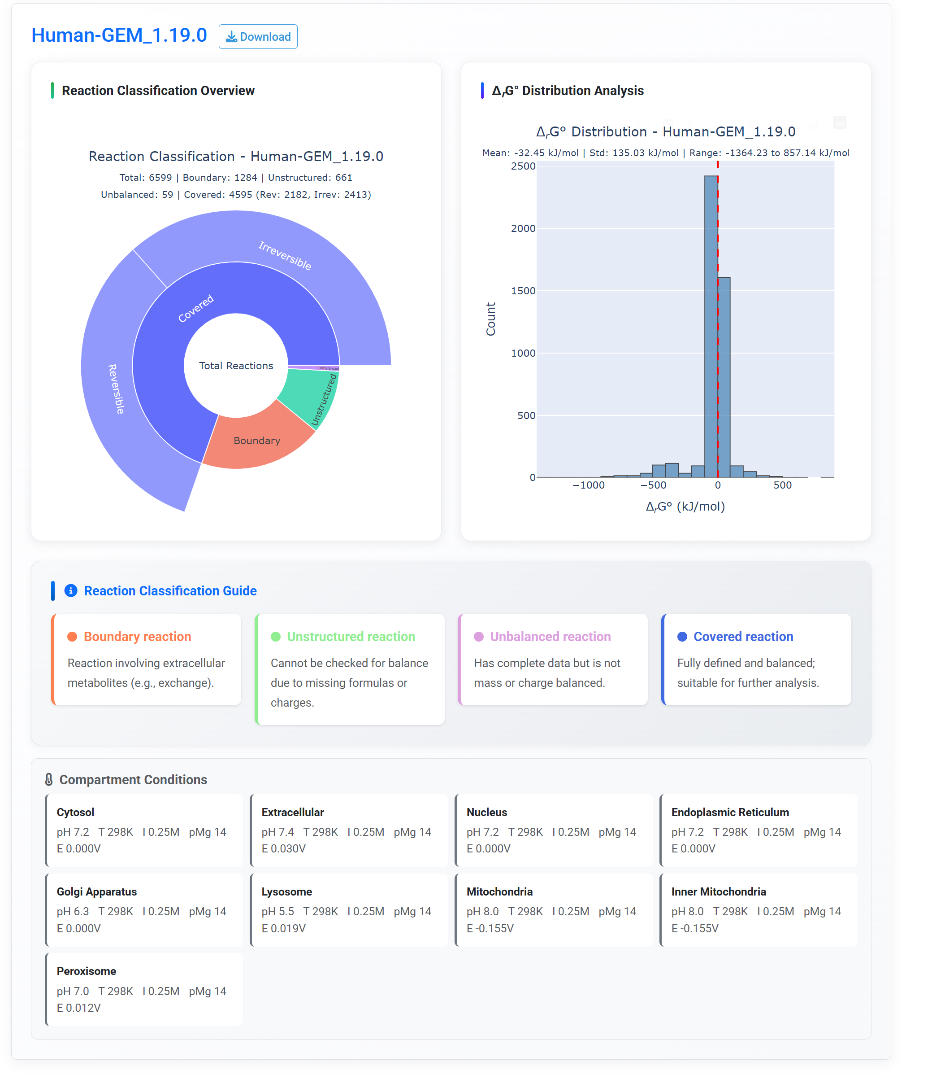
Download results for the GEM model
Reaction classification overview chart
Δ_{r}G° distribution analysis chart
The definition of four class reactions
The compartment conditions use for prediction

Slide 5
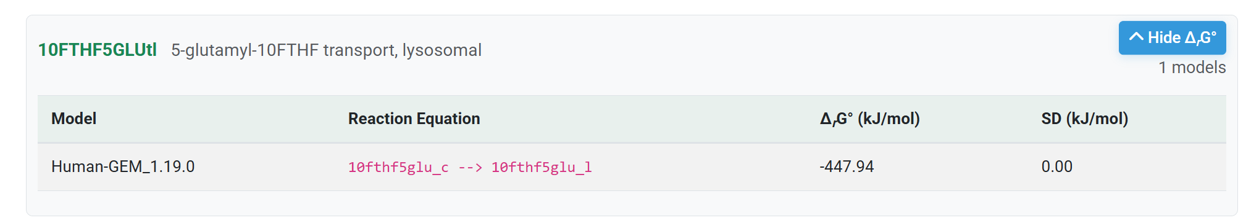
Reaction BiGG ID
Δ_{r}G° data Table

Slide 6
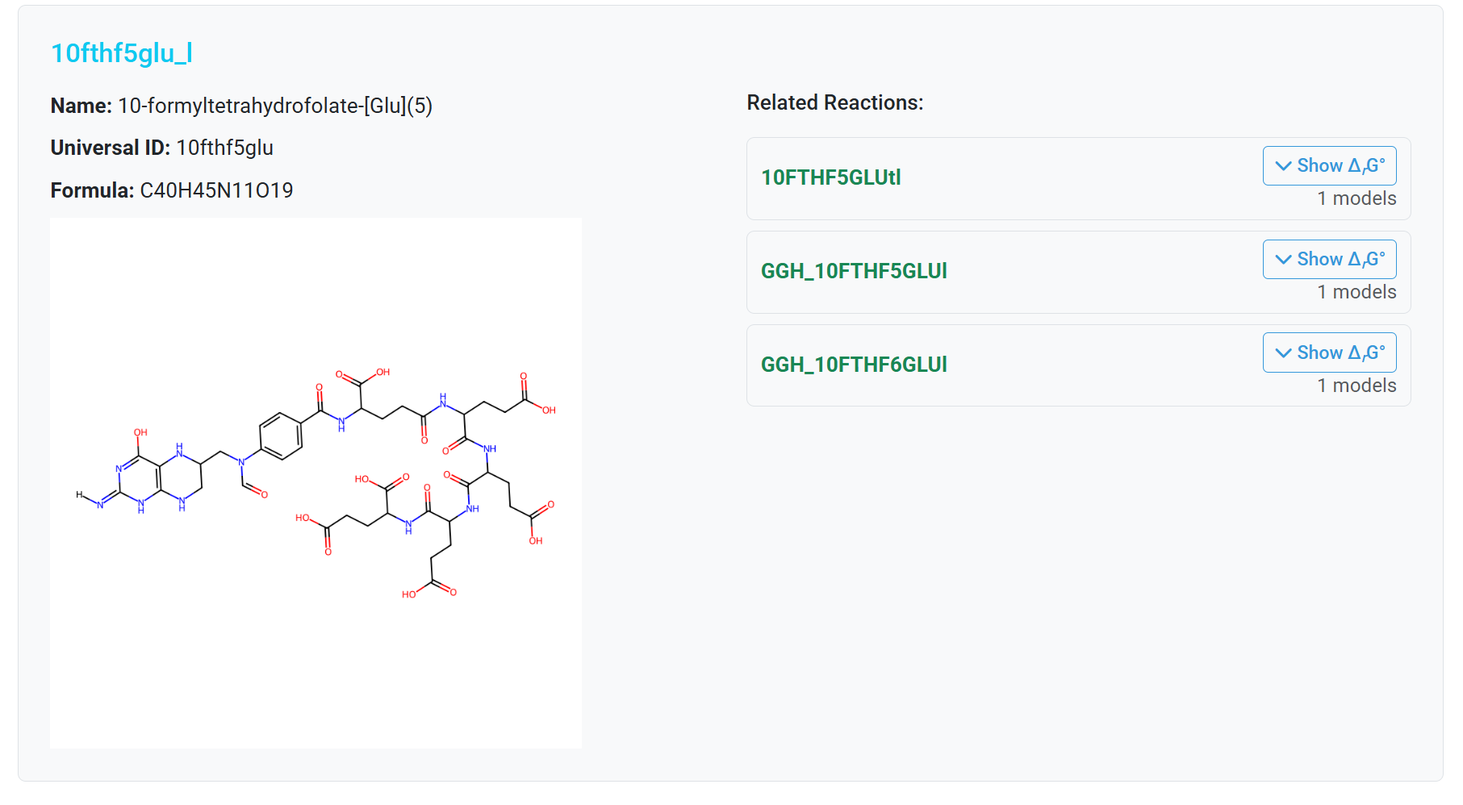
Metabolite BiGG ID
Reactions involving this metabolite
2D chemical structure image

Slide 7
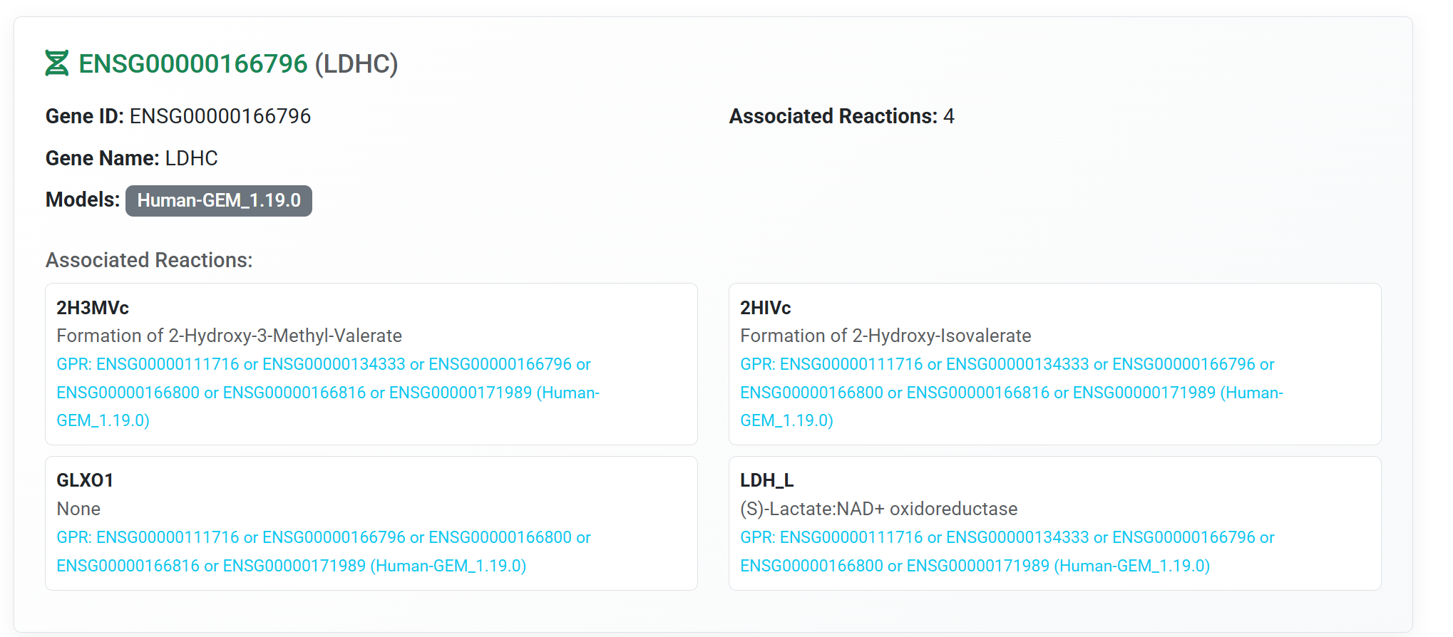
Gene ID
Reaction BiGG ID
GPR information

Slide 8
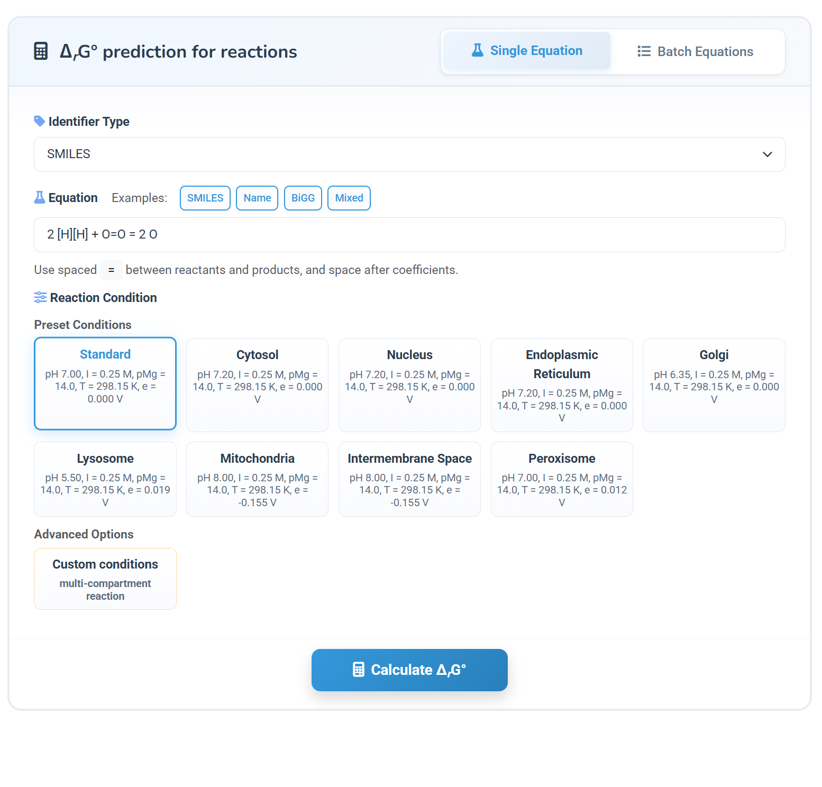
Single equation mode
Select identifier type
(e.g. SMILES)
Load examples
Input chemical equation
(e.g. 2 [H][H] + O=O = 2 O )
Select reaction condition
(e.g. standard condition)
Set custom conditions
Calculate button

Slide 9
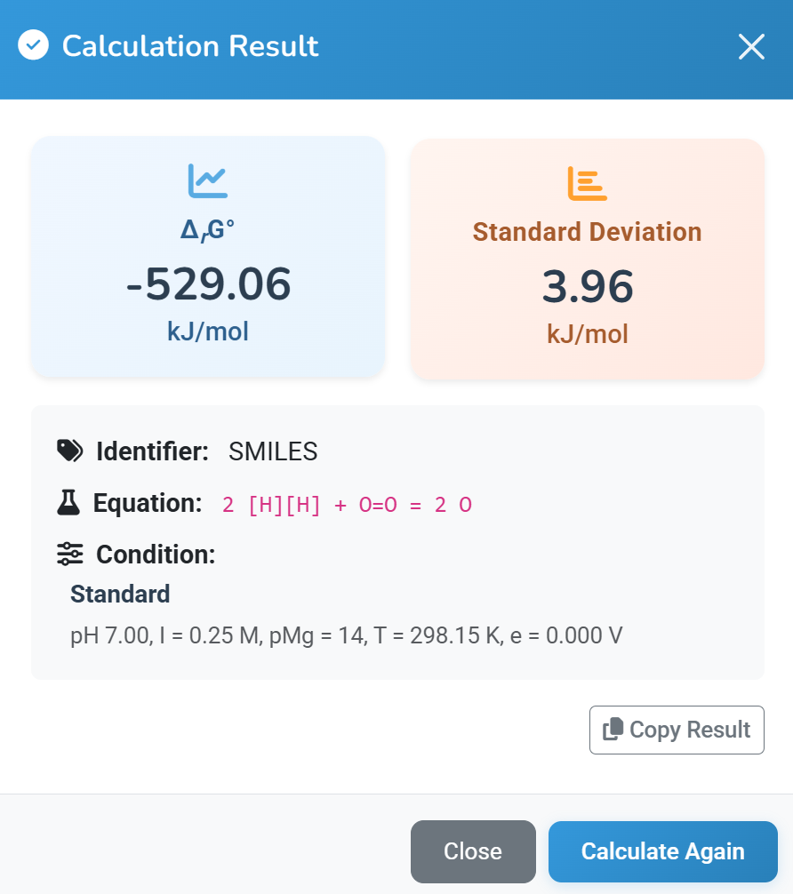

Slide 10
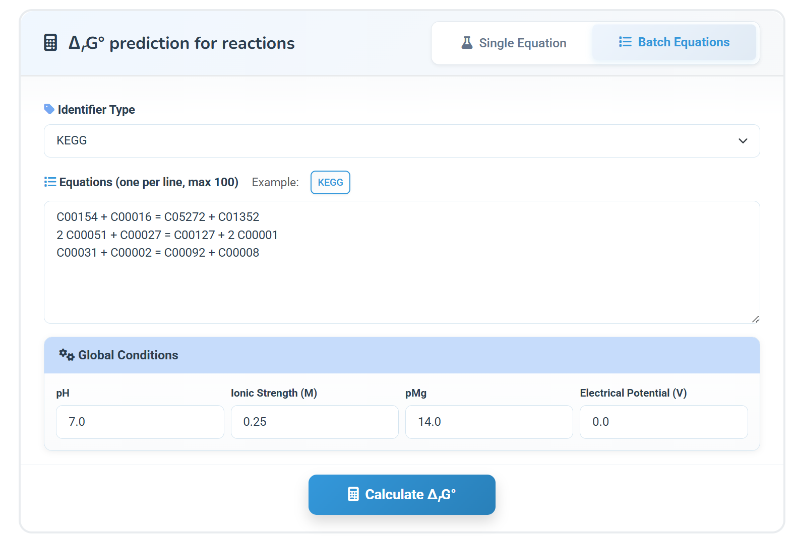
Batch equations mode
Select identifier type
(e.g. KEGG)
Load an example
Input equations
Set conditions for all equations
Calculate button

Slide 11
