Slide 1
Grad-CAM: Visual Explanations from Deep Networks via Gradient-based Localization For Image Classification
Jie Lu
Joaquin

Slide 2
Motivation?
Today most CNN models support for different tasks.
Hard to Interpret: lack of decomposability into intuitive and understandable components.
Grad-CAM: a technique to make the Network (CNN)-based models more transparent.

Slide 3
Goal
Achieve “Visual Explanation” for the decisions from based-CNN models.
Suitable for any based-CNN models.
Less computation: without architecture changing and re-training.

Slide 4
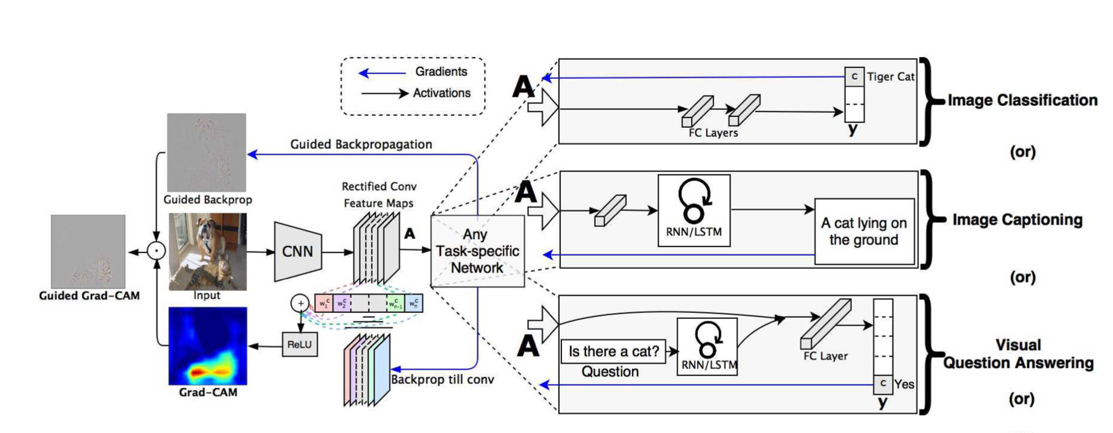
Architecture

Slide 5
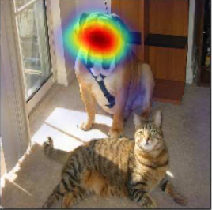
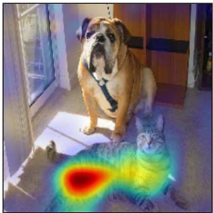
Method
How to localize the target class (class-discriminative)?
Grad-CAM ‘Dog’
Grad-CAM ‘Cat’

Slide 6

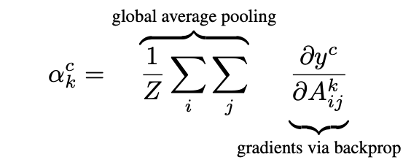
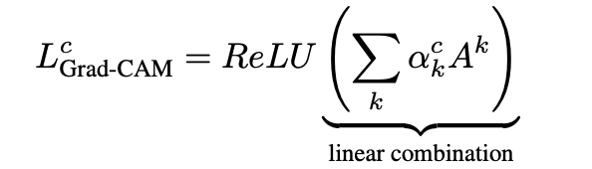

Method
1.Compute the gradient of the score for class c, yc w.r.t the feature maps Ak of a convolutional layer i.e. ∂yc/∂Ak
2.Obtain the weights : flowing back these gradients, then global-average-pooled
3.Perform a weighted combination of forward activation maps, and follow it by a ReLU to obtain
Here, we can see a coarse heap map of the same size of the convolutional feature maps.

Slide 7
Experiment Set up and results
The Experiment part(finish in July 2nd) added in the github README file. Here is the link:
https://github.com/Jie1995tbc/CS523-project

Slide 8
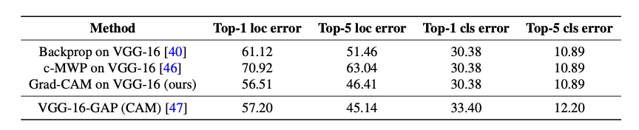
Results
Pretrained off-the-shelf VGG-16 model from the Caffe Model Zoo.
Evaluate the VGG-16 models from the model zoo and compare that the top-1 and top-5 localization error between different methods.

Slide 9
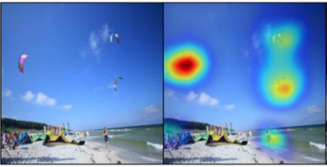
Application
Grad-CAM apply on the CNN models.
1.Image Classification
2.Visual Question Answering
3.Image Captioning
A group of people flying kites on the beach
Notes:
How Grad-C_A_M applies to Cnn models?
Its seen in
Image classification
Visual question answering
Image captioning
The picture of a group of people flying kites on the beach is an example of visual question answering

Slide 10
Bias and Fairness
AI systems learn to make decisions based on training data, which may contain skewed human decisions or represent historical or social inequities
Example: COMPAS an algorithm used in US court systems
Notes:
Decisions are made based on training data
This data might include human decisions or represent historical or social inequities
And Even if sensitive variables such as gender, ethnicity or sexual identity are excluded
A bias can still be observed
An example is Compas
An algorithm used in us court systems to predict the likelihood that a defendant would become a recidivist.
Discrimination by the model here is Caused by the data, and the algorithm creation process itself

Slide 11
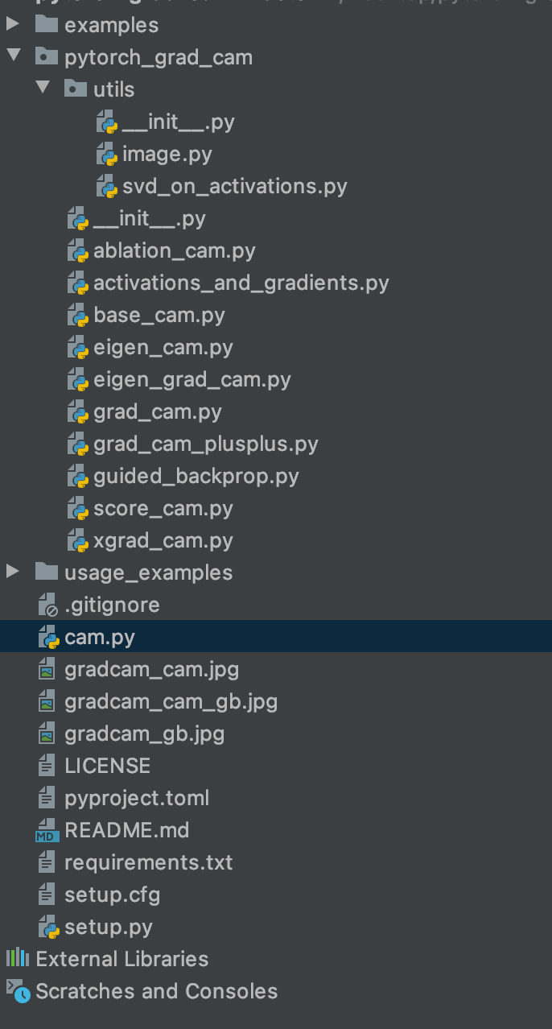
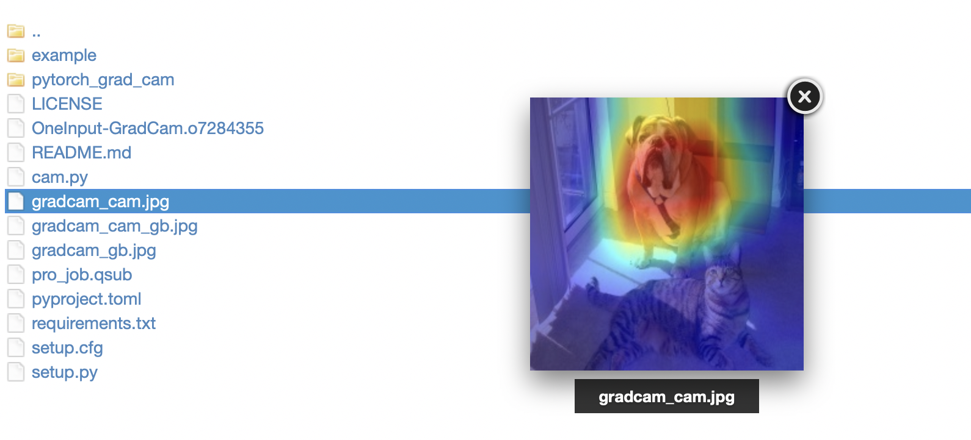
Demo

Slide 12
Github Link
https://github.com/Jie1995tbc/CS523-project

Slide 13
Main Reference Work
R.Selvaraju,M.Cogswell,A.Das,R.Vedantam,D.Perikh,D.BatraGrad-CAM: Visual Explanations from Deep Networks via Gradient-based Localization
S.Antol,A.Agrawal,J.Lu,M.Mitchell,D.Batra,C.Lawrence Zitnick, and D. Parikh. Image Classification. In ICCV, 2015.

