Slide 1
SNAKE GAME
in DIGITAL SYSTEM DESIGN FINAL LAB

Slide 2
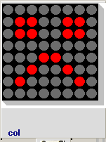
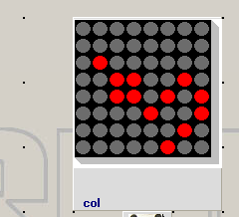
Start of snake game
End of snake game

Slide 3
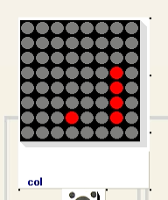
GAME SCENE
MY SNAKE
THE APPLE YOU NEED TO EAT

Slide 4
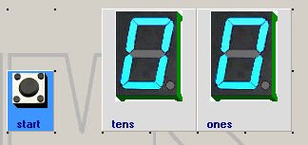
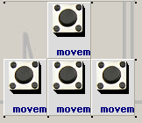
BUTTON AND DISPLAY
PRESS START TO PLAY
SCORE DISPLAY

Slide 5
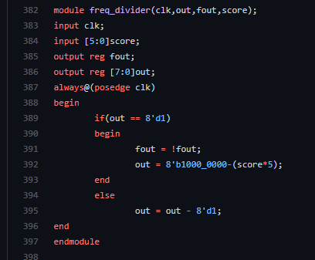
DIFFICULTY VARIATION

Slide 6
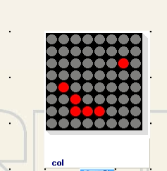
GAMES’ EASTER EGG
REAL APPLE (FROM USA)
FAKE APPLE (FROM CHINA)
MY SNAKE’S HEAD

Slide 7
THANK YOU

