Slide 1

Mini Project 3
name：陳桀泓
Student ID：111062210

Slide 2
Evaluate
If the game cost more than 50 steps, we consider the value of the pieces. The player with a higher piece value wins the winner. Therefore, I evaluate a state using a similar approach.

Slide 3
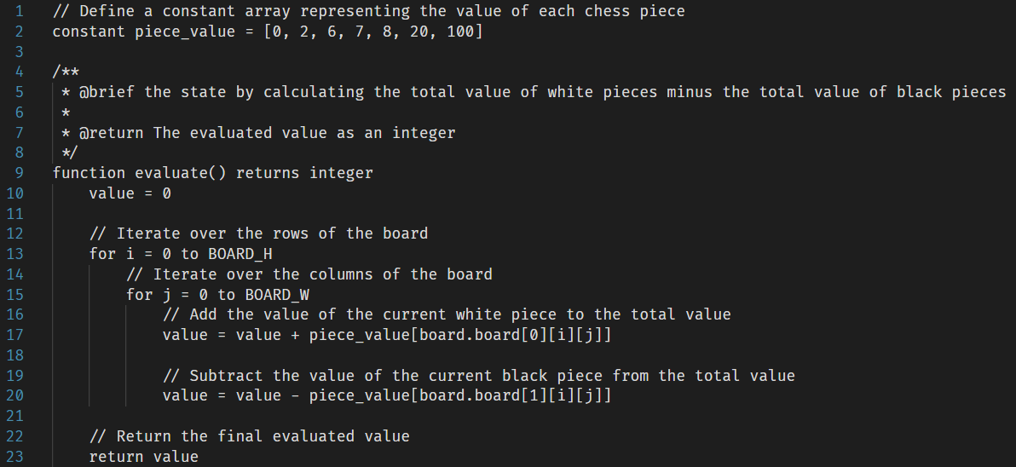
Evaluate Pseudocode

Slide 4
Minimax
In the original approach, we only evaluate the state at leaf nodes. However, if a player wins at an intermediate node, the descendant nodes of it will never be reached in the game. Therefore, before continuing the search at a deeper level, I verify whether a player has already won.

Slide 5
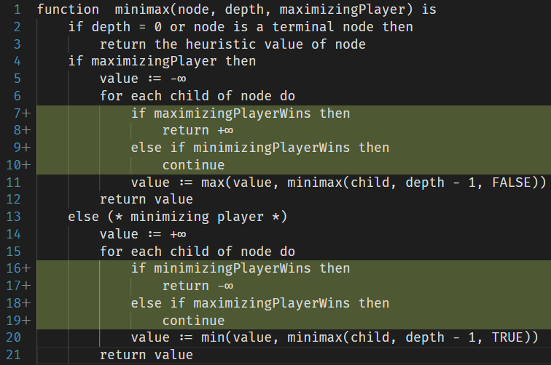
Minimax Pseudocode
Source: https://en.wikipedia.org/wiki/Minimax

Slide 6
Negamax
After implementing Minimax, I discovered another algorithm known as Negamax. Unlike the approach of maintaining separate logic for each player, the Negamax algorithm employs the concept of negation to handle both scenarios.

Slide 7
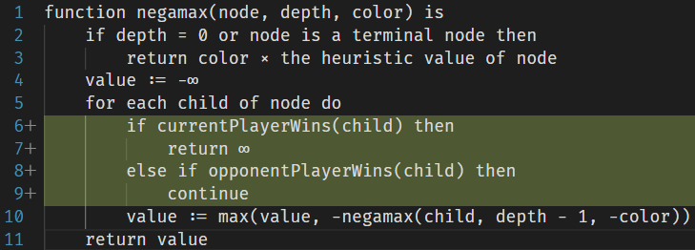
Negamax Pseudocode
Source: https://en.wikipedia.org/wiki/Negamax

Slide 8
Negamax with Alpha-Beta Pruning
Algorithmic optimizations applicable to Minimax can also be applied to Negamax. Alpha-beta pruning, for instance, can reduce the number of nodes evaluated by the Negamax algorithm in a search tree, like its utilization in the Minimax algorithm.

Slide 9
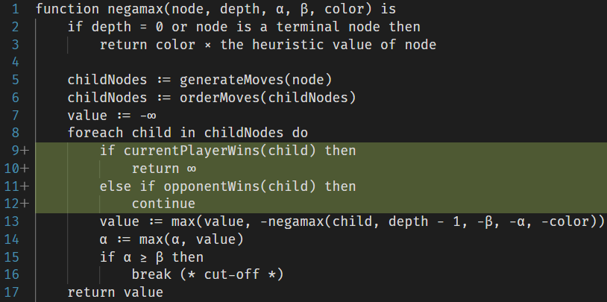
Negamax with Alpha-Beta Pruning Pseudocode
Source: https://en.wikipedia.org/wiki/Negamax

Slide 10
Alpha-Beta Pruning Optimization
The order in which consider moves can greatly affect the effectiveness of alpha-beta pruning. By starting with the most promising moves first, have a higher chance of triggering cutoffs and reducing the search space. Techniques like move ordering based on history heuristics, killer moves, or transposition table information can help improve the effectiveness of alpha-beta pruning.

