Slide 1
Abstraction Hierarchy of Cooking Rice with Hangou
PF
Enjoyment of Rice
Taste of Rice
Effort of Cooking
AF
GF
Heating
Pre-processing & Post-processing
PFn
Heat Transfer
Heat Preserve
Handle & Operation
PFo
Base
Bail Handle
Cap
Lip
L-Shaped Wire Handle

Slide 2
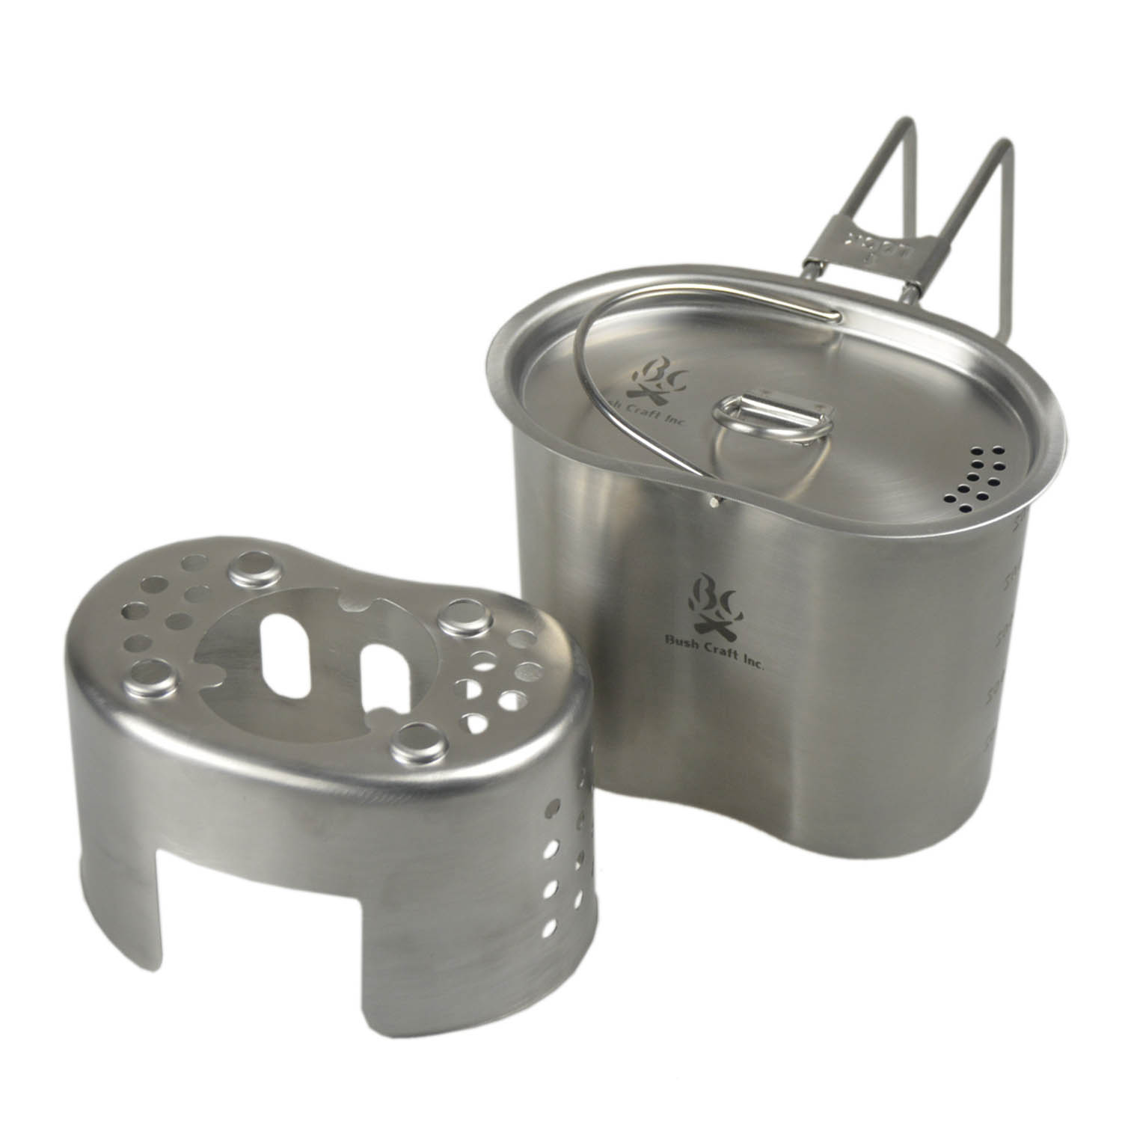
L-Shaped Wire Handle
Lip
Bail Handle
Base
Cap

Slide 3
Raw rice and water
temperature sensor
Increase the heat
Boiling water
temperature stay near 100°
Keep the heat
Water dry out
temperature increase again
Reduce the heat and switch to insulation
Done

Slide 4
Raw rice and water
several holes in the lip
Increase the heat
Boiling water
bubbles through the holes
Keep the heat
Water dry out
bubbles dry out on the lip
Reduce the heat and switch to insulation
Done

Slide 5

Search box
List boxes
Buttons
Image Carousel

Slide 6

Buttons
List boxes

Slide 7

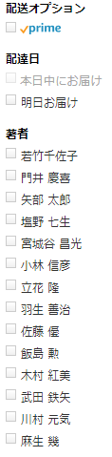





Buttons
Check
boxes
Image Carousel
Buttons
Pagination
Modal Window
Text fields
Breadcrumb
Radio buttons
Notifications
Progress Bars

Slide 8
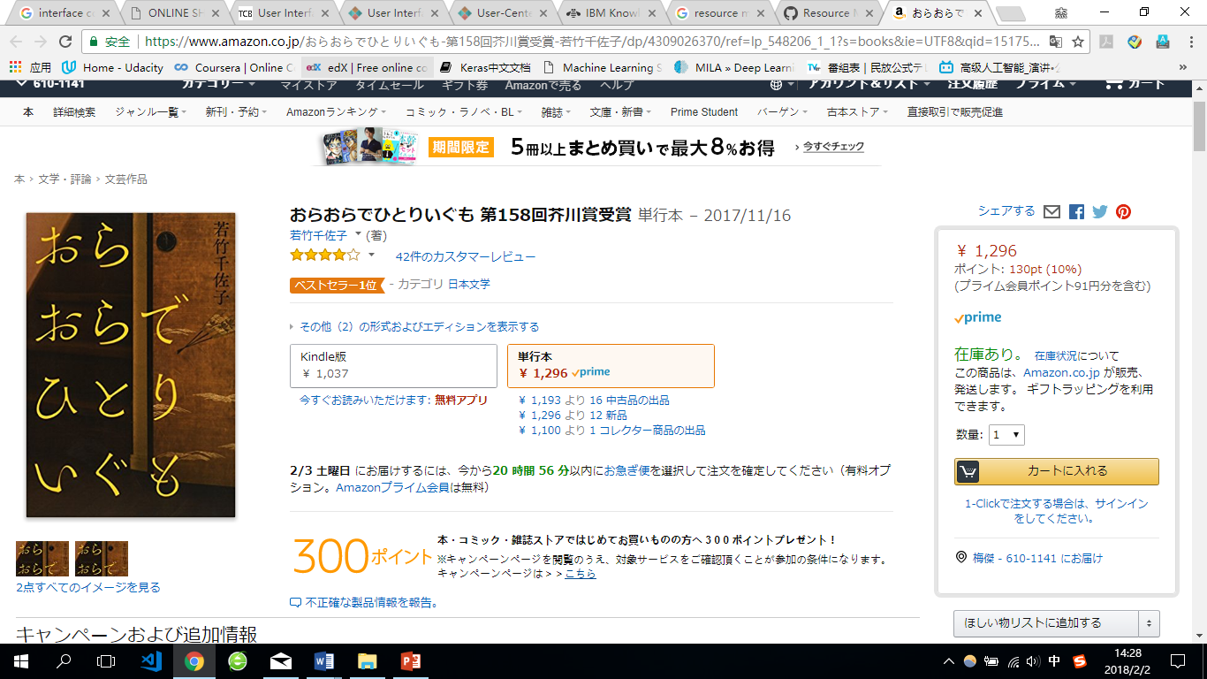
Breadcrumb

Slide 9


Checkboxes
Radio buttons
Buttons
Dropdown Button
Search Field

Slide 10
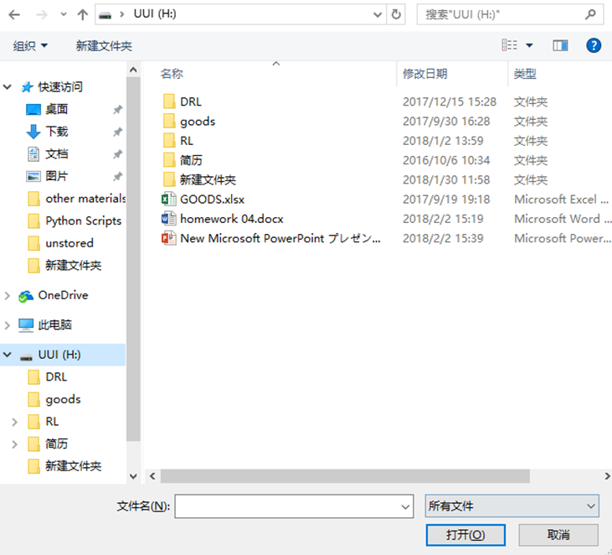
Breadcrumb
Search Field
Dropdown lists
Dropdown Button
Buttons

Slide 11
