Slide 1
地域システム
１．Conclusion
２．Propose

Slide 2
Conclusion
安価な移動
規律ある善意を表すシステム
属人性高い
地方都市間の中長距離の移動な困難
アパート単位のカーシェアリングは運営側の負担大
Lack of transportation for tourists
コミュニティ構築
社縁の喪失
血縁の喪失
地縁の喪失
サポートする若者が少ない
Lack of data
Lack of communication

Slide 3
Solution
安価な移動
マイカーの会い乗り
観光バスと公交通バス
Low-speed EV
Physical/digital IC card
Shuttle bus and route-changeable bus
コミュニティ構築
助け会う文化
信頼を生む
Digital bulletin broad
Speech to text + TV announcement
Goods deliver service
Sharing service

Slide 4
Conclusion
Meeting
Non-exchangeability of the IC card
Deficit of the public transport system
Lack of data
Restraints of the residence area distribution
Unbalance in the population structure
Survey
Unwillingness of asking for help and offering help personally
Lack of contacts between new residents
Overload of the volunteers
Potential of the sharing society

Slide 5
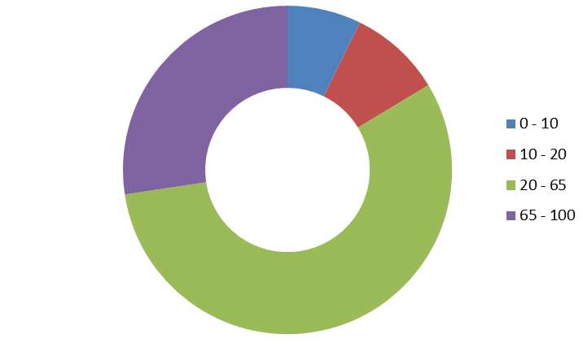
Propose
Digital bulletin broad
Speech to text + TV announcement
Low-speed EV sharing
Goods deliver service and sharing service
Shuttle bus in certain time
Physical/Digital IC card
Changeable bus route

Slide 6
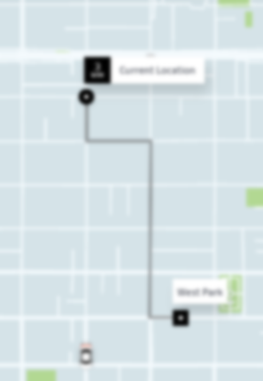
Scene
Reduce the burden of Mr. Kimura
A) Book a car
Digital bulletin broad to
Speech to text
+ TV announcement
B) Organize the passenger
C) Create a path
D) Complete the pay
E) Evaluation
Where to
When
How much
Make a plan

Slide 7
Benefit of the inconvenience
Benefit
Digital bulletin broad
- Offer a chance to communicate
- Not convenient to disability
Inconvenience
Convenience
Both exit but with different cost
Difference in price
Difference in work
Speech to text
+ TV announcement
- Lack of communication
- Convenient to disability
Non-benefit

Slide 8
Scene
Increase the way of transportation
Low-speed EV sharing
- to reduce the difficulties of driving
Goods transportation service
- to decrease the load of carry heavy goods
Shuttle bus in certain time
- between hospital/supermarket and certain place
Changeable bus route
- change according to the booking plan
Physical/Digital IC card
- for individuals who use smart phone
Hospital
Super
market
Others

